Slide 1


Introduction to
Next Generation Sequencing
Olga Vinnere Pettersson, Uppsala University
Scientific Lead of Planetary Biology Capability, SciLifeLab
EVOMICS,
Český Krumlov
2026-01-12

Slide 2

Outline
Brief history of Genomics
What is sequencing?
Glossary
How do sequencing technologies work?
  Short reads: Illumina, Ion, MGI, Element Biosciences (Aviti), Roche
  Long reads: PacBio and ONT

Slide 3
Where am I from: SciLifeLab

Slide 4
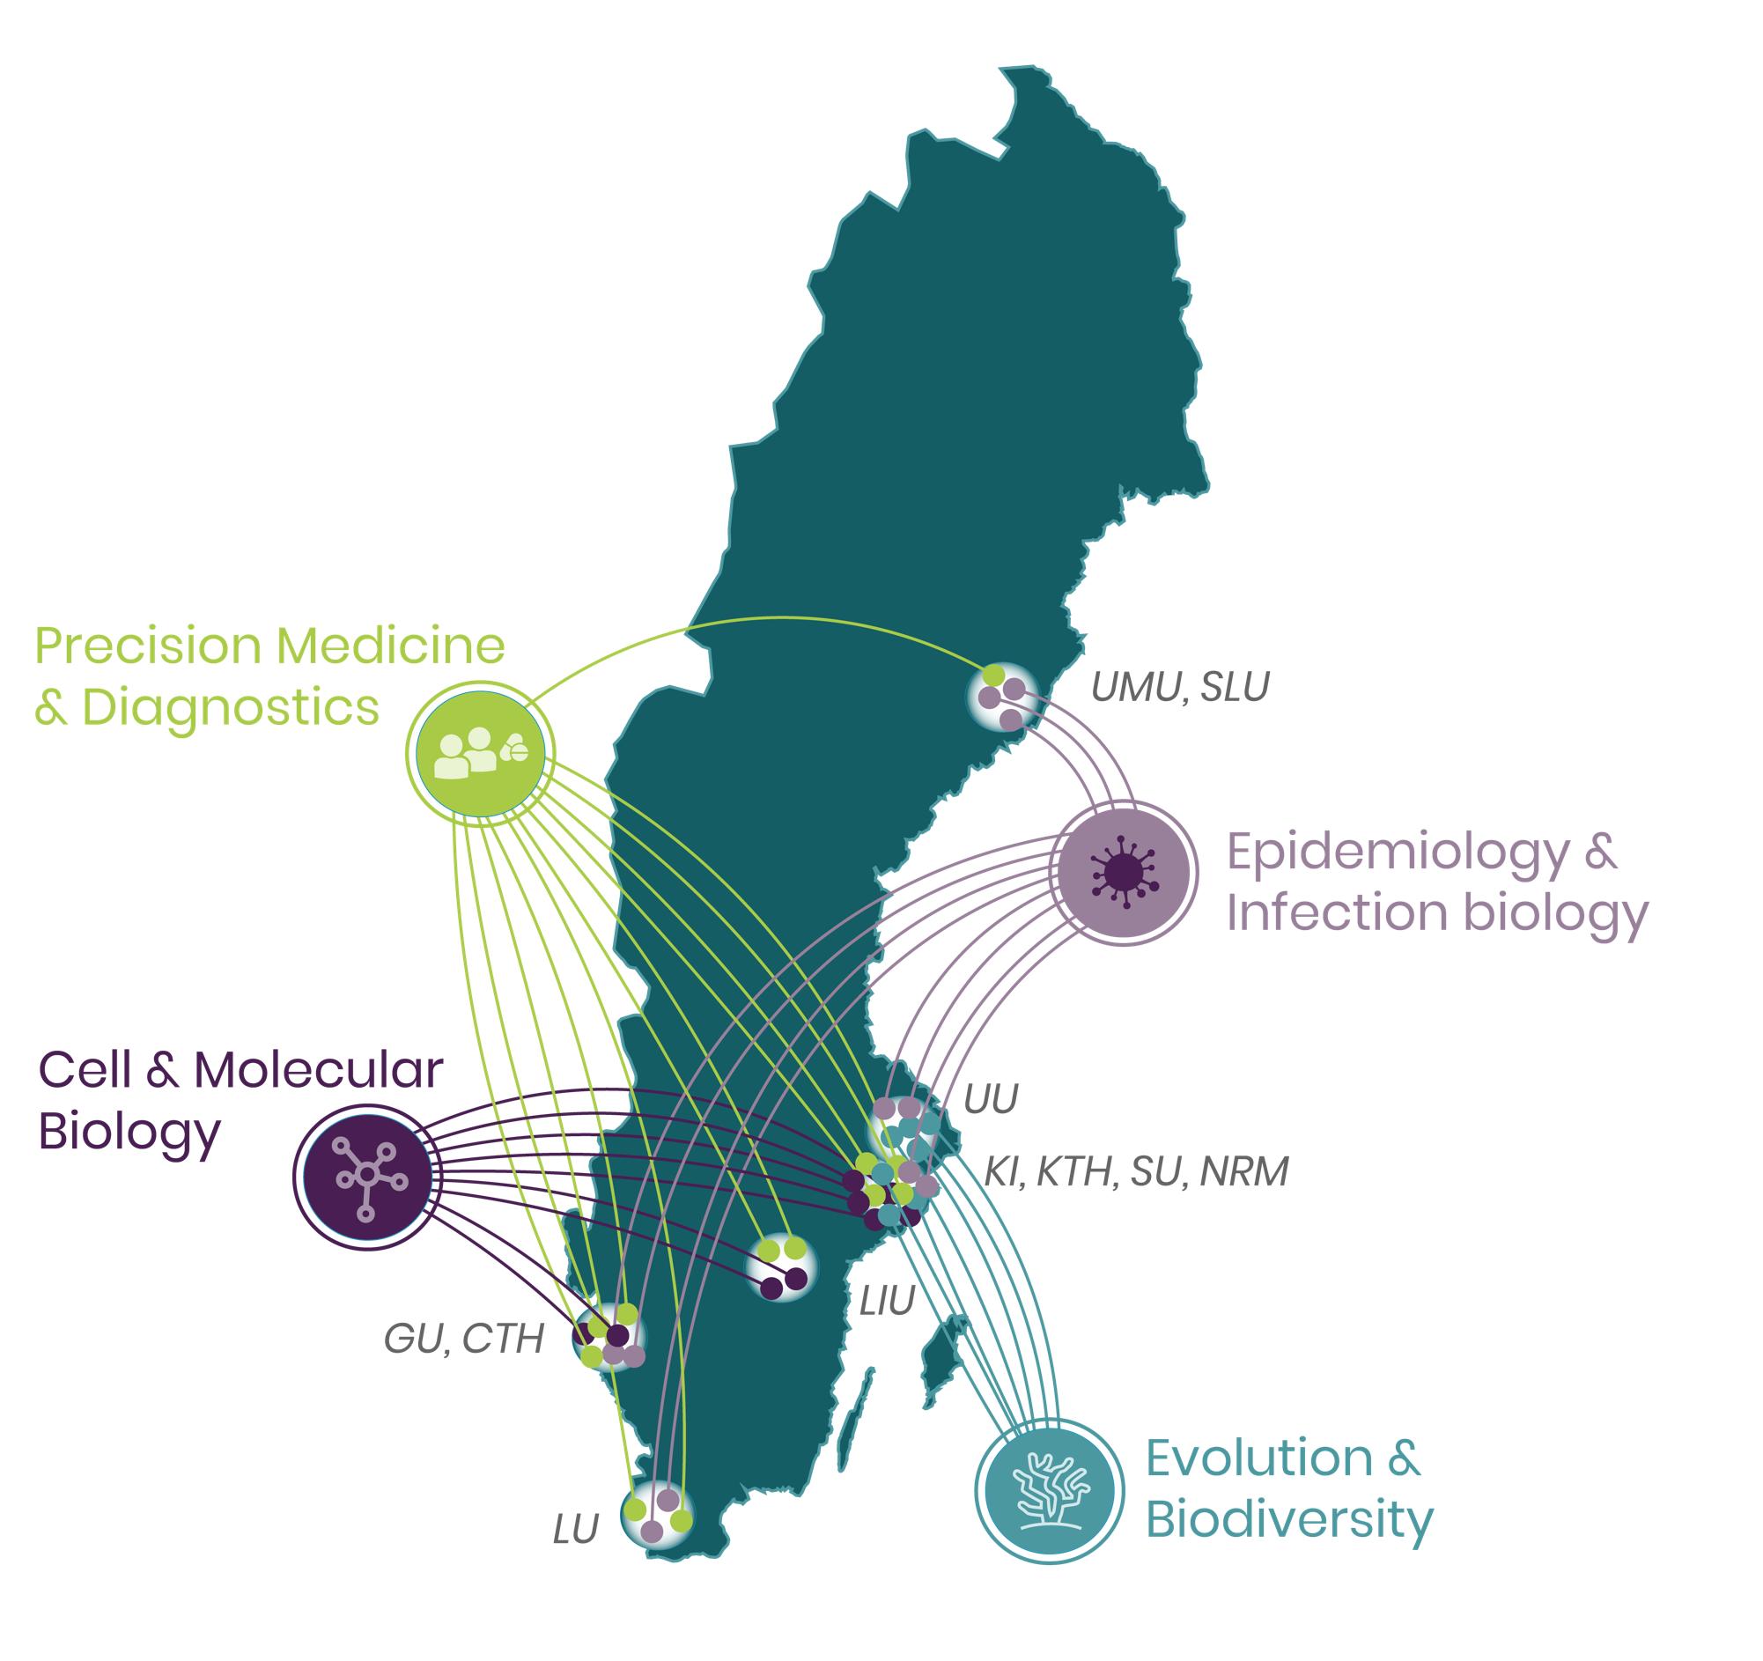
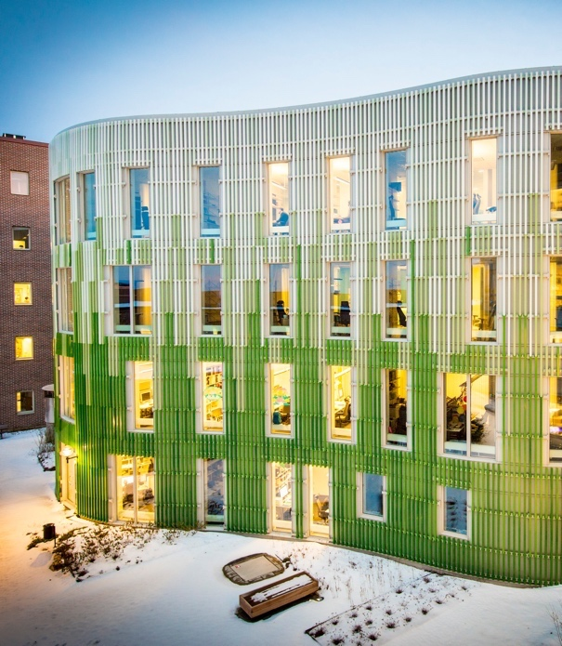
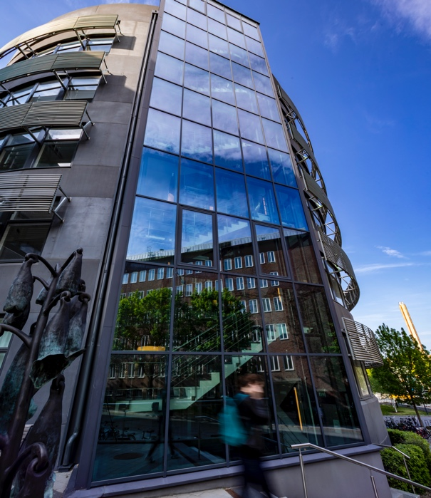
Sweden’s national center for molecular biosciences
SciLifeLab
UU, SLU
Connecting strong research environments
LU, SLU

Slide 5
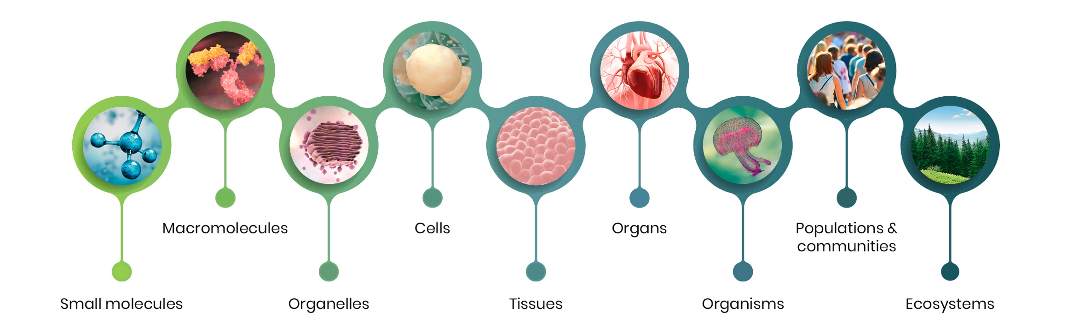
Enabling research across the full spectrum of life science
SciLifeLab infrastructure technologies:
Can be used to study the molecular aspects of life ranging from the atomic scale up to entire ecosystems
Are applicable across a large spectrum of disciplines and research fields in life science
Are available to all academic researchers in Sweden on equal terms
Are available to healthcare and industry all over the country, as well as international users

Slide 6
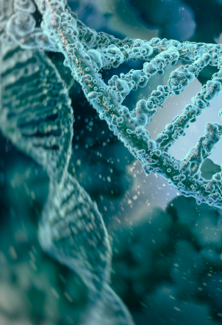
SciLifeLab Genomics Platform
Consists of:
  National Genomics Infrastructure – 3rd largest NGS core in Europe
  Ancient DNA facility
Advanced user support (even without previous NGS experience):
  Project design
  Choice of sequencing technology and methodology
  Sample requirements and experimental design
  DNA and RNA extraction for reference genome sequencing
  Ancient DNA extraction and library construction
  Sequencing
  Primary data analysis

Slide 7
Brief history of Genomics and NGS

Slide 8

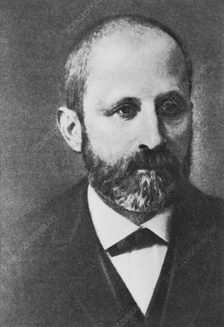
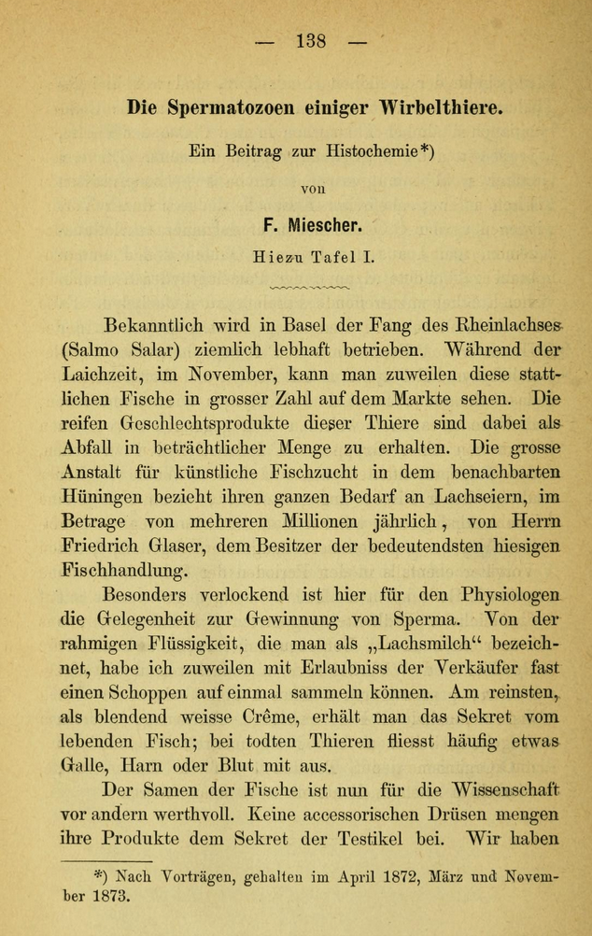
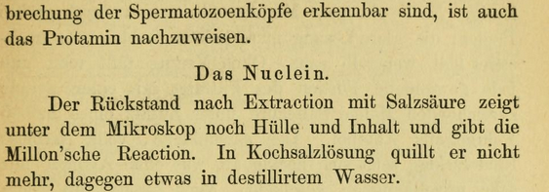
It all begun in late 19th century…
Johannes Friedrich Miescher
(13 August 1844 – 26 August 1895)

Slide 9
From Miescher to Sanger
Koltzoff
Prediction of a
”giant hereditary molecule
of 2 mirrow strands”
1924
Sutton and Boveri
Chromosome
theory of heredity
1904
Sanger and Coulson
Nobel Prize for
Chain Termination Sequencing
1977
Watson, Crick, Franklin
Double helix DNA model
1953
1873
Miescher
Nuclein discovery
1910
Kossel
Nobel Prize
for discovery of
A, G, T, C and U
1928
Griffith
DNA carried
genetic information
(theory)
1942
Avery
DNA carried
genetic information
(experimental)
1976
Fiers et al.
Complete nucleotide seiquence
of bacteriophage MS2 RNA
(3569 nucleotides)

Slide 10
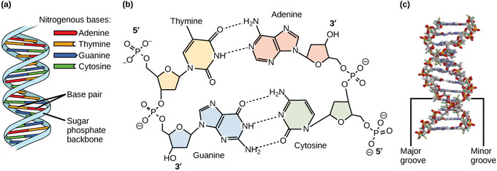
What is sequencing?
https://figures.boundless-cdn.com
Sequencing is the process of arranging items, steps, or elements in a specific, logical order

Slide 11
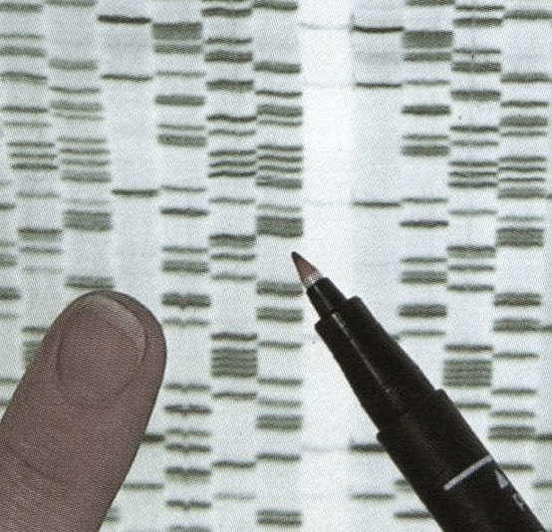
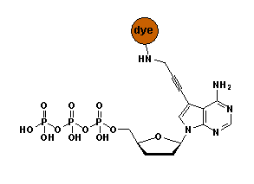
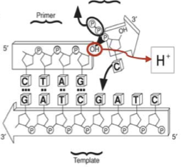
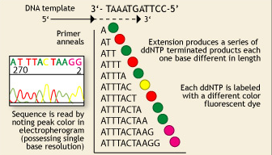
Once upon a time…
Fredrik Sanger and Alan Coulson
Chain Termination Sequencing (1977)
Nobel prize 1980
Principle:
SYNTHESIS of DNA is randomly TERMINATED at different points
Separation of fragments that are 1 nucleotide different in size
!
Lack of OH-group at 3’ position of deoxyribose
1 molecule sequenced at a time = 1 read
Capillary sequencer: 384 reads per run

Slide 12

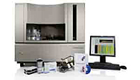
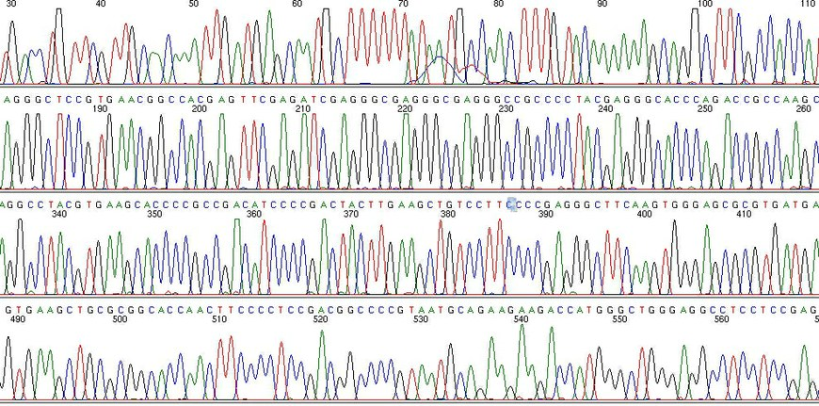
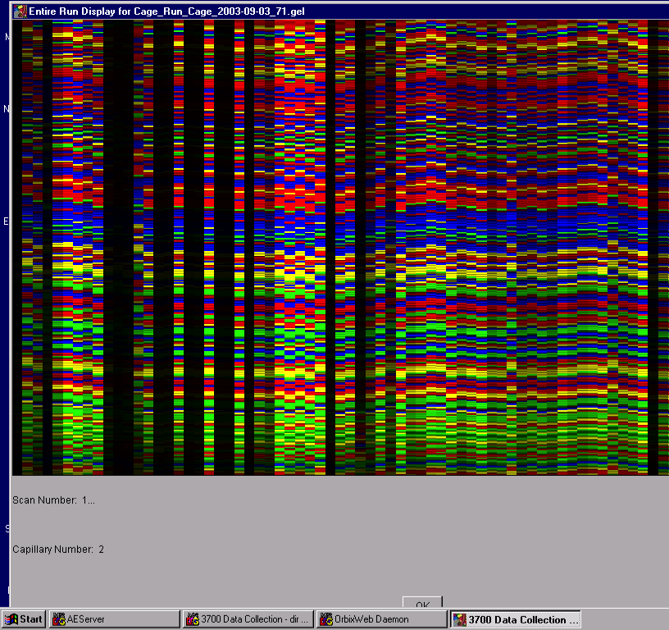
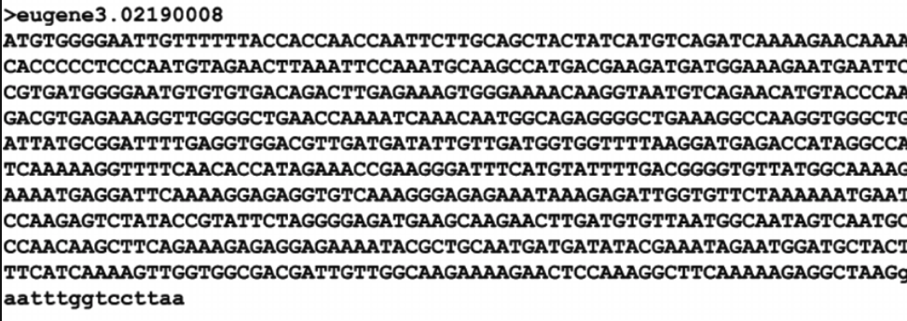
Sanger sequencing
Chromatogram file size: c:a 250 kb
FASTA file size: 12 kb
Prerequisite: amplified DNA

Slide 13
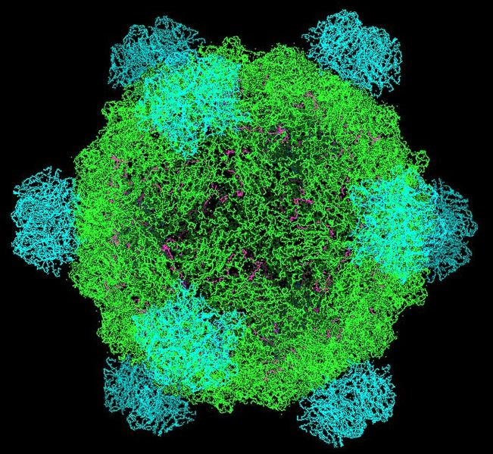
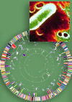
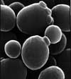
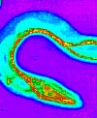

At the very beginning of genome sequencing era…
First DNA genome: virus φ X 174 - 5 368 bp (1977)
First organism: Haemophilus influenzae - 1.5 Mb (1995)
First eukaryote: Saccharomyces cerevisiae - 12.4 Mb (1996)
First multicellular organism: Cenorhabditis elegans - 100 MB (1998)
First plant: Arabidopsis thaliana - 157 Mb (2000)

Slide 14

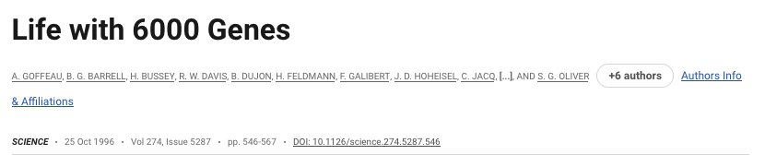

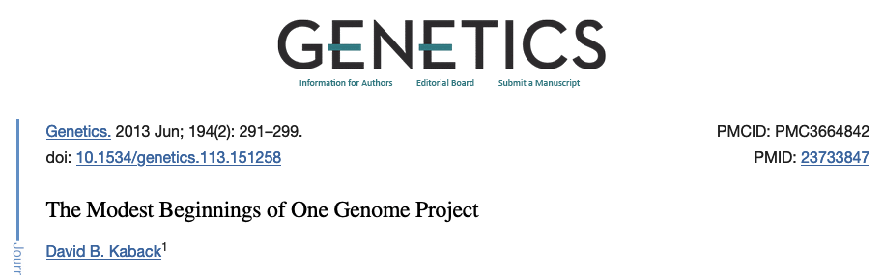
The Yeast Genome project
“The genome of the yeast Saccharomyces cerevisiae has been completely sequenced through an international effort involving some 600 scientists in Europe, North America, and Japan. It is the largest genome to be completely sequenced so far (a record that we hope will soon be bettered) and is the first complete genome sequence of a eukaryote.”
“New graduate students are already wondering how we all managed in the “dark ages” before the sequence was completed. We must now tackle a much larger challenge, that of elucidating the function of all of the novel genes revealed by that sequence. As with the sequencing project itself, functional analysis will require a worldwide effort. In Europe, a new research network called EUROFAN [for European Functional Analysis Network has been established to undertake the systematic analysis of the function of novel yeast genes. Parallel activities are underway in Germany, Canada, and Japan. In the United States, the National Institutes of Health has recently sent out a request for applications for “Large-Scale Functional Analysis of the Yeast Genome.” “

Slide 15
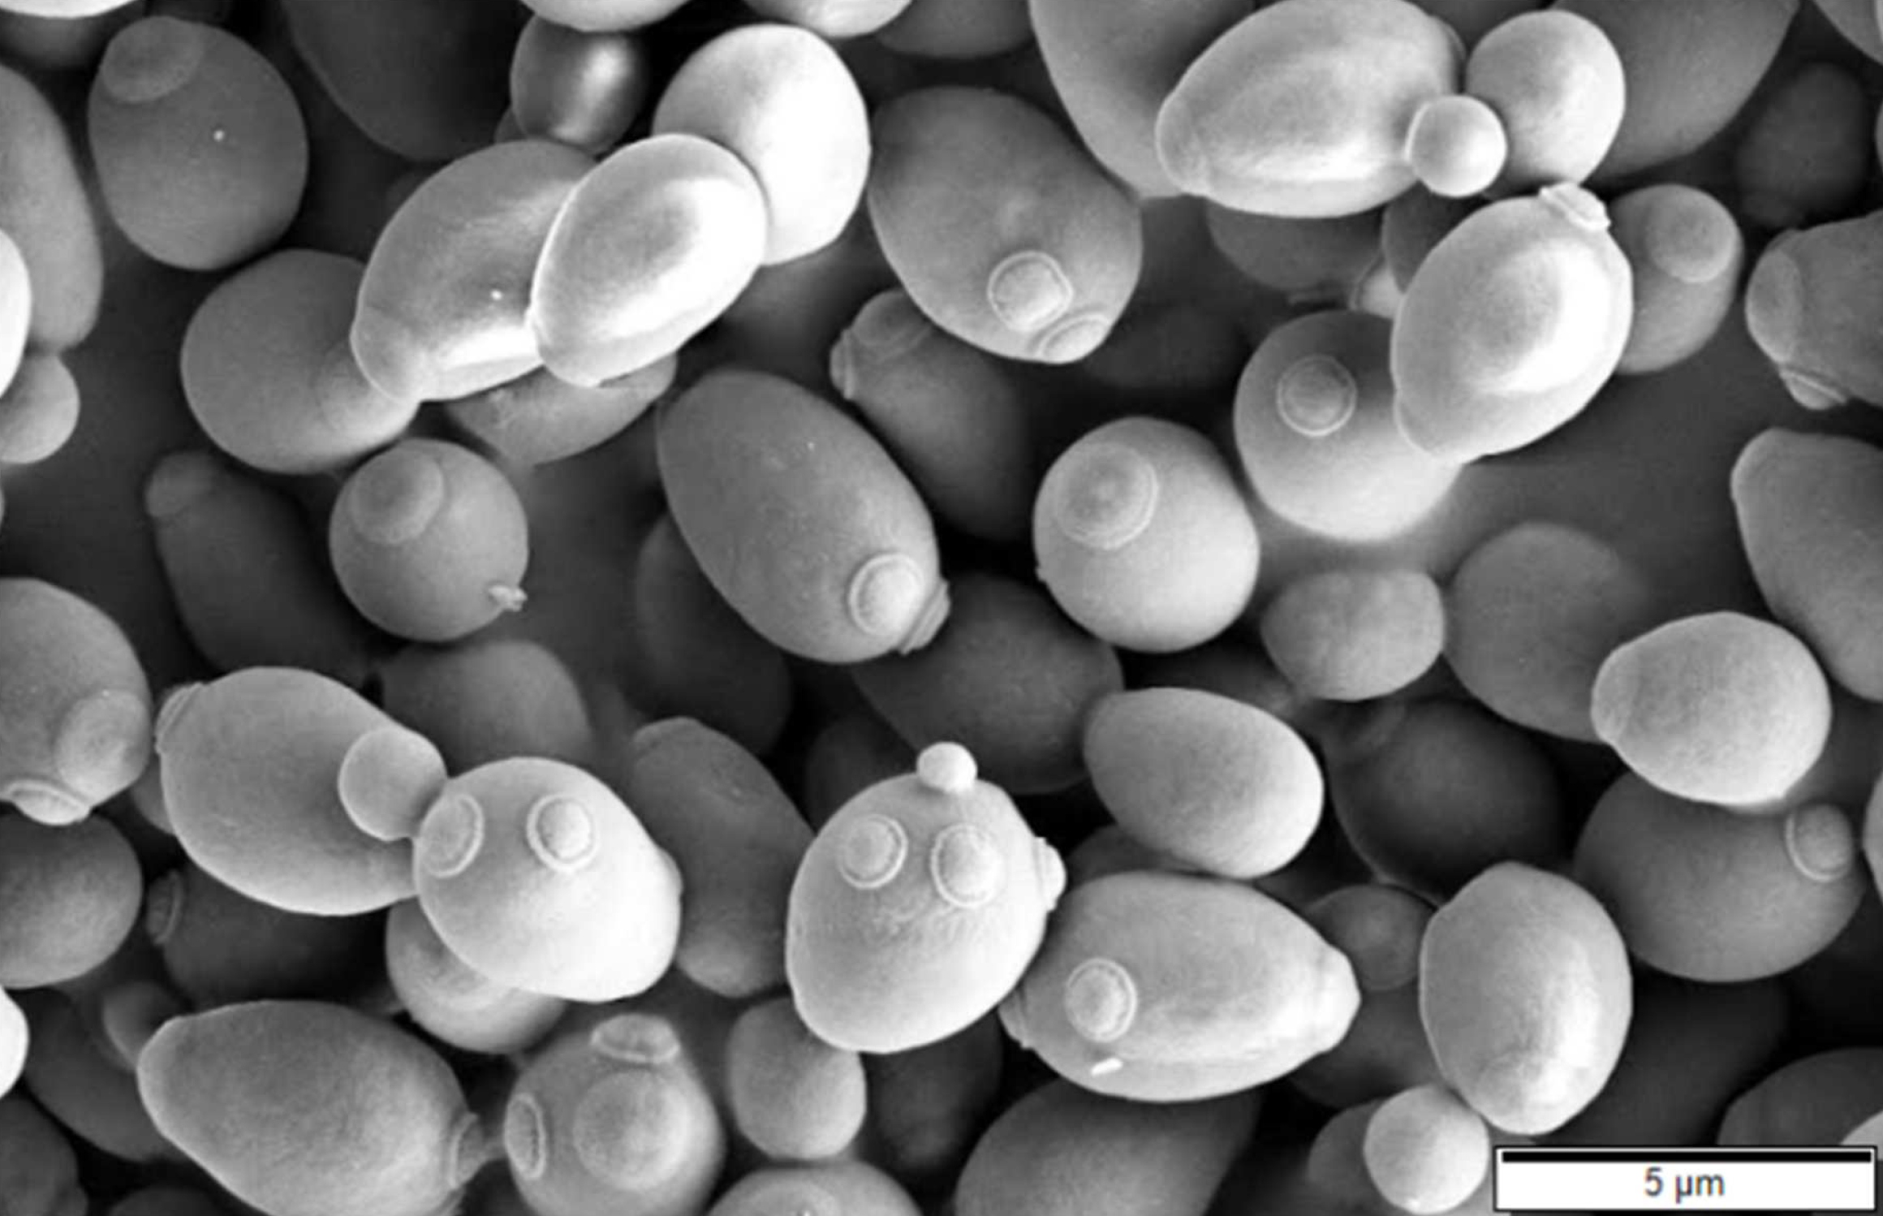
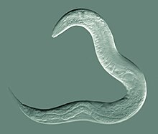
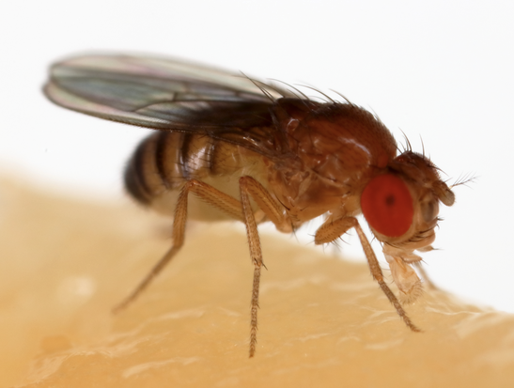

First genomic references
1/3 of genes related to
human by homology
Basic cell functions
Human disease gene discovery
Phenotypical traits
Plant genome
structure and function
But it was not enough…

Slide 16
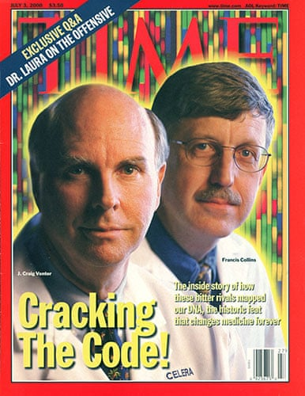
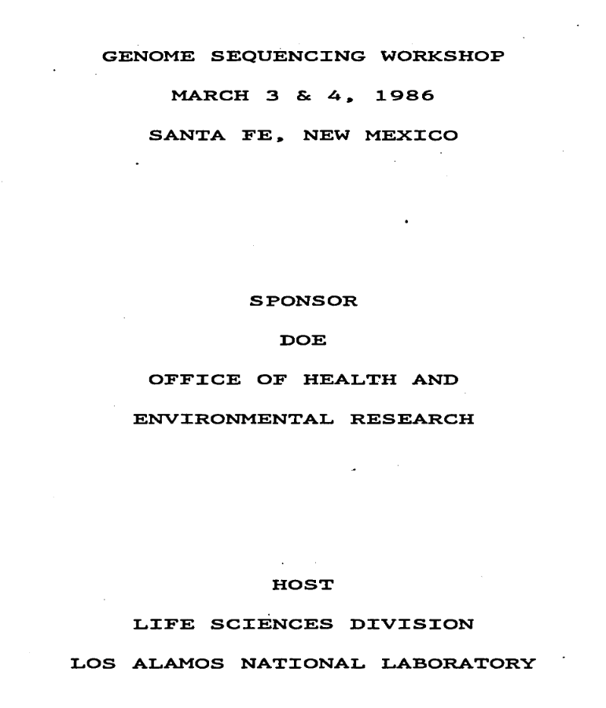

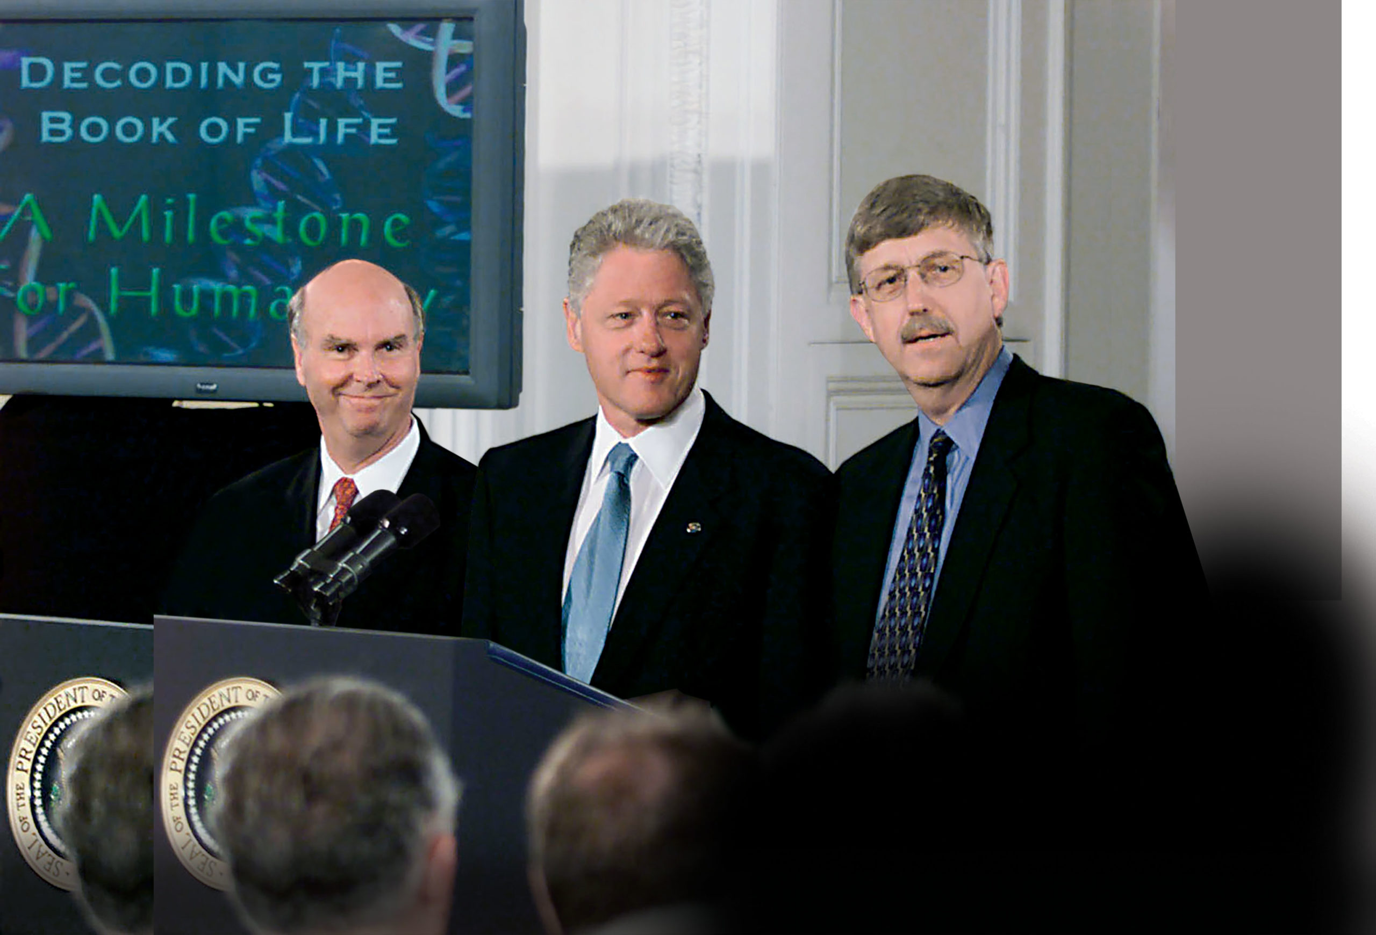
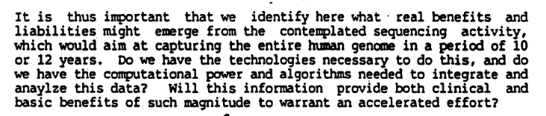

Slide 17
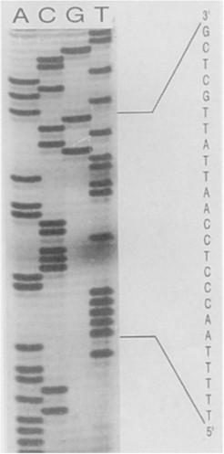
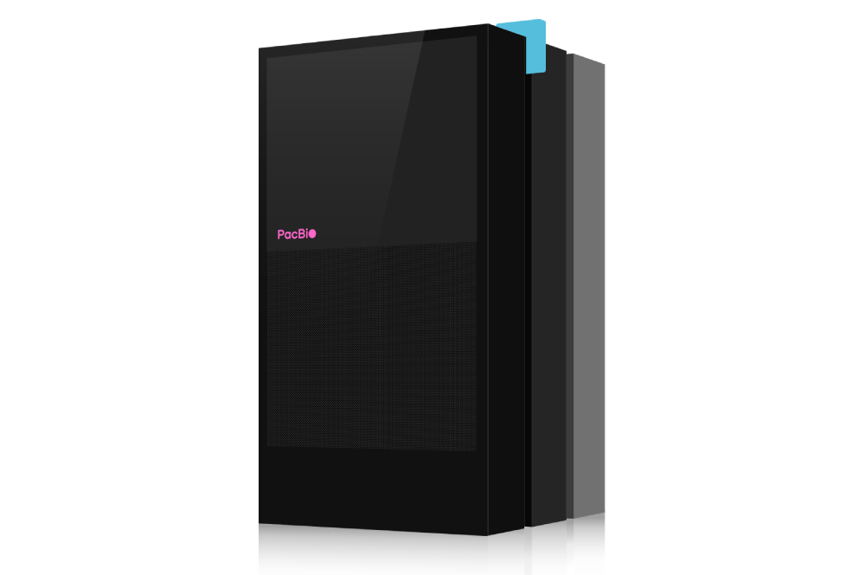
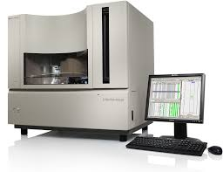
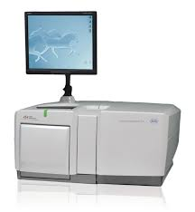
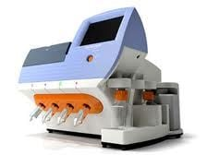
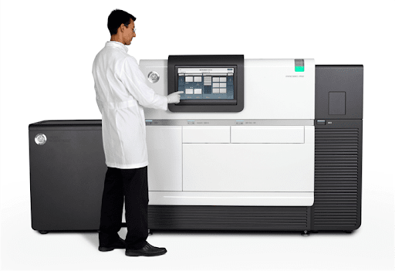
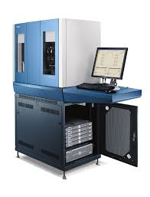
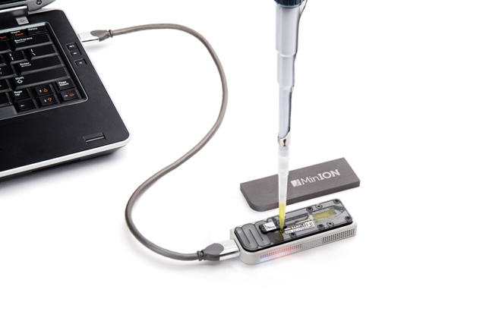
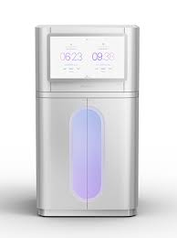
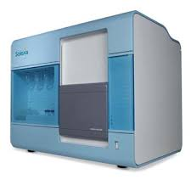
An outcome of HUGO – Genomic Revolution
NGS
2024 WE ARE HERE
Solexa
ABI SOLiD
2006
PacBio
ONT
2012
2021 HiFi reads
1977
Sanger
P³² labeled gels
2000
Sanger
ABI 3000 series
2005
454
2010
IonTorrent
2023
PacBio
REVIO
1990 HUGO

Slide 18

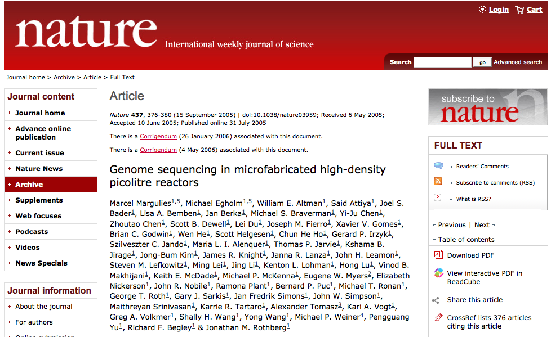
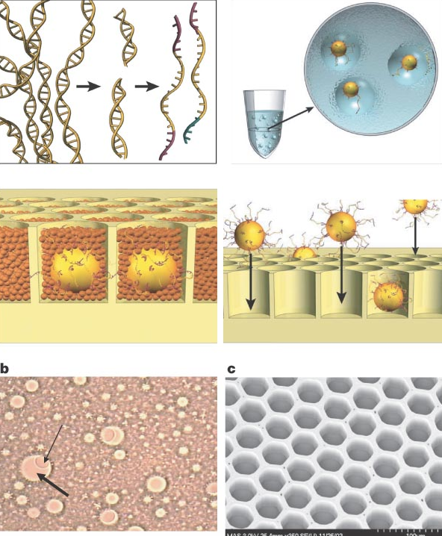
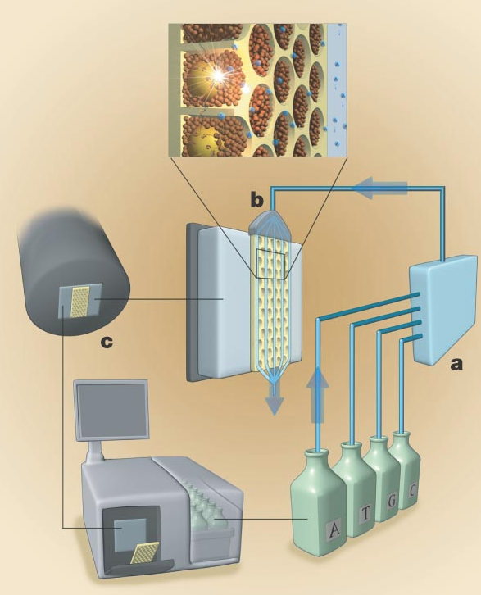
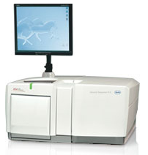
2006: NGS was borne
Thousands of molecules sequenced in parallel
1 mln molecules sequenced per run
Roche 454 GS FLX

Slide 19
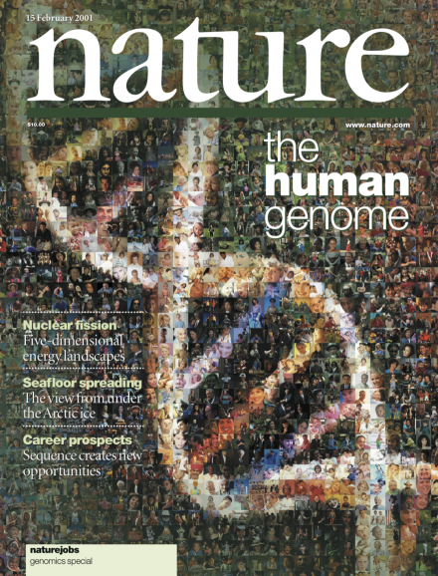

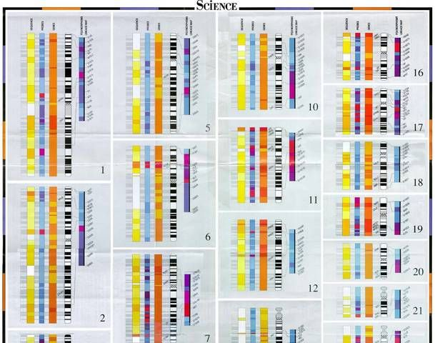
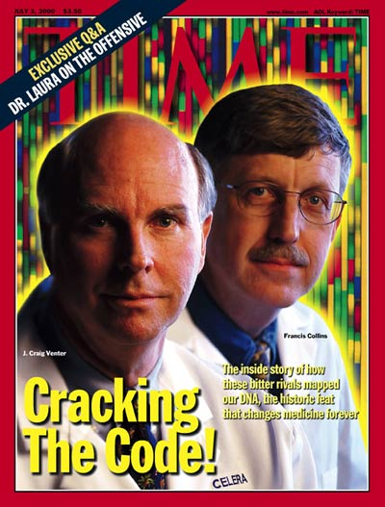
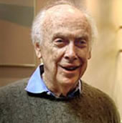
Just a comparison
1990 - 2003
HUGO
Sanger traditional
$2.7 bln
2007
Craig Venter’s genome
Sanger ABI 3730
$300 mln
2008
Jim Watson’s genome
454 FLX
$1 mln
TODAY
any human
$200-600 with short reads
$1-3k with long reads

Slide 20
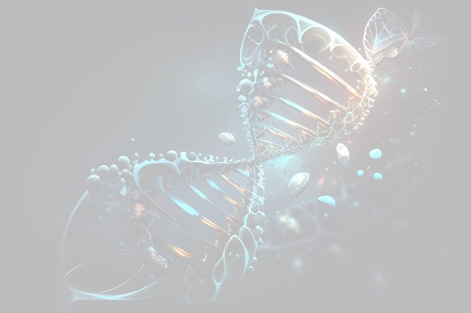
Outcome of genomics revolution: paradigm shift
  Single genes Complete genomes

Slide 21
Outcome of genomics revolution: paradigm shift
  Single genes Complete genomes
  Single transcripts Whole transcriptomes

Slide 22
Outcome of genomics revolution: paradigm shift
  Single genes Complete genomes
  Single transcripts Whole transcriptomes
  Single organisms Metagenomes

Slide 23
Outcome of genomics revolution: paradigm shift
  Single genes Complete genomes
  Single transcripts Whole transcriptomes
  Single organisms Metagenomes
  Model organism Any species

Slide 24
Outcome of genomics revolution: paradigm shift
  Single genes Complete genomes
  Single transcripts Whole transcriptomes
  Single organisms Metagenomes
  Model organism Any species
  Available to highly specialized labs Available to anyone

Slide 25
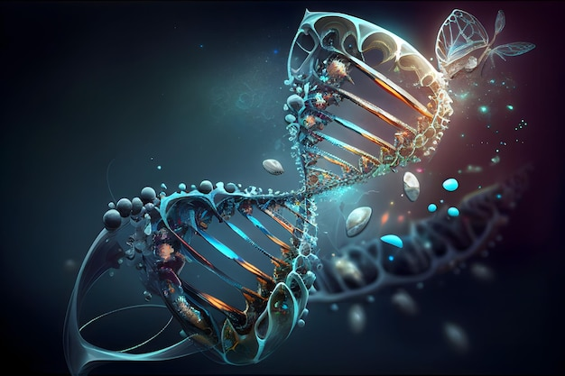
DEMOCRATISATION
OF
GENOMIC RESEARCH

Slide 26
Sequencing technologies: theory and principles

Slide 27









NGS market overview / Read length
Before going into details, let’s understand the main principles.

Slide 28

Types of sequencing by read length
NGS glossary
Sequencing
110 - 600 bp
Amplified template
Short-read
Long-read
200 bp - Mb
Native (non-amplified) template
Single read
SE
Paired read
Single read
Circular read
ION and Roche - per default
Optional: Illumina, MGI,
Element Biosciences
Illumina, MGI,
Element Biosciences
ONT
PacBio
Paired reads (PE) = better mappability

Slide 29

Any NGS starts with a library
NGS glossary
Template (aka “insert”)
Adaptor ligation
Tells the reaction
where to start
OR:
Barcode and
adaptor ligation
Barcodes different
samples for pooling
Type of adaptor, primer and insert size are technology- and application-specific
For all short-read technologies: libraries have to be amplified

Slide 30


NGS library construction procedure
NGS glossary
Library construction steps ->
DNA fragmentation
Sizing
Quantification
Size selection
Sizing
Quantification
End repair and
adaptor ligation
Sizing
Quantification
Purification
Quality control steps ->
Up to 40% of material is lost in each step

Slide 31
Amplification: PCR (Copy of a copy)
NGS glossary
Sanger, ION, Illumina
Is it a SNP or a PCR artifact?

Slide 32


Amplification: Rolling circle (RCA)
NGS glossary
(Copy of the same molecule)
Element Biosciences, MGI
Reduced amplification bias

Slide 33


DNA synthesis - Back to school!
NGS glossary
Sequencing fuel:
Deoxyribonucleoside triphosphates (dNTP)
DNA polymerization:
Pyrophosphate is released
(and with that - color signal)
O of 3’-OH stays put
H is released as a proton, H+
γ
β
α
Phosphate groups
Gets attacked to form a bond
Where “dye” is attached
3’ position of deoxyribose
Present = reaction happens (long-read)
Blocked = reaction stops (most short-read)
Nucleotide incorporation
Short reads: 1 at a time (cycle)
Long reads: constant flow
α
γ

Slide 34



Mode of sequencing: SBS and SBB
NGS glossary
Sequencing by Synthesis
dNTP* is BOUND
G
A
C
T
T
C
A
(Fluorophore)
A G T C C T G
G
AC
C
T
T
C
A
(Block)
Sequencing by Binding
dNTP* presented, removed, and then a native nucleotide is bound
SBB is gentler than SBS

Slide 35


SBS and SBB comparison
NGS glossary
Traits: | SBS | SBB
Core differences | Detection = incorporation Modified nucleotides Errors locked in | Detection -> incorporation Natural nucleotides Errors can reset
Quality drop with cycle | Steep | Shallow
Read accuracy | Lower | Higher
Homogeneous clusters | Hard to maintain | Easier to maintain
End-of-read noise | Common | Reduced
SBS is prone to phasing errors

Slide 36

Q-score
NGS glossary
Q (quality) score - measurement of machine confidentiality that the base (A, G, T, C) was correctly identified
Why it matters? Example:
Looking for a rare mutation (SNP), appears 1 in 5000 DNA molecules
Q30 = 1 error per 1 000 bases -> the somatic mutation will be drowned in the noise of incorporated errors
To collectedly call a 1:5000 rare SNP, one needs a technology with Q40 or higher

Slide 37
Types of sequencing errors
NGS glossary
Indels: Insertions and deletions - machine sees something that is not there
Substitutions: incorporation of wrong bases
Homopolymers: stretches of the same nucleotide
Insertion
Actual: A T G C
Read: A T T G C
Deletion
Actual: A T G C
Read: A T _ C
Actual: A T G C
Read: A T A C
Actual: A A A A
Read1: A A A A
Read2: A A A
Read3: A A A A A
All technologies have their own error profiles

Slide 38
Short break and then:
Finally, the technologies…

Slide 39



Current leader on the NGS market
SBS
Instrument | Run time | Max output | Max reads/run | Max read length, bp
iSeq | 9.5 – 19 hrs | 1.2 Gb | 4 mln | PE 150
MiniSeq | 4-24 hrs | 7.5 Gb | 25 mln | PE 150
MiSeq | 4-55 hours | 15 Gb | 25 mln | PE 300
NextSeq series | 12-48 hours | 120-300 Gb | 0.4 – 1 bln | PE 150
NovaSeq 6000 | 13-44 hours | 6 Tb | 26 bln | PE 250
NovaSeq X Plus | 15-18 hrs | 16 Tb | 52 bln | PE 150
Technology highlight: bridge amplification
Used for: everything
Strength: cheap; robust data analysis pipelines
Weakness: more bias than people think, GC-bias

Slide 40



Illumina: bridge amplification
Notes:
De fragment som ska sekvensera amplifiera I flödescellen för att möjliggöra detektion av signalerna från sekvensningen. Detta sker I en så kallad klulstergenerering, där de fragment som ska sekvenseras kopieras ca 1000x på en liten delyta och varje fragment då bildar ett sk klluster.
Förenklad bild, sker samtidigt för ca 200M fragment per lane I flödescellen.
Adaptern på sekvensningsbiblioteken binder till komplementära sekvenser på ytan I flödescellen. Den komplementära sekvensen fungerar

Slide 41

Illumina flow cells: important differences
Random
Patterned
NextSeq
NovaSeqX
MiSeq i100 Series
Traditional MiSeq
1 flow cell per run

Slide 42


ION (ThermoFischer)
Instrument | Run time | Max output | Max reads/run | Max read length, bp
Gene Studio S5 | 3 - 24 hrs | 50 Gb | 150 mln | SE 600
Genexus | 14-24 hrs | 20 Gb | 60 mln | SE 400
Technology highlight: H⁺ ion-sensitive field effect transistors
Used for: gene panels, advantage in clinical setting
Strength: scalable, very fast turn-around, inbuilt analysis software
Weakness: limited number of applications, AT-bias, (homopolymers bias)

Slide 43



Ion Torrent: H⁺ ion-sensitive field effect transistors
https://doi.org/10.1099/vir.0.043182-0

Slide 44

Ion technology: scalability
1 chip per run

Slide 45


Ultima
SBS
Instrument | Run time | Max output | Max reads/run | Max read length, bp
UG 100 | 12 - 14 hrs | 2.4 Tb | 6-8 bln | SE 300
UG 100 Solaris | 14 hrs | 3.6 Tb | 10-12 bln | SE 300
UG Solaris Boost | 24 hrs | unspecified* | 100 bln/day | SE 300
* based on 100 billion reads/day
Technology highlight: no flow cell, lots of AI
Used for: potentially - everything, still new on the market
Strength: very cheap but accurate
Weakness: Few analysis pipelines available, GC-bias, analysis bias

Slide 46



Ultima technology
No more flow cells, chips and SMRT cells - introduced wafers
Library: emulsion PCR, similar to ION technology
CD-manufacturing precision

Slide 47

Ultima technology
Continuous extension: higher speed and throughput (avoiding repetitive chemical de-blocking steps).
Mix of fluorescent and native dNTPs: signal events are rare
Pro: High speed - no need to resolve every single base individually.
Con: weaker fluorescent signal
Hence - machine learning for base calling

Slide 48


MGI
SBS
Instrument | Run time | Max output | Max reads/run | Max read length, bp
DNBSEQ-T7 | 5.5 - 24 hrs | 7 Tb | 23 bln | PE 150
DNBSEQ-G400 | 13-109 hrs | 1.4 Tb | 3.6 bln | PE 300
DNBSEQ-G99 | 11 hrs | 0.24 Tb | 0.2 mln | PE 150
DNBSEQG-50 | 9-40 hrs | 150 Gb | 500 mln | PE 150
DNBSEQ-T1+ | 24 hrs | 1.5 Tb | 12 bln | PE 150
Technology highlight: DNA nanoballs (RCA)
Used for: high-throughput projects
Strength: high accuracy and throughput, coupled with automatization
Weakness: labour-intensive, GC bias, software limitations

Slide 49

MGI: DNA nanoball (DNB) technology
Crucial step: library circularization,
followed by rolling-circle amplification.
Result: negatively charged nanoballs.
Physical confinement to patterned nanoarrays
(nanowell of 200-300 nm):
No competition for primers
No runaway amplification
No bias towards shorter fragments

Slide 50



MGI chemistry: cPAS
Combinatorial Probe-Anchor Synthesis
Cool
Hot

Slide 51

Element Biosciences
SBB
Instrument | Run time /cell | Output /cell | Max reads /cell | Max read length, bp*
AVITI™ | 24-60 hrs | 300 Gb | 1 bln | PE 300
AVITI24™ | 24-60 hrs | 450 Gb | 1.5 bln | PE 300
AVITI LT™ | 17-51 hrs | 150 Gb | 500 mln | PE 300
Technology highlight: DNA colonies (colonies), multiomics
Used for: everything + single cell multiomics
Strength: low cost, few artifacts, muti-omics on the same sample,
      Illumina-library compatible
Weakness: throughput limitations, GC homopolymers, Read 2 quality

Slide 52


Avidities and polonies
Polony = polymerase colony
Avidity = multivalent labelled probe, recognizes the incorporated nucleotide in a polony.
Reusable, reversible, strong signal.
Avidities
Library is Illumina-compatible (P5 & P7 adaptors)
Similar to Illumina: amplification on a slide
Similar to MGI: RCA
Patterned flow cell
Decoupled incorporation and detection = low error rates
Polonies
Think of Velcro

Slide 53

Multiomics on AVITI
Teton™ CytoProfiling
Simultaneous detection of RNA, proteins and morphology in cells - in situ profiling approach
Provides spatial information
Cells fixed on a slide > target probes hybridized > polonies formed > avidities added > signal detected.
RNASeq: ~350 transcripts with seq-specific probes
    Spatial & single cell differential expression
Protein profiling: ~50 markers in the same cell
Cell morphology is scanned

Slide 54


Instrument | Run time /cell | Output /cell | Max reads /cell | Max read length, bp*
Sequel II | 12-30 hr | 30* | 4 M* | 20 k, circular consensus HiFi
Revio | 12-30 hr | 100-120 Gb* | 7 M* | 20 k, circular consensus HiFi
Onso | 48 hr | 150 Gb | 800-1000 M | PE 150
* What company tells you (achievable mainly on fresh human samples)
Technology highlight Revio: Single Molecule Real Time (SMRT) sequencing
Used for, Revio: everything where long reads are needed
Technology highlight Onso: SBB
Used for, Onso: “needle in the stack” applications
Strength: very high quality of reads
Weakness, Revio: sensitivity to DNA quality, GA bias
Weakness, Onso: higher cost, low throughput, new technology

Slide 55


PacBio HiFi: SMRT - technology
HiFi Q-score up to 50+

Slide 56


Slide 57
PacBio Onso: SBB reminded
Sequencing by Synthesis
dNTP* bound
G
A
C
T
T
C
A
A G T C C T G
Template
G
A
C
T
C
A
T
Sequencing by Binding
dNTP* presented, then native nucleotide is bound

Slide 58

Comparison Illumina vs Onso
Onso utilizes a proprietary cluster generation technology, non-patterned flow cell

Slide 59



Instrument | Run time /FC | Output / FC | Nr of pores | Max read length
Flongle | 16 hrs | 1 Gb | 126 | 1 Mb
MinION | 24 hrs | 2-15 Gb | 512 | 1 Mb
GridION | 24 hrs | 2-15 Gb | 512 | 1 Mb
PromethION | 72 hrs | 10 – 150 Gb | 3 000 | 2 Mb
Technology highlight: nanopores, no fluorescence, ultra-long reads, native RNA
Used for: reference genomes, SV detection
Strength: size and portability
Weakness: sample-sensitive, software limitations, lower Q-score than PacBio

Slide 60



ONT: DNA + Motor + Pore
Q-score 20-30

Slide 61







Main advantages of ONT:
SPEED and PORTABILITY

Slide 62

Roche
Sequencing by expansion
Instrument | Run time /cell | Output /cell | Max reads /cell | Max read length, bp*
AXELIOS | 500 mln bp/sec | 5 bln/hour | 75-90 bln | SE 1 kb
Technology highlight: novel sequencing by expansion, uses nanopores
Used for: massive sample size, high sensitivity, poor quality samples
Strength: highest speed on the market, very high accuracy
Weakness: high running costs, labor-intensive, software limitations

Slide 63


Sequencing by expansion (SBX)
Xpandomer - synthetic molecule 50x longer than the template
Standard NGS library construction
SBX encoding: from template to Xpandomers - proprietary expandable nucleotides (X-NTPs)
Single molecule detection by CMOS sensor array (Complementary Metal-Oxide-Semiconductor)
X-A, X-G, X-C, X-T carry a reporter code - later will produce a high-signal readout
Translocation control elements - movement through a nanopore
Enhancer - robust synthesis
Acid-cleavable bonds - allow polymer expansion after synthesis
Enzyme: XP synthase + help from polymerase enhancers (PEMs)
No amplification

Slide 64


Xpandomers, CMOS and nanopores
ONT
Xpandomers make the electronic signal easy to read
CMOS detect Xpandomer units, not bases
Each Xpandomer = large, base-specific reporter structure
X-A, X-G, X-C and X-T have unique engineered electrical signatures
1 Xpandomer passes the pore at a time (unlike constant stream in ONT)
Signal is strong, base-specific and time-separated
Homopolymers: each Xpandomer is read separately, but long stretches is always an issue
SBX

Slide 65
Let’s compare all the short reads
Platform | Sequencing type | Library / amplification | Signal detection | Main advantage | Main disadvantage | Error profile | Q score | Best uses
Illumina | SBS, optical | Bridge PCR | Fluorescence | Accurate, common | Old? | Substitutions | Q30-40 | WGS, RNA
Utima | SBS, flow-based | Emulsion PCR | Fluorescence | Throughput, cost | Homopolymers, repeats | Substitutions, homopolymers | Q30-35 | High-throughput
Element | SBB with avidities | RCA polonies | Fluorescence | High accuracy | Small ecosystem | Low substitutions | Q40+ | Variant calling
MGI | SBS with DNB | RCA nanoballs | Fluorescence | High accuracy | Complex, loading issues | Low substitutions | Q30-35 | High-throughput
ION | Semiconductor pH | Emulsion PCR | pH change | Fast, simple Inbuilt analysis | Homopolymers, single-end | Indels in homopolymers | Q30 | Gene panels
Roche | SBE | Xpandomers | Electronic | Ultra-fast | Higher cost/base, new tech | New tech | Q40+ | Fast, rare variant detection
PacBio ONSO | SBB | ? | Fluorescence | High accuracy, superb in homopolymers | Higher cost/base, lower output | ? | Q40-50+ | Rare variant detection

Slide 66


How it looked yesterday

Slide 67




How it looks now: technology progress
Sequencing technologies
Informatics
Biotech & medical applications
Ecosystem science
Reference genome sequencing

Slide 68






NGS Technologies and Applications
NGS technologies
Short read NGS
Long-read NGS
Whole genome re-sequencing
RNA-seq
Targeted re-seq
Panels
Amplicons up to 600 bp
De novo genome sequencing
Whole-transcript sequencing
Structural variant resolving
Targeted re-seq
Amplicons up to 13 kb
Research and development

Slide 69





Thank you!

