Slide 1
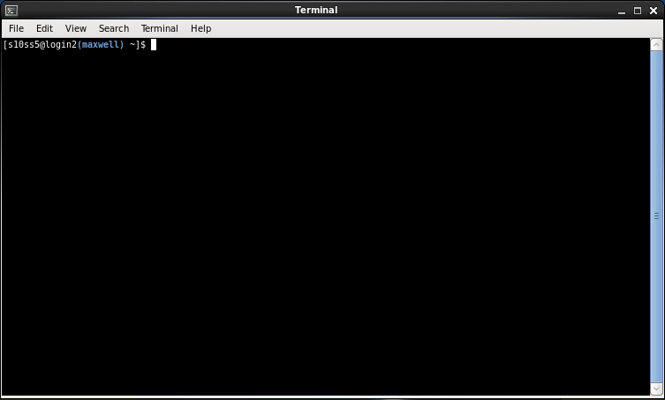
Introduction to Sequencing and Quality Control
Dr. Sophie Shaw
University of Aberdeen, UK
s.shaw@abdn.ac.uk

Slide 2

These Slides!
http://evomics.org/2020-workshop-on-genomics-cesky-krumlov-czech-republic/

Slide 3
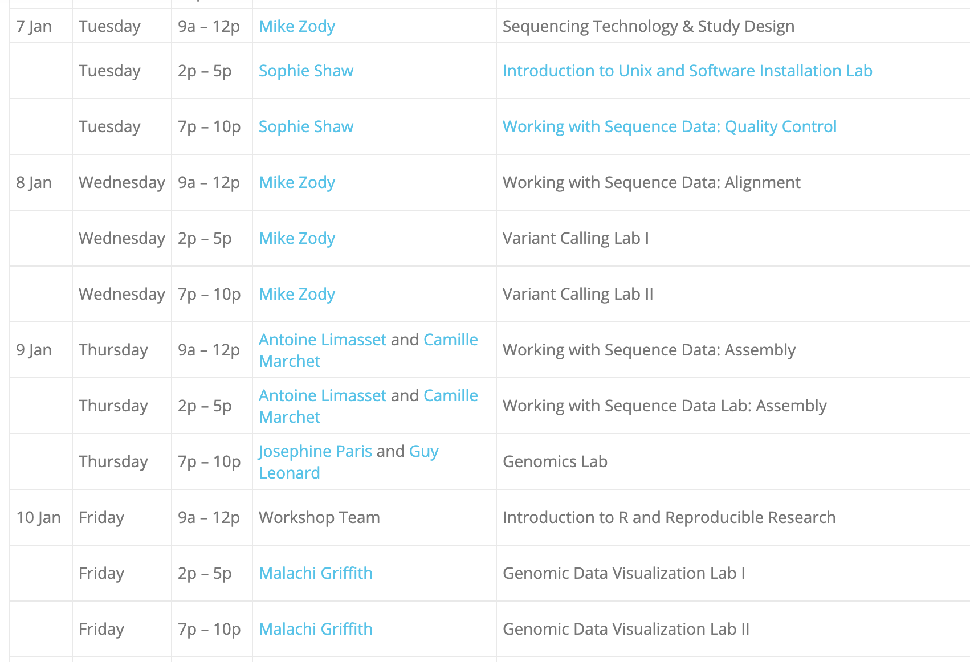
What We’re Going To Do
What is Sequence Data?

Slide 4


Watching vs Doing
Listen when you see this cat
Do when you see this cat

Slide 5

Reconnect to your Instance!
Get your public domain and reconnect to your instance using Guacamole.

Slide 6
Looking at File Contents
Navigate back to the Sequence files that we unarchived and renamed this afternoon. They should be in this path:
Don’t forget about tab complete whilst changing directories!
cd ~/workshop_materials/unix/Sequences
List the files to make sure that you have two sequencing files
called sequence_1.fq and sequence_2.fq
If your file names are different, you will need to use these names in
all of the following examples.

Slide 7

Paired Reads
Illumina Adaptors
DNA for Sequencing
Illumina Adaptors
Fragment
R1
Forward Read
Insert
R2
Reverse Read
An example: 300 bp paired end reads with a 700 bp fragment size
R1 = 300 bp, R2 = 300 bp, Insert = 100bp

Slide 8
Looking at File Contents
head | tail | more | less | cat
Shows the top lines of a file | Shows the bottom lines of a file | Shows the file one full screen at a time | Shows the file one full screen at a time | Shows an entire file all at once AND Used to combine files
-n specifies the number of lines (default 10) | -n specifies the number of lines (default 10) | Enter to scroll one line Space to scroll a page q to quit | Enter to scroll one line Space to scroll a page q to quit / to search n shows next | Ctrl + C to stop
Use these command line programs to look at the sequence files
head –n 10 sequence_1.fq

Slide 9
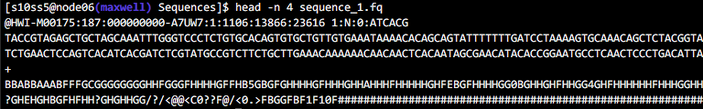
Let’s put this to use
ç
Fastq File Format:
Header
Sequence
Second Header (often +)
Phred Quality Score
Lots of analysis software like paired reads to be in the same order
CHALLENGE!
Use head and tail to check that the five bottom and top headers are in the same order in
sequence_1.fq and sequence_2.fq
(You may need to use the –n option to show more lines)
Notes:
Mention barcodes – inline here but can sometimes be indexed in the sequencing line

Slide 10
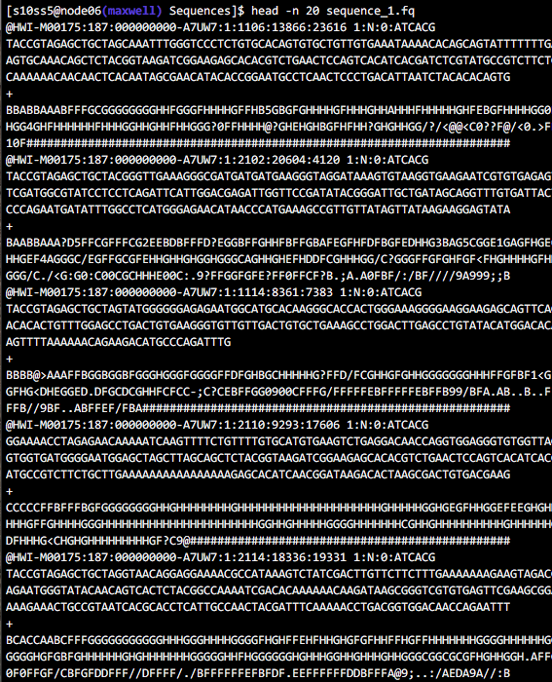
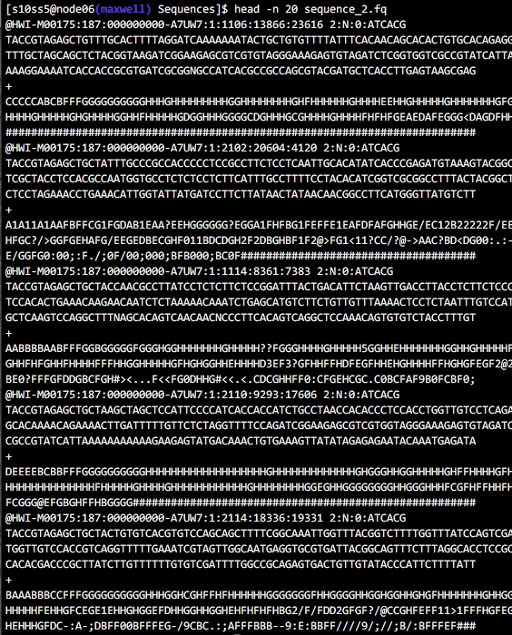
Challenge

Slide 11
Sequencing Stats
How many reads?
Count the number of lines
100000 lines THEREFORE 25000 reads
Are there the same number of reverse reads?
How about just counting the header lines?
Each header line starts @H
25121
BUT the numbers from the two programs don’t match?!
How about with this
25000
^ matches this pattern at the start of the line
This is the letter l
$ wc –l sequence_1.fq
$ grep –c “@H” sequence_1.fq
$ grep “@H” sequence_1.fq
$ grep –c “^@H” sequence_1.fq

Slide 12

Other Cool Things Unix Can Do
Unix commands can be used to manipulate files.
Within workshop materials, there is a file called scientists.txt
Use more to take a look at it:
more ~/workshop_materials/unix/scientists.txt
Run the following commands and work out what cut and sort do.
cut –f 3 ~/workshop_materials/unix/scientists.txt
sort –k 3 ~/workshop_materials/unix/scientists.txt
Then repeat the more command to look at the original file again.
Has it changed?
These are really great with pipes…

Slide 13
Pipelines
STDIN
PROGRAM 1
STDOUT
+ STDERR

Slide 14
Pipelines
STDIN
PROGRAM 1
STDOUT
STDIN
PROGRAM 2
STDOUT

Slide 15
Pipelines
STDIN
PROGRAM 1
Pipe |
PROGRAM 2
STDOUT

Slide 16
Let’s put this to practice:
Building Pipelines
Count the number of files and folders in your home directory
Let’s build the first part of the pipeline, listing the files:
Number 1
$ ls -1 /home/genomics/
PIPE this into wc –l to count the number of lines:
(i.e. the number of files and folders)
Letter l
$ ls -1 /home/genomics/ | wc -l

Slide 17
Let’s put this to practice:
Building Pipelines
How many base pairs in first sequence?
Firstly let’s get the top two lines of the sequence file:
$ head –n 2 sequence_1.fq
Now let’s PIPE this into tail to get just the sequence line
$ head –n 2 sequence_1.fq | tail –n 1
Finally PIPE this into word count of characters to count the base pairs
$ head –n 2 sequence_1.fq | tail –n 1 | wc -c
Is the first reverse read the same length?

Slide 18

So You’ve Got Some Sequencing Data – Now What?
The first thing you should do is check the quality of the data…

Slide 19
Quality Control
Quality Control is a multi-step process:
  Assessing read quality.
  Visualising adaptor contamination.
  Improving quality and removing adaptors.
  Removing further contaminating sequences.

Slide 20
Read Quality
Fastq File Format:
Header
Sequence
Second Header (often +)
Phred Quality Score
This line contains the Phred Quality Score for every base in the sequence

Slide 21
How it Works
Sequencing
A
T
G
A
A
A
C
T

Slide 22
How it Works
Sequencing
A
A
A
A
A
T
T
T
T
T
G
G
G
G
G
A
A
A
A
A
A
A
A
A
A
A
A
A
A
A
C
C
C
C
C
T
T
T
T
T

Slide 23
How it Works
Sequencing
A
Laser
T
Fluorescence Recorded
G
A
A
A
C
T

Slide 24
How it Works
Sequencing
A
Laser
T
G
Fluorescence Recorded
A
A
A
C
T

Slide 25

Read Quality – Base Calling
Sequencing
Image taken at every nucleotide incorporation

Slide 26
Read Quality – Base Calling
T
C
A?
C
T
Base pair sequences are called based on the fluorescence signal.
Quality scores are associated with each base call depending on how well it can
indiscriminately determine the base.

Slide 27
Why are some bases poorer quality?
The base caller is unable to determine the base when:
Cluster fluorescence is unclear.
  Dephasing of cluster.
  Reagent degradation.
Clusters overlap or are too close together.
Lack of sequence diversity.

Slide 28
Read Quality – Phred Score
Phred Quality Score | Probability of incorrect base call | Base call accuracy
10 | 1 in 10 | 90%
20 | 1 in 100 | 99%
30 | 1 in 1000 | 99.9%
40 | 1 in 10,000 | 99.99%
50 | 1 in 100,000 | 99.999%
60 | 1 in 1,000,000 | 99.9999%
https://en.wikipedia.org/wiki/Phred_quality_score

Slide 29
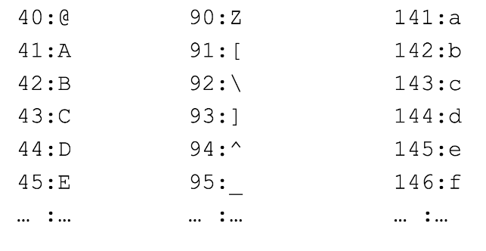
ASCII Encoding
Each number is converted to one symbol:

Slide 30
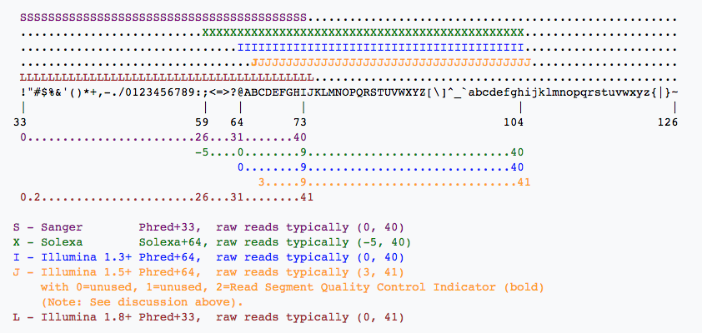
Different Phred Scores

Slide 31
Long Read Phred Scores
Error rates are much higher!
Oxford Nanopore:
  Phred+33 (sort of!)
  Q10 != 90% accuracy, Q15 = 90% accuracy (or so people say…)
PacBio:
  Depends on the data!
  RSII = Phred+33.
  Sequel = no encoding!

Slide 32
Why Do We Care?
Low quality reads, contamination and adaptors introduce errors into data.
Filtering and trimming these sequences may help to improve downstream analysis.
Filtering isn’t always needed. Some programs take quality into account.
HOWEVER a visualisation of data quality should be carried out at the beginning of ANY analysis.

Slide 33
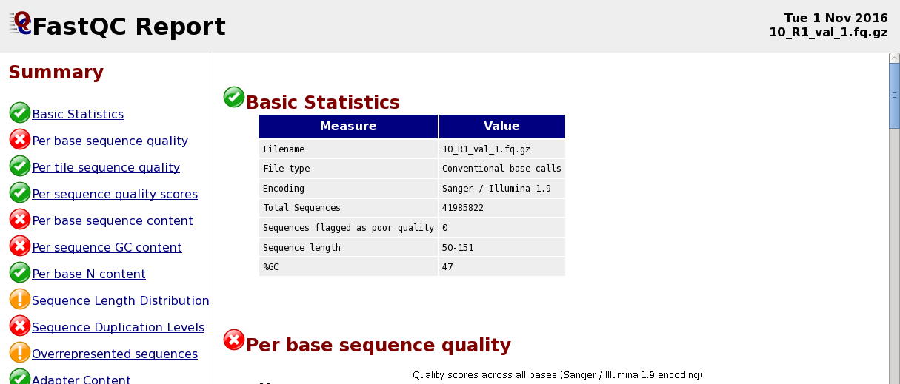
Read Quality
How do we easily look at the quality of >100000 sequences?
FastQC is software that does this for us.

Slide 34
Read Quality
Let’s run FastQC on our forward reads:
$ fastqc sequence_1.fq
Once finished, repeat the command with the reverse reads.
List your files.
You should find two html files have been produced, as well as two zipped files.
We can use Firefox to open the forward read report:
$ firefox sequence_1_fastqc.html

Slide 35

Read Quality
Distribution of quality at each base pair location of ALL of the reads

Slide 36

Read Quality

Slide 37
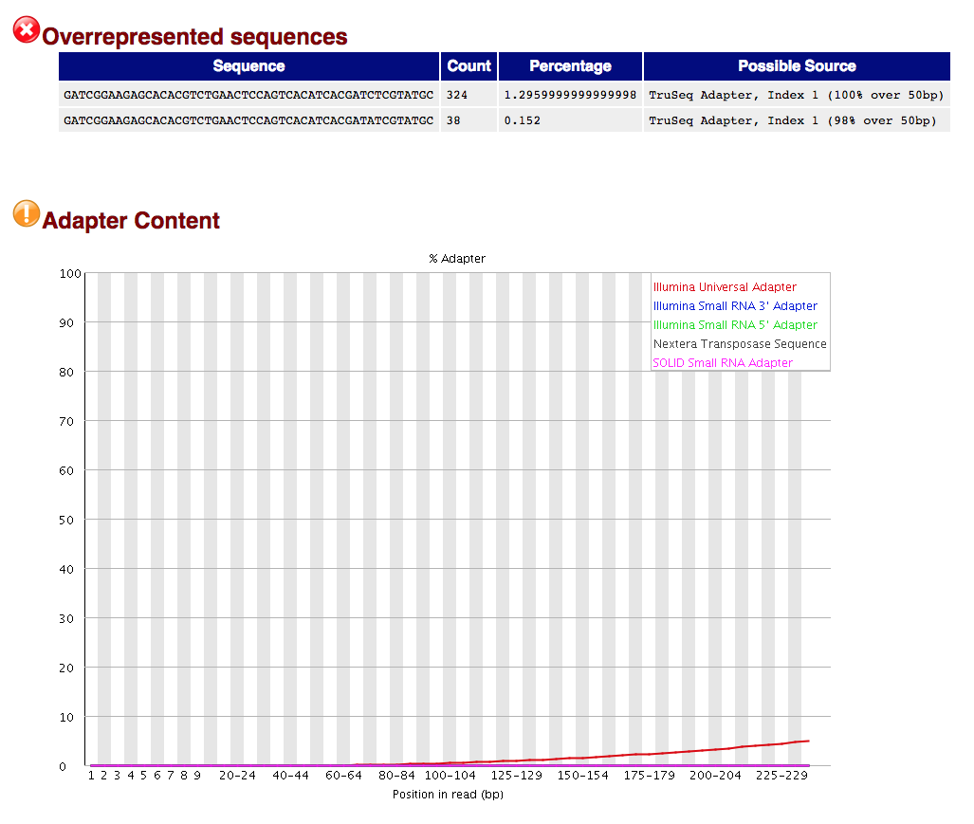
Adaptors

Slide 38
Adaptors
Where have these adaptor sequences come from?
Why are they at the 3’ end?
Adaptor
Actual sequence that we care about
Adaptor
Flow Cell

Slide 39
Adaptors
The first adaptor sequence is given as GATCGGAAGAGCACACGTCTGAACTCCAGTCACATCACGATCTCGTATGC
Let’s visualize this in our data:
$ grep --colour “GATCGGAAGAGCACACGTCT$” sequence_1.fq
This highlights the pattern in red.
This is the first half of the adaptor sequence.
This $ matches patterns AT THE END OF THE LINE
(It’s called a regular expression – they’re pretty cool)
Notes:
Copying and pasting doesn’t work due to the q

Slide 40
Getting Rid of Adaptors
sed – “stream editor”
sed –r ‘s/PATTERN/REPLACE/’
The
Binary
Program
Substitute
What you
Want to
Replace it
with
Pattern
You’re Searching
For

Slide 41
Getting Rid of Adaptors
Let’s look at an example, using pipelines!
First, let’s open the file:
$ cat sequence_1.fq
Let’s pipe that into grep to capture the lines which contain the adaptor.
$ cat sequence_1.fq | grep “GATCGGAAGAGCACACGTCT$”
Let’s pipe that into sed to replace all of the occurrences of the adaptor with nothing.
(All on one line!)
$ cat sequence_1.fq | grep “GATCGGAAGAGCACACGTCT$”
| sed –r ‘s/GATCGGAAGAGCACACGTCT$//’
Replace this
With this
Now re-run the original grep command (two slides back) – has the original file changed?!

Slide 42
Getting Rid of Adaptors
We can modify this search for those sequences ending with the same sequence, minus the last base pair…
$ grep --colour “GATCGGAAGAGCACACGTC$” sequence_1.fq
And then again, minus the next last base pair…
$ grep --colour “GATCGGAAGAGCACACGT$” sequence_1.fq
But imagine doing this for every iteration of the adaptor sequence!
What about sequencing errors within the adaptor!?
And then if we used sed, we’d have to make new files every time…

Slide 43
How Do We Improve the Quality?
Software is available to filter reads based on quality and trim adaptor sequences.
Many(!) different software available but all essentially do the same thing.
  Today we’re going to use TrimGalore!

Slide 44

Let’s Filter!
Let’s take a look at the manual page for TrimGalore!
$ trim_galore --help
Generally:
[ ] means optional
< > means mandatory files
| means or

Slide 45
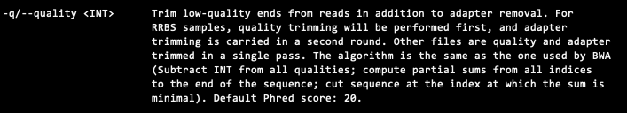
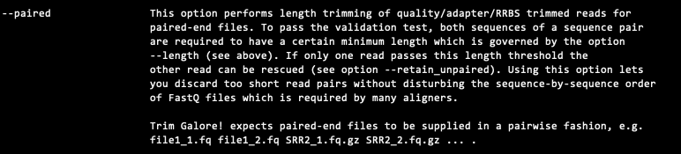
Let’s Filter!
Let’s take a look at the manual page for TrimGalore!
$ trim_galore --help

Slide 46
Let’s Filter!
Make a directory for the newly filtered reads!
$ mkdir Filter
And the trim:
$ trim_galore –q 30 –o Filter --paired sequence_1.fq sequence_2.fq
Phred score cut off
Output file directory
Specifies that our data is paired

Slide 47
Let’s Filter!
List the output files:
$ ls ./Filter
Run FastQC on the new filtered files
(sequence_1_val_1.fq and sequence_2_val_2.fq)
Then use Firefox to take a look at the new report files
(sequence_1_val_1_fastqc.html and sequence_2_val_2_fastqc.html)
What percentage of reads remain after filtering?

Slide 48
Quality Before

Slide 49

Quality After
But what is this!?

Slide 50
How Trimming Works
5’
3’
A
T
C
G
T
C
. . . . . . . . .
32
28
25
32
28
22
A
T
C
G
T
. . . . . . . . .
32
28
25
32
28
A
T
C
G
. . . . . . . . .
32
28
25
32

Slide 51
Adaptors Before

Slide 52
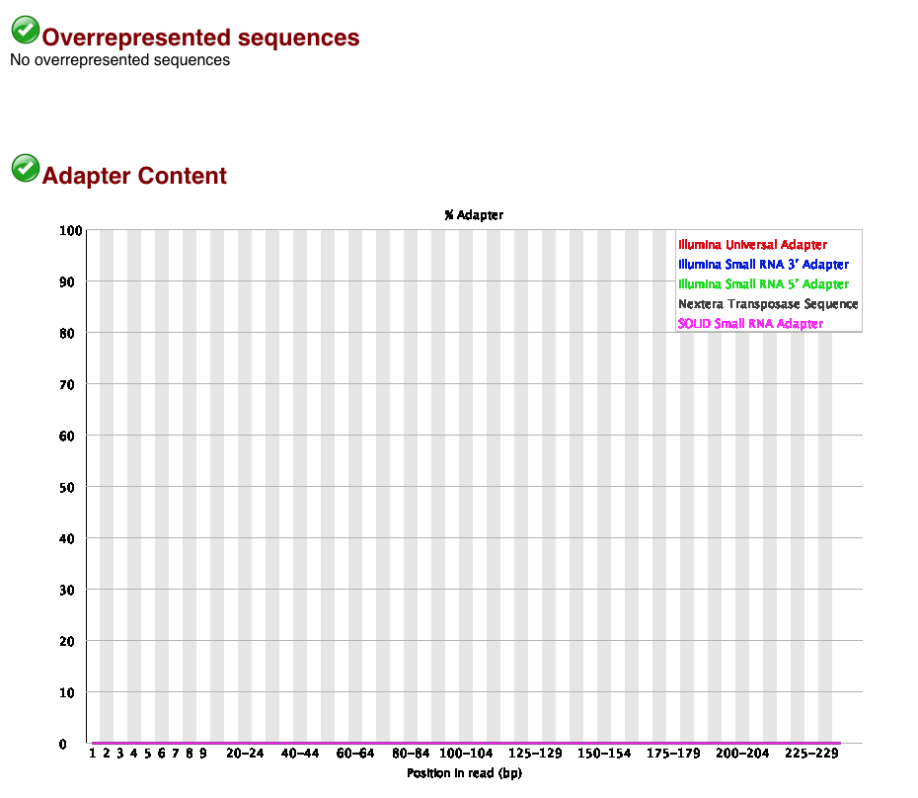
Adaptors After

Slide 53
Adaptors After
Let’s double check by visualizing this in our data
(all on one line):
$ grep --colour “GATCGGAAGAGCACACGTCT$” Filter/sequence_1_val_1.fq
They’re all gone!
So the data is good now! Right? Right….?

Slide 54

Is the Data Good Now...??
What’s this?!

Slide 55
Is the Data Good Now...??
How do these sequences relate to this?

Slide 56

Library Preparation
Adaptor
DNA
Adaptor

Slide 57
Library Preparation
Adaptor
DNA
Adaptor
Illumina 5’ Adaptor:
This “primes” the sequencing reaction
Barcode:
Different for each sample
Primers:
Used to amplify the material so there is enough!
DEPENDING ON YOUR PROJECT, YOU MAY HAVE PRIMER SEQUENCES, YOU MAY NOT! SPEAK TO THE PERSON PREPARING YOUR LIBRARIES SO YOU KNOW WHAT TO EXPECT!

Slide 58
Primer Sequences
As we did with the adaptors, we can visualize this!
(All on one line):
$ grep --colour “^TACCGTAGAGCTGCTA” Filter/sequence_1_val_1.fq
^ means from the start of the line
How many lines contain this?
$ grep -c “^TACCGTAGAGCTGCTA” Filter/sequence_1_val_1.fq
If the fragment was shorter than read length, the reverse complement of the primer
will be at the 3’ end – see if you can see visualize this first, and then count it.
Reverse complement = TAGCAGCTCTACGGTA

Slide 59
Remove Primers - sed
sed – “stream editor”
sed –r ‘s/PATTERN/REPLACE/’
The
Binary
Program
Substitute
What you
Want to
Replace it
with
Pattern
You’re Searching
For

Slide 60
Remove Primers - sed
First, let’s open the file:
$ cat Filter/sequence_1_val_1.fq
Let’s pipe that into sed to replace all of the occurrences of the primer at the start of the line with nothing.
$ cat Filter/sequence_1.fq | sed –r ‘s/^TACCGTAGAGCTGCTA//’
Finally REDIRECT the standard out into a new file.
(all on one line):
$ cat Filter/sequence_1.fq | sed –r ‘s/^TACCGTAGAGCTGCTA//’ > Filter/clean_1.fq
But removing primers manually isn’t the best approach…

Slide 61
Remove Primers - bbmap
OPTION 1 – Hard trimming 16 bp from the 5’ end of all of the reads with TrimGalore!
OPTION 2 – Use bbduk from BBMAP to remove specific sequences.
And this is what we’re going to do! Take a look at the manual:
$ bbduk.sh -h
Have a look at the following parameters:
in=
in2=
ref=
out=
out2=
k=
rcomp=
mink=
ktrim=

Slide 62
Remove Primers - bbmap
OPTION 1 – Hard trimming 16 bp from the 5’ end of all of the reads with TrimGalore!
OPTION 2 – Use bbduk from BBMAP to remove specific sequences.
And this is what we’re going to do! Take a look at the manual:
$ bbduk.sh -h
Have a look at the following parameters:
in= input file
in2= input file pair
ref= reference file containing contaminants (I’ve made this for you!)
out= output file
out2= output file pair
k= length of kmer used for finding contaminants
rcomp= match reverse complements
mink= look for shorter kmers up to this length at the ends
ktrim= specify which direction to trim reads from

Slide 63
Remove Primers - bbmap
Run bbduk!
I’ve assumed you’re working in the Sequences directory here,
and the reference file (primers.fasta) is one directory above.
(All on one line)
$ bbduk.sh in=Filter/sequence_1_val_1.fq in2=Filter/sequence_2_val_2.fq ref=../primers.fasta out=Filter/clean_1.fq out2=Filter/clean_2.fq
k=16 mink=11 ktrim=1 rcomp=t
Run FastQC again on your clean files!

Slide 64
Is the Data Good Now...??

Slide 65
Is the Data Good Now...??
But what about other contaminants? These need to be removed as well.
  Host species.
  Other organisms.
  PhiX controls.
Can use bbduk.sh (easy) or DeconSeq (little bit more involved)

Slide 66
Any Questions So Far?

Slide 67
Now it’s your turn (Maybe!)
Within the following directory, there are 3 datasets:
Set 1: Genome sequencing of the bacteria Bartonella
  bartonella_illumina.fastq
Set 2: RAD sequencing data
  can152.fq
Set 3: Amplicon sequencing of 16S rRNA from environmental samples
  P160A-44-S44_L001_R*_001.fastq.gz
~/workshop_materials/QC_Workshop

Slide 68
RAD Sequencing
RAD = Restriction-site Associated DNA
Genomic DNA
Restriction Enzyme
Fragmented DNA
Sequencing

Slide 69
Amplicon Sequencing
Amplify Region via PCR
(16S rRNA gene)
Sequence
Grouped
Based on Sequence
Similarity

Slide 70
Now it’s your turn
You need to run quality control on these samples!
Assess the quality using FastQC.
Determine if the data looks like what you expect FOR THIS EXPERIMENT
Decide whether the quality needs to be improved and if any sequences need to removed.
Filter!
Assess the quality of the clean reads.

Slide 71
Set One
Genome Sequencing Data
There are 10,000 sequences of 38 bp in length
The GC content is 37%
Quality score is > Q30, which = 1 error in 1000 so base call quality is 99.9%
Would you think this is good quality sequencing data?

Slide 72
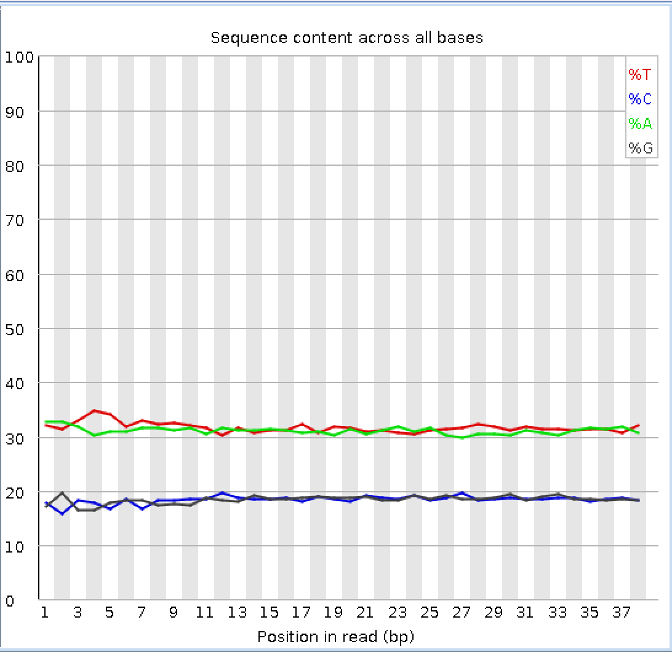
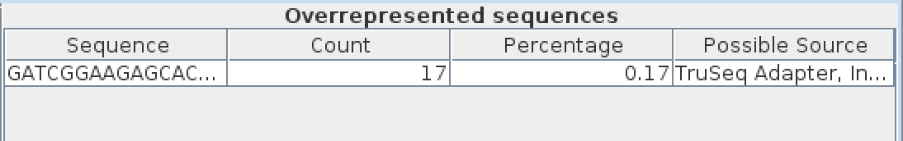
Set One
Genome Sequencing Data
Are we worried about this data?!
No - This shows the GC content we
expect and very few adaptors.

Slide 73
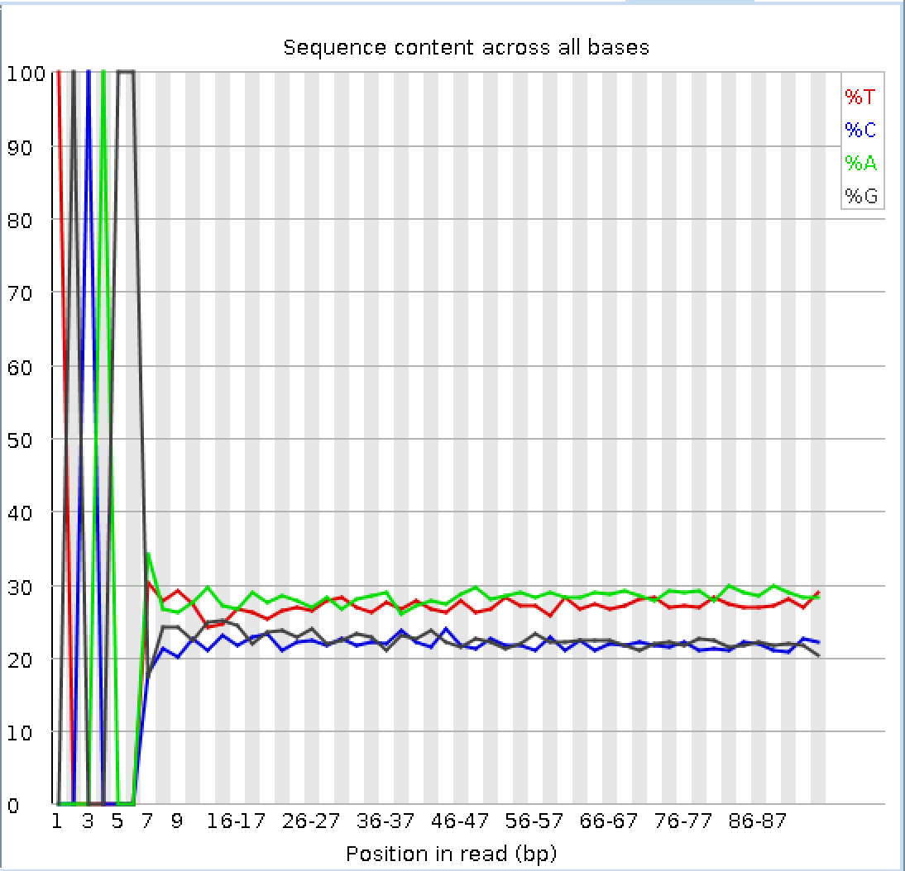
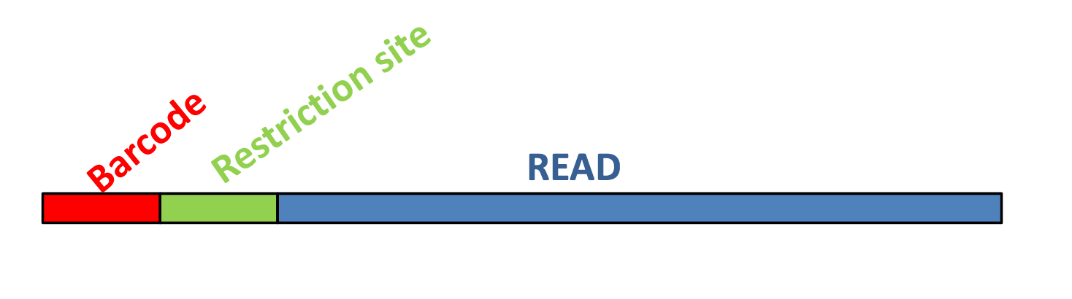
Set Two
RAD Sequencing Data
Restriction Enzyme Digestion Site

Slide 74
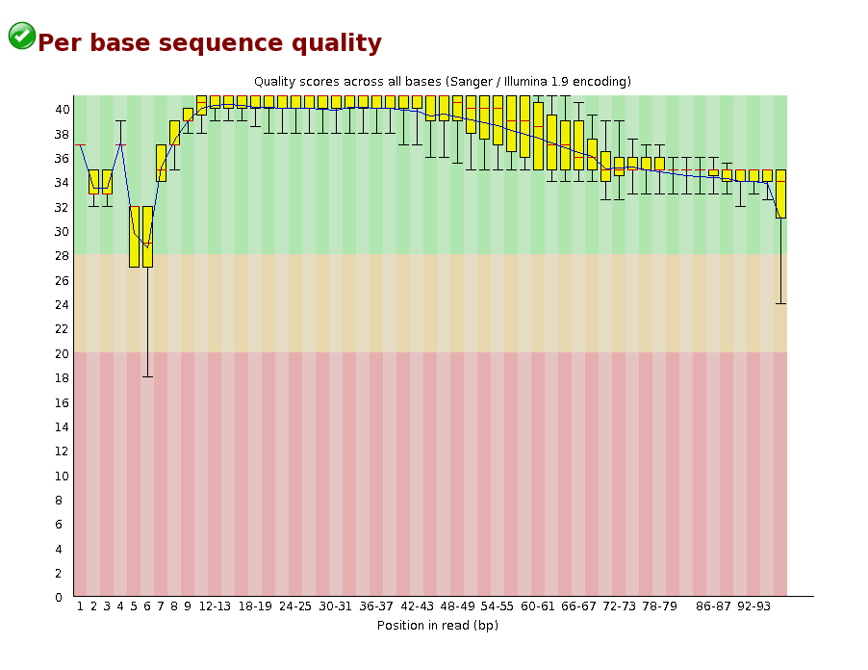
Set Two
RAD Sequencing Data
Lack of diversity between clusters confuses the sequencer.
All the dots are identical and therefore it can not decide where one cluster starts and one ends!

Slide 75
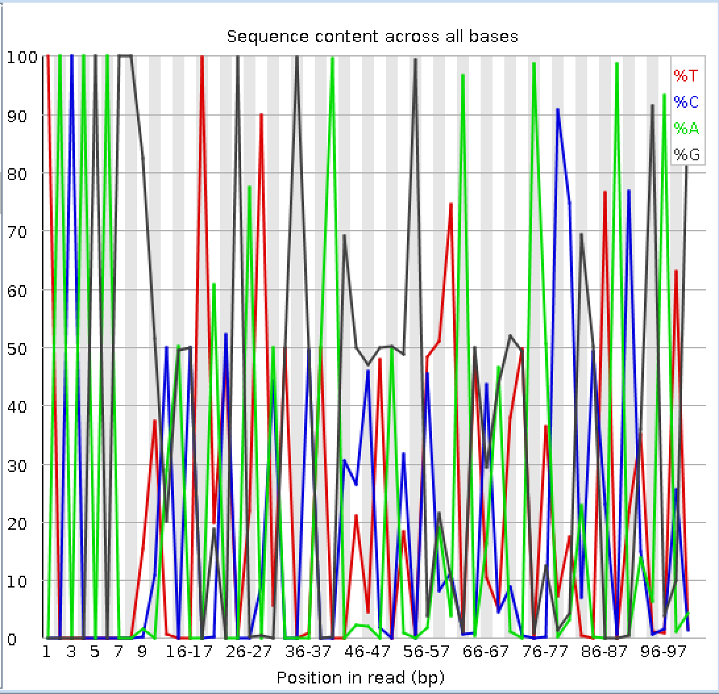
Set Three
Amplicon Sequencing Data
Filter Low Quality &
Remove the Primer Sequence

Slide 76
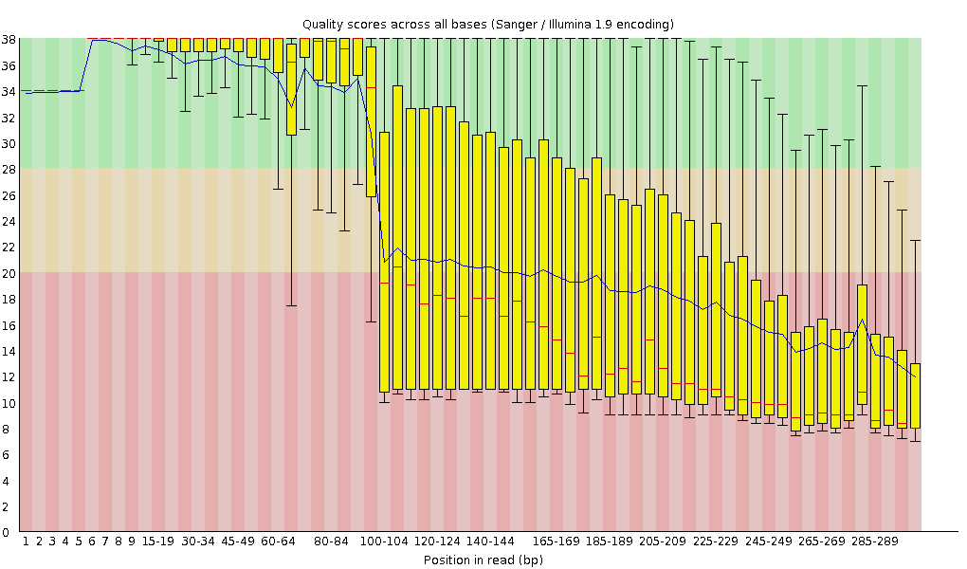
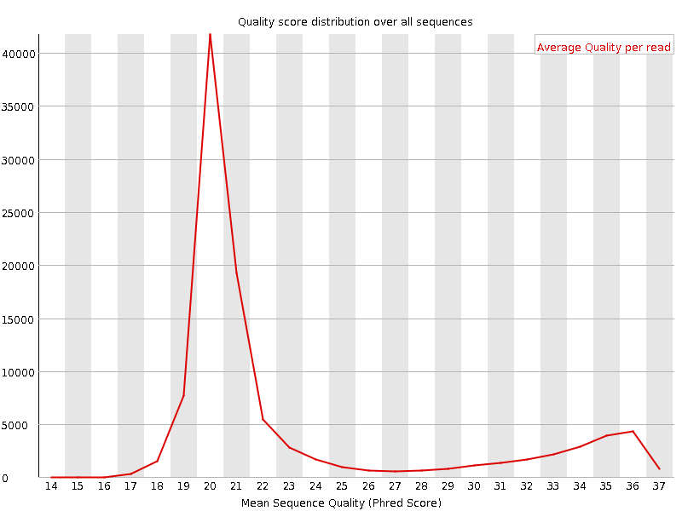
Set Three
Amplicon Sequencing Data
Very low average quality

Slide 77
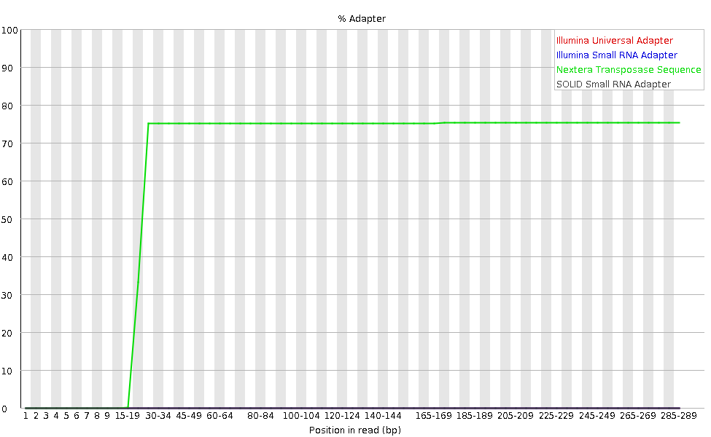
Set Three
Amplicon Sequencing Data
75% of bases are adapters after 15 bp
Majority adaptor dimers
Unlikely to be able to save this data!

Slide 78
Take Home Message!
It is essential to QC your data before beginning analysis.
What are you expecting? Think about your experimental design, your species etc…
What are you doing with the data? Alignment, assembly etc…
No two datasets are the same!

Slide 79
Any Questions So Far?

