Slide 1
GENOME-enabled METABOLIC PREDICTIONS to interrogate
the STRUCTURE and FUNCTION of microbial communities

Slide 2
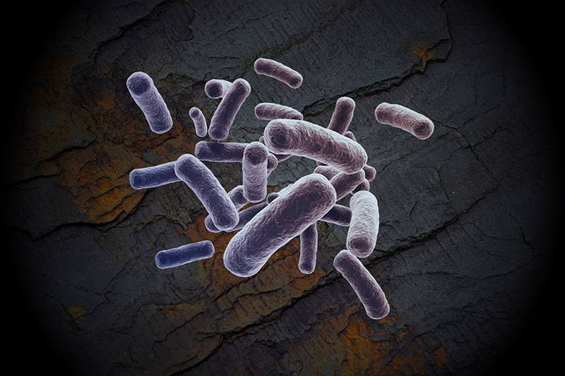
Case study from my group: Survivor Fractured Shale
TITLE FOR TALK
How meta-omics can provide new mechanistic insights in an engineered ecosystem

Slide 3
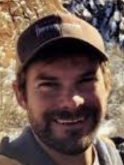







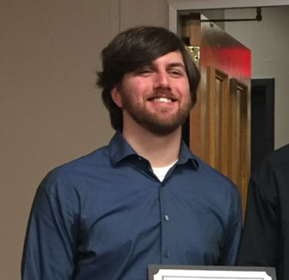
Acknowledgments
Mike Wilkins
PI
Rebecca Daly
Research scientist
Mikayla Borton
grad student
Kaela Amundson
grad student
Anne Booker
grad student, alumni
Robert Danczak
grad student, alumni

Slide 4
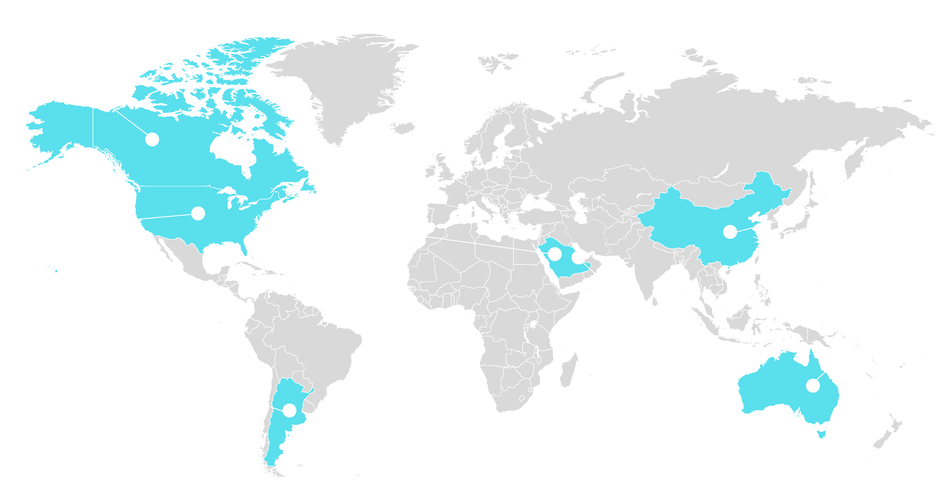
Countries with commercial shale energy
Notes:
Shales are sedimentary rocks distributed across the globe- here is their distribution in north America

Slide 5
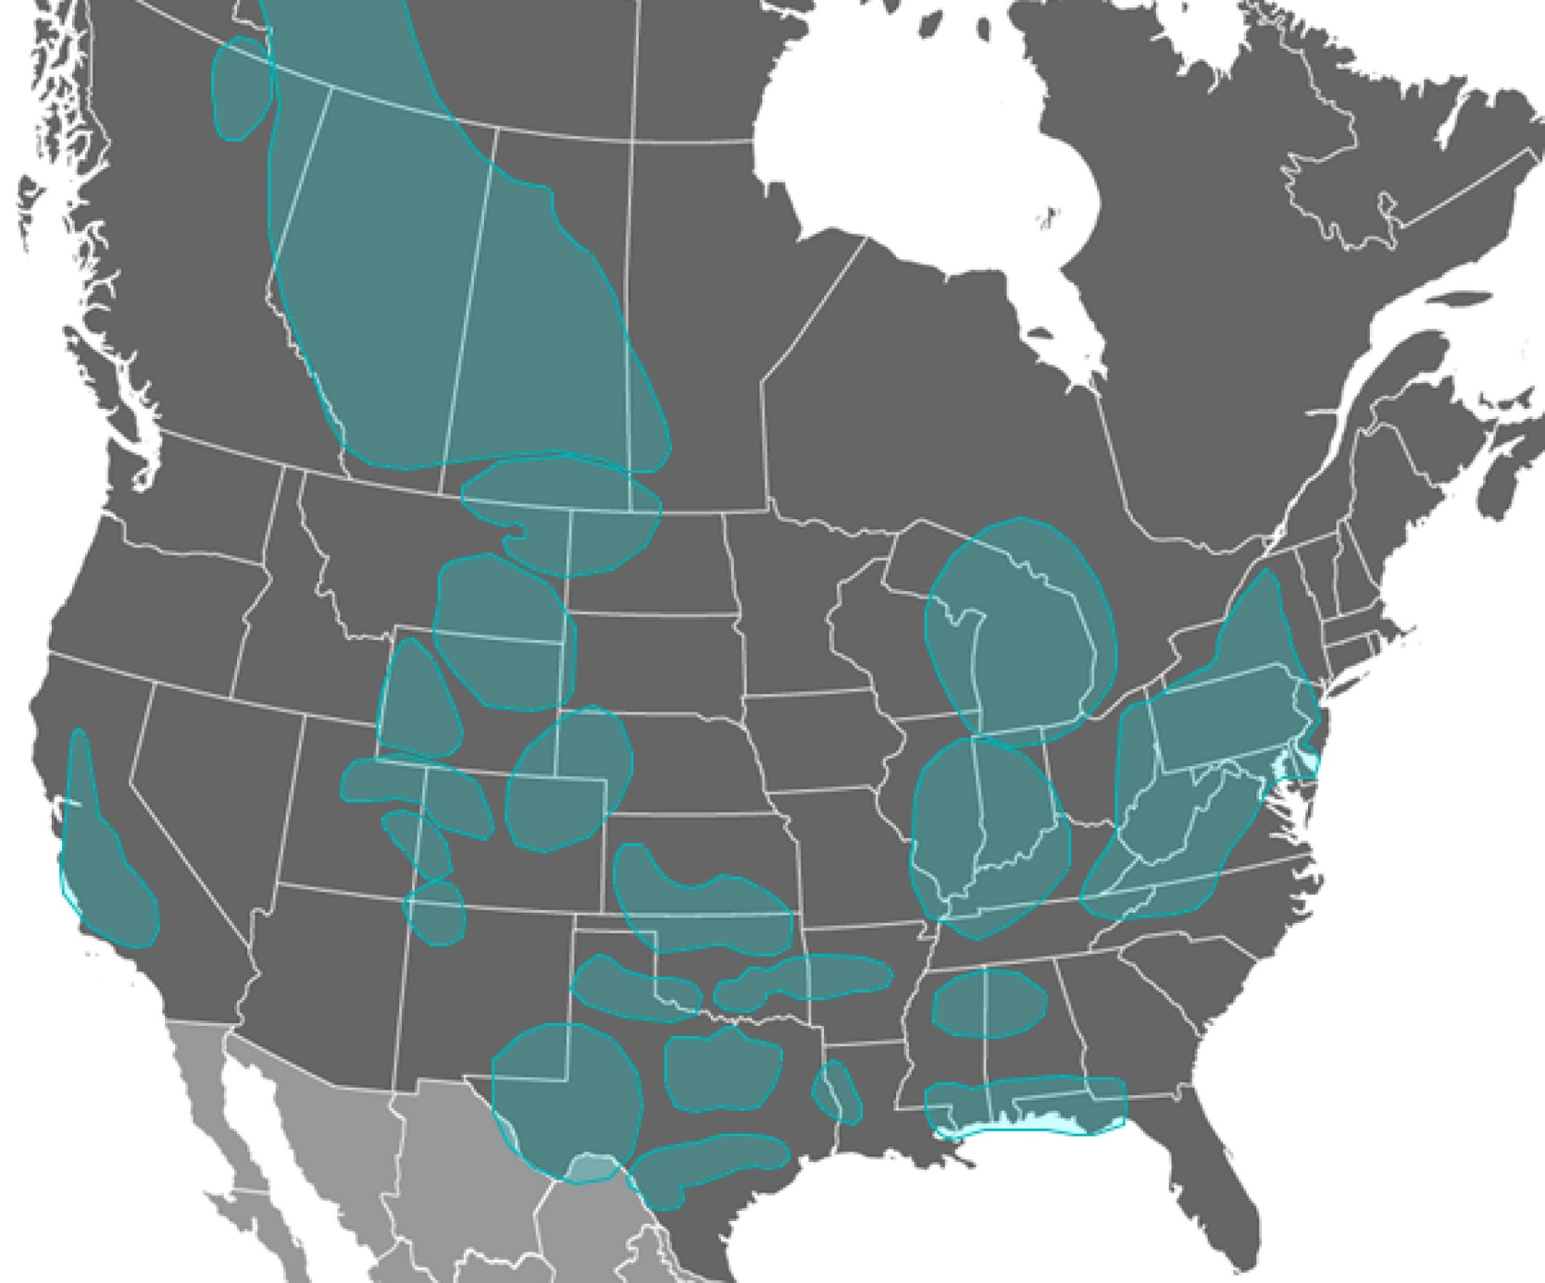
Hydraulically fractured shales and US energy portfolio
16 States in the US
Marcellus contributes 30% of gas for the eastern seaboard
Permian contributes 35% of U.S. crude production and 17% of the natural gas supply
First time in US history natural gas replaces coal as main source for electricity
Marcellus/Utica
Permian
Notes:
Hydraulic fracturing is occurring in over 16 states in the united states- with two of the most promising regions that we have been working in being the permmian and Marcellus
https://www.forbes.com/sites/judeclemente/2019/05/01/exxon-chevron-leading-the-permian-oil-and-natural-gas-surge/#bbeaafbc4f20
MORE FROM CA
https://thenarwhal.ca/what-is-fracking-in-canada/
200,000 wells have been horizontally fracked for shale gas or oil, primarily in the western provinces. It is now estimated that 80 per cent of new oil and gas wells in Canada are fracked.
fracking could still be economically feasible at $45-$50 a barrel.
100 active drilling rigs in Alberta, 23 in B.C. and a small amount in Manitoba and Saskatchewan, although numbers fluctuate regularly.
Particularly in Alberta, it’s not all about drilling new wells, as companies are increasingly fracking older wells to access what they couldn’t previously in areas such as the Duvernay formation. In 2015-2016, the Alberta government collected $493 million in revenues from natural gas activities, the majority of which involved fracking of unconventional wells. After a review of royalty rates, the provincial government decided last year to keep rates low, thus continuing to incentivize fracking.
As opposed to the shale gas further west, fracking in both Saskatchewan and Manitoba is for shale oil, also referred to as tight oil. The Bakken oil field, which made North Dakota a global energy giant, extends into southeast Saskatchewan and a bit into southwest Manitoba. As new formations continue to be found, fracking has spread to the southwest of Saskatchewan in the Viking and Lower Shaunavon formations. As of 2015, Saskatchewan had 7,500 horizontally fracked wells.

Slide 6
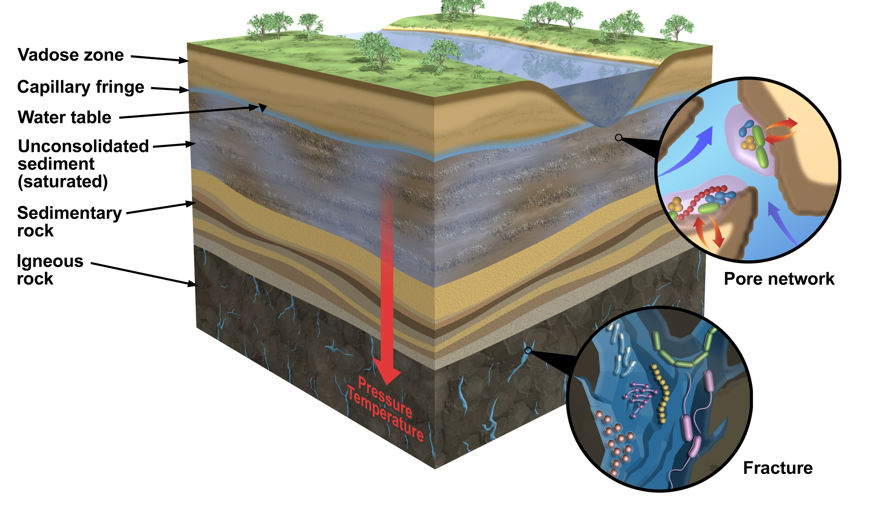
The deep terrestrial subsurface:
The microbial frontier
1/3 earths biomass is below soil layer, but remains poorly characterized
Notes:
Cell numbers in terrestrial subsurface : 25-250 x 10²⁸
Not evenly distributed! Introduce sedimentary rock.

Slide 7




Pristine Appalachian shales
do not appear a conducive habitat for life
Low permeability
Nanopores (<0.2 um sized)
Limited meteoric water exchange
Andrea Hanson
Paula Mouser
Kai
Hendricks
Julius
Lipp
Notes:
Cell numbers in terrestrial subsurface : 25-250 x 10²⁸
Not evenly distributed! Introduce sedimentary rock.

Slide 8
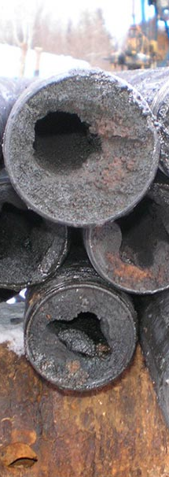
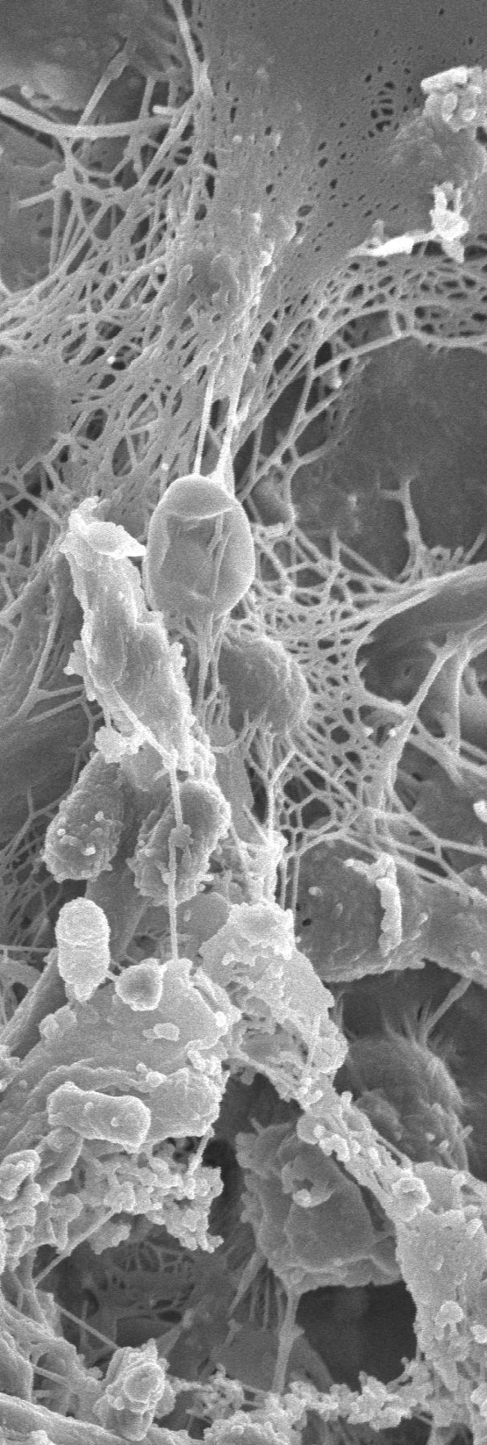
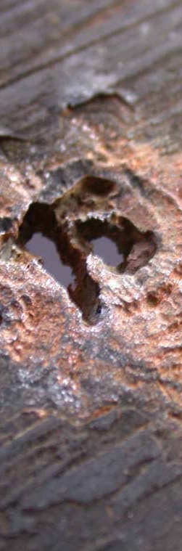
Negative Impacts
Booker et al, 2016, AEM & Booker et al, 2019, Msphere
Notes:
BILLION DOLLAR industry- look up
How much to

Slide 9

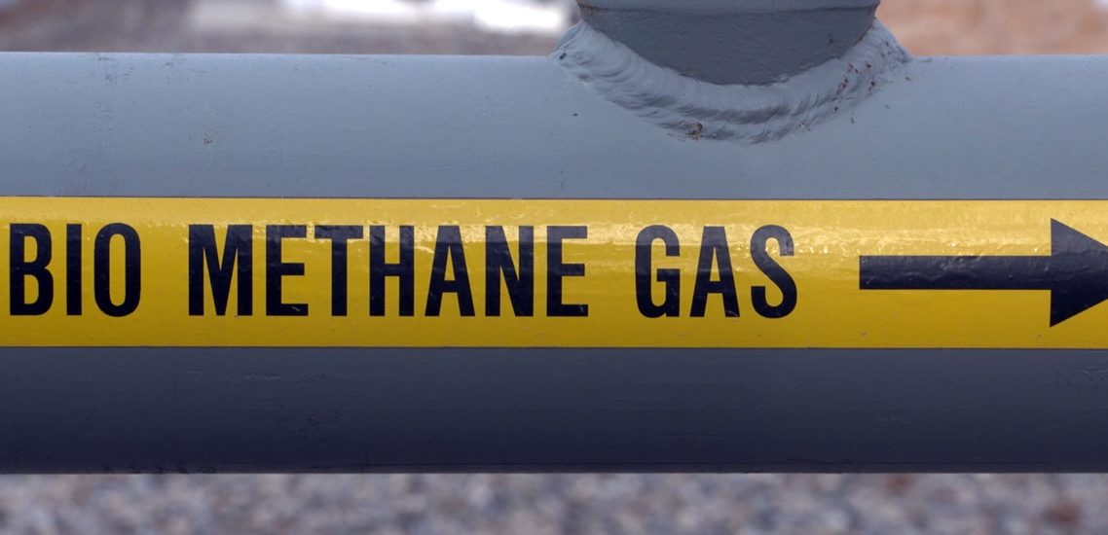
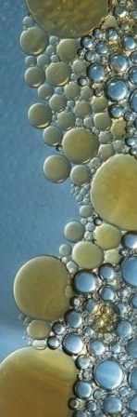
Negative Impacts
Positive Impacts
Booker, Borton, et al. (Msphere 2017)
Booker et al, 2016, AEM & Booker et al, 2019, Msphere
Borton et al, 2018 Env Micro & Park et al ,2013

Slide 10
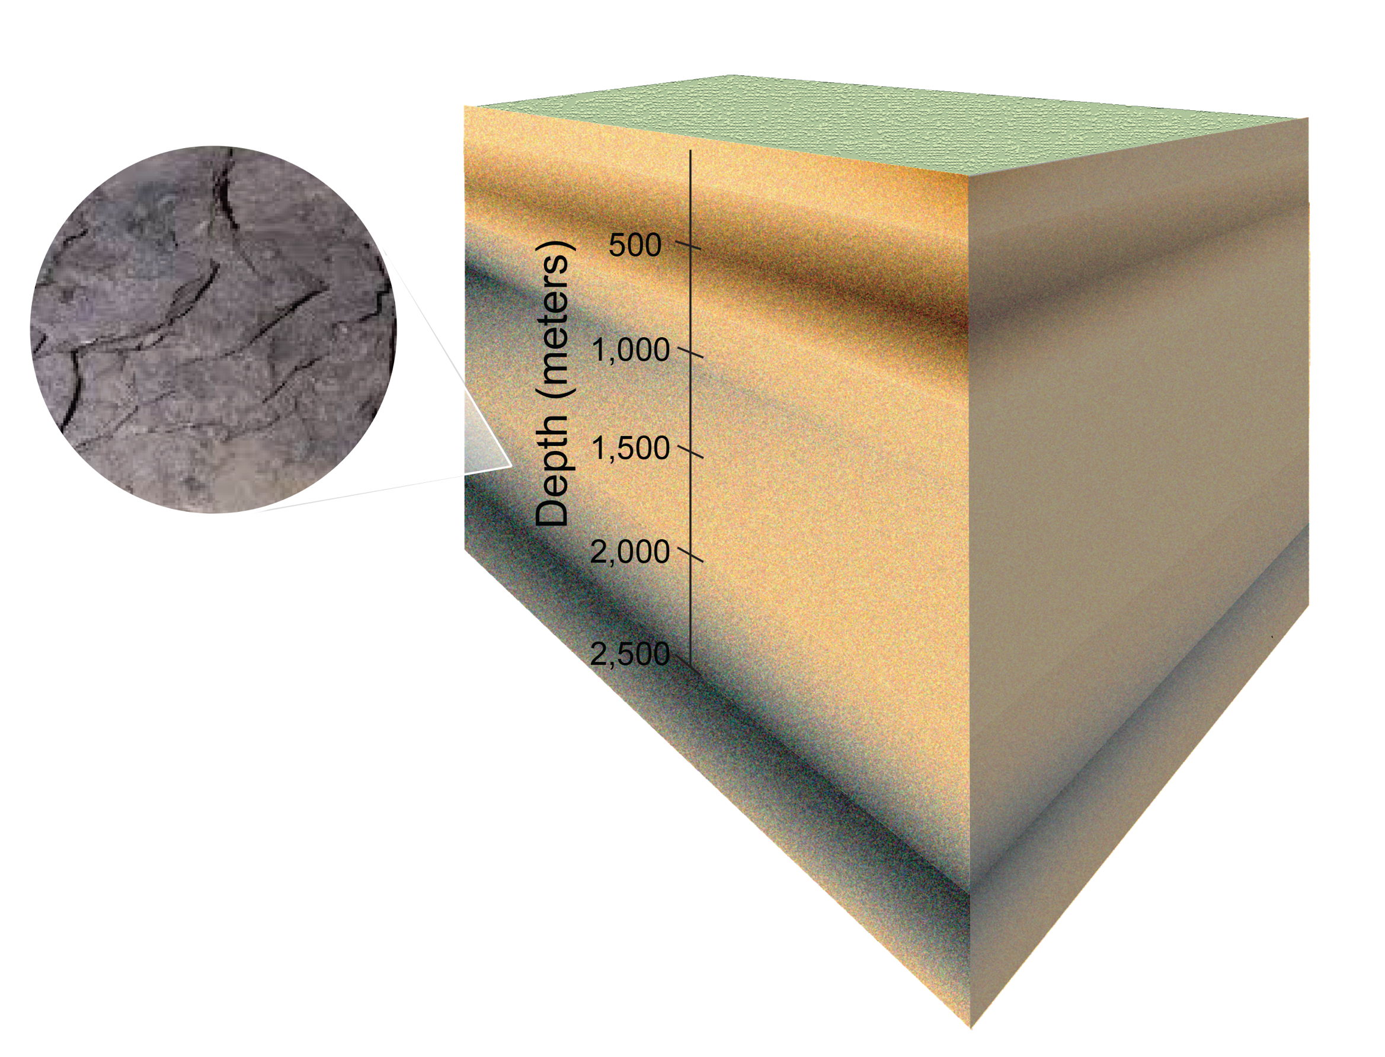
What the frack?
Prior to energy extraction,
most deep shales lack requirements for life
Notes:
Cell numbers in terrestrial subsurface : 25-250 x 10²⁸ Not evenly distributed! Introduce sedimentary rock.

Slide 11
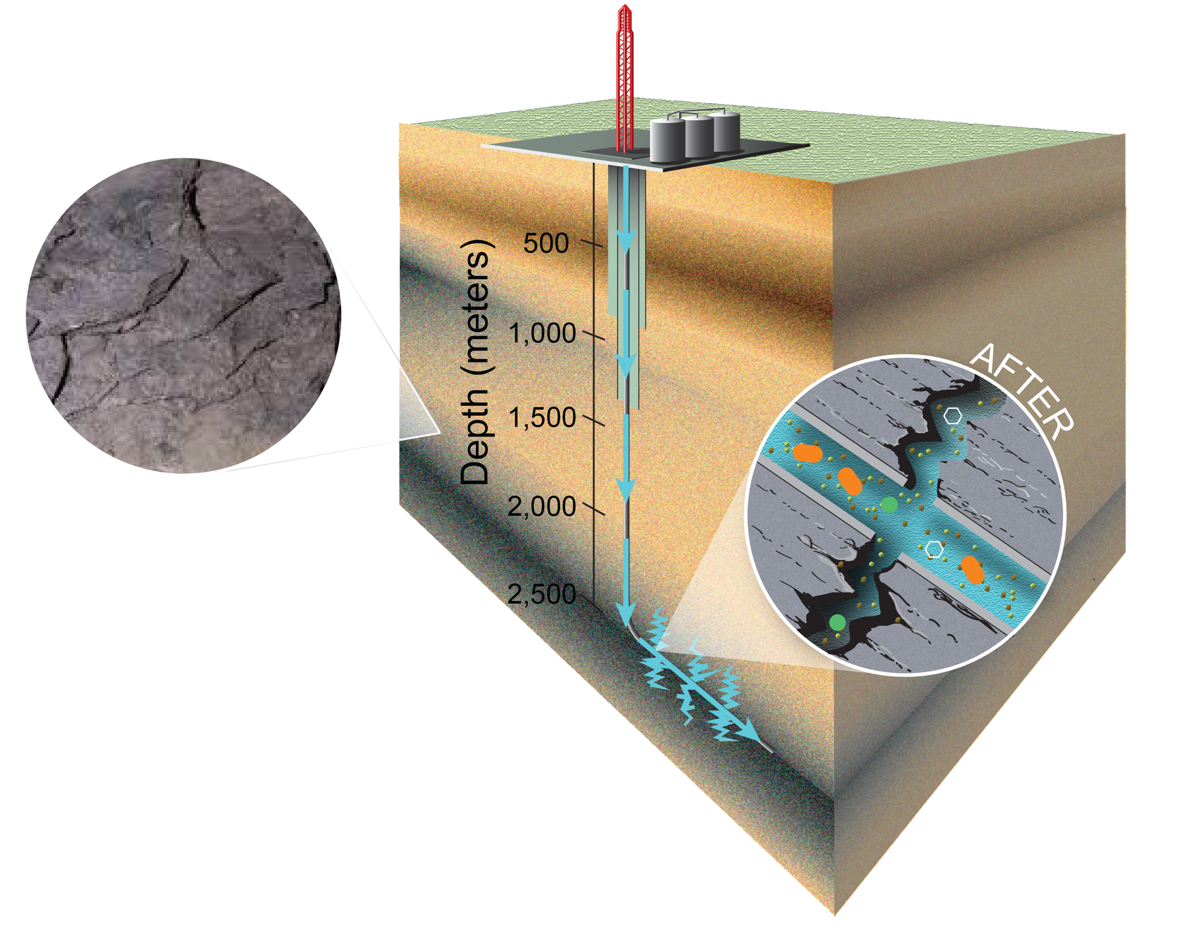
One take away point for today
Fracking creates an ecosystem 2,500 meters below the surface
Daly, 2016, Nature Micro; Hanssen et al, in prep
Notes:
5-100 million liters of water- typicaly 20M which is about 8 Olympic pools

Slide 12
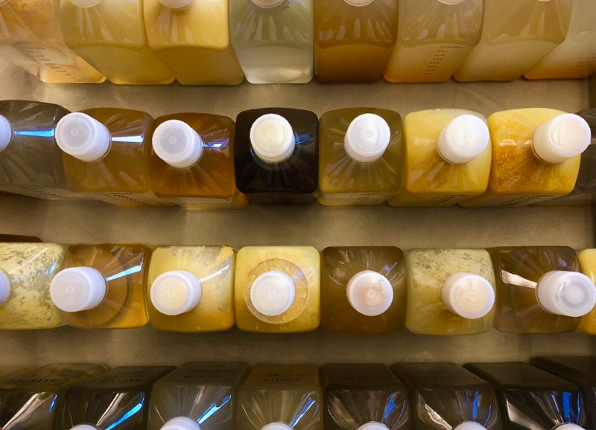
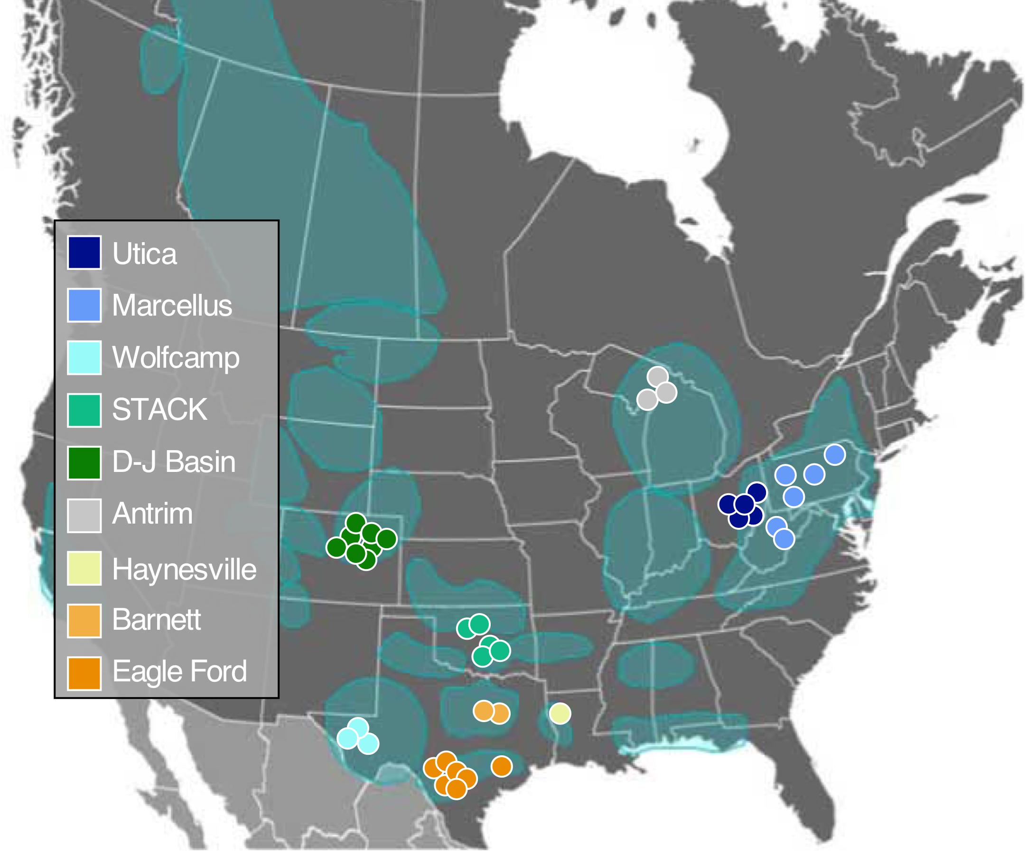
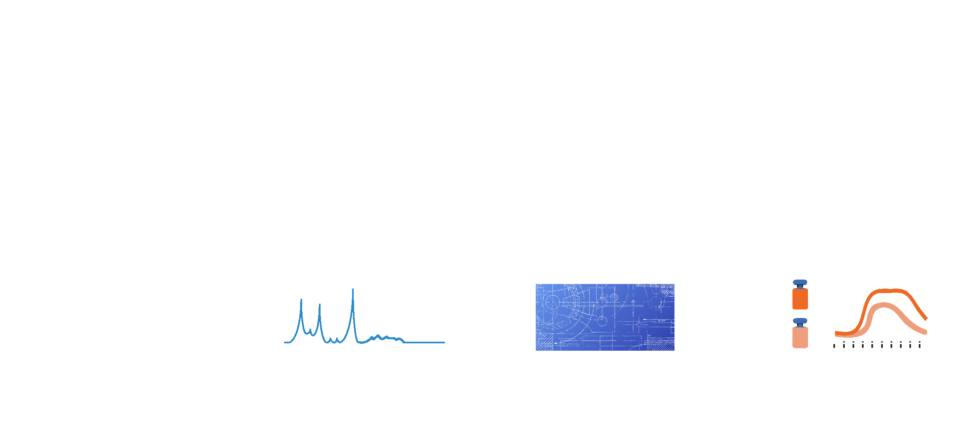
Development of a multi-omic spatial, temporal database
identify persisting taxa
Define chemical
niche
Genes that support persistence
Validate field
hypotheses
Notes:
Cell numbers in terrestrial subsurface : 25-250 x 10²⁸
Not evenly distributed! Introduce sedimentary rock.

Slide 13
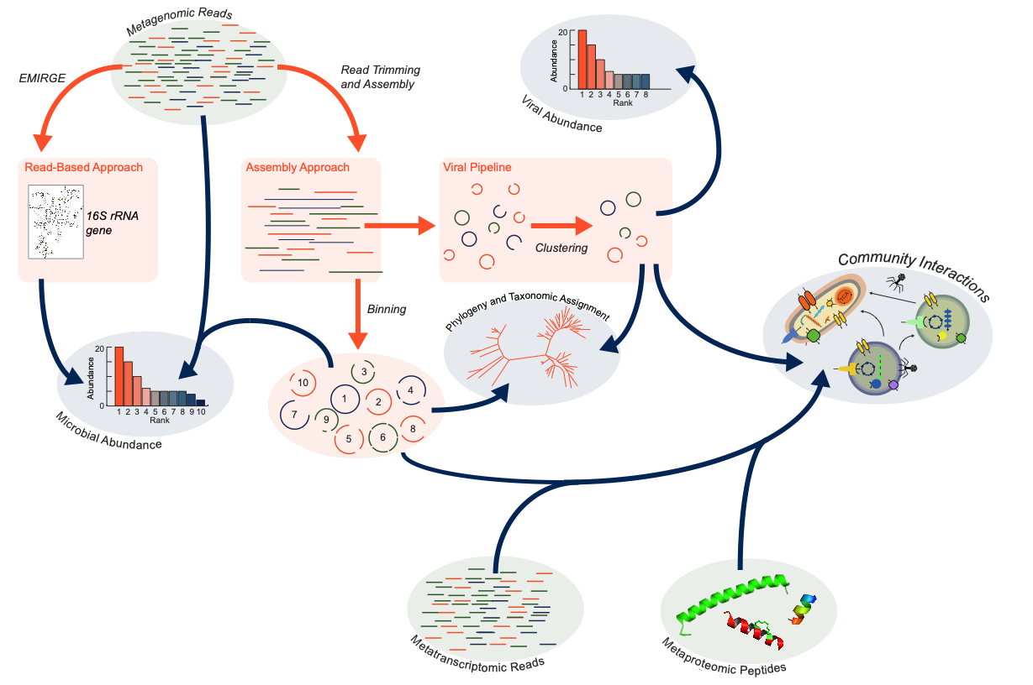
Computational pipeline used in this case study

Slide 14
1
What is the shale environment like?
What type of microorganisms persist in this system?

Slide 15
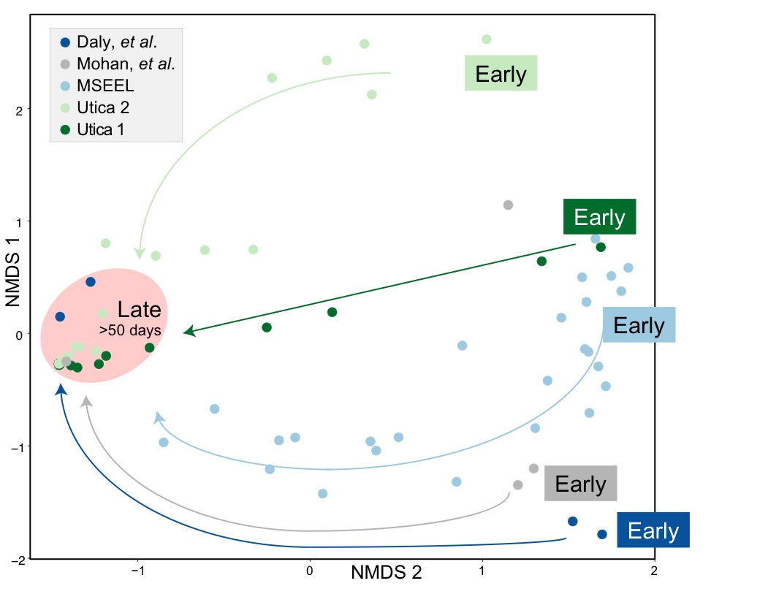
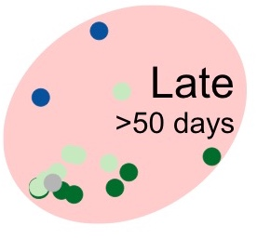
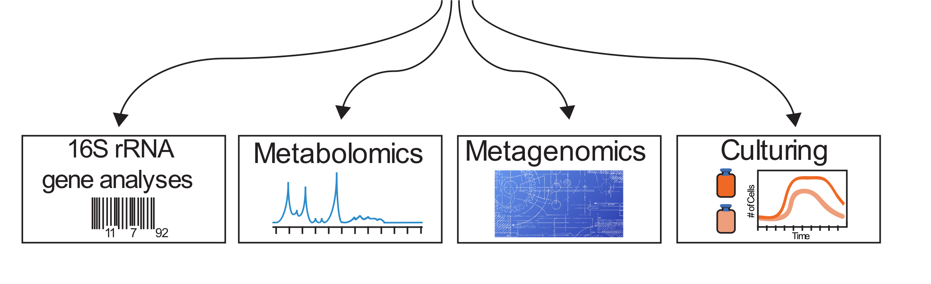
16S rRNA analyses of persisting microbial communities
Cell counts increased by ~2 log fold in late samples
Data from Borton, reviewed in part in Mouser et al 2016, FEMS Microbiology
Notes:
Cell numbers in terrestrial subsurface : 25-250 x 10²⁸
Not evenly distributed! Introduce sedimentary rock.

Slide 16
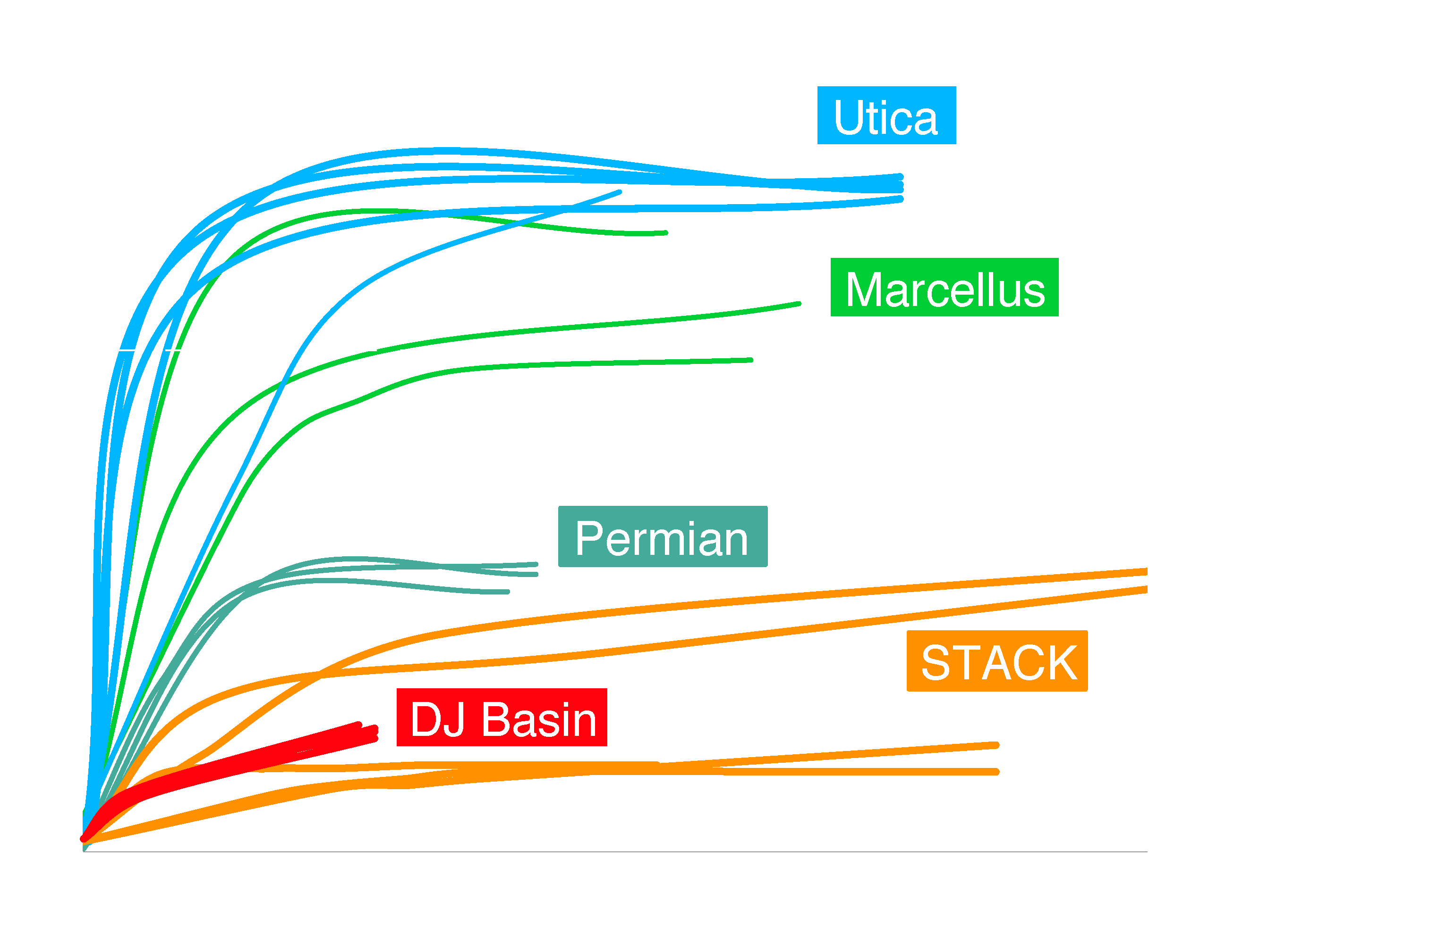
Unpublished data
(Wilkins and Wrighton)
Fractured shale communities must
Adapt to increasing salinity
Notes:
All the mseel, sh and w 4 are na-ca-cl brines with TDS in the Utica from 100 to 200 g/l and mseel from about 50 to 200 g/l. Cl is most abundant ion by mass and is about half the total salt. Sr and Ba are a few. Grams/l, often higher than Mg. There is almost no So4.

Slide 17
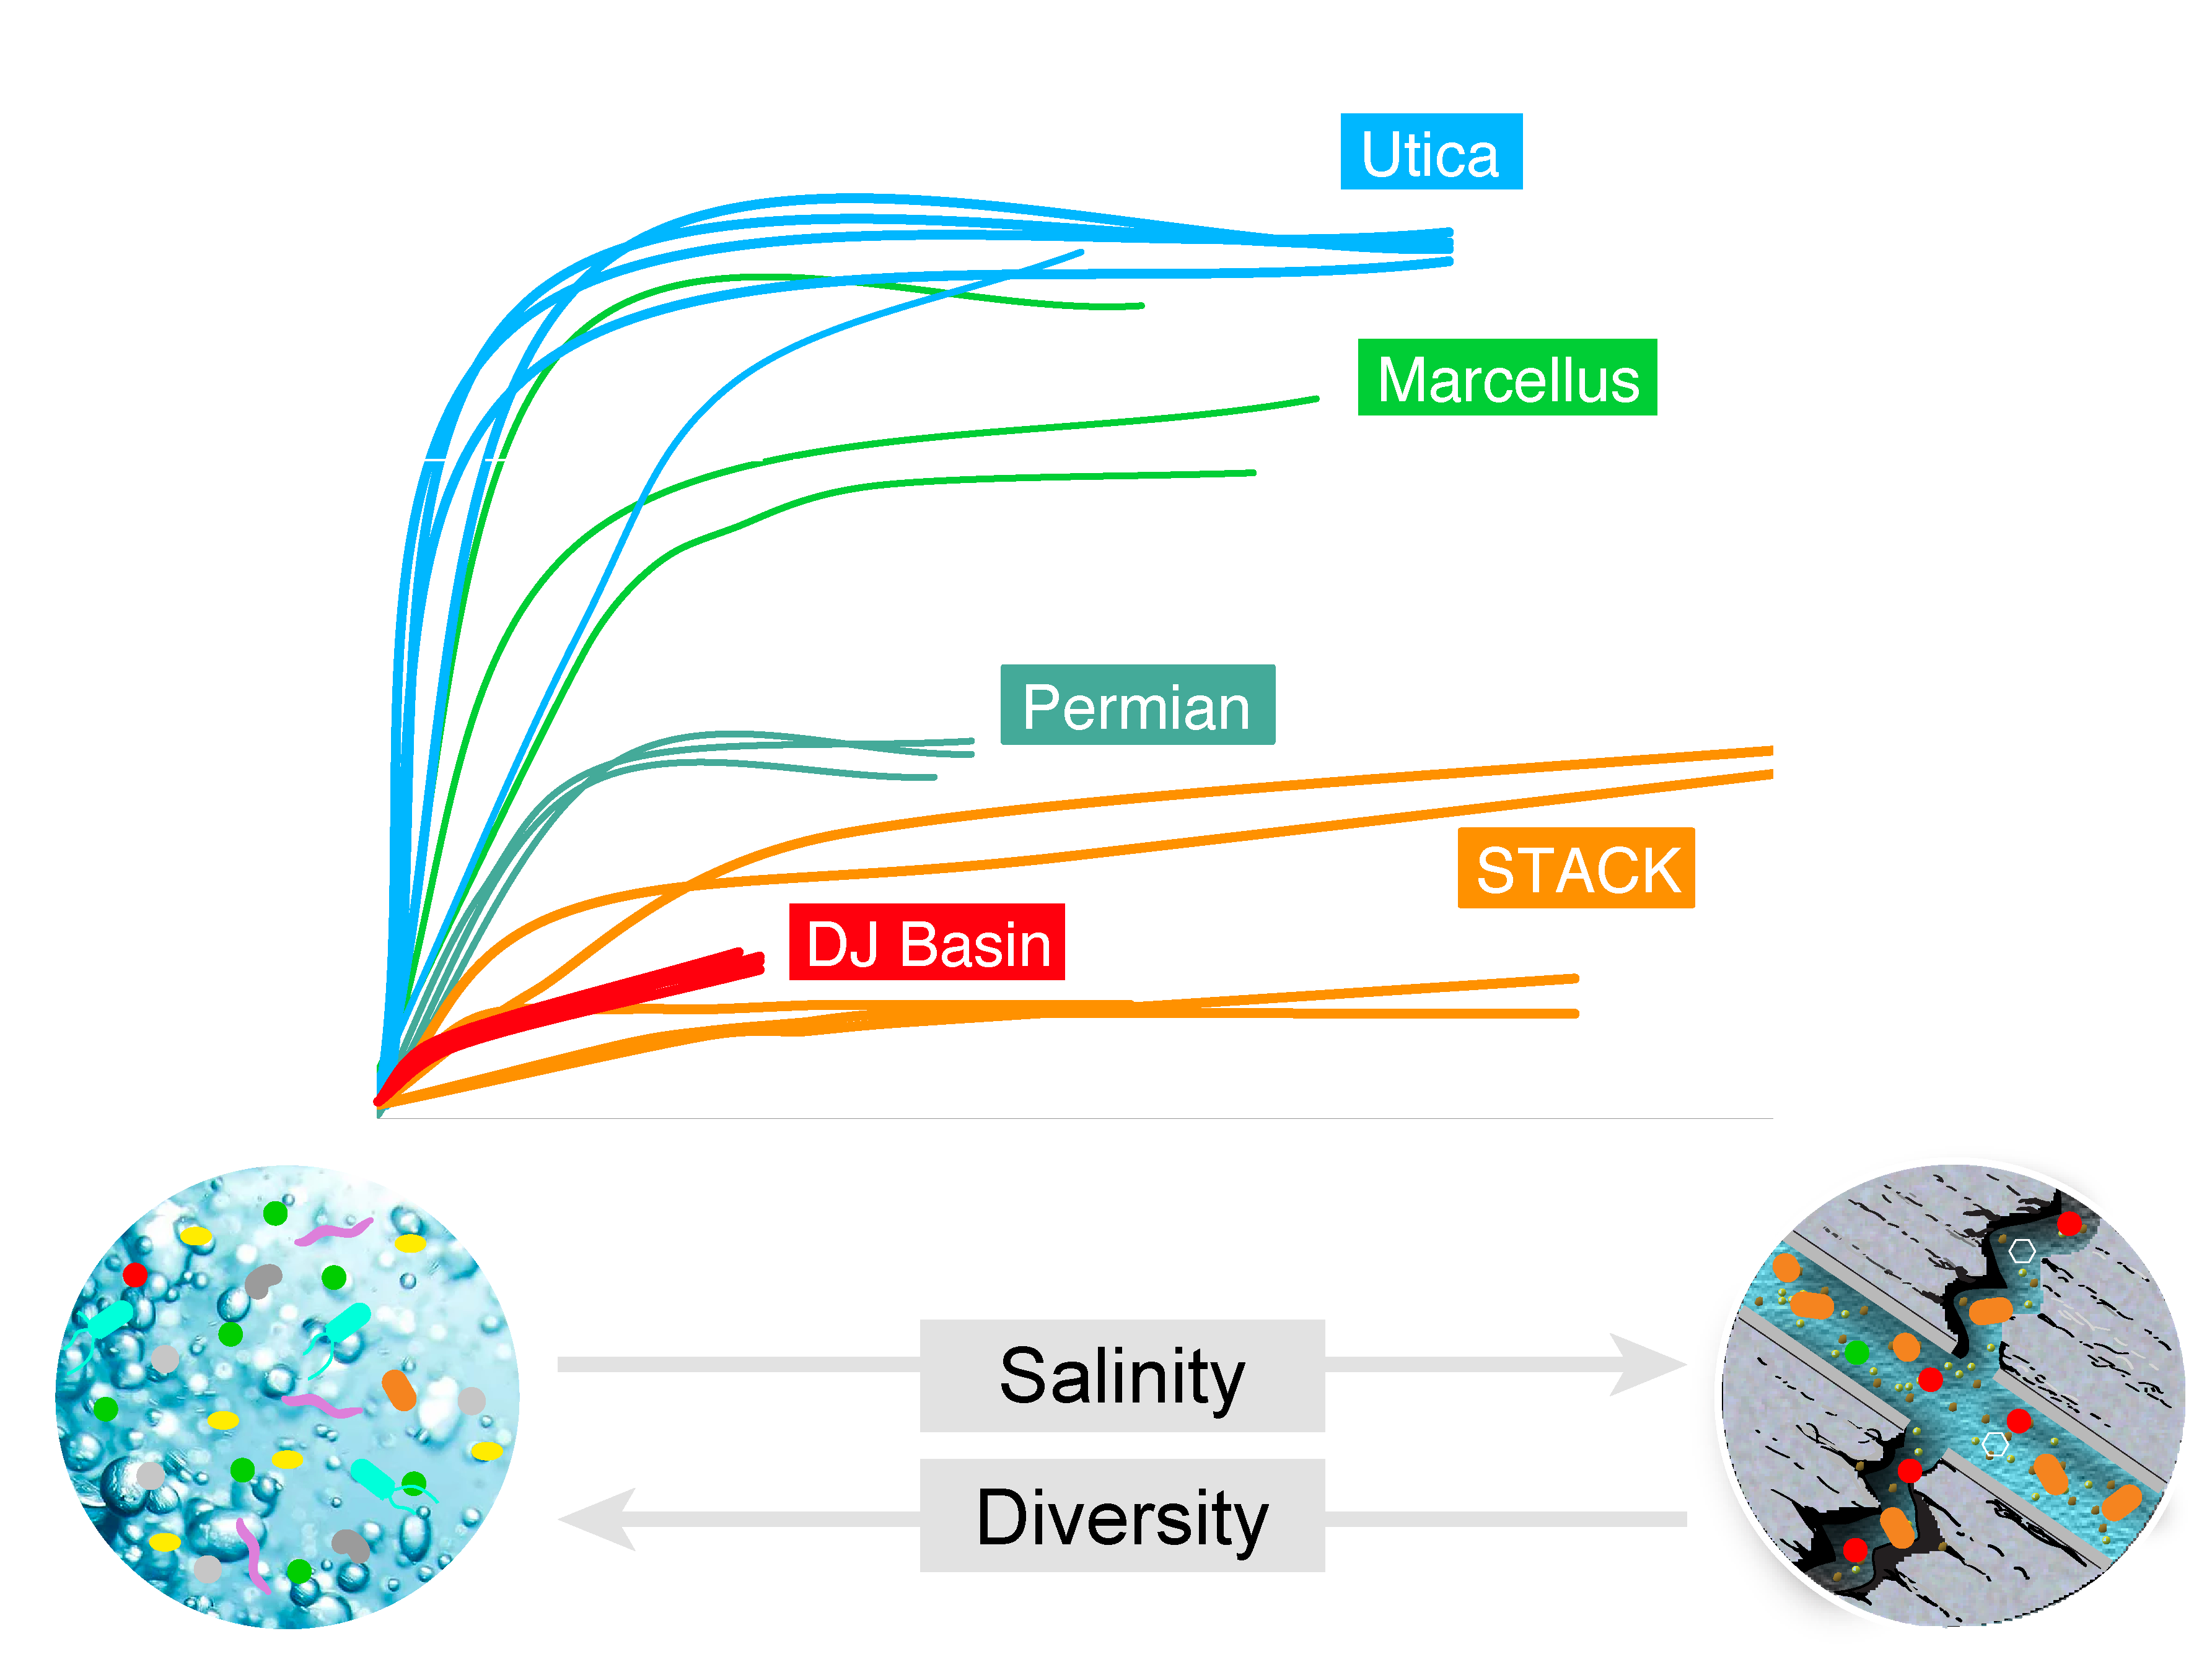
Mouser, FEMS 2016
Notes:
All the mseel, sh and w 4 are na-ca-cl brines with TDS in the Utica from 100 to 200 g/l and mseel from about 50 to 200 g/l. Cl is most abundant ion by mass and is about half the total salt. Sr and Ba are a few. Grams/l, often higher than Mg. There is almost no So4.

Slide 18
16S rRNA Fracking “core” members persist after 50 days (saline adapted)
Notes:
Cell numbers in terrestrial subsurface : 25-250 x 10²⁸
Not evenly distributed! Introduce sedimentary rock.

Slide 19
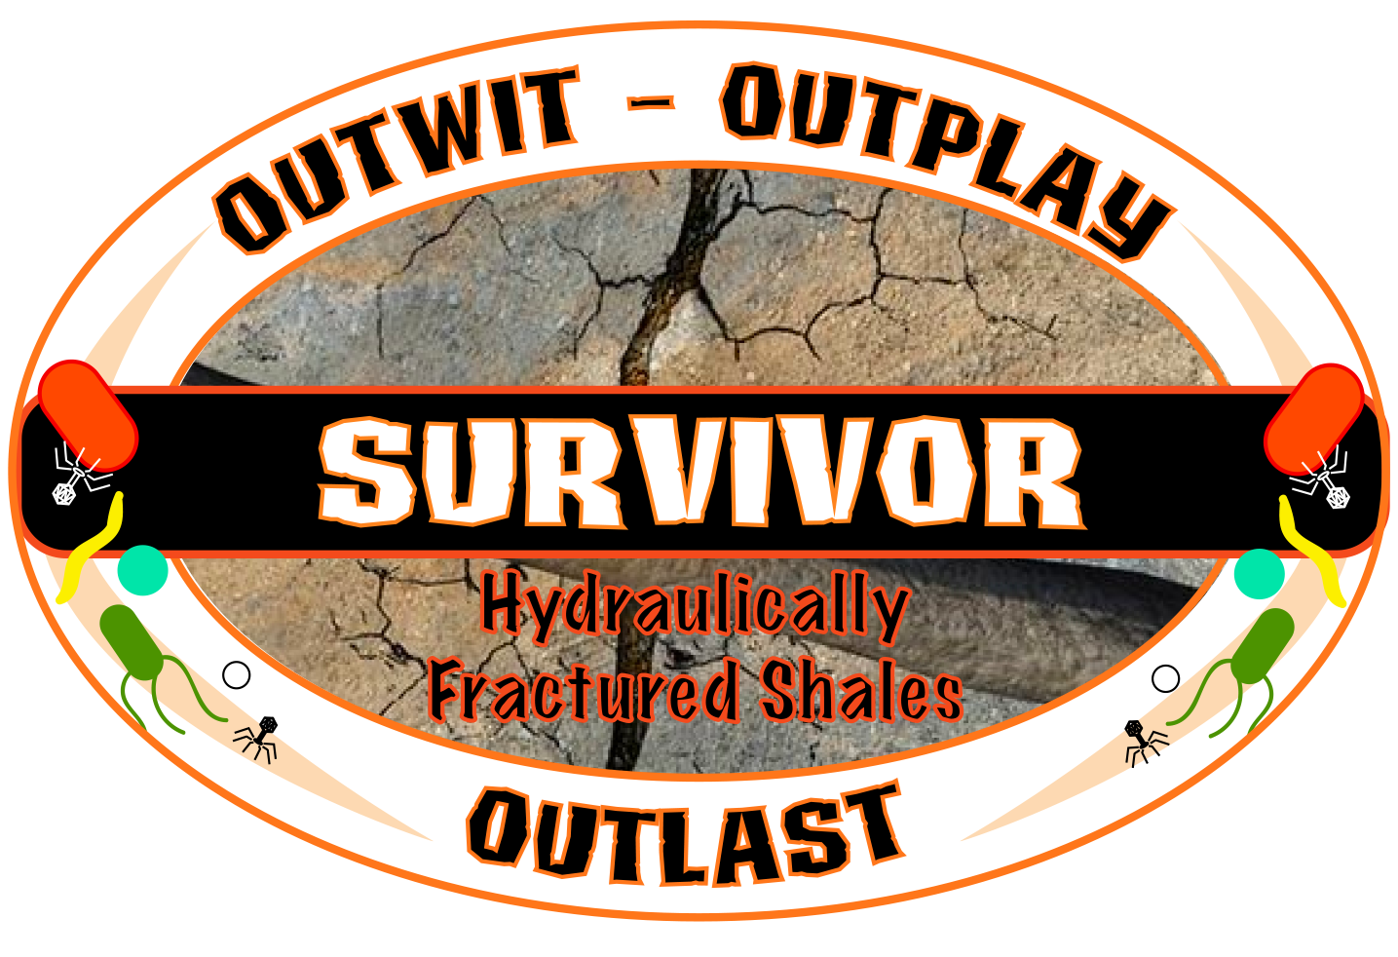
Microbes compete, cooperate, and ward off elimination
Notes:
what really happens when our microbial contestants are marooned in an isolated location and must provide their own food and shelter
Alliances are formed and broken, there are predators, and the fight for immunity to live another day

Slide 20
1
Core community composed of several genera
How do surface organisms adapt to deep subsurface?

Slide 21
To address persistence:
What microbial metabolites are produced in situ?
  Osmoprotection
  Some microbes synthesize metabolites that maintain osmotic balance with environment
  Other microbes utilize metabolites
  Energetically costly to produce small, organic acid or amino acid products
  Enable flexibility to salt ranges

Slide 22
Genome resolved: no single signal in our MAGs
Daly et al, 2016, Nature Microbiology

Slide 23
Genome resolved: Glycine betaine was interesting…
Glycine betaine
Daly et al, 2016, Nature Microbiology

Slide 24
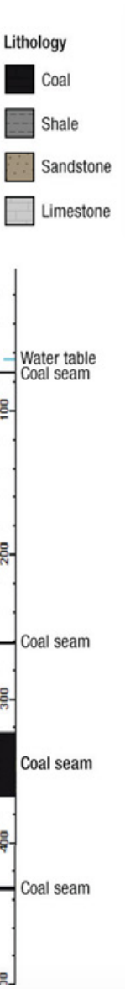


Extracellular metabolites:
Glycine betaine is a core, persisting metabolite
Glycine betaine
David
Hoyt
Notes:
The Methanohalophilus isolate paper says they reached what was "stoichiometrically" expected in 15 days. We would expect to see ~900 umol converted to methane total with our conditions.
10 mL of Mh. isolated from shale can make 838 total umol methane in 1 week (93%).
In the 3- member consortium paper accumulates 54 umol/day. This is the paper with Methanohalophilus.
According to Methanosarcina isolate paper, it can make 20 mmol methane in 6 days with 100mL culture. In other words, it can make ~33 umol per day per mL of culture. In Methanohalophilus case, it can make 11 umol per day per mL of culture.

Slide 25
Glycine betaine is a core,
persisting metabolite in fractured shale fluids
Glycine betaine
Notes:
The Methanohalophilus isolate paper says they reached what was "stoichiometrically" expected in 15 days. We would expect to see ~900 umol converted to methane total with our conditions.
10 mL of Mh. isolated from shale can make 838 total umol methane in 1 week (93%).
In the 3- member consortium paper accumulates 54 umol/day. This is the paper with Methanohalophilus.
According to Methanosarcina isolate paper, it can make 20 mmol methane in 6 days with 100mL culture. In other words, it can make ~33 umol per day per mL of culture. In Methanohalophilus case, it can make 11 umol per day per mL of culture.

Slide 26
1
Certain microbes and osomolyte metabolites persist across shales in response to salinity
2
Can glycine betaine serve as an energy source for microbes persisting in shales

Slide 27
Could glycine betaine also serve as energy source?
Glycine betaine
Stickland reaction
1
amino acid
electron donor
?
glycine betaine
Reductase
trimethylamine
2
Demethylation reaction
Methyl
transferase
glycine betaine
dimethylglycine
Metabolism Ref: Ticak et al, 2014 + Andreesen et al, 2004

Slide 28
Could glycine betaine also serve as energy source?
Glycine betaine
Stickland reaction
1
amino acid
electron donor
?
Isn’t metagenomics enough?
Genes are poorly annotated in genomes
Electron donor cannot be identified from existing data alone
Expression is challenging due to sample collection
glycine betaine
Reductase
trimethylamine
2
Demethylation reaction
Methyl
transferase
glycine betaine
dimethylglycine

Slide 29
Validating a meta-omics hypothesis from the field in the lab
Glycine betaine
THIS SAMPLE
Notes:
MtgB (this is the one the methanogens use) (mttB)
Glycine.betaine can be disporpotinated in a demethylation

Slide 30
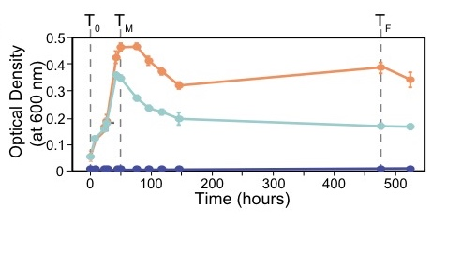
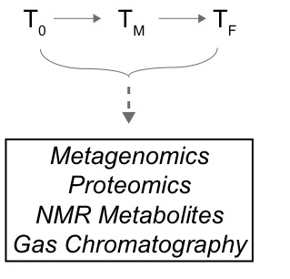

Co-expression patterns from shale reactors could identify
Glycine betaine
David
Hoyt
Mary
Lipton
Metaproteomics
¹H NMR
Notes:
MtgB (this is the one the methanogens use) (mttB)
Glycine.betaine can be disporpotinated in a demethylation

Slide 31
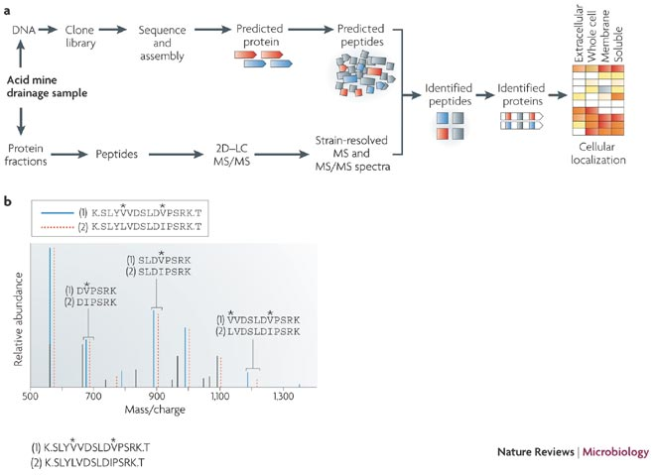
Metaproteomics crash course- paired to metagenomes
Meta
G
Identify unique proteins to genome bins
SAMPLE
Meta
P
Notes:
Create peptide database by in sillico trypsin digest (cleave proteins at the carboxyl aide of the amino acid) lysine and arginine
Lysine=K
Arginie= R

Slide 32
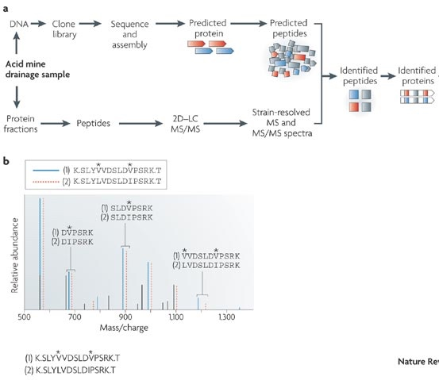
Now that we know who is there, proteome can give us how they can function
Meta
G
HOW DO WE CLEAVE THE PROTEINS?
Create peptide database by in sillico trypsin digest (cleave proteins at the carboxyl aide of the amino acid) lysine and arginine
Lysine=K
Arginine= R
Notes:
Create peptide database by in sillico trypsin digest (cleave proteins at the carboxyl aide of the amino acid) lysine and arginine
Lysine=K
Arginie= R

Slide 33
Proteomics- uses and challenges
Meta
G
Meta
P
Proteomics
  Demonstrates expression of genes in metagenomes
  Correlate to metagenomic data
  No amplification: need high signal, doesn’t do well for low abundance organisms
  Outer membrane proteins not as well resolved unless separate fractionation done
Notes:
Create peptide database by in sillico trypsin digest (cleave proteins at the carboxyl aide of the amino acid) lysine and arginine
Lysine=K
Arginie= R

Slide 34
4 core, persisting members from field
detected in metaproteomics from laboratory microcosms
\
Notes:
\

Slide 35
Combining time series meta- omics
Halanaerobium reduced GB to yield TMA, a methanogenic substrate
74% of GB converted to TMA
_{In amended or unamended!}

Slide 36
Laboratory Proteomics and Metabolomics:
Methanohalophilus preferentially utilizes Halanaerobium metabolites
CH₄
Borton et al, 2018, PNAS

Slide 37
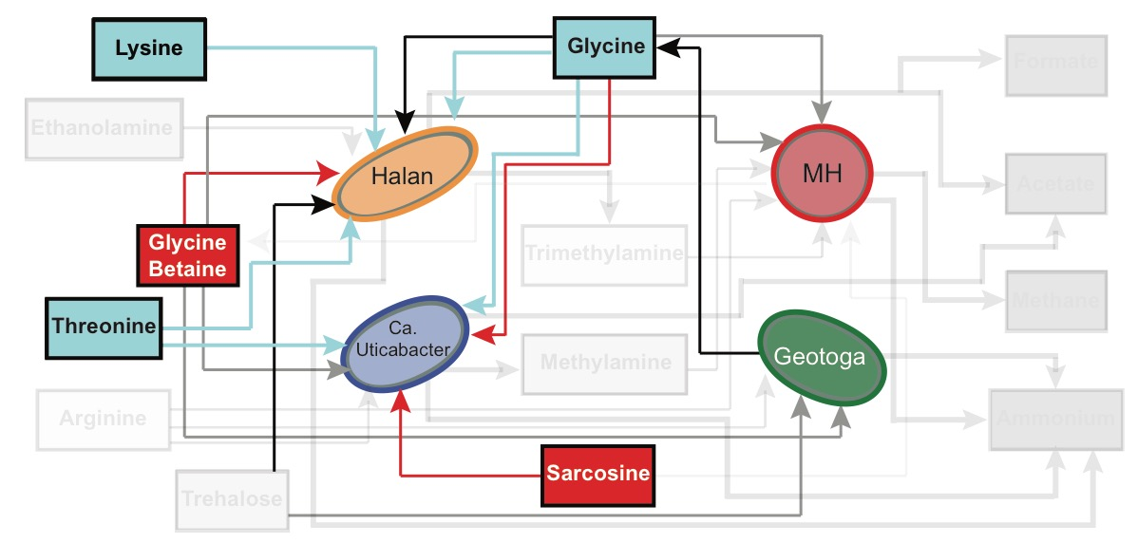
Expression and metabolite correlation analyses
Glycine betaine, glycine, and sarcosine are Stickland acceptors
glycine and lysine are possible Stickland donors

Slide 38
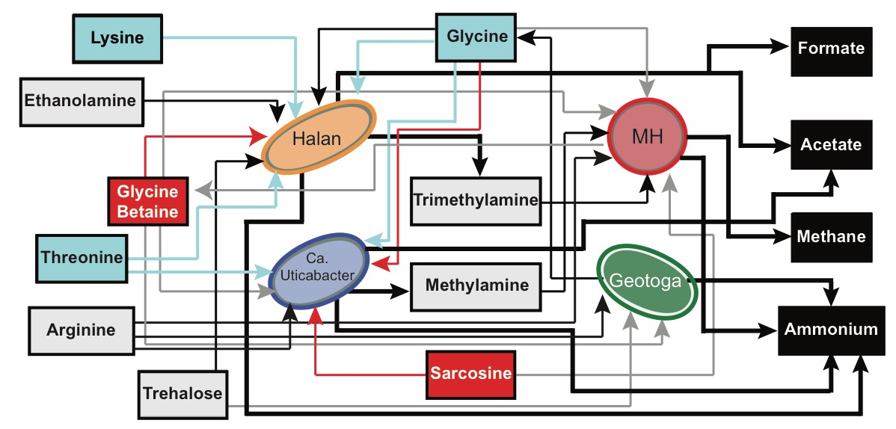
Even very “simple” microbial communities,
have complicated mutualistic and competitive metabolic interactions
Borton et al, PNAS

Slide 39
1
What type of microorganisms persist in this system?
2
Can glycine betaine metabolism sustain microbes in shales long after fracking
3
What roll do viruses play in controlling population dynamics?

Slide 40
Laboratory proteome studies hint at active viruses in fluids
16 unique viral genomic contigs
*viral genes expressed in lab
*Clustergenomes-54 contigs with 95%ANI, 80% shortest contig
Notes:
From laboratory: 54 viral contigs Clustered by 95% ANI into 15 unique populations (using cluster genomes)
Clustergenomes (on cyverse)- used to identify which viral contigs are unique, clusters viral contigs to 95% identity over at least 80% of the shortest contig

Slide 41
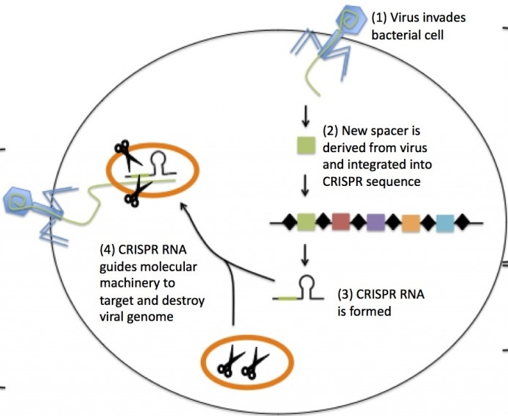
CRISPR-Cas systems in genomes
are a mechanism for tracking viral-microbial encounters
CRISPR stores genomically recoverable timelines of virus-host coevolution in natural organisms
Adaptation: spacer incorporation
v
v
Notes:
What is iCRISPR- bacterial host innate immunity
Essentially host takes a “snap shot” of foregin DNA has it enters the cell. This foriegin DNA is stored in host genome. A spacer, in a CRISPR array.
This array can be transcribed and CR-RNA guides molecular machinery to target (analgous to RNA silencing)
CRISPR loci, named for the clustered regularly interspaced short palindromic repeats that separate spacer sequences that are transcribed and processed into small interfering RNAs (crRNAs) to confer immunity to phage, plasmids and transposons
The crRNA silencing requires identity with targeted sequences, and immunity may be lost by mutation in either the target region or an associated proto-spacer adjacent motif (PAM) that is required for CRISPR function Whereas some mechanistic aspects remain unclear, cells that contain at least one CRISPR spacer that perfectly matches a region of the invading phage or plasmid with a flanking PAM will be immune (Deveau et al., 2008; Horvath and Barrangou, 2010). However, studies in a certain type of CRISPR-Cas system have shown that mutations in the proto-spacer, nearest the PAM, allows the phage to escape, whereas mutations in other regions of the proto-spacer have no impact on immunity (Deveau et al., 2008; Semenova et

Slide 42
CRISPR-Cas systems in genomes
are a mechanism for tracking viral-microbial encounters
CRISPR stores genomically recoverable timelines of virus-host coevolution in natural organisms
Adaptation: spacer incorporation
v
v
Expression: RNA is formed
Notes:
What is iCRISPR- bacterial host innate immunity
Essentially host takes a “snap shot” of foregin DNA has it enters the cell. This foriegin DNA is stored in host genome. A spacer, in a CRISPR array.
This array can be transcribed and CR-RNA guides molecular machinery to target (analgous to RNA silencing)
CRISPR loci, named for the clustered regularly interspaced short palindromic repeats that separate spacer sequences that are transcribed and processed into small interfering RNAs (crRNAs) to confer immunity to phage, plasmids and transposons
The crRNA silencing requires identity with targeted sequences, and immunity may be lost by mutation in either the target region or an associated proto-spacer adjacent motif (PAM) that is required for CRISPR function Whereas some mechanistic aspects remain unclear, cells that contain at least one CRISPR spacer that perfectly matches a region of the invading phage or plasmid with a flanking PAM will be immune (Deveau et al., 2008; Horvath and Barrangou, 2010). However, studies in a certain type of CRISPR-Cas system have shown that mutations in the proto-spacer, nearest the PAM, allows the phage to escape, whereas mutations in other regions of the proto-spacer have no impact on immunity (Deveau et al., 2008; Semenova et

Slide 43
CRISPR-Cas systems in genomes
are a mechanism for tracking viral-microbial encounters
CRISPR stores genomically recoverable timelines of virus-host coevolution in natural organisms
Adaptation: spacer incorporation
v
Interference: cleavage complex destroys foreign DNA
v
Expression: RNA is formed
Notes:
What is iCRISPR- bacterial host innate immunity
Essentially host takes a “snap shot” of foregin DNA has it enters the cell. This foriegin DNA is stored in host genome. A spacer, in a CRISPR array.
This array can be transcribed and CR-RNA guides molecular machinery to target (analgous to RNA silencing)
CRISPR loci, named for the clustered regularly interspaced short palindromic repeats that separate spacer sequences that are transcribed and processed into small interfering RNAs (crRNAs) to confer immunity to phage, plasmids and transposons
The crRNA silencing requires identity with targeted sequences, and immunity may be lost by mutation in either the target region or an associated proto-spacer adjacent motif (PAM) that is required for CRISPR function Whereas some mechanistic aspects remain unclear, cells that contain at least one CRISPR spacer that perfectly matches a region of the invading phage or plasmid with a flanking PAM will be immune (Deveau et al., 2008; Horvath and Barrangou, 2010). However, studies in a certain type of CRISPR-Cas system have shown that mutations in the proto-spacer, nearest the PAM, allows the phage to escape, whereas mutations in other regions of the proto-spacer have no impact on immunity (Deveau et al., 2008; Semenova et

Slide 44
Host expression data highlights viral predation in fractured shales
15 unique viral populations
viral genes expressed in lab
2 bacterial hosts
express CRISPR genes in lab
(A) Adaptation: spacer incorporation
(E) Expression: cognate RNA synthesis
(I) Interference: cleavage-complex to destroy foreign DNA
Interpretation from Makarova et al, 2015
Notes:
From laboratory: 54 viral contigs Clustered by 95% ANI into 15 unique populations (using cluster genomes)
Clustergenomes (on cyverse)- used to identify which viral contigs are unique, clusters viral contigs to 95% identity over at least 80% of the shortest contig

Slide 45
Time-series genome sampling provides evidence that
NEW spacer incorporation occurs in the field
Spacer
Halan 1-M1
Direct repeat
Field metagenomics
Halan 5-U2
Halan 6-U2

Slide 46
Can viral predation explain
Halanaerobium 16S rRNA relative abundance changes?
relative abundance (%)
time
Notes:
examination of metagenomes showed high # viral genomes
viruses only predator in ecosystem, no eukaryotes

Slide 47
Halanaerobium viruses are prevalent in metagenomes
1,838 viral genome populations (vOTUs) identified
representing 156 new viral genera from fractured shales
68.2% of viruses are associated with Halanaerobium
relative abundance (%)
time
Notes:
using analyses explained by Ann, Gary, Paula

Slide 48
relative abundance (%)
relative abundance (%)
time
Notes:
statistically significantly correlated

Slide 49
relative abundance (%)
relative abundance (%)
time
Notes:
Reason we think for fluctuating populations is due to viral predation (geochemistry is stable)

Slide 50
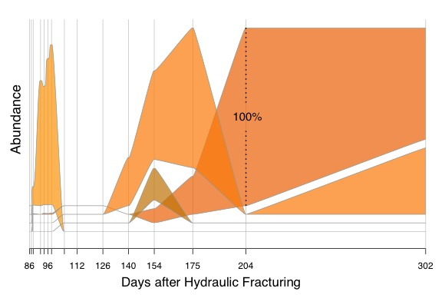
Viral predation may cause changes in Halanerobium strain dominance 4 most dominant strains shown
84% increase in Halan6
66% decrease in Halan5
Notes:
14 strains of Halanaerobium detected in this well –
3 were dominant

Slide 51
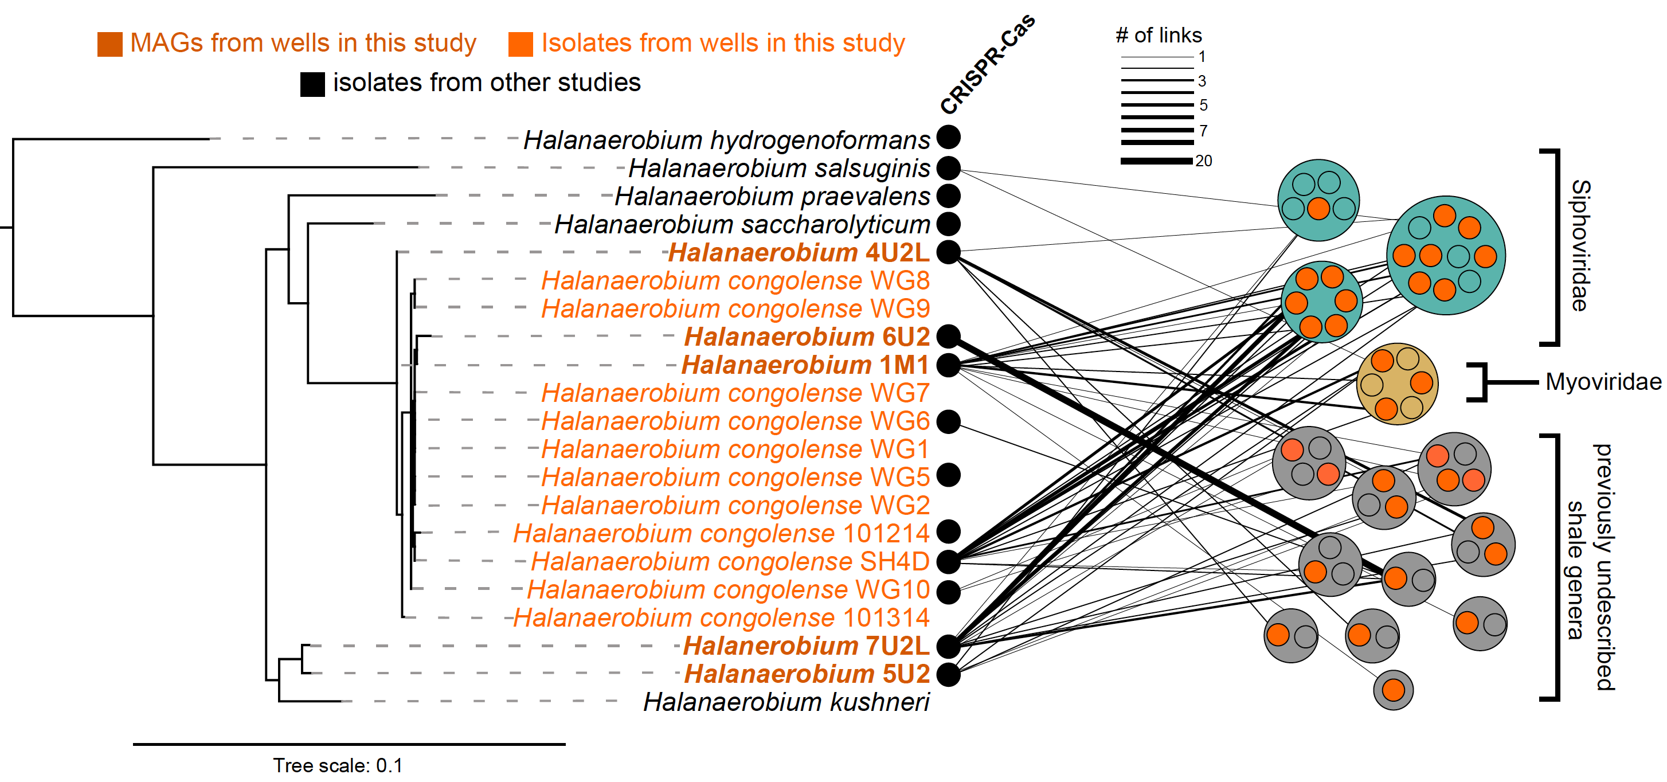
Halanaerobium strains recovered from a single well
Notes:
14 strains of Halanaerobium detected in this well –
3 were dominant

Slide 52
Link Halanaerobium spacers to viral genome database
host have multiple link to same virus
Notes:
14 strains of Halanaerobium detected in this well –
3 were dominant

Slide 53
1
What type of microorganisms persist in this system?
2
Can glycine betaine metabolism sustain microbes in shales long after fracking?
3
What roll do viruses play in controlling population dynamics?
4
Viruses: Friend or foe? Roles in nutrient release

Slide 54
Where are the viruses in fractured shales coming from?
environmental
stress
lysogenic
lytic

Slide 55
With an isolated strain of Halanaerobium that has a prophage
Can we induce the virus and lyse the cell
Succinate addition
(100 mM)
Halanaerobium cells/mL
Time (Hours)
Notes:
Bacterial cells % decrease: Copper 58%, Succinate 54%, ‘natural induction’ Control 44%, Mitomycin C 55%

Slide 56
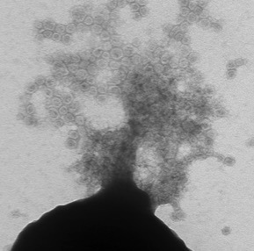
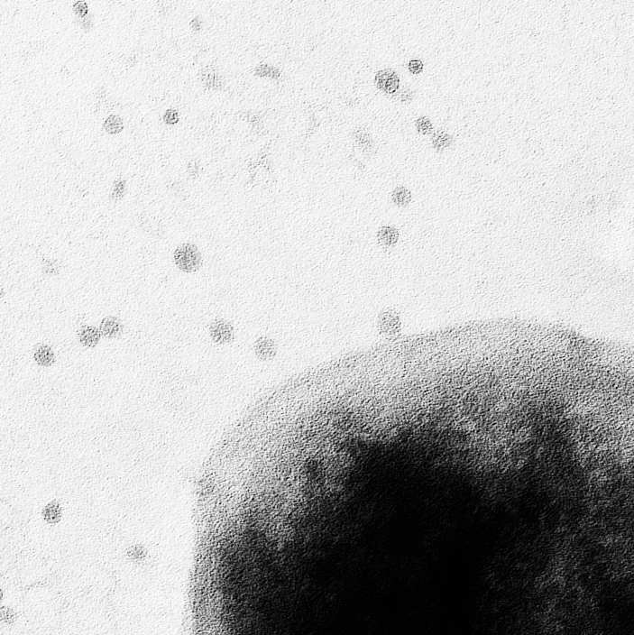
In lab induced prophage into lytic lifestyle
Halanaerobium
cell lysis
50 nm
VLPs Size
27.5 nm ± 3.8 nm
*
0.2 μm
Notes:
Bacterial cells % decrease: Copper 58%, Succinate 54%, ‘natural induction’ Control 44%, Mitomycin C 55%

Slide 57
Prophage induced cell lysis causes host metabolite release
metabolites released following viral lysis
Halanaerobium
cell lysis
*
*Stickland amino acids
*
*
50 nm
VLPs Size
27.5 nm ± 3.8 nm
0.2 μm
Notes:
Bacterial cells % decrease: Copper 58%, Succinate 54%, ‘natural induction’ Control 44%, Mitomycin C 55%

Slide 58
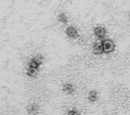
Virome and microscopy suggest tail less, novel virus
metabolites released following viral lysis
Halanaerobium
cell lysis
*
*Stickland amino acids
*
*
50 nm
VLPs Size
27.5 nm ± 3.8 nm
viral genomic fragment
45.8 Kbp, novel taxonomy
0.2 μm
Notes:
Bacterial cells % decrease: Copper 58%, Succinate 54%, ‘natural induction’ Control 44%, Mitomycin C 55%

Slide 59
Microbes compete, cooperate, and ward off elimination
Notes:
what really happens when our microbial contestants are marooned in an isolated location and must provide their own food and shelter
Alliances are formed and broken, there are predators, and the fight for immunity to live another day

Slide 60
REVIEW: computational pipeline used in this case study

Slide 61

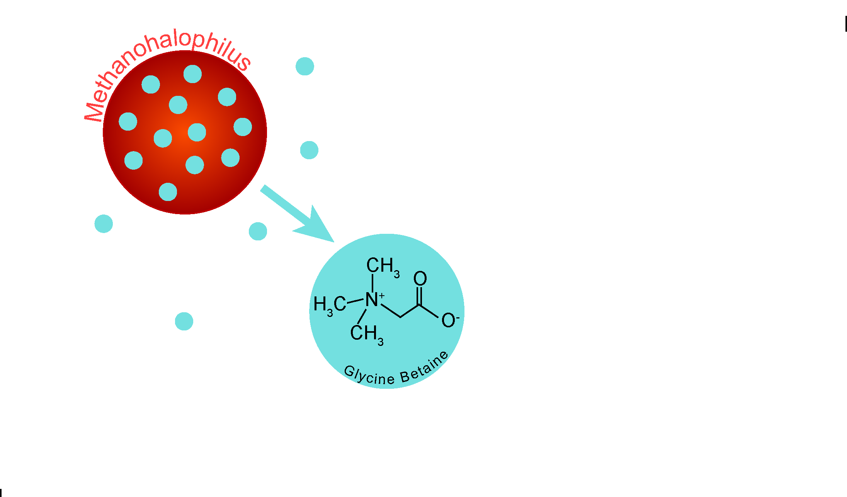
Core microbes adapt to
environmental hardships
Borton et al, PNAS, 2018
Notes:
To deal with brine level salinities microbes produce compounds called osmoprotectants, that equilibrate osmotic pressure inside cell with outside environment

Slide 62

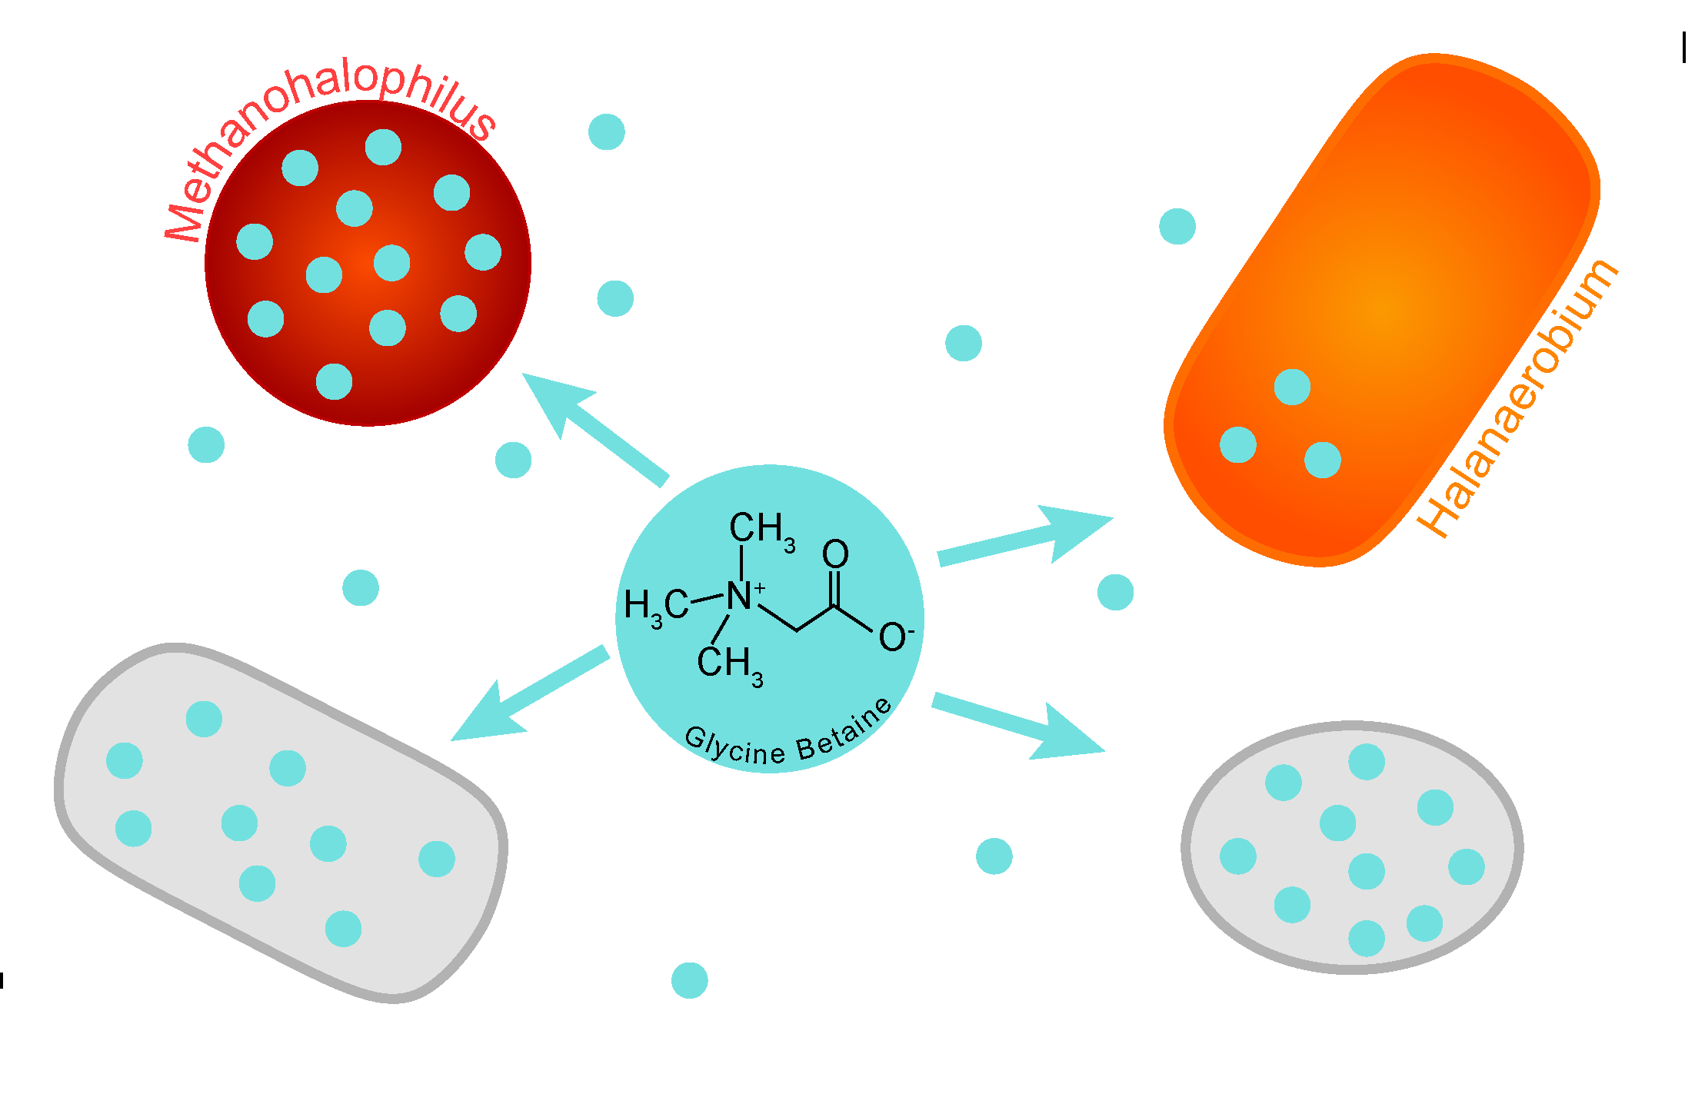
Compete for resources in the tribe
Borton et al, PNAS, 2018
Notes:
These public goods are used by the other members of the community

Slide 63
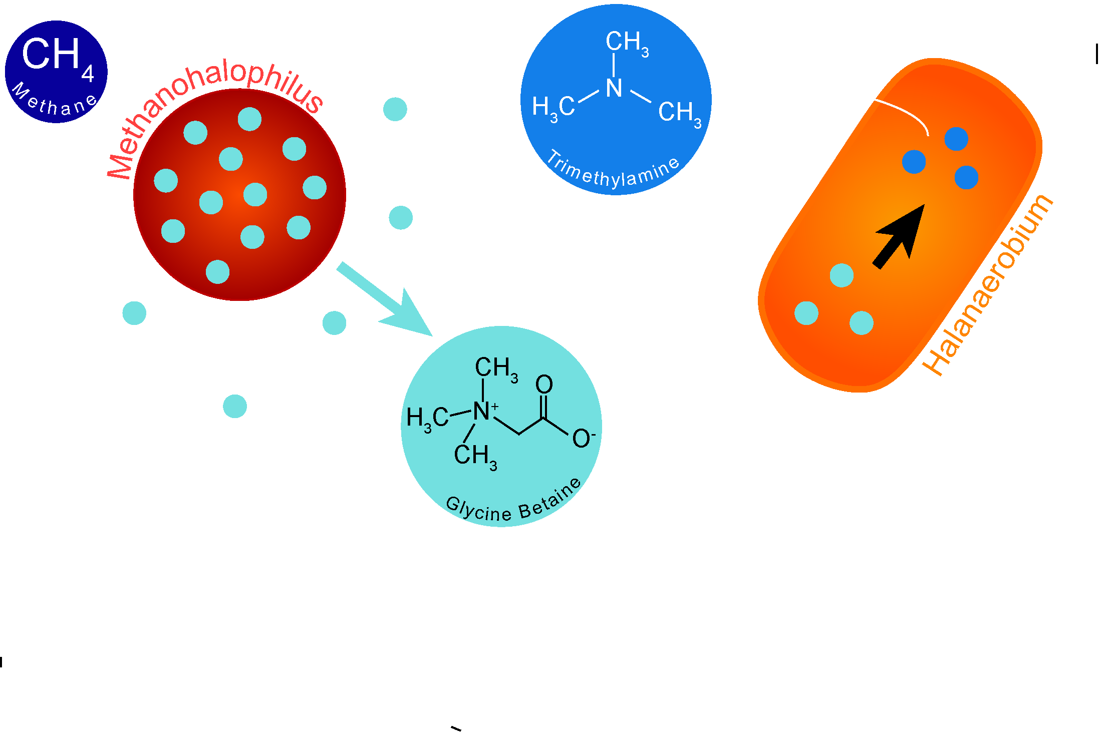
Form alliances within the tribe
Borton et al, PNAS, 2018
Notes:
Metabolic partnerships sustain persisting microbial members to sustain life in this harsh system

Slide 64
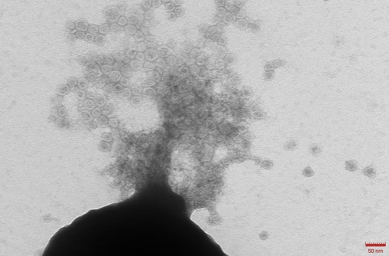
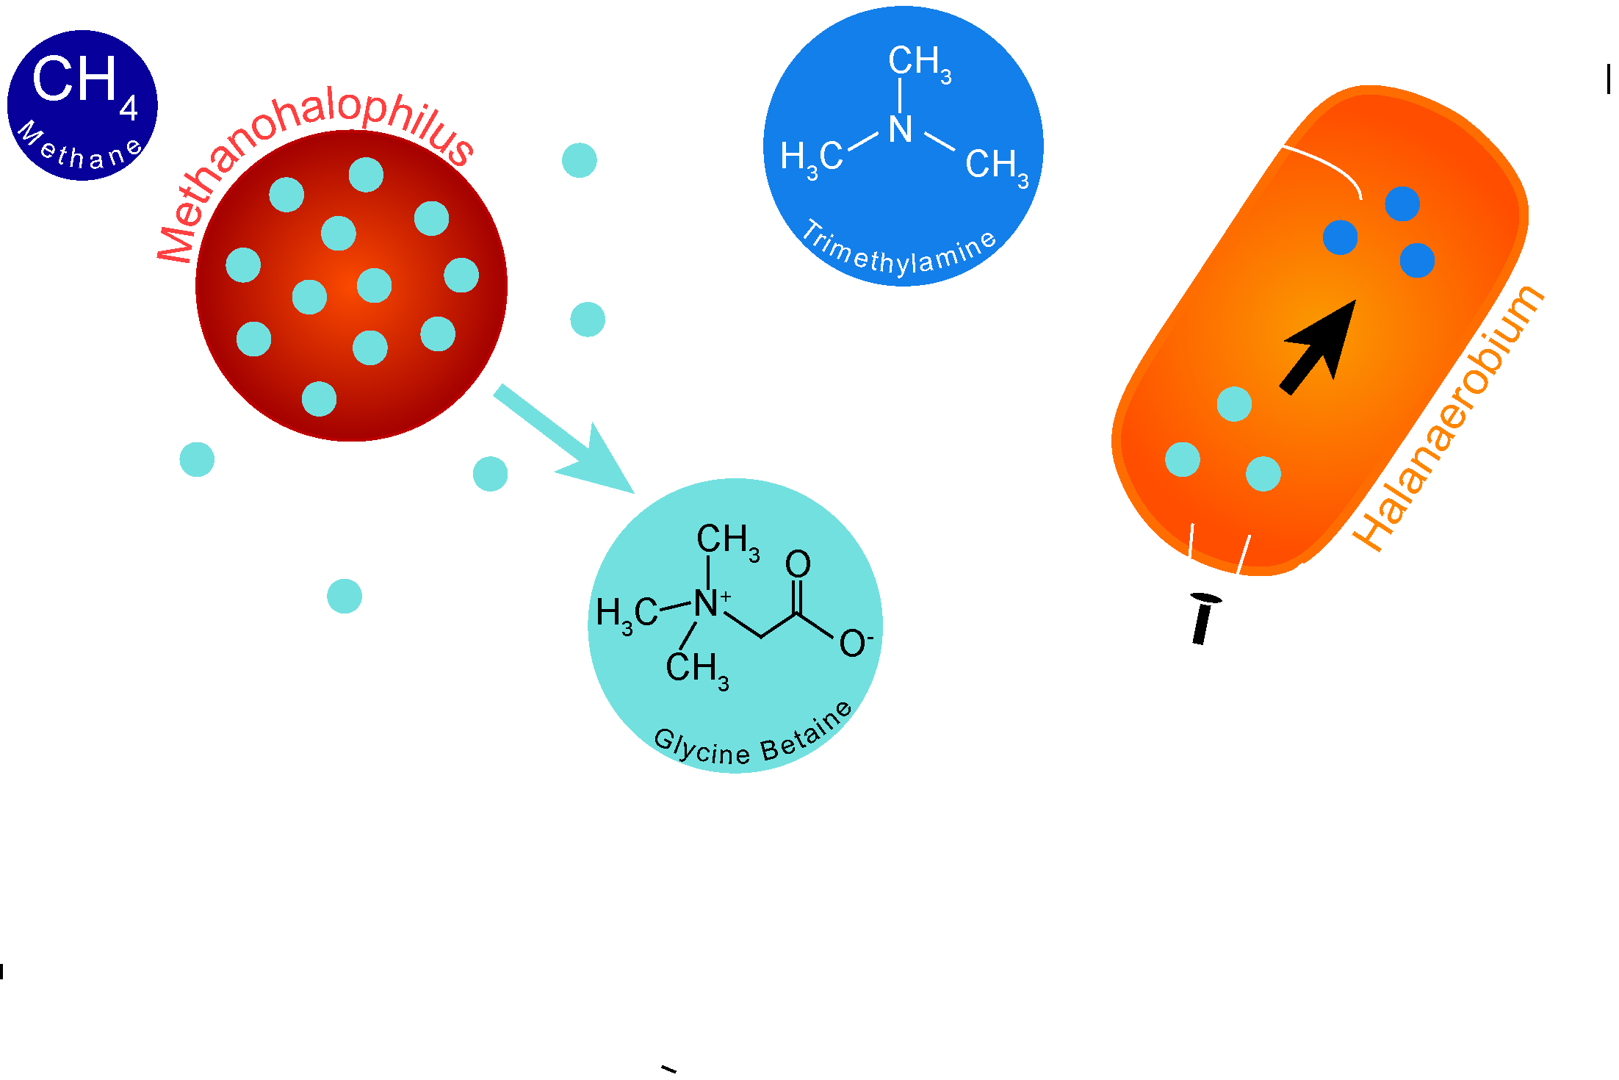
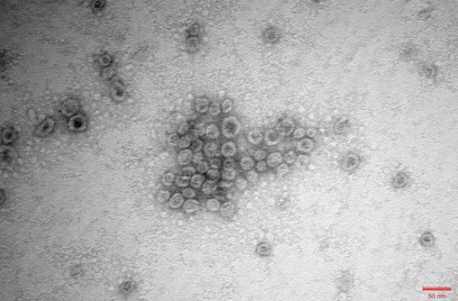
Ward off viral elimination
Daly et al, Nature Micro, 2019
Notes:
Microbes are attacked by viral predaators that drastically alter abundanace .
Additionally, all persisting microbes in this system have CRISPR immune systems to ward off viral predators

Slide 65
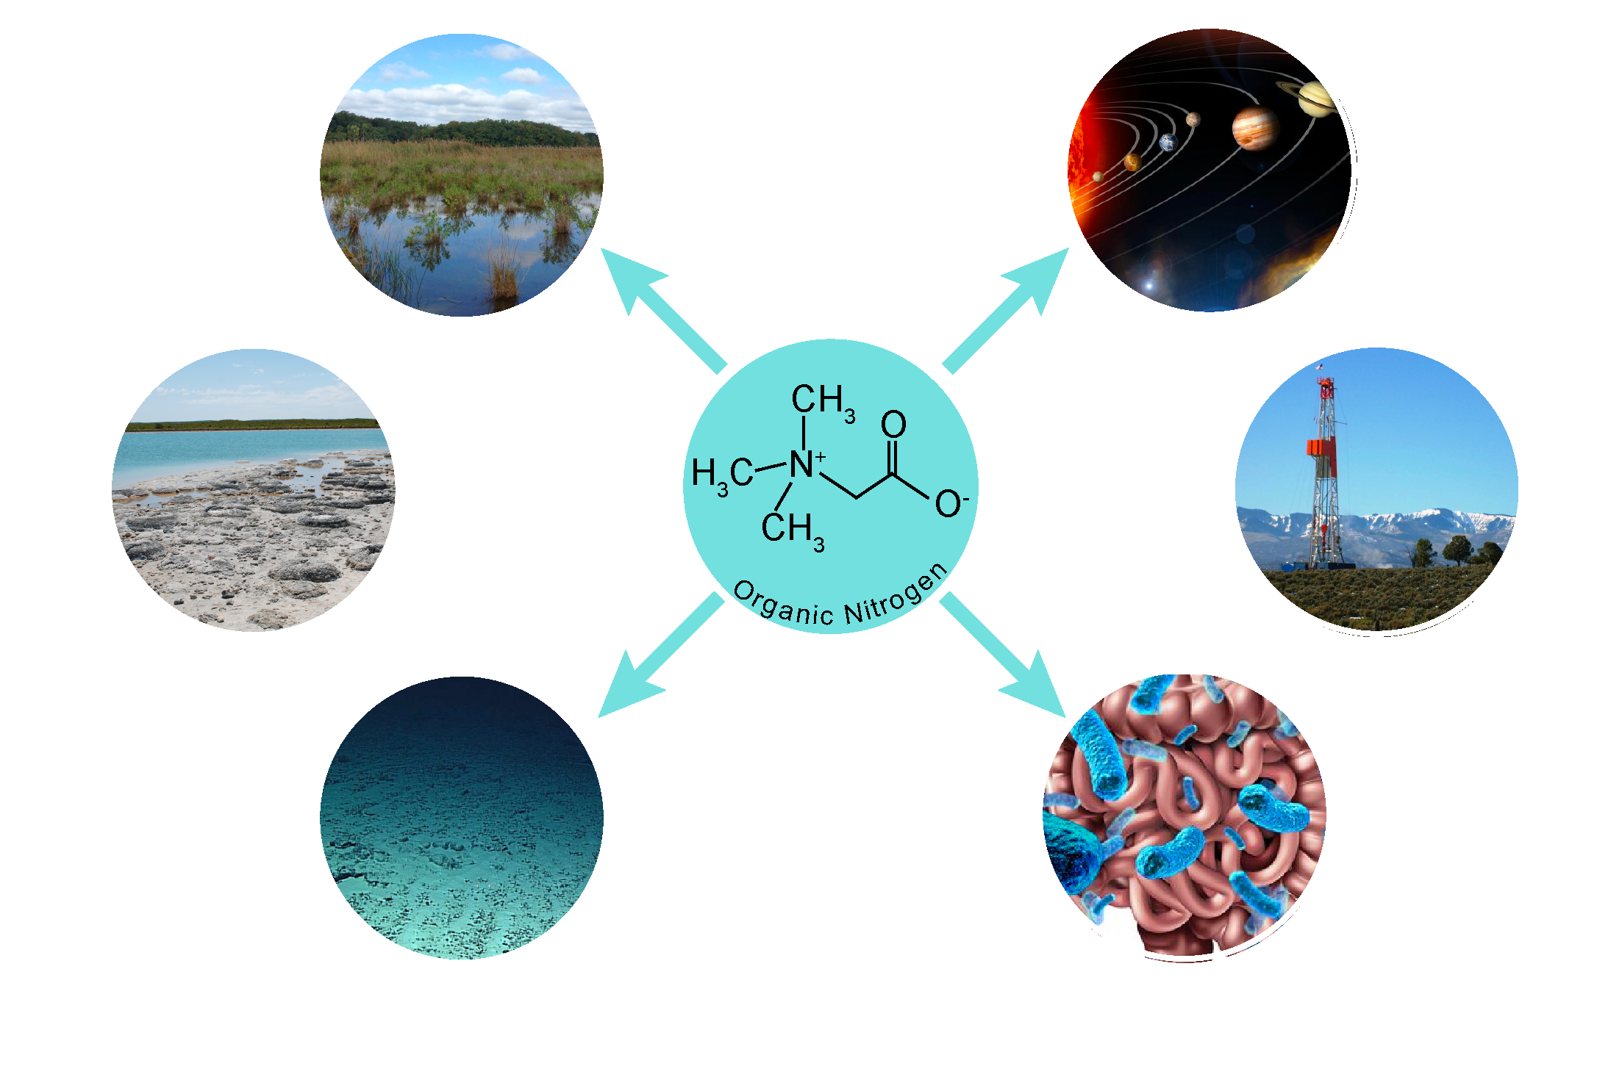
Shale is a model for other ecosystems
Notes:
The glycine betaine fermentataion we discussed today is critical to methane production in other ecostyems.
Metabolite analyses of meteorites (chondrites) have previously revealed the presence of both free amino acids and amine compounds^{24,42} that play central roles in these cycles, suggesting that these substrates could potentially fuel life on other planets. Methane has been detected in fluid plumes emitted from Saturn’s moon, Enceladus⁴³, whose core is thought to mainly consist of such chondritic rocks⁴⁴. Additionally, recent analyses of sedimentary rocks from the shallow Martian subsurface hinted at the presence of organic carbon⁴⁵. Moreover, there is increasing knowledge of the prevalence of hypersaline conditions across different extraterrestrial planetary habitats.

Slide 66
Shale is a model for other ecosystems
Notes:
The glycine betaine fermentataion we discussed today is critical to methane production in other ecostyems.
Metabolite analyses of meteorites (chondrites) have previously revealed the presence of both free amino acids and amine compounds^{24,42} that play central roles in these cycles, suggesting that these substrates could potentially fuel life on other planets. Methane has been detected in fluid plumes emitted from Saturn’s moon, Enceladus⁴³, whose core is thought to mainly consist of such chondritic rocks⁴⁴. Additionally, recent analyses of sedimentary rocks from the shallow Martian subsurface hinted at the presence of organic carbon⁴⁵. Moreover, there is increasing knowledge of the prevalence of hypersaline conditions across different extraterrestrial planetary habitats.

Slide 67
Shale is a model for other ecosystems
Notes:
The glycine betaine fermentataion we discussed today is critical to methane production in other ecostyems.
Metabolite analyses of meteorites (chondrites) have previously revealed the presence of both free amino acids and amine compounds^{24,42} that play central roles in these cycles, suggesting that these substrates could potentially fuel life on other planets. Methane has been detected in fluid plumes emitted from Saturn’s moon, Enceladus⁴³, whose core is thought to mainly consist of such chondritic rocks⁴⁴. Additionally, recent analyses of sedimentary rocks from the shallow Martian subsurface hinted at the presence of organic carbon⁴⁵. Moreover, there is increasing knowledge of the prevalence of hypersaline conditions across different extraterrestrial planetary habitats.

Slide 68
Shale is a model for other ecosystems
Notes:
The glycine betaine fermentataion we discussed today is critical to methane production in other ecostyems.
Metabolite analyses of meteorites (chondrites) have previously revealed the presence of both free amino acids and amine compounds^{24,42} that play central roles in these cycles, suggesting that these substrates could potentially fuel life on other planets. Methane has been detected in fluid plumes emitted from Saturn’s moon, Enceladus⁴³, whose core is thought to mainly consist of such chondritic rocks⁴⁴. Additionally, recent analyses of sedimentary rocks from the shallow Martian subsurface hinted at the presence of organic carbon⁴⁵. Moreover, there is increasing knowledge of the prevalence of hypersaline conditions across different extraterrestrial planetary habitats.

Slide 69
Summary- Genes to Ecosystem
Ecosystem process
emission or health
Microbial community
16S rRNA barcode
Organism physiology
(meta)genomics, lab cultivation
Enzymes
(meta)transcripts or proteomes
Chemistry
geochemistry,
metabolites

Slide 70
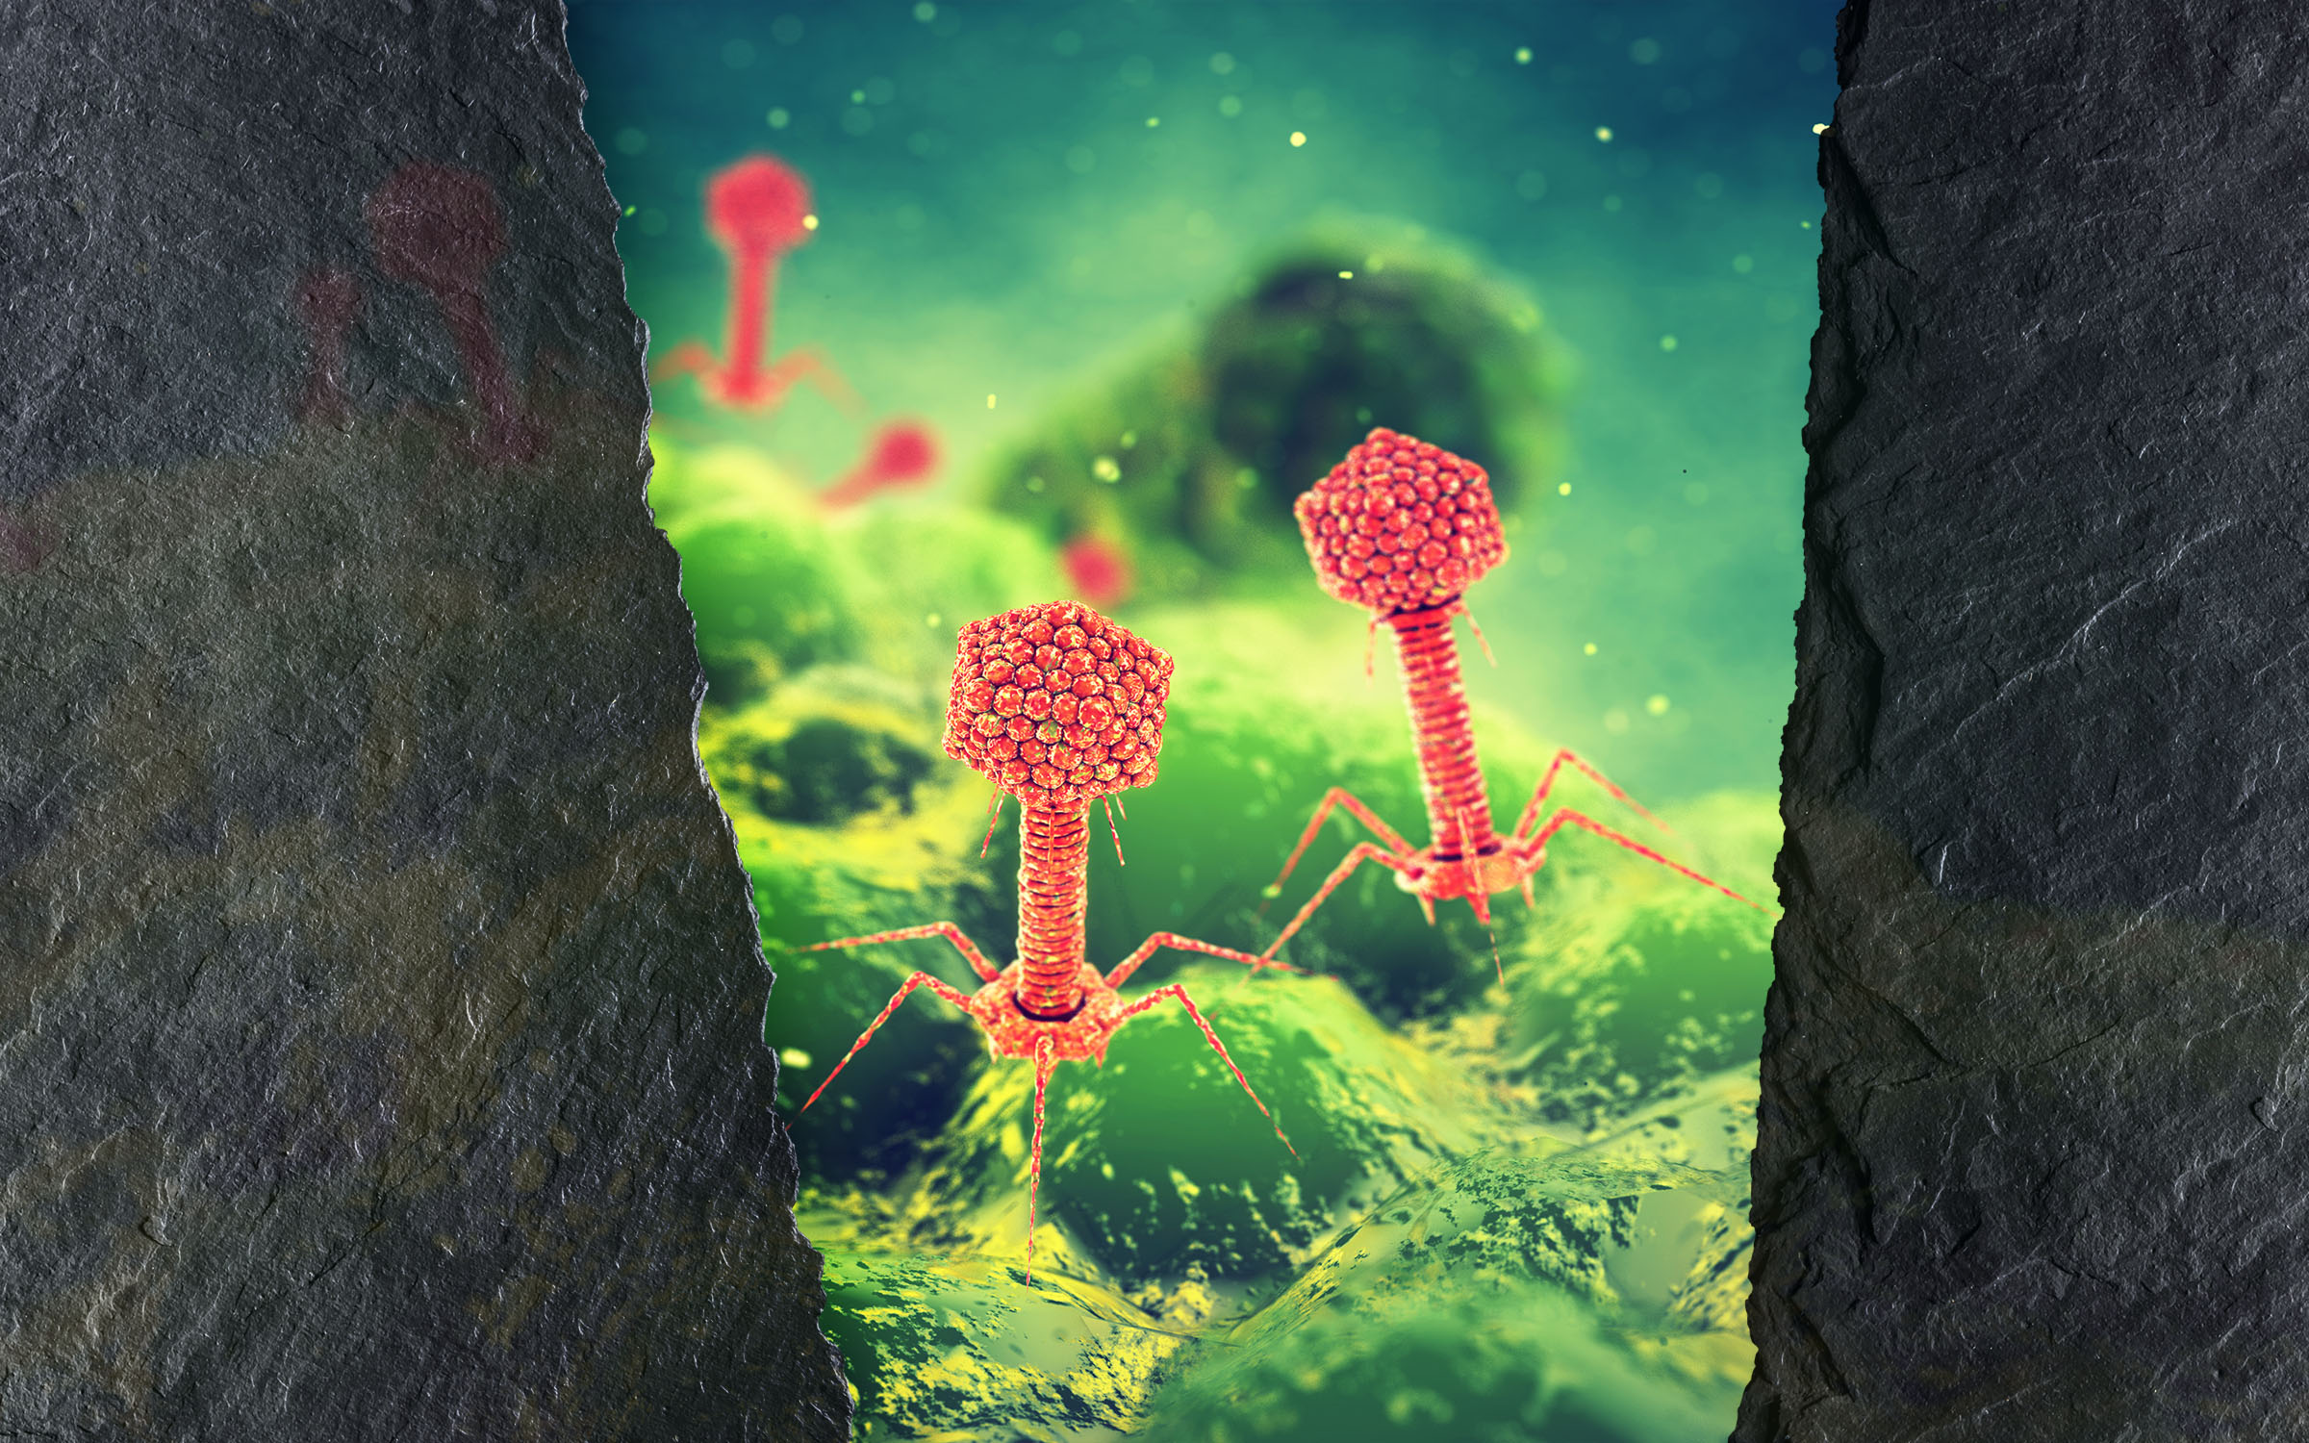
I welcome your questions

