Slide 1
MICROBIOME- scaling genomics to communities
Kelly Wrighton
@kwrighton
Wrightonlab.com

Slide 2
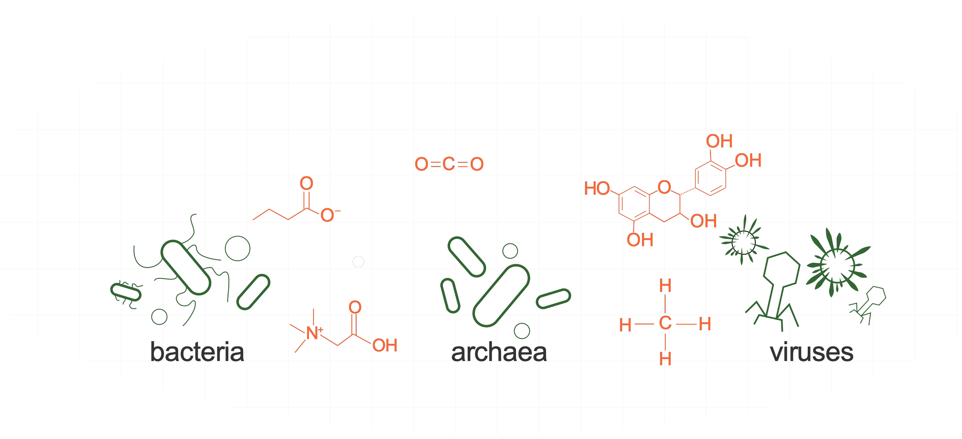
What is the microbiome?
The study of microorganisms, their genomes, and their surrounding environmental conditions
fungi

Slide 3
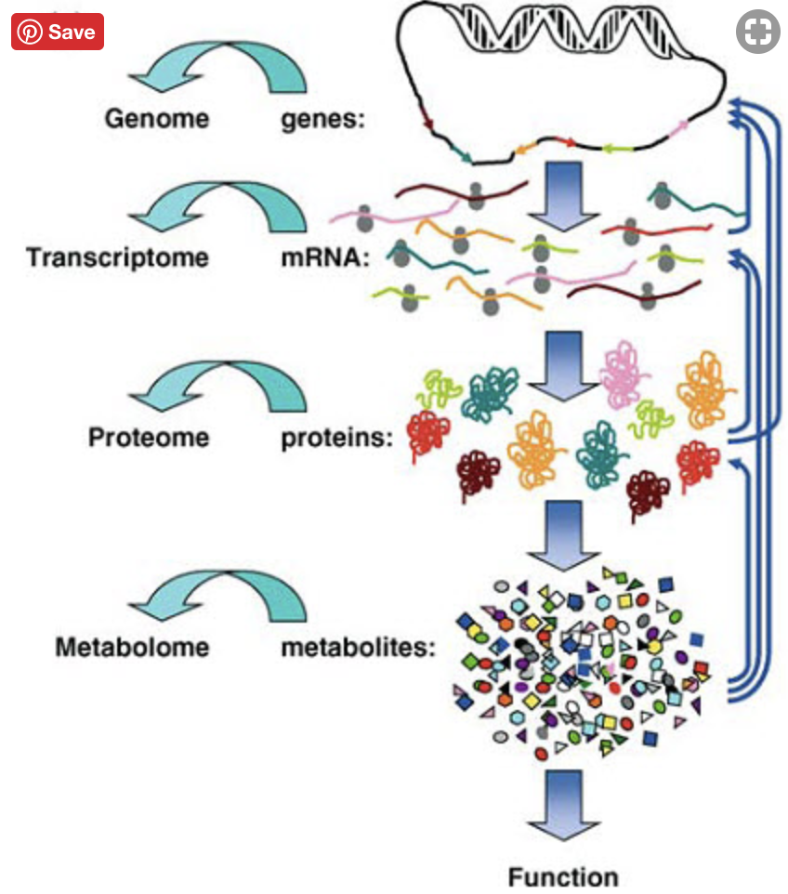
Today we are going to discuss many of these multi-omics tools
&
provide case studies to help contextualize

Slide 4
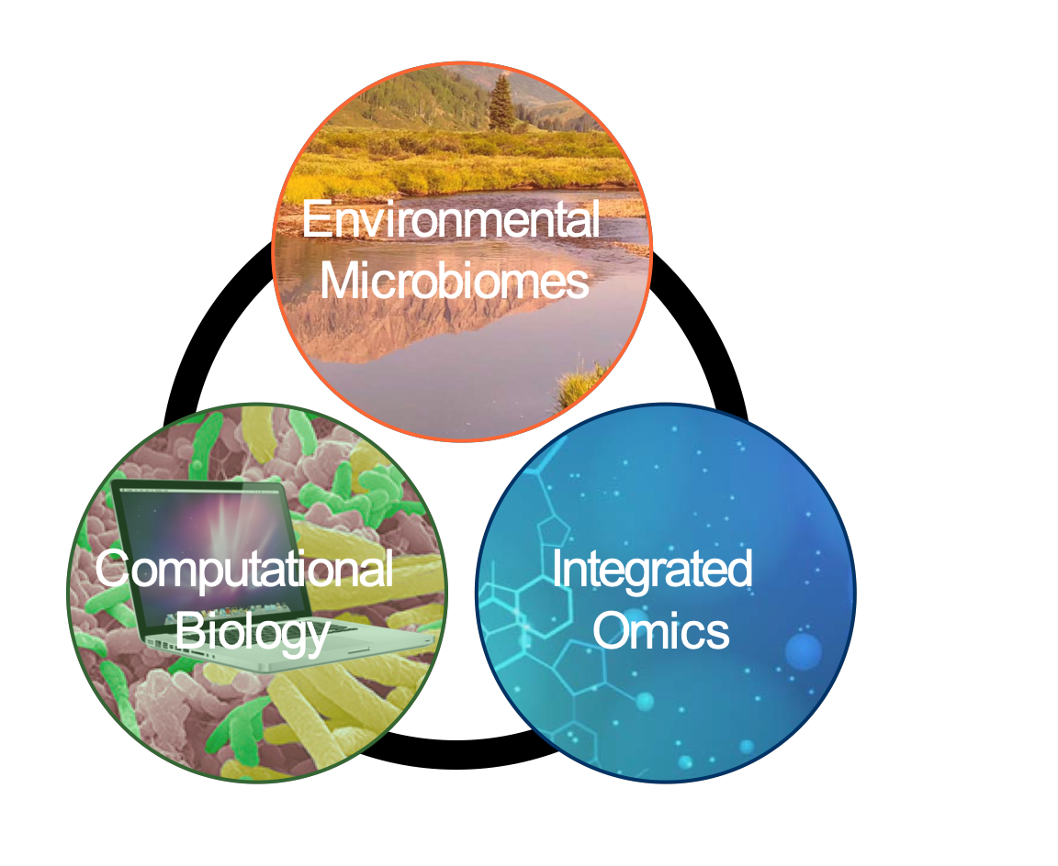
Genomics meets the Microbiome
About Wrighton Microbiome Lab
Overview of microbiome relevant methods
Session 1: Metagenomics: where have we been, where are we today.
Session 2: Case study to highlight how we use these tools to gain new insights into ecosystems

Slide 5
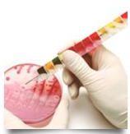
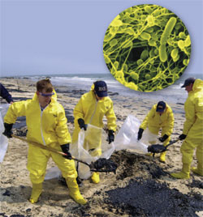
My Science Trajectory
Hardy Diagnostics-
clinical microbiology
Maters-molecular tools
bioremediation

Slide 6
My Science Trajectory
Hardy Diagnostics-
clinical microbiology
PhD UC Berkeley- Coates Lab
mechanisms extracellular respiration
Maters-molecular tools
bioremediation

Slide 7
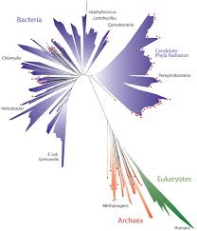
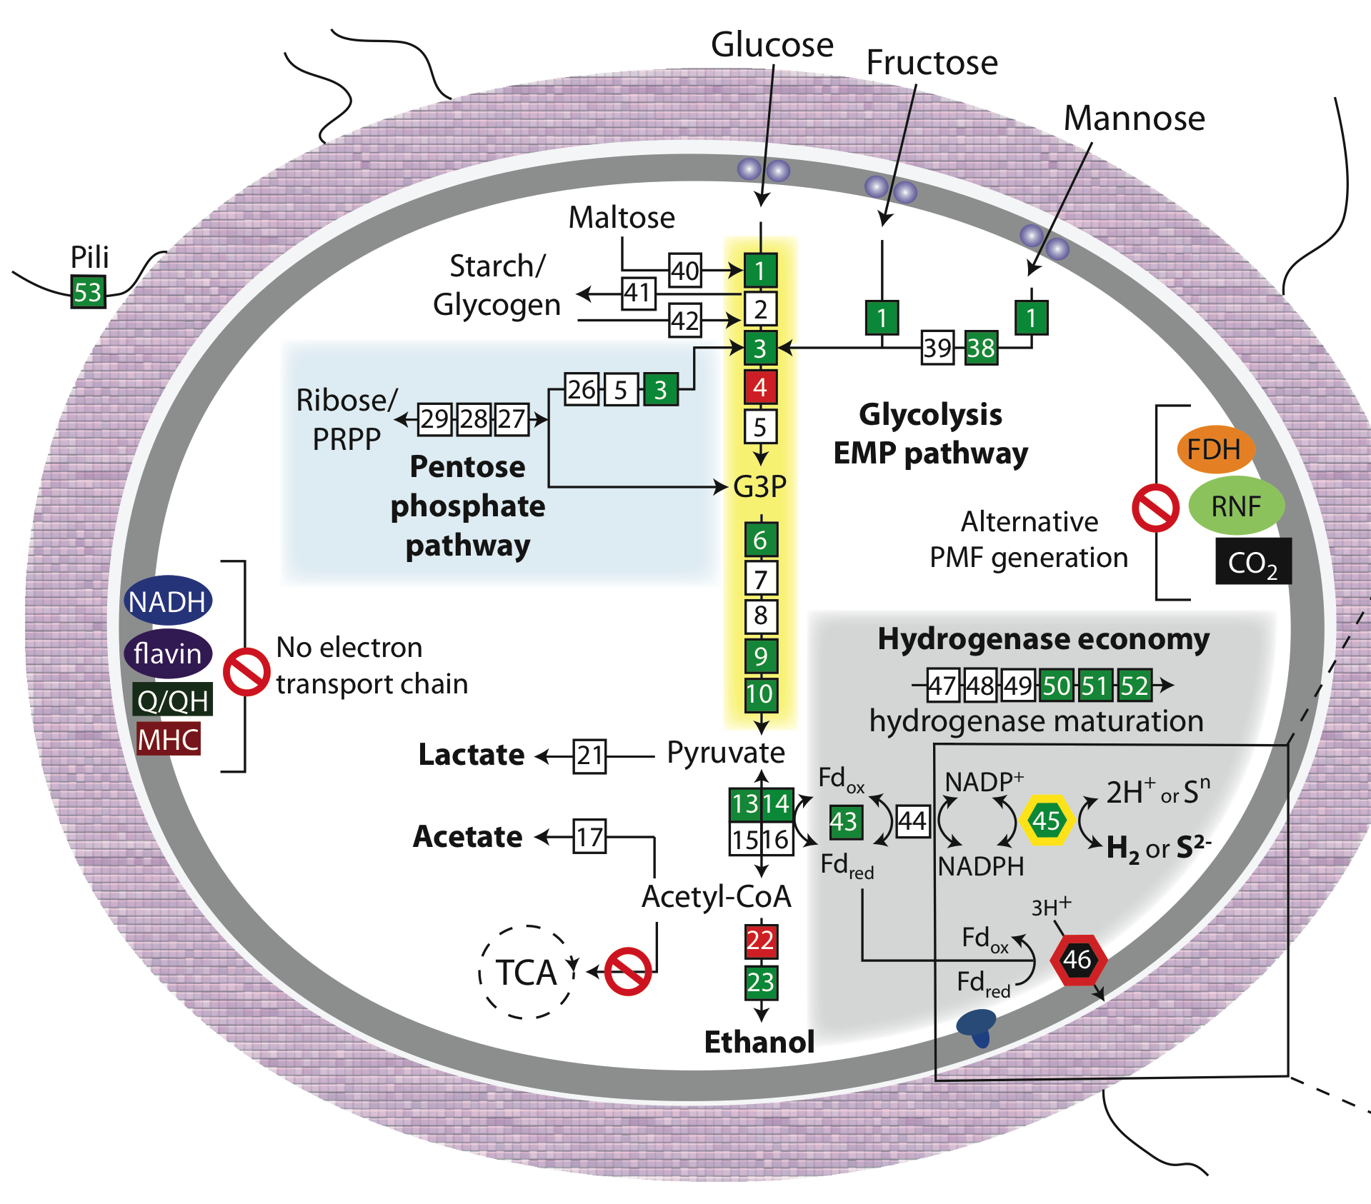
My Science Trajectory
Hardy Diagnostics-
clinical microbiology
PhD UC Berkeley- Coates Lab
mechanisms extracellular respiration
Post-doc- UC Berkeley Banfield Lab
Omics to discover new branches of tree of life
Maters-molecular tools
bioremediation

Slide 8
Wrighton Lab Started in 2013
2002 MS in Ecology
2005 Phd UC Berkeley- Microbiology
2010 Post-Doc UC Berkeley- Computational Biology
2013 Assistant Professor, Ohio State University
Microbiology
2018 Assistant Professor, CSU
Microbiome Data Sciences, Soil and Crop Science
@kcwrighton
Wrighton@colosate.edu
Wrightonlab.com

Slide 9
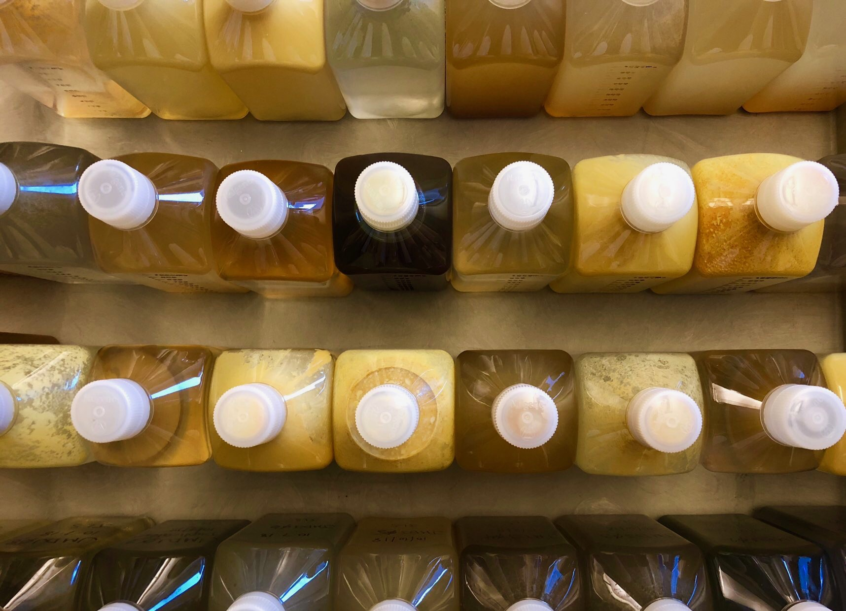
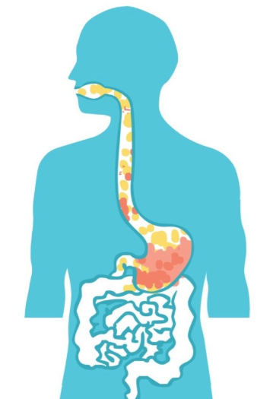

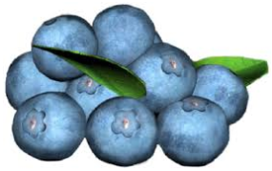
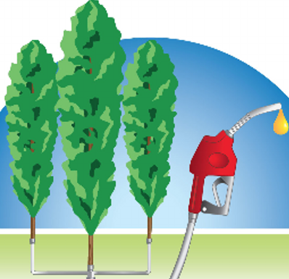
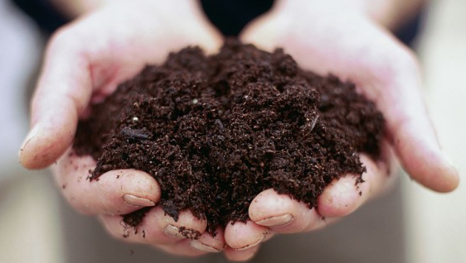
A little about the Wrighton Microbiome Lab Group
Ecosystem agnostic- but with a consistent focus on microbial metabolism and metabolic connectivity that contribute to ecosystem properties

Slide 10
Genomics meets the Microbiome
About Wrighton Microbiome Lab
Overview of microbiome relevant methods
Session 1: Metagenomics: where have we been, where are we today.
Session 2: Case study to highlight how we use these tools to gain new insights into natural systems

Slide 11
Cultivation
geochemistry or metabolome
amplicon
Meta-P
Meta-G
Meta-T
FISH
Isotopes
Microbiome in the genomics era :
You need to use the right tool for the job,
but this depends on your question
Notes:
Get this qutoe

Slide 12
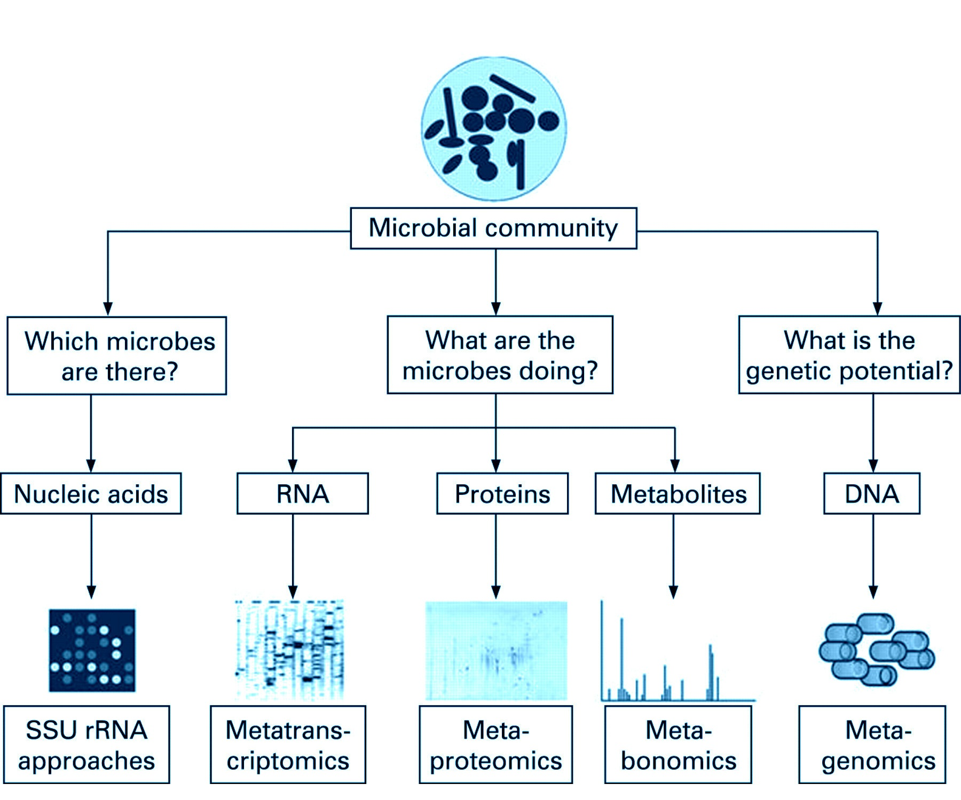
The multi-omics tool box

Slide 13
The multi-omics tool box

Slide 14
The multi-omics tool box

Slide 15
The multi-omics tool box

Slide 16
The multi-omics tool box

Slide 17
Session 2 today with me
Workshop with Scott
Session 1 today with me

Slide 18
Genomics meets the Microbiome
About Wrighton Microbiome Lab
Overview of microbiome relevant methods
Session 1: Metagenomics: where have we been, where are we today.
Session 2: Case study to highlight how we use these tools to gain new insights into natural systems

Slide 19
Session 1 Learning objectives
What is microbial dark matter, why does it exist?
What is metagenomics and how has it changed our understanding of microbial diversity (to uncover dark matter_
What is the difference between 16S and metaG when to use each method
What is the value of the unbinned metagenome approach- know example
What is the value of the binned metagenome approach- know example
Since these original papers, where is the field today

Slide 20
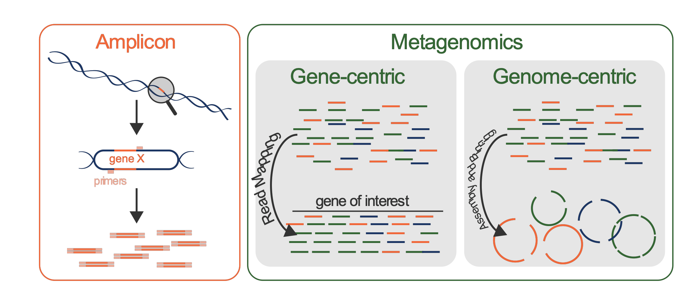
DNA tools in the microbiome field
16S rRNA
16S rRNA versus Whole Genome Sequencing

Slide 21
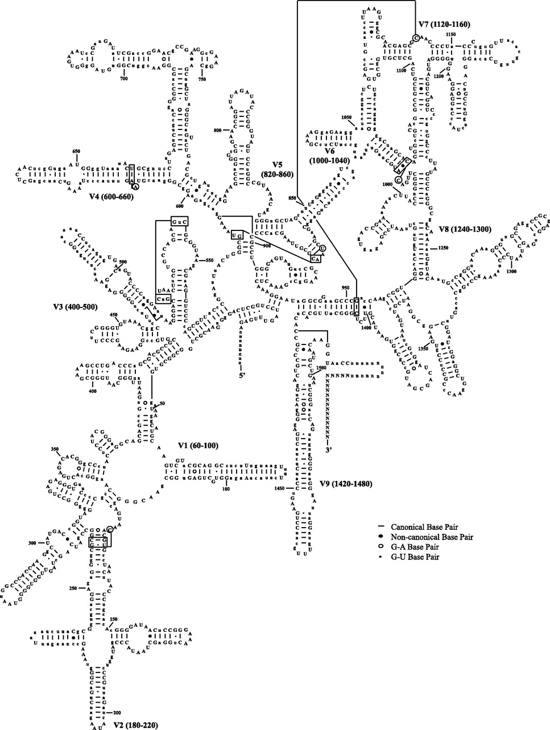
16S rRNA gene is a commonly used biomarker
track taxonomy and ‘relative abundance’

Slide 22
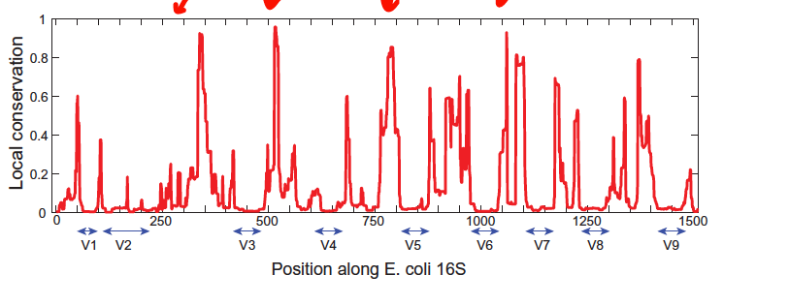
16S rRNA gene is a good biomarker ubiquity, variability, conservation
Series of 9 variable regions (denoted by V) represented by valleys
Conserved regions are represented by peaks
Amir et al. NAR 2013
Notes:
Understand how Variable regions link to structure of 16S- if you don’t get it, ask to clarify. This matters.

Slide 23
From Woese to PCR :16S rRNA sequencing today
High-throughput sequencing of hypervariable fragment of 16S rRNA
SSU gene
515F
806R
100-300 bp overlapping reads
Amir et al. NAR 2013
e.g. Kozich et al AEM 2013; Fadrosh et al Microbiome 2014

Slide 24
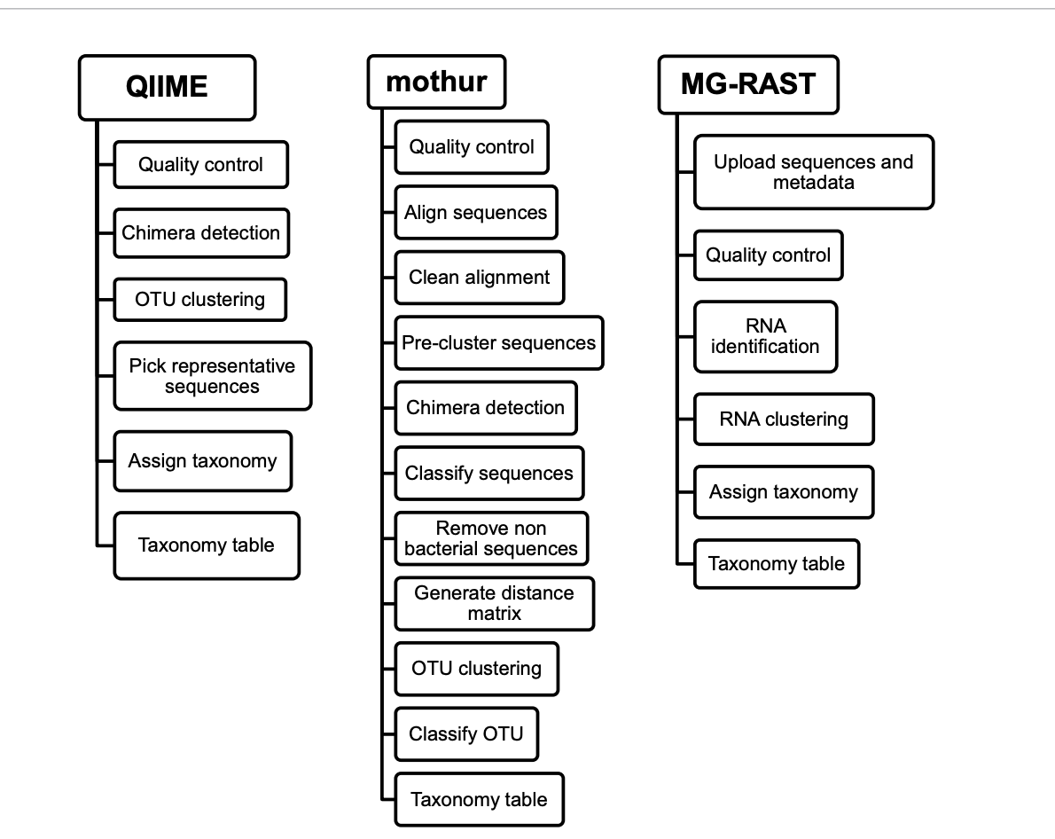
16S rRNA gene is a good biomarker sequencing affordable and computationally accessible
Notes:
https://www.longdom.org/open-access/a-comparison-of-three-bioinformatics-pipelines-for-the-analysis-ofpreterm-gut-microbiota-using-16s-rrna-gene-sequencing-data-jpb-1000381.pdf

Slide 25

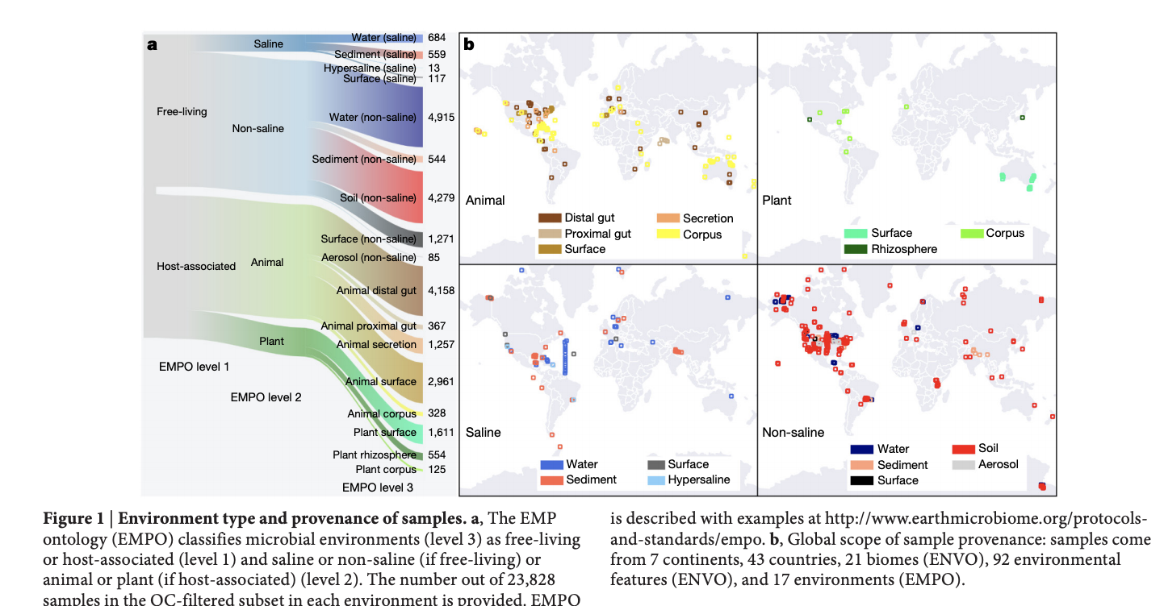
Notes:
https://www.longdom.org/open-access/a-comparison-of-three-bioinformatics-pipelines-for-the-analysis-ofpreterm-gut-microbiota-using-16s-rrna-gene-sequencing-data-jpb-1000381.pdf

Slide 26
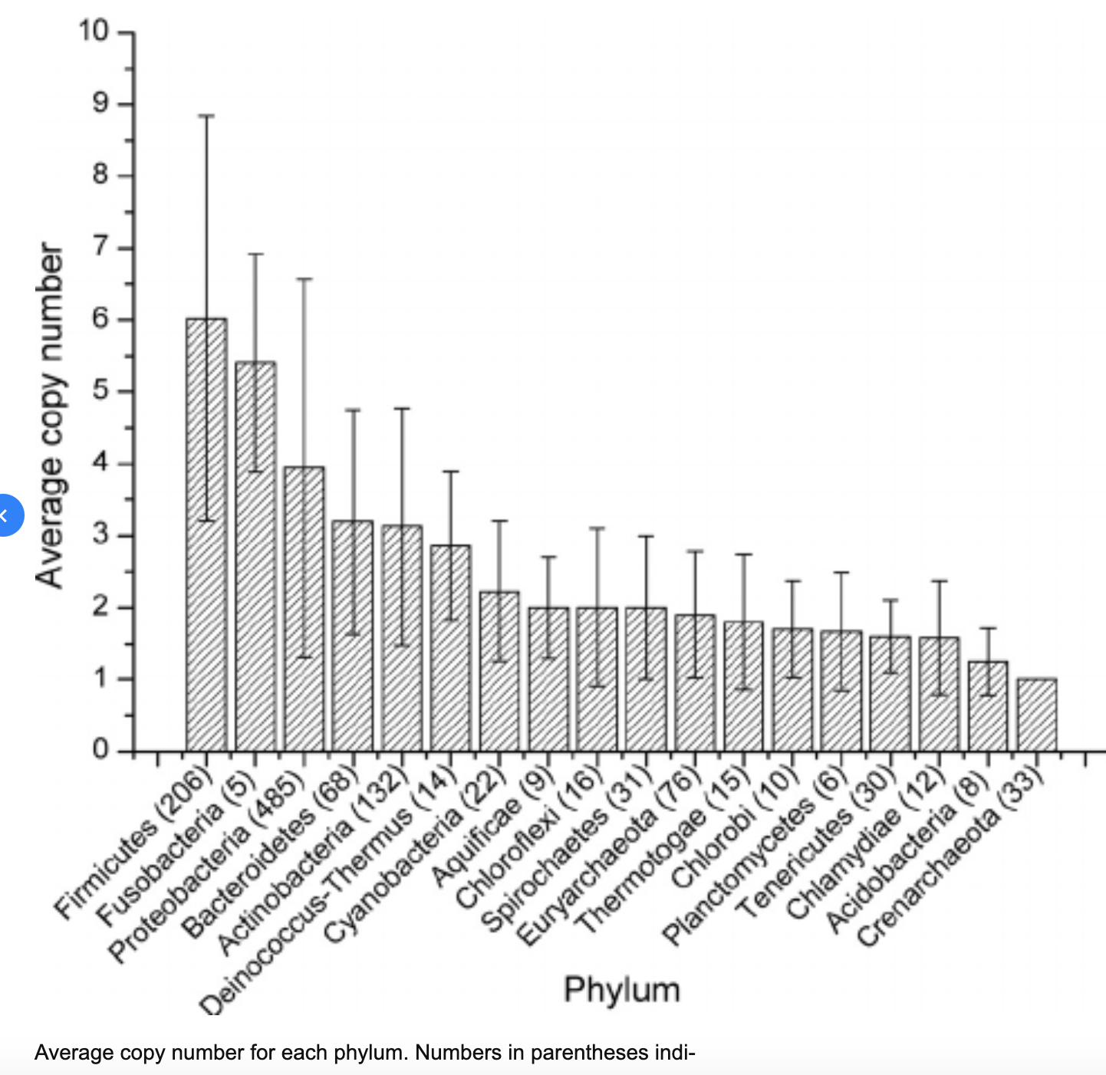
16S rRNA gene has copy number differences can skew interpretation of relative abundance
2013 completely sequenced genomes of bacteria and archaea were analyzed

Slide 27
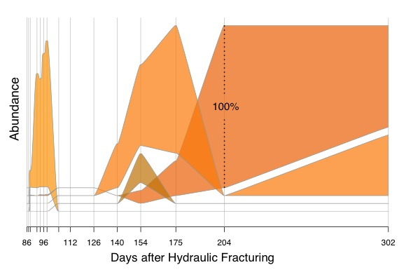
For many organisms, 16S might not provide enough resolution for ecological significance
FROM 16S rRNA-full length only 1 ASV
FROM genomes resolved from metagenomes, 5 strains with >99.9% identical 16S rRNA gene

Slide 28
DNA based microbiome tools

Slide 29
Metagenome- or community genomics- provides organisms in context of their environment
Two methods worth discussing

Slide 30
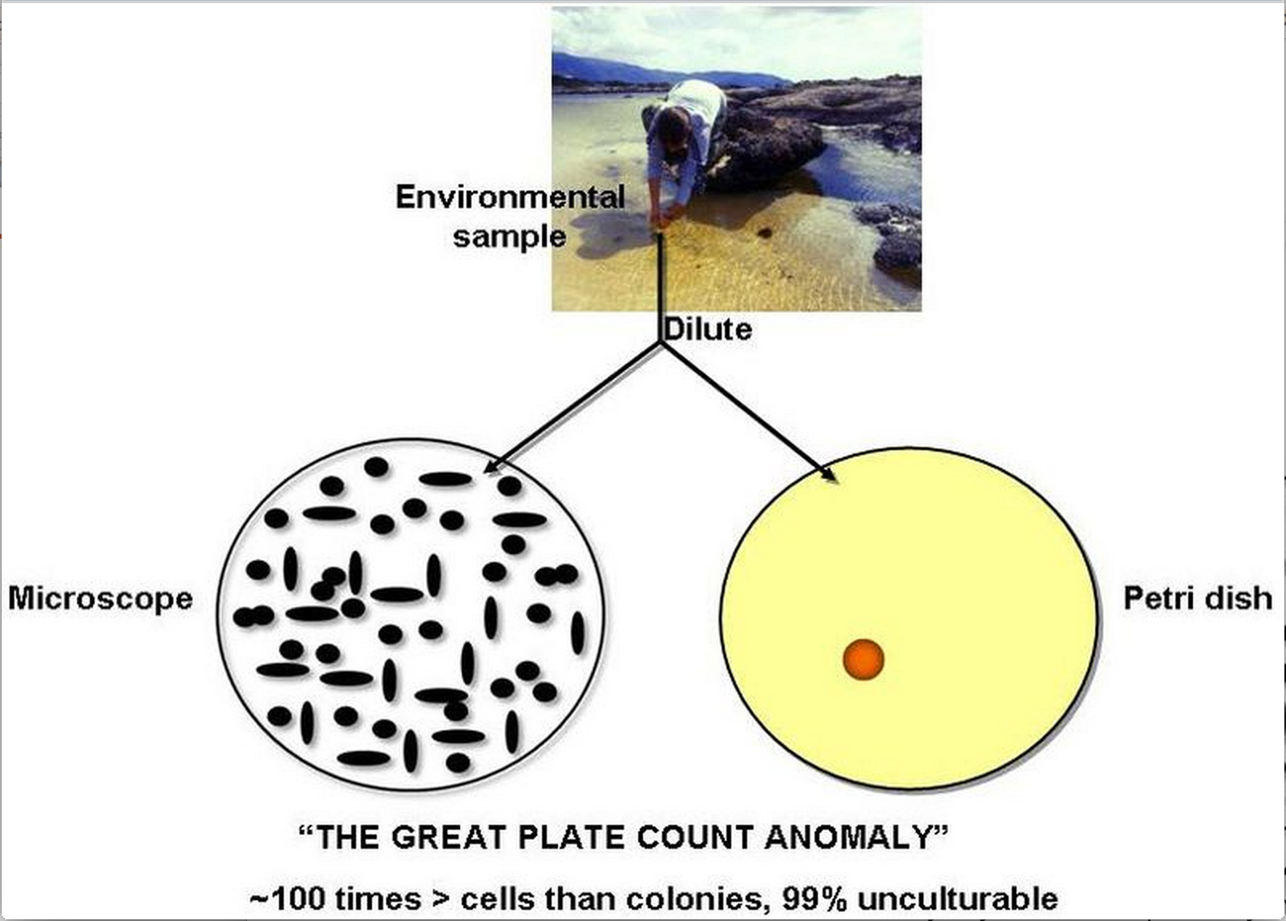
the microbial world before metagenomics

Slide 31
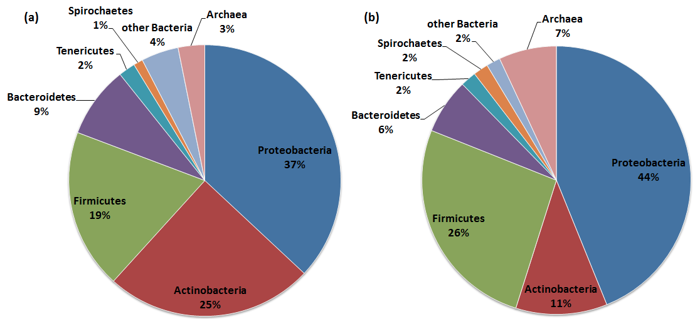
Genomes used to be only from cultured- bias!
DSMZ: Culture bias
Joint Genome Institute: Sequenced genomes
Four phyla comprise more than 88% of all isolates maintained at DSMZ.
Four phyla comprise more than 87.8% of all isolates maintained at DSMZ.
Rinke et al (Nature, 2012)
Notes:
Why do we care about this bias? What does it mean?

Slide 32
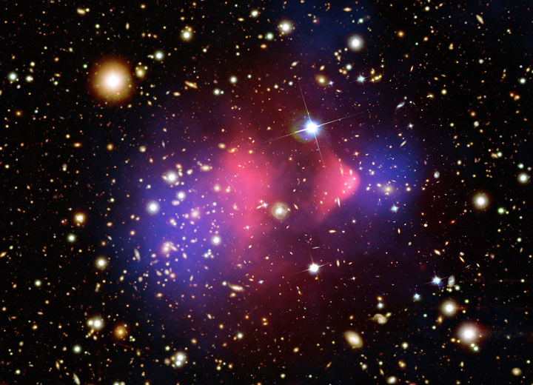
Microbial dark matter: The uncultivated majority
Dark matter is a type of matter hypothesized in astronomy to account for a large part of the mass that appears missing from the universe.
Dark matter cannot be seen directly.
Instead, dark matter existence and properties are inferred.

Slide 33
Microbial dark matter: The uncultivated majority
Because of its ability to reveal the previously hidden diversity of microscopic life, metagenomics offers a powerful lens for viewing the microbial world that has revolutionize understanding of the entire living world
Notes:
we don’t have to culture the organisms to get near complete, or in many cases closed microbial genomes anymore
It’s not perfect, and genome recovery is based on many features

Slide 34
Name that noun and verb pair
DNA is sequenced into ?
are Assembled into ?
are Binned into ?
Bins are curated into Metagenome Assembled Genomes (MAGs)

Slide 35
Name that noun and verb pair
DNA is sequenced into Reads
Reads are Assembled into Contigs
Contigs are Binned into Bins
Bins are curated into Metagenome Assembled Genomes (MAGs)
unbinned
binned

Slide 36
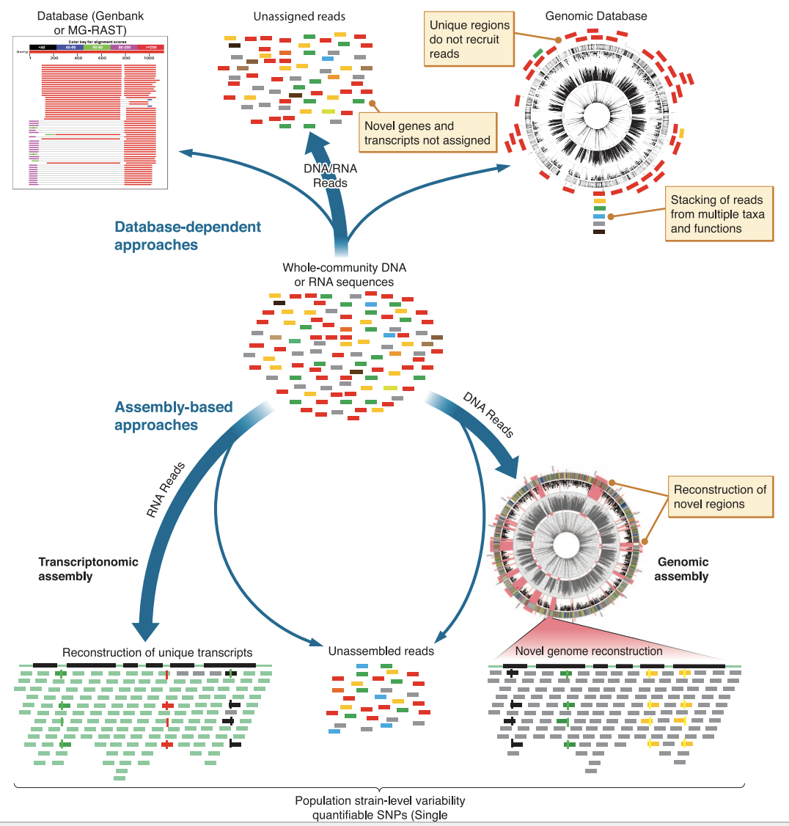
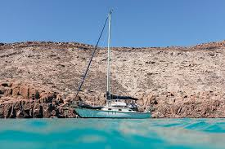
DNA from environment
1
Unbinned
To bin or not to bin that is the question

Slide 37
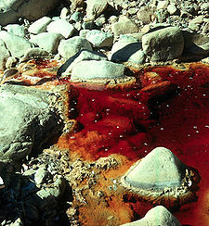
DNA from environment
1
Unbinned
To bin or not to bin that is the question
2
Binned

Slide 38
Venter paper work flow
1
Unbinned
DNA is sequenced into Reads
Reads are Assembled into Contigs
Contigs are Annotated to Genes
Reads are Mapped to contigs for Coverage
unbinned

Slide 39

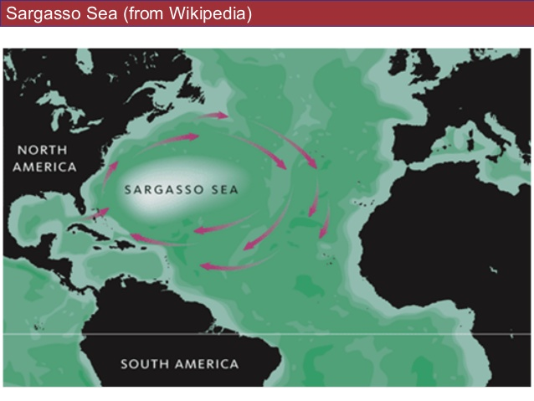
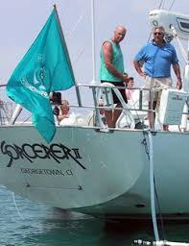
Unbinned metagenome can uncover new functional diversity in the world around us
Global ocean sampling expedition (GOS)
APRIL2004
Notes:
and carbon cycling in the ocean through a
non–chlorophyll-based pathway

Slide 41
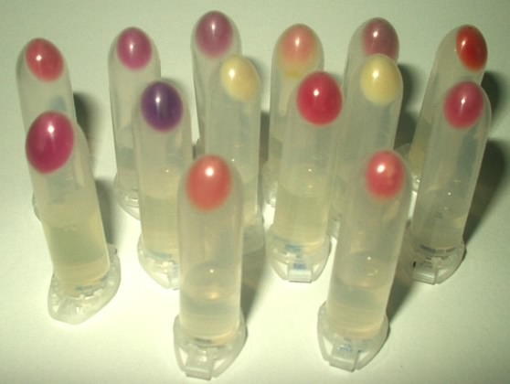
New genes recovered- expand gene diversity by sampling the uncultivated
Mind blowing compared to single gene approaches!!!
A total of 69,901 novel genes belonging to 15,601 clusters were identified
782 Proteorhodopsin genes
  Increase number order magnitude (blue previously know)
  Increase diversity into uncultivated lineages (from 4 to 13 gene families)

Slide 42
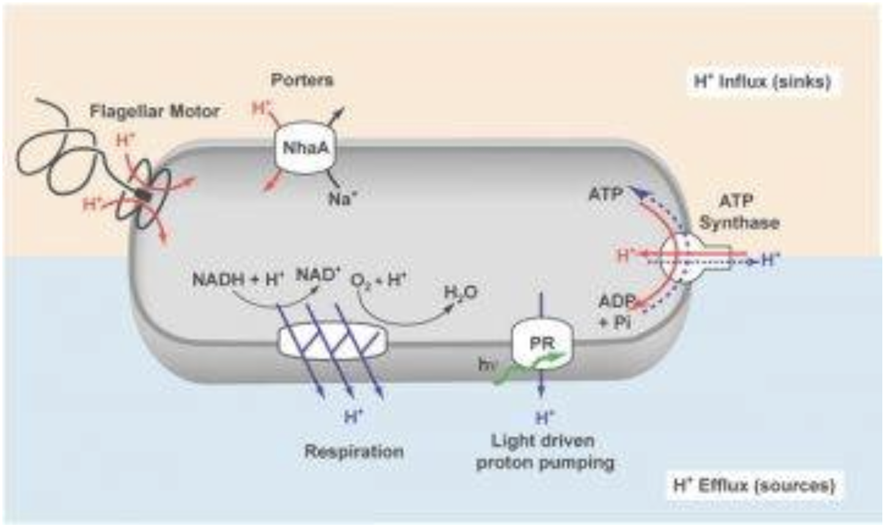
Challenge- assign these genes to organisms or provide overall organismal context

Slide 43
DNA from environment
1
Unbinned
To bin or not to bin that is the question
2
Binned

Slide 44
Banfield lab work flow
2
Binned
DNA is sequenced into Reads
Reads are Assembled into Contigs
Contigs are Binned into Bins
Bins are curated into Metagenome Assembled Genomes (MAGs)
binned

Slide 45
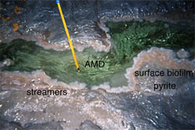
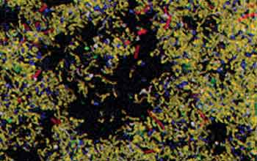
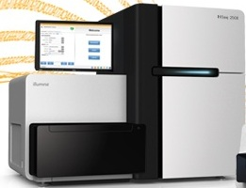
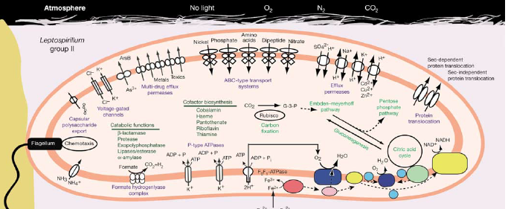
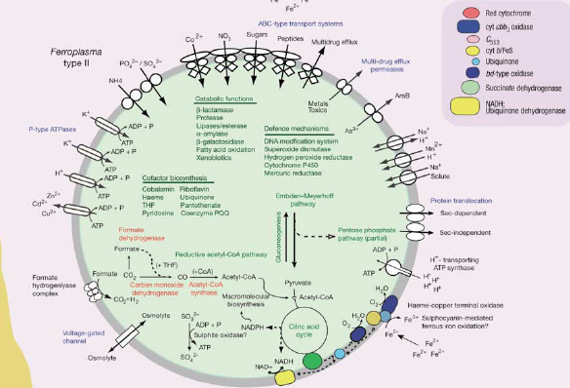
1. Environmental sample
2. Get microbial biomass
3. Extract genomic DNA
4. Sequence
7. Reconstruct genomes
6. Bin
5. Assemble
8. Phylogeny and Infer organism metabolism

Slide 46
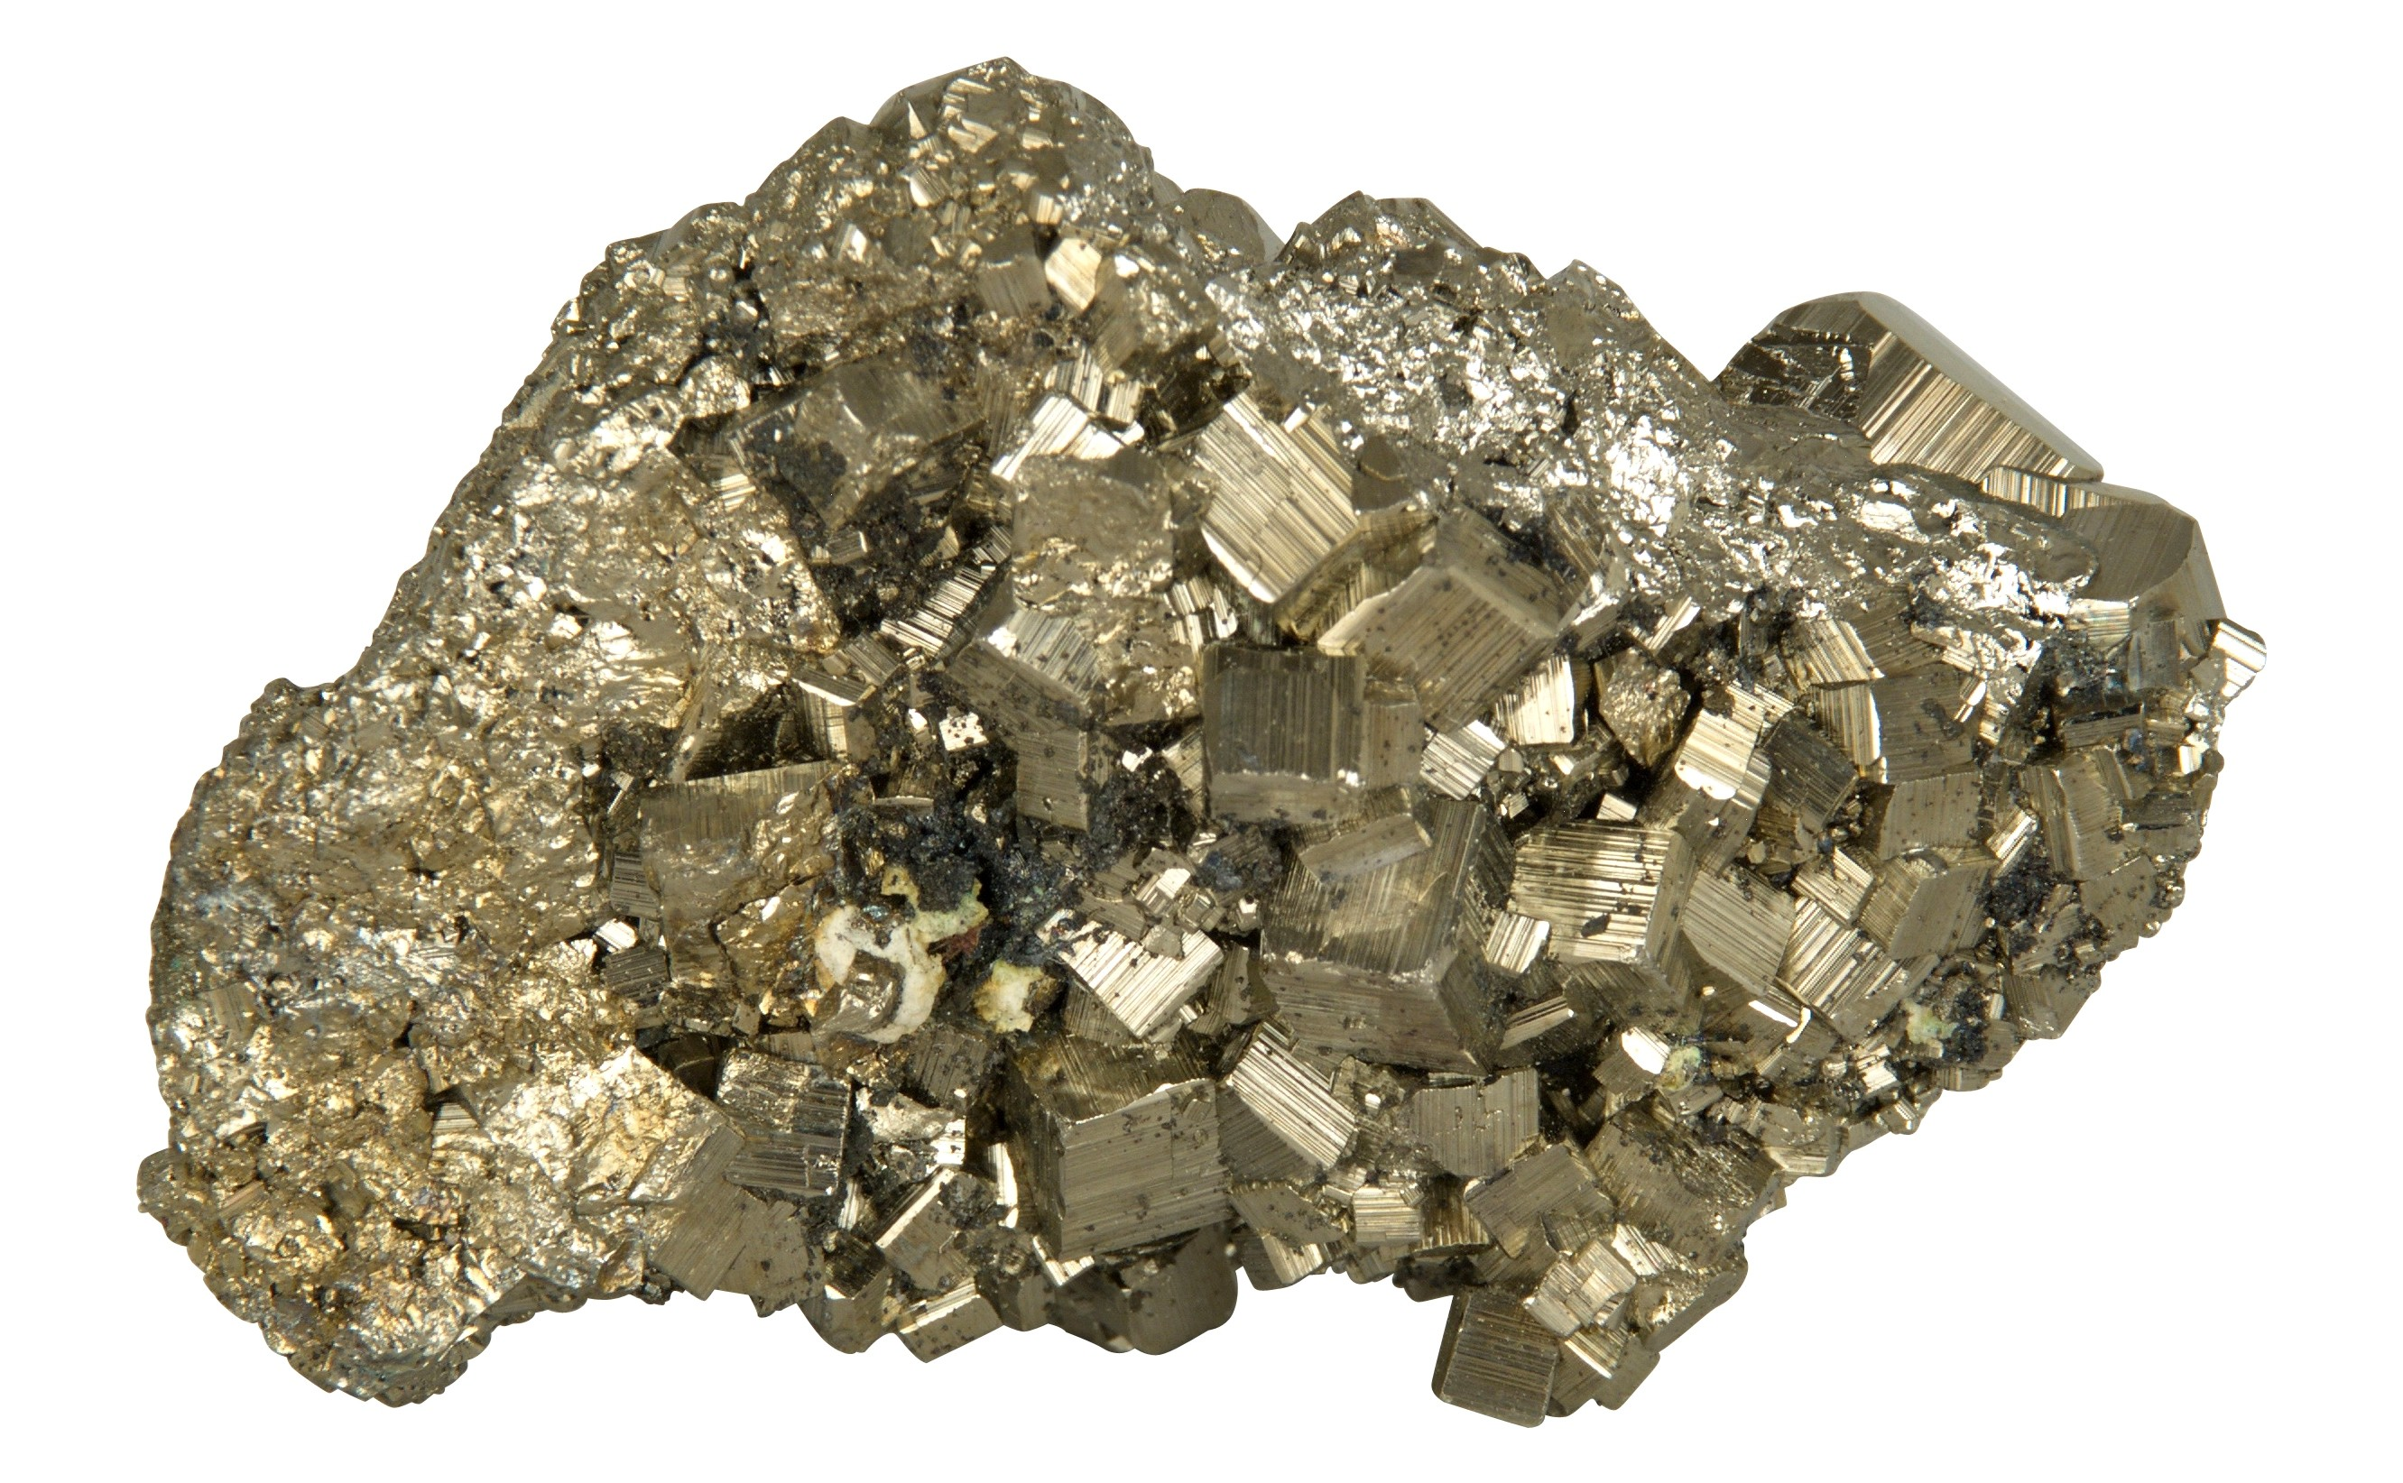
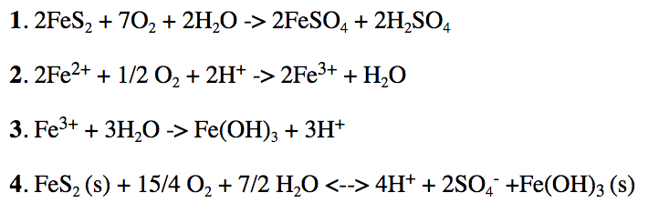
Genomics meet biogeochemistry
Sulfuric acid
Drops pH
Iron hydroxide waste stream- causes additional leaching of Cu, Ca, radioactive metals
Fe(II)
Ferrous sulfate
Pyrite
Abiotic reaction
Microbial aerobic ferrous iron oxidation
Abiotic precipitation reaction
(s)
Notes:
Normally mines are kept dry, empty water0 it is pumped out.
So when they are done it fills with water, which is aerobic and reactors with pyrite.
Mines are rich in pyrite FeS2, reacts with water and oxygen
Gets sulfuric acid being produced
Get all metals in solution, Fe(3) preceipates into revier. Oxidized.
Runs thorugh wetalnds to raise pH

Slide 47
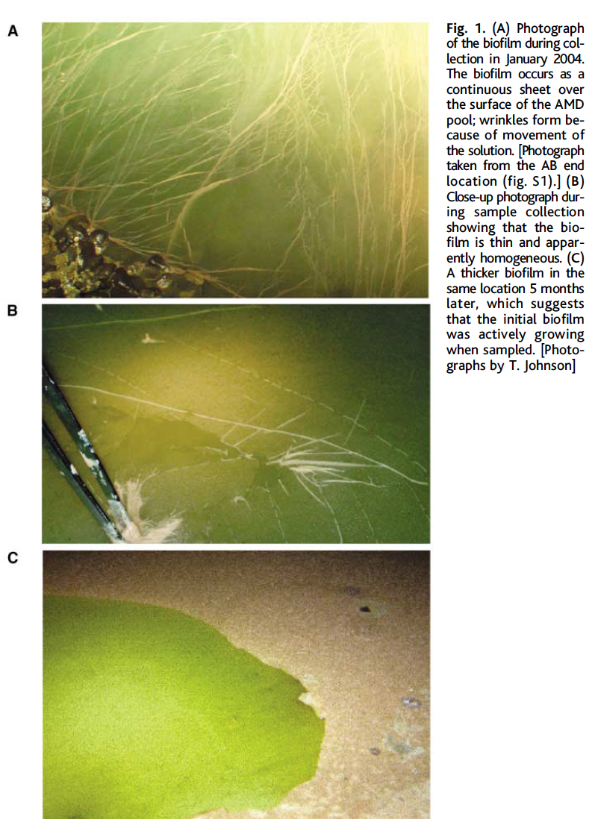
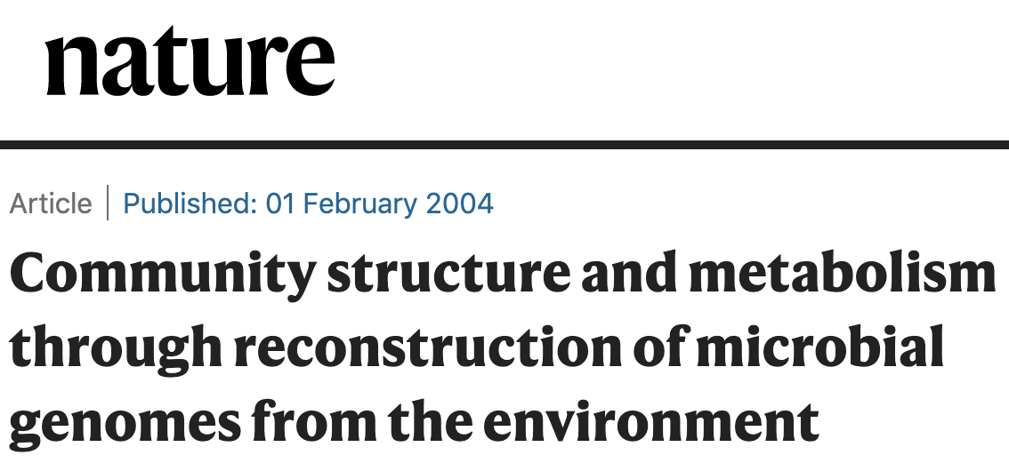
MAGs from AMD biofilms
Use 16S FISH and metagenomics to reconstruct genomes to answer these questions in a new ecosystem:
Who is there?
How do they grow in the pH 1.5 heavy metal fluid?
How do they change over time?
How do the organisms interact?
FEB 2004

Slide 48
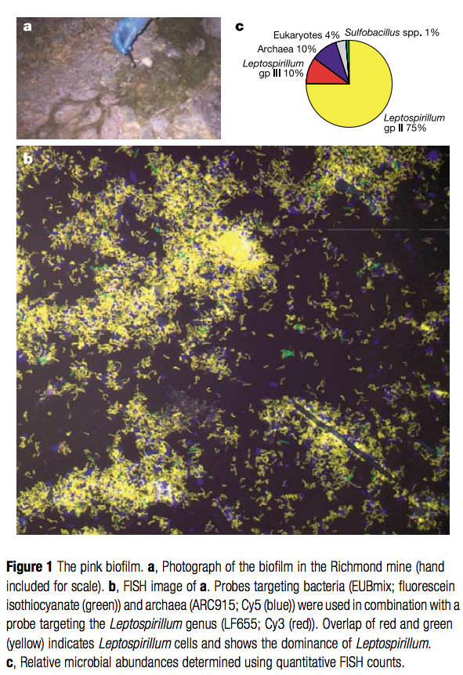
Multiple 16S rRNA approaches: amplicon barcoding (clone libraries are PCR based) and FISH
FISH: to quantify organisms in a community

Slide 49
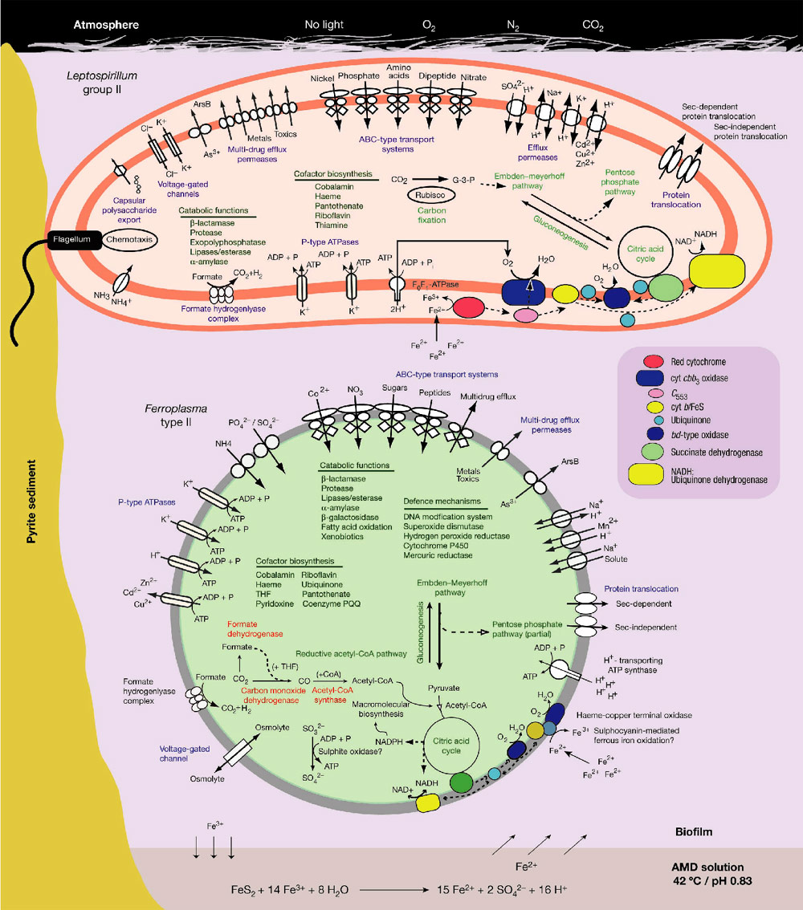
Binned community genome: Metabolic profiling at organismal (genome) level
Near complete genomes for the five dominant members of the biofilm community
  Dominant Lepto group II
  How do we assess genome quality? How complete the MAGS are?
Notes:
HINT FOR HW- Genome directed cultivation paper by same authors
http://aem.asm.org/content/71/10/6319.short
Other markes in the papers:
Ventner uses recA, radA
Single copy-= what does this mean?
Banfield use tRNA synthase and translation machinery proteins.

Slide 50
MAG quality standards –
Standardizing genome completion and quality
High, medium, low
  Estimated Completion and contamination
Inventory Single copy genes- CheckM or other method
Pull rRNA from MAG (5, 16, 30S)
tRNA profile
Contamination less than 10%
Notes:
Single copy genes
Ventner uses recA, radA
Single copy-= what does this mean?
Banfield use tRNA synthase and translation machinery proteins

Slide 51
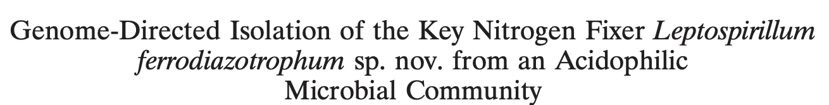
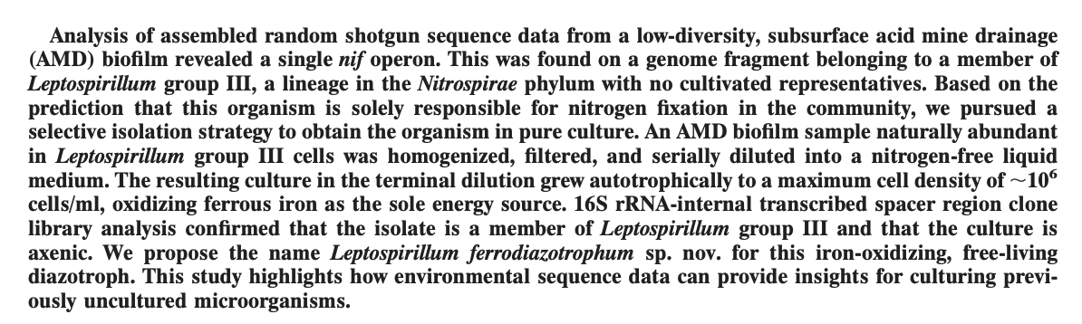
Binned community genome: Metabolic profiling at organismal (genome) level
Showed only one organism had capacity for nitrogen fixation, thus supplied nitrogen to rest of community

Slide 52
Challenges of binned approach: then and now
Computationally intensive- most assemblers require high memory
AMD is a 5 member community, much more tractable for binning, could it scale to more complex communities?
Workflows today are fairly well established, but at the time were using or modifying single genome tools
How much sequencing is enough? How much of your reads go into your assembly? How much of your assembly goes into your bins? How well do your bins recruit your meta-T

Slide 53
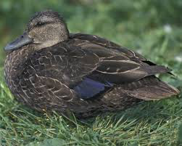
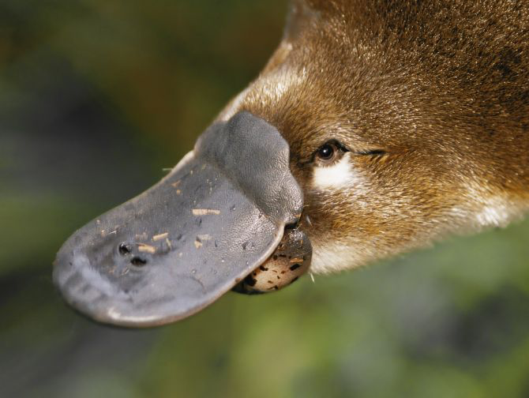
Partially complete genomes are challenging
audobon.org
tes.com
1 complete duck contains:
2 legs
2 wings
tail
beak
bin contains:
4 legs
0 wings
tail
beak
contaminated
Incomplete
But likely a duck

Slide 54
Partially complete genomes are challenging
audobon.org
tes.com
1 complete duck contains:
2 legs
2 wings
tail
beak
bin contains:
4 legs
0 wings
tail
beak
contaminated
Incomplete
But likely a duck

Slide 55
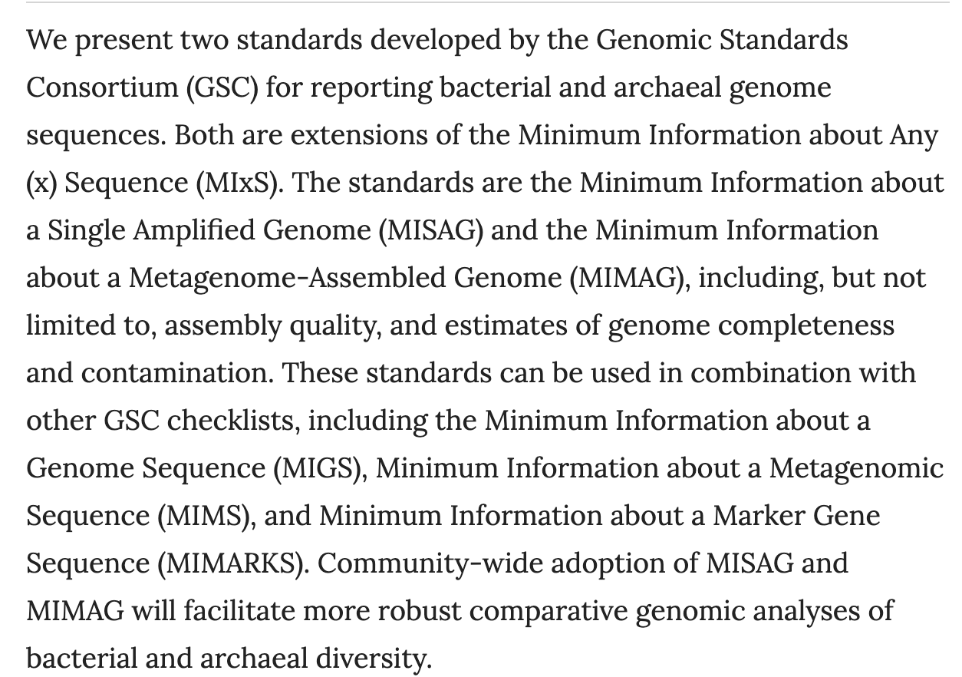
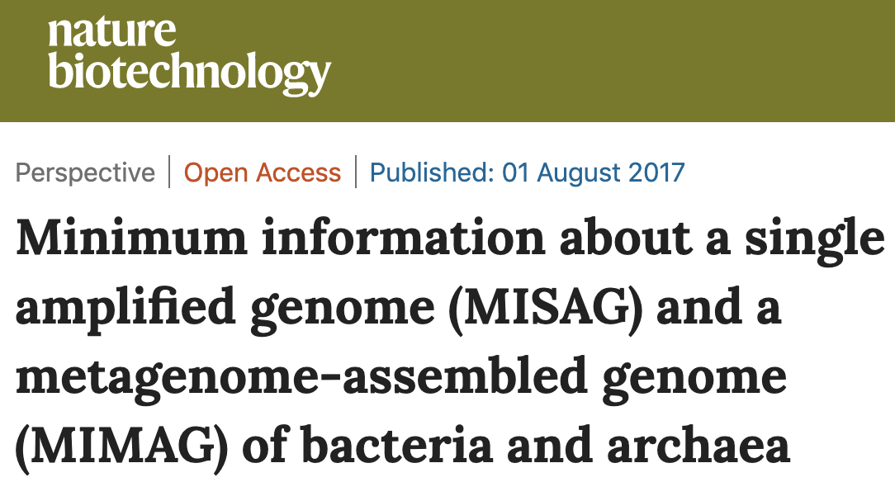
Metagenome assembled genomes (MAGs) standards
Notes:
https://www.nature.com/articles/nbt.3893

Slide 56
Greatest hit Microbial Community Genomics
Banfield
and
Venter
Metaproteome
AMD
2008
2016
2004
2012
2019

Slide 57
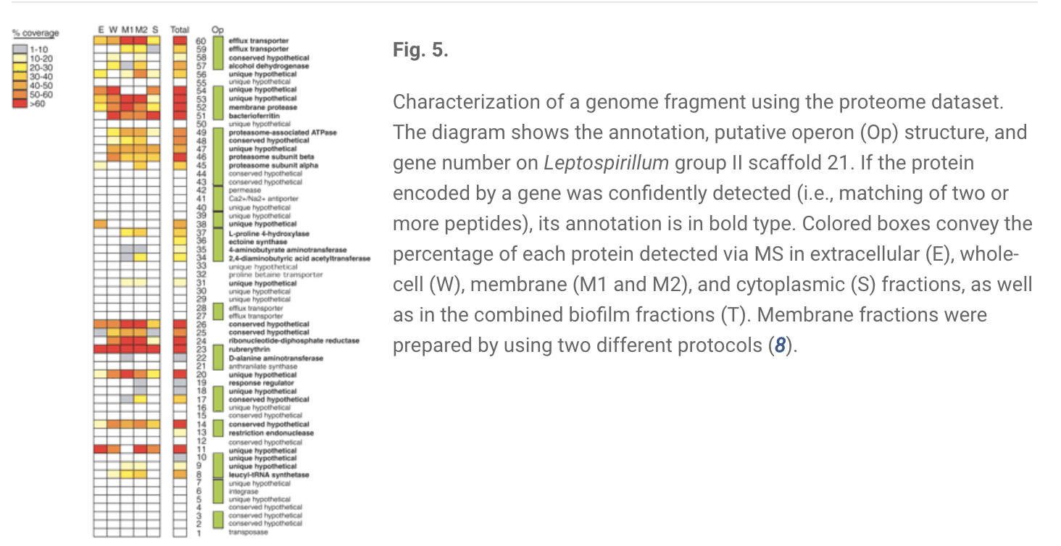
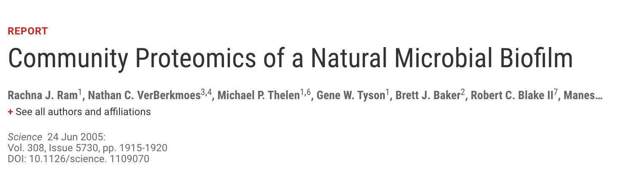

Slide 58
Greatest hit Microbial Community Genomics
Jeff Gordon Gut
Metagenome
HMP genome db
Banfield
and
Venter
Metaproteome
AMD
2008
2016
2004
2012
2019

Slide 59
Greatest hit Microbial Community Genomics
Jeff Gordon Gut
Metagenome
HMP genome db
Banfield
and
Venter
Metaproteome
AMD
Rise of CPR
Wrighton, Brown, Hug
2008
2016
2004
2012
2019

Slide 60
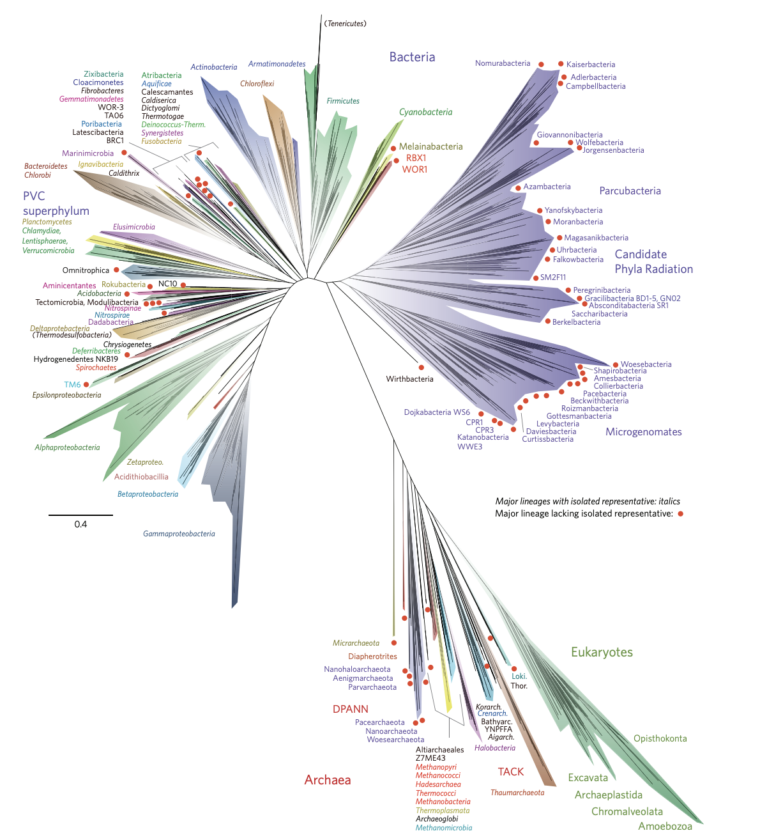



2017
2015
2012
Notes:
Figure 1 | A current view of the tree of life, encompassing the total diversity represented by sequenced genomes. The tree includes 92 named bacterial phyla, 26 archaeal phyla and all five of the Eukaryotic supergroups. Major lineages are assigned arbitrary colours and named, with well-characterized lineage names, in italics. Lineages lacking an isolated representative are highlighted with non-italicized names and red dots.
For details on taxon sampling and tree inference, see Methods. The names Tenericutes and Thermodesulfobacteria are bracketed to indicate that these lineages branch within the Firmicutes and the Deltaproteobacteria, respectively. Eukaryotic supergroups are noted, but not otherwise delineated due to the low resolution of these lineages. The CPR phyla are assigned a single colour as they are composed entirely of organisms without isolated representatives, and are still in the process of definition at lower taxonomic levels. The complete ribosomal protein tree is available in rectangular format with full bootstrap values as Supplementary Fig. 1 and in Newick format in Supplementary Dataset 2.

Slide 61
Greatest hit Microbial Community Genomics
Jeff Gordon Gut
Metagenome
IDBA-ud, SPADES, Concot 2012-2014
HMP genome db
Banfield
and
Venter
Metaproteome
AMD
Rise of CPR
Wrighton, Brown, Hug
2008
2016
2004
2012
2019

Slide 62




2012
2012
2015
2014
2015

Slide 63
Greatest hit Microbial Community Genomics
Jeff Gordon Gut
Metagenome
IDBA-ud, SPADES, Concot 2012-2014
Delong
MetaT
HMP genome db
Banfield
and
Venter
Metaproteome
AMD
Rise of CPR
Wrighton, Brown, Hug
2008
2016
2004
2012
2019

Slide 64



Slide 65
Greatest hit Microbial Community Genomics
Jeff Gordon Gut
Metagenome
IDBA-ud, SPADES, Concot 2012-2014
Delong
MetaT
HMP genome db
Banfield
and
Venter
Metaproteome
AMD
Rise of CPR
Wrighton, Brown, Hug
Era of MAG database
2017
2008
2016
2004
2012
2019

Slide 66





Slide 67
Some questions- choose a method- many work
16S rRNA, unbinned, binned
If you wanted to address the who is there and relative changes in diversity across thousands of samples?
If you wanted to rapidly profile the nitrogen fixing capacity in a community, and account for the recovery of novel genes (hint may not be picked up by primers)
If you wanted to profile metabolic interdependencies between different organisms
If you wanted to profile the archaeal and bacterial dsDNA viruses in your community

Slide 68
Terminology review: Word choice matters
Microbiota [NOT MICROFLORA]: assemblage of organisms present in a defined environment
16S rRNA gene analyses [NOT METAGENOMICS]: Survey of 16S rRNA genes present in an environment
Metagenome: collection of genomes and genes from the microbiota
Microbiome: entire habitat, including microbes (bacteria, archaea, euks, viruses), their genomes, and surrounding environment can include metabolome or chemistry data too.
From Microbiome Journal

Slide 69
Session 1 Learning objectives Let’s Review
What is microbial dark matter, why does it exist?
What is metagenomics and how has it changed our understanding of microbial diversity (to uncover dark matter_
What is the difference between 16S and metaG when to use each method
What is the value of the unbinned metagenome approach- know example
What is the value of the binned metagenome approach- know example
Since these original papers, where is the field today
[Fun discussion- where are we going? Areas for improvement? Challenges? ]

