Slide 1
Downloading workshop files to your computer
Karin Steffen
Workshop on Genomics 2019

Slide 2
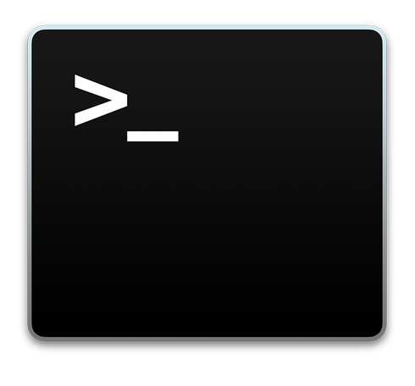
Terminal: rsync (scp …)
Connect from your own local terminal $ ssh
Locate the files, e.g. use $ pwd
Optional: $ md5sum
Download your file of interest $ rsync

Slide 3
Terminal: rsync (scp …)
Connect from your own local terminal
$ ssh genomics@ec2-3-84-41-42.compute-1.amazonaws.com
Locate the files, e.g. use $ pwd
Download your file of interest
$ rsync -avz genomics@ec2-18-212-16-174.compute-1.amazonaws.com:/home/genomics/workshop_materials/evomics_stat_2019/03.Exercises/*_KS.* .

Slide 4
Terminal: rsync (scp …)
$ md5sum <filename>
or
$ md5sum <filename> > outputfile
Compare md5sum after downloading, outputfile must be in the same directory as the downloaded file
$ md5sum -c outputfile

Slide 5

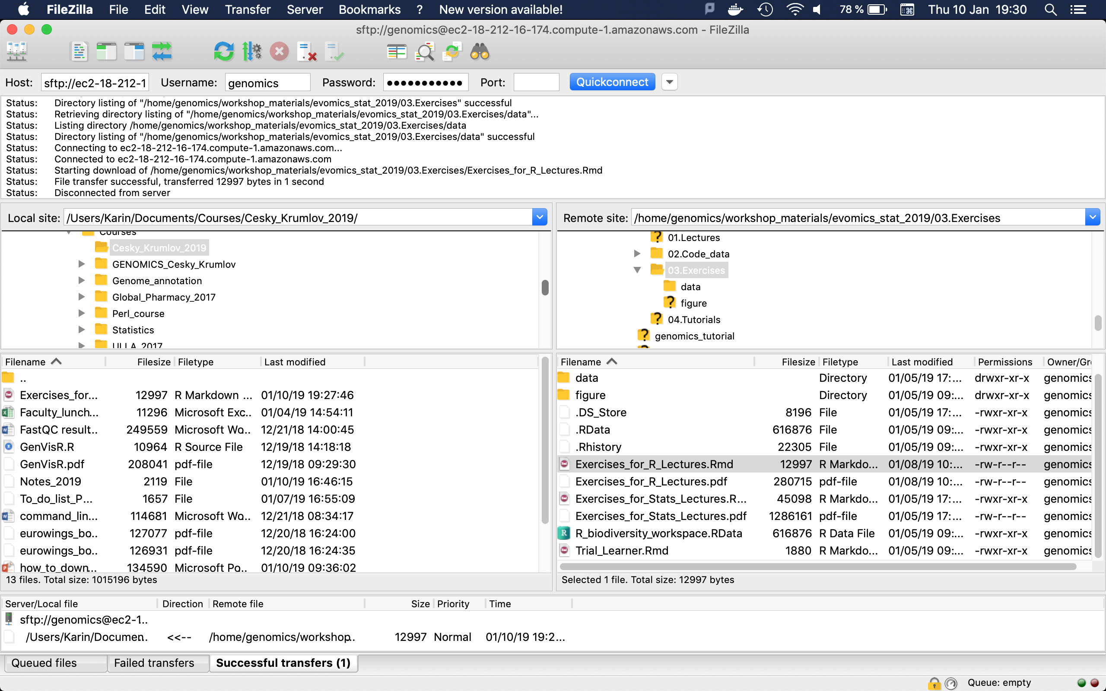
GUI: Filezilla https://sourceforge.net/projects/filezilla/
22
Instance address
Username
Password
Drag & Drop
Notes:
FileZilla® is a cross-platform FTP, SFTP, and FTPS client with a vast list of features, which supports Windows, Mac OS X, Linux, and more. FileZilla's dynamic tools help you move files between your local machine and your Web site's server effortlessly. For example, Filezilla lets you compare your files with in-directory server files to manage file syncing.

