Slide 1
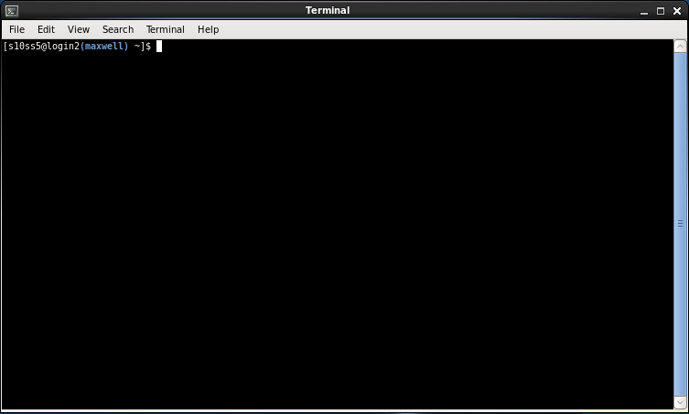
Introduction to Unix:
Getting to Grips with the Command Line
Dr. Sophie Shaw
University of Aberdeen, UK
s.shaw@abdn.ac.uk

Slide 2
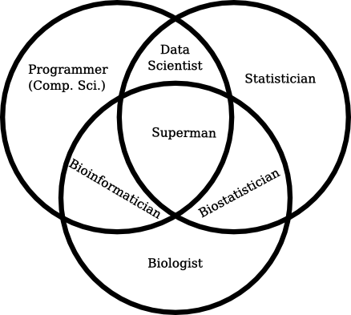


Slide 3
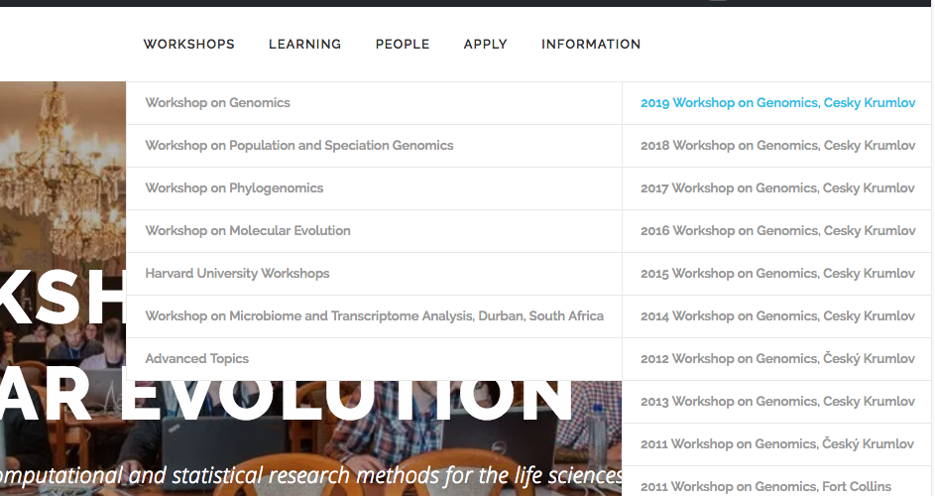
These Slides!
http://evomics.org/workshops/workshop-on-genomics/2019-workshop-on-genomics-cesky-krumlov/

Slide 4
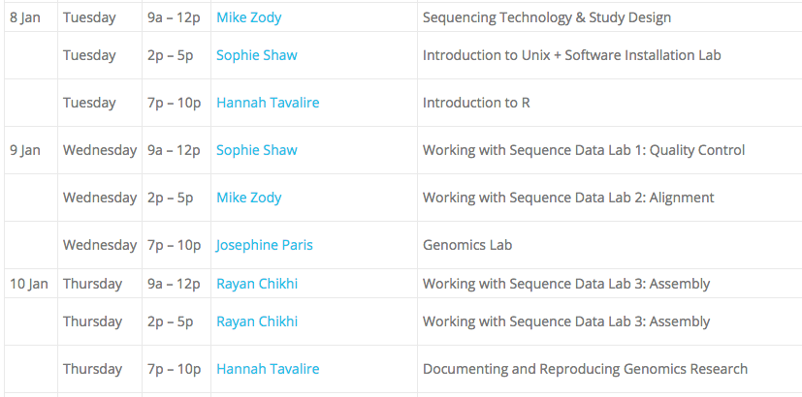
What We’re Going To Do
Introduction to the System

Slide 5
What We’re Going To Do
What is Sequence Data?

Slide 6
What We’re Going To Do
When You Have a Reference
Genome

Slide 7
What We’re Going To Do
Bringing it all together into a workflow

Slide 8
What We’re Going To Do
When You Don’t Have a Reference
Genome

Slide 9
What We’re Going To Do
Being a Good Bioinformatician

Slide 10

Good Workshop Practice
PowerPoint interspersed with Challenges
Ask lots of questions!
Work together
Take breaks
Cheat!

Slide 11
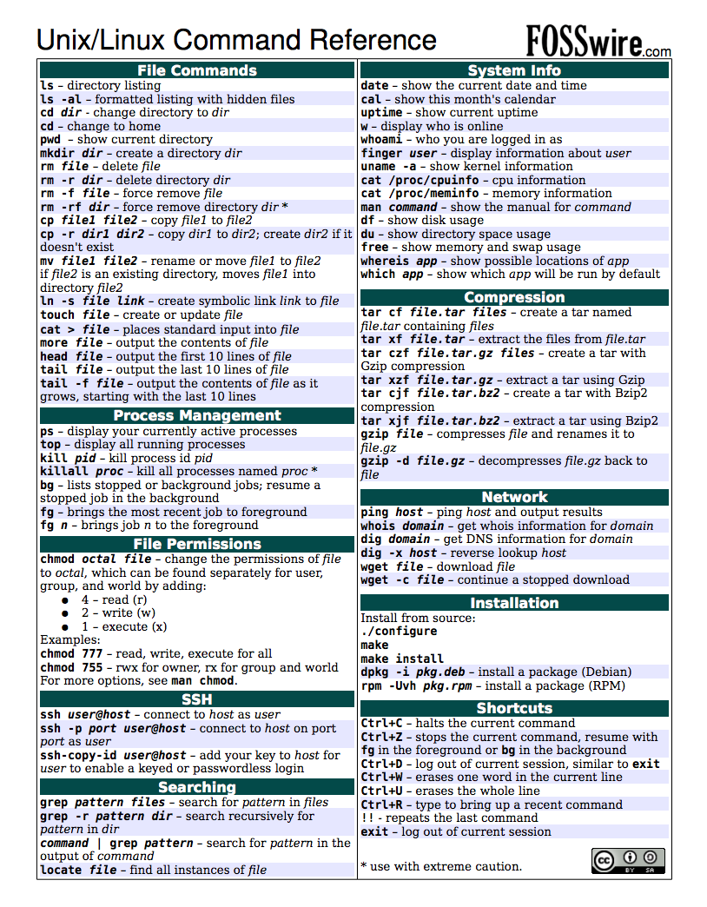

Slide 12


Watching vs Doing
Listen when you see this cat
Do when you see this cat

Slide 13

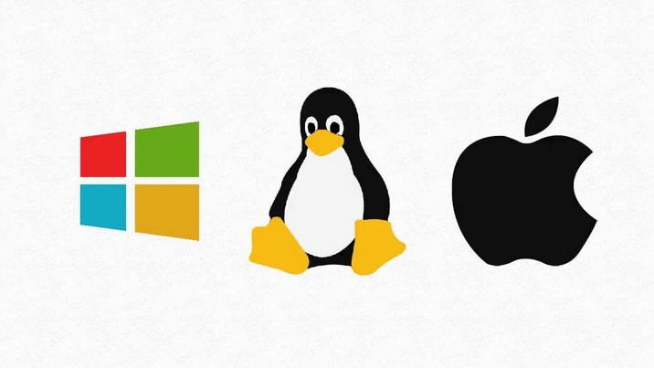
What is Unix?
Operating System

Slide 14
Why Unix?
Bioinformatics software designed to run on Unix platforms.
Large amounts of data.
Much faster than your Windows PC.

Slide 15

How Can We Use Unix?
Linux computers or servers.
Compute clusters.
The cloud.
  What we’re going to use this week

Slide 16
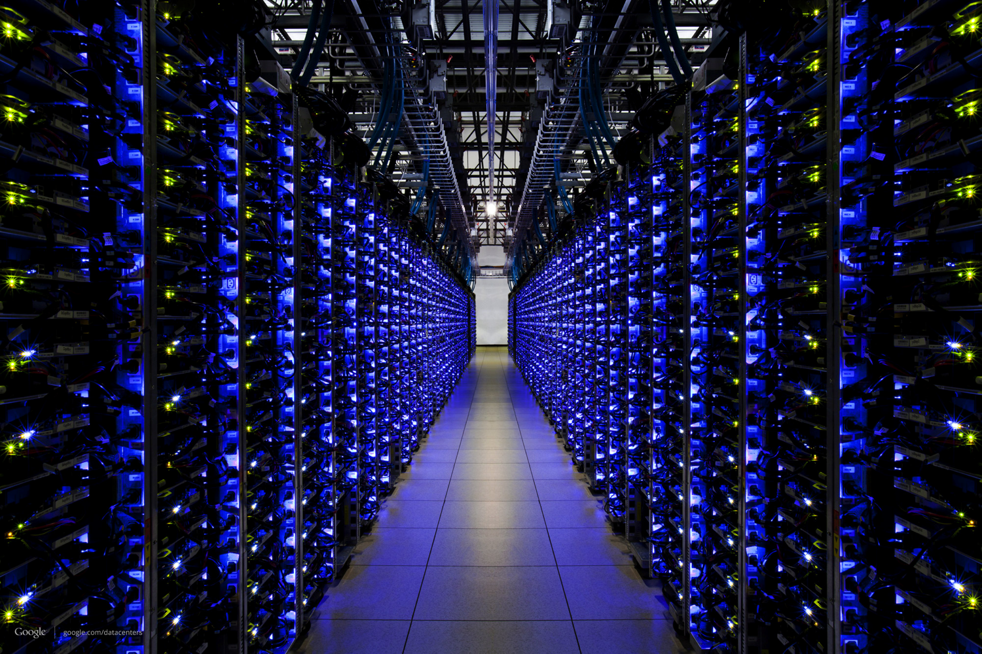

Slide 17



Cloud Computing Solutions

Slide 18
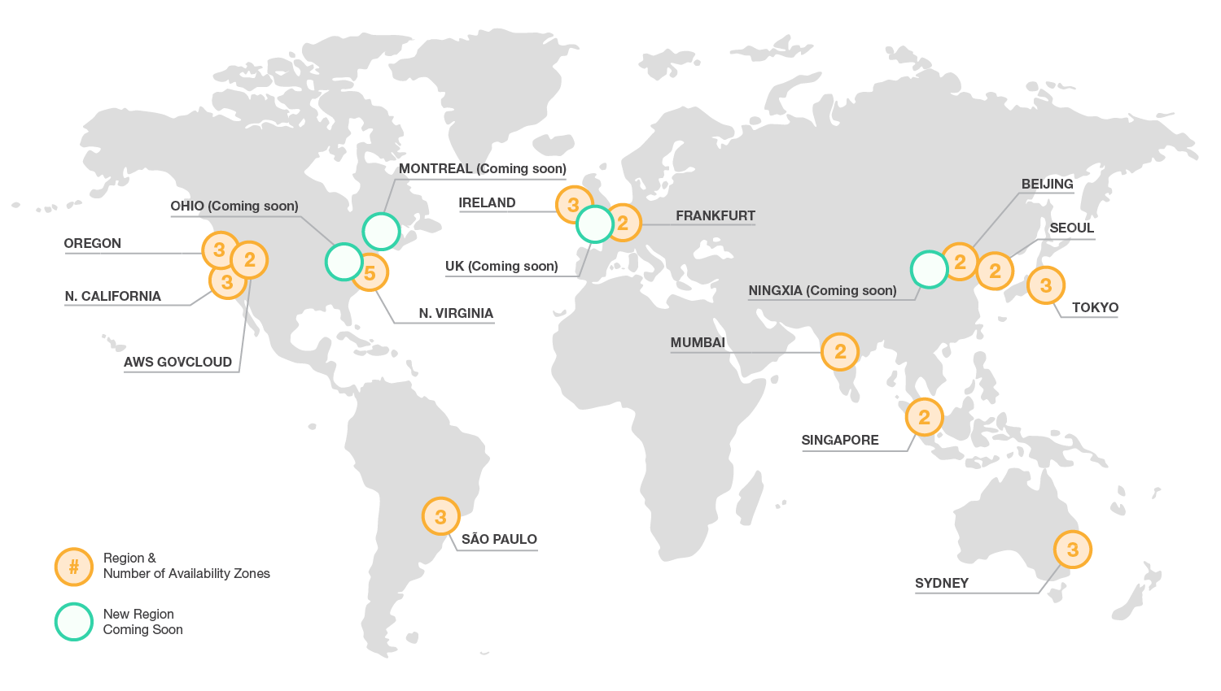
AWS “Availability Zones” and Data Centres

Slide 19
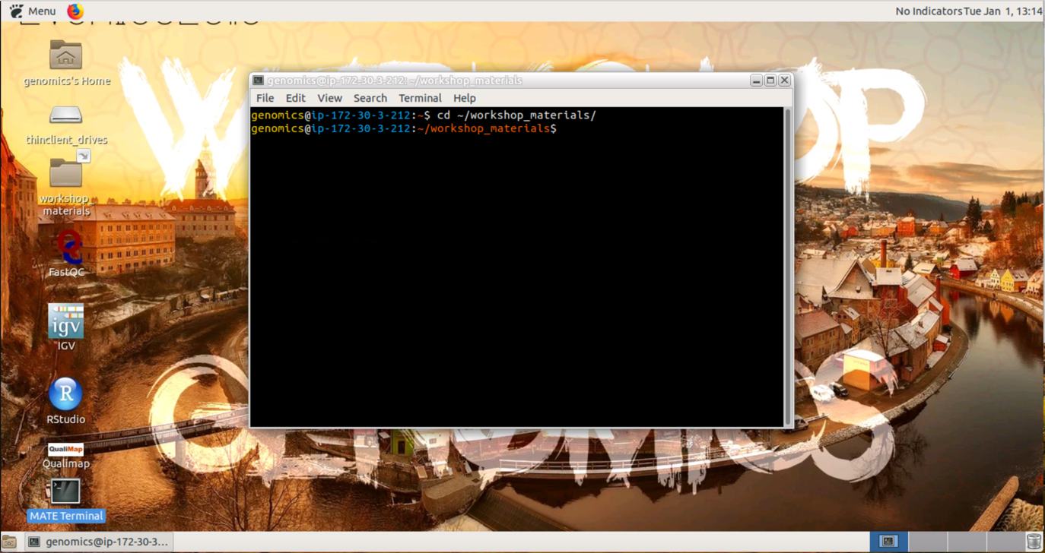

How it Works
AMI (“Amazon Machine Image”)
Base computer with all data and software

Slide 20


How it Works
Own copy of the AMI = Instance (Virtual Machine or VM)

Slide 21
Terminology
Creating an instance – buying a brand new computer with software already installed.
Starting an instance – turning that computer on.
Stopping an instance – turning that computer off.
Terminating an instance – setting that computer on fire and throwing it out of the window.

Slide 22

Connecting to Your Instance
Remote Desktop Software
e.g. Guacamole or X2Go
Secure Shell – “SSH”
e.g. SSH or PuTTY

Slide 23

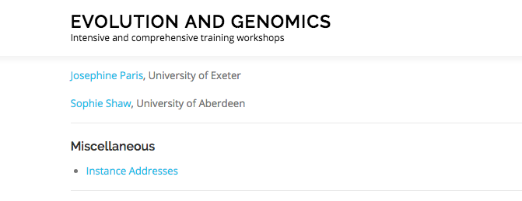
http://evomics.org/workshops/workshop-on-genomics/2019-workshop-on-genomics-cesky-krumlov/

Slide 24
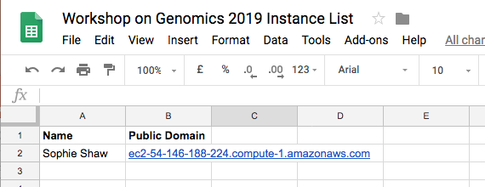
Find your name and copy your public domain

Slide 25
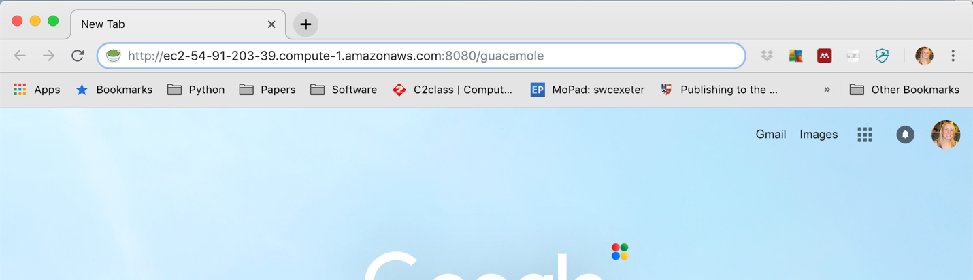
Open your internet browser
(e.g Google Chrome)
Paste the public domain followed by :8080/guacamole
Example:
ec2-54-91-203-39.compute-1.amazonaws.com:8080/guacamole

Slide 26
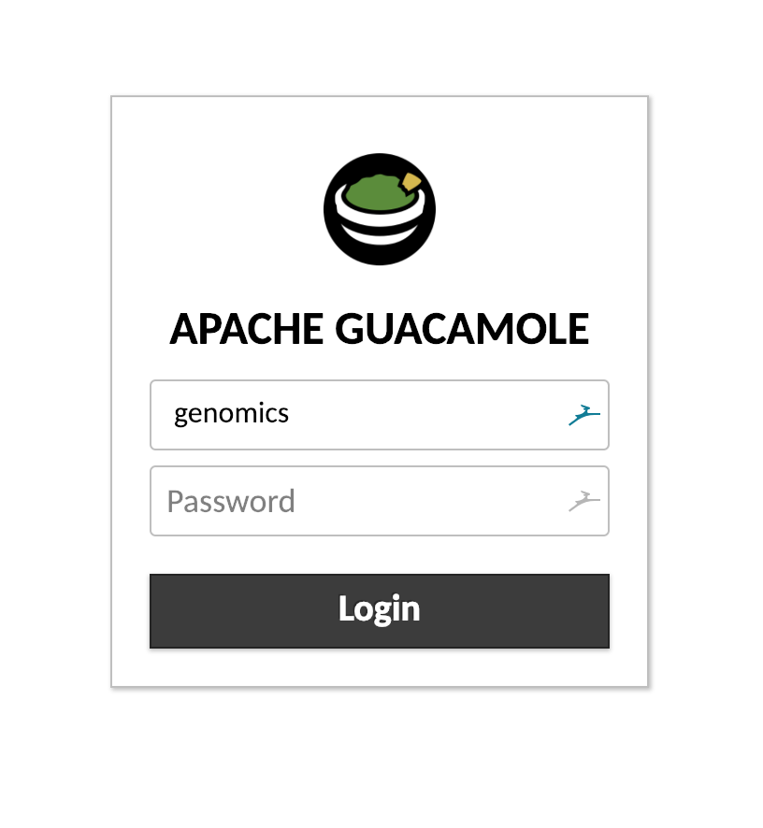
Enter the username “genomics” and password

Slide 27
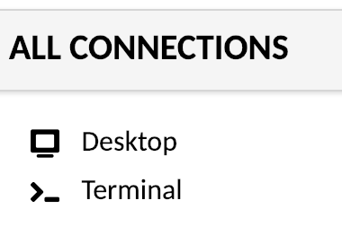
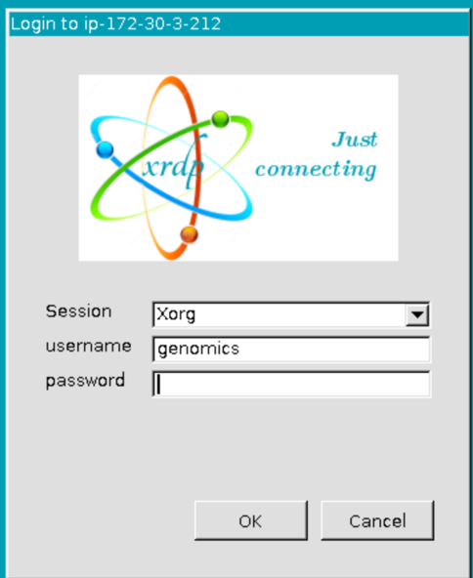
Select Desktop
Enter the username “genomics” and password again

Slide 28

Open a Terminal Window using this icon

Slide 29
You’re now connected and you’re ready to learn some Unix!

Slide 30
But First…
The domain address will change every day after we stop and re-start the instances.
Each morning, you will need to return to the “Instance List” webpage, retrieve your new address and log in again

Slide 31
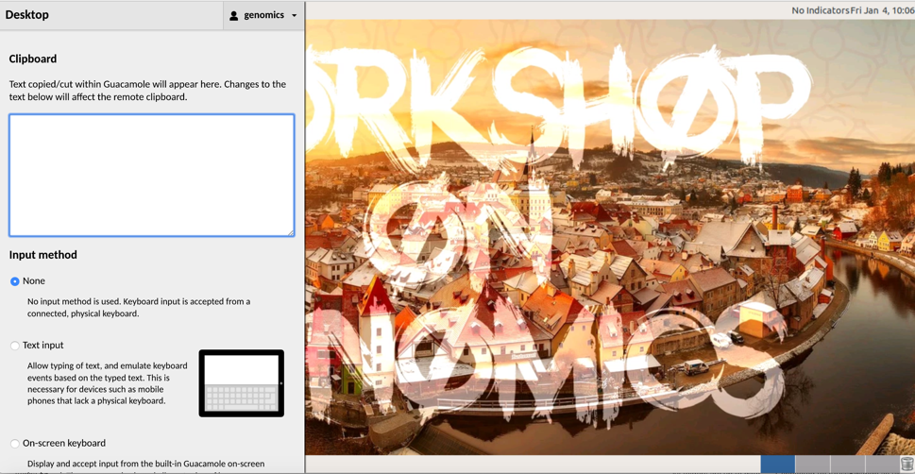
Copying and Pasting
AVOID COPYING AND PASTING WHEREVER POSSIBLE!
But if you do need to…
Press Ctrl+Alt+Shift
Paste the text into the box with right click -> Paste
Press Ctrl+Alt+Shift again
You can now paste into the instance using right click

Slide 32
Your final task before we get started!
Make sure that typing tilde (~), backslash (\), and carat (^) in the terminal works.
If this isn’t working, get the attention of an instructor!

Slide 33
Any Questions So Far?

Slide 34
The Terminal
The Command Line, The Shell, The Prompt
Where you see this “$” followed by text, I want you to type the text on your command line

Slide 35
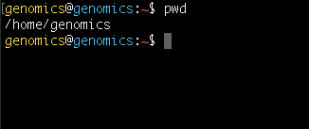
Location is Important
First Task – Where am I?
$ pwd
This is your “present working directory”.

Slide 36
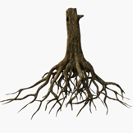

/
= ROOT
…
home
bin
lib
genomics
master
ubuntu

Slide 37
/
…
home
bin
lib
genomics
master
ubuntu

Slide 38

/
…
home
bin
lib
~
genomics
master
ubuntu
This location is also known as your Home Directory
Tilde is shorthand for Home ~

Slide 39
Now let’s create some directories
and files
Make a directory
$ mkdir Data
Change into this directory
$ cd Data
Now what is your present working directory?
NOTE! Directory names (and file names for the matter) can not contain spaces.
Underscores are often used instead if you want to separate words.

Slide 40

/
…
home
bin
lib
genomics
master
ubuntu
~
Data

Slide 41
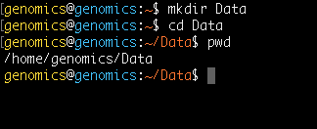
/
…
home
bin
lib
genomics
master
ubuntu
~
Data

Slide 42
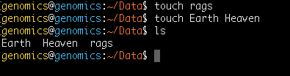
Now let’s create some directories
and files
Make an empty file
$ touch rags
And another two
$ touch Earth Heaven
Now let’s list the contents of the current directory (Data)
$ ls

Slide 43


home
genomics
master
ubuntu
~
Data
rags
Earth
Heaven

Slide 44

home
genomics
master
ubuntu
~
Data
Now list ALL of the files
$ ls -a
rags
Earth
Heaven

Slide 45
home
genomics
master
ubuntu
~
Data
Now list ALL of the files
$ ls -a
rags
Earth
Heaven
..
.

Slide 46
..
home
..
..
..
genomics
master
ubuntu
~
..
Data
These special files are in every directory
.. Points to one directory above
. Points to the current directory
rags
Earth
Heaven

Slide 47
.
home
.
.
.
genomics
master
ubuntu
~
.
Data
These special files are in every directory
.. Points to one directory above
. Points to the current directory
rags
Earth
Heaven

Slide 48

. and .. are used for specifying location
Whenever you do anything on Unix
(move around, move a file, rename a file etc…)
You have to tell the system where that thing is using a path
. and .. are part of RELATIVE paths

Slide 49
home
genomics
master
ubuntu
Moving from Data to New
RELATIVE PATH
~
Data
New
$ cd ../New

Slide 50
home
genomics
master
ubuntu
Moving from Data to New
RELATIVE PATH
~
Data
New
$ cd ../New

Slide 51
home
genomics
master
ubuntu
Moving from Data to home
RELATIVE PATH
~
Data
New
$ cd ../../

Slide 52
home
genomics
master
ubuntu
Moving from Data to home
RELATIVE PATH
~
Data
New
$ cd ../../

Slide 53
Relative paths will always change
depending on your location.
The alternative is ABSOLUTE paths.
These always start from root and will never change.

Slide 54
/
= ROOT
…
home
bin
lib
genomics
master
ubuntu
Moving from Data to New
ABSOLUTE PATH
~
Data
New
$ cd /home/genomics/New

Slide 55
/
= ROOT
…
home
bin
lib
genomics
master
ubuntu
Moving from Data to New
ABSOLUTE PATH
~
Data
New
$ cd /home/genomics/New

Slide 56
/
= ROOT
…
home
bin
lib
genomics
master
ubuntu
Moving from Data to home
ABSOLUTE PATH
~
Data
New
$ cd /home/

Slide 57
/
= ROOT
…
home
bin
lib
genomics
master
ubuntu
Moving from Data to home
ABSOLUTE PATH
~
Data
New
$ cd /home/

Slide 58
A Note About Dot!
. means “In your pwd …”
This command means “List everything that’s in the pwd”
This command means “List everything that’s in the pwd within a sub-directory called Data”
$ ls ./
$ ls ./Data/
In most cases, people don’t use ./ at the beginning of a path. As long as the file/directory is within your pwd, the command will work.
=
$ ls ./Data/
$ ls Data
Dot is most helpful when you want to “copy a file to your pwd”
…But we’ll talk about this more later!

Slide 59
Let’s put this to practice
Where am I right now? (Should be the Data directory)
$ pwd
Change to the directory above
$ cd ../
Let’s list the contents of the Data directory
$ ls ./Data/
CHALLENGE 1!
Move into the Data directory and list the contents of your home directory
In Data, make a new directory and move into this location
From this new directory, move into your home directory IN ONE COMMAND and check your location

Slide 60
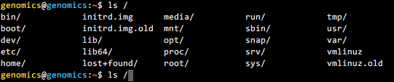
If You’re Typing, You’re Doing Something
Wrong!
Tab complete is a nice trick to save you typing paths
For this example we are going to list everything in the directory
/home/genomics/workshop_materials/
Start by typing:
Followed by tab twice quickly
$ ls /
This shows the contents of the root directory

Slide 61
If You’re Typing, You’re Doing Something
Wrong!
Now type:
$ ls /h
Followed by tab once. The path to the /home/ directory has filled in.
$ ls /home/
Now type:
$ ls /home/g
Followed by tab once. The path to the /home/genomics/ directory has filled in.
$ ls /home/genomics
Finally type:
$ ls /home/genomics/w
Followed by tab once to finish the path, and then enter.
You’ve now listed that directory contents.
Tab complete will fill in paths, save you time in typing
and prevent typos!

Slide 62

If You’re Typing, You’re Doing Something
Wrong!
Two more tricks for less typing!
* Represents a special character
For example:
Will list everything in my home directory ending .txt
The up arrow can be used to re-run commands
Press your up arrow and see
If you want all of these commands listed, simply type
$ ls /home/genomics/*.txt
$ history

Slide 63
Any Questions So Far?

Slide 64
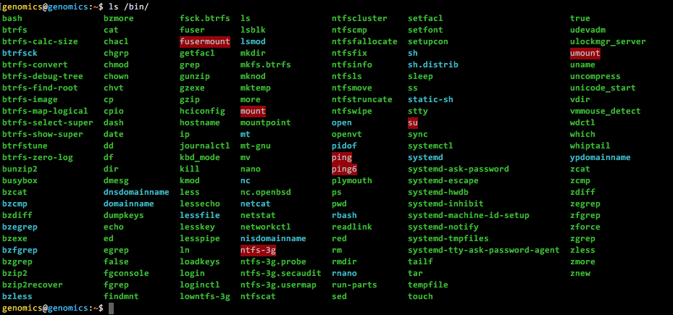
Binary programs
These are all programs installed on the Unix machine.
They can be found in /bin
$ ls /bin
These include pwd, mkdir, ls …

Slide 65
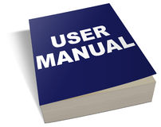
Every binary program has a
manual
To view the manual page, type man followed by the name of the program
Open the manual page for ls
Scroll through (enter) and find the options for:
long listing format (-l), human-readable sizes (-h) and sort by modification time (-t)
Exit the manual page (type q) and give these ls options a go in your Data directory
$ man <PROGRAMME>
$ man ls
$ ls –l ./Data
OR
$ ls –t ./Data
$ ls –l -h ./Data
OR
$ ls –lh ./Data
$ ls –l -h -t./Data
OR
$ ls –lht ./Data
$ ls –l –h –t -a ./Data
OR
$ ls –lhta ./Data

Slide 66
/
…
home
bin
lib
Examples!
genomics
master
ubuntu
~
First I need you to make a new directory
called “Working” within your home directory.
Afterwards your file structure should look like
this!
Data
Working
rags
Earth
Heaven

Slide 67
/
…
home
bin
lib
Moving Files
genomics
master
ubuntu
~
Lets move Heaven and Earth from Data to Working
Now move Heaven too
REMEMBER TAB COMPLETE!
$ cd ~/Data
$ mv ./Earth ../Working/
Data
Working
File Path
Location Path
rags
Earth
Heaven

Slide 68
/
…
home
bin
lib
Moving Files
genomics
master
ubuntu
~
mv can also be used to rename files
Let’s change rags to riches
Data
Working
$ mv ./rags ./riches
File Path
Location Path
rags
Earth
Heaven

Slide 69
/
…
home
bin
lib
genomics
master
ubuntu
~
Data
Working
riches
Earth
Heaven

Slide 70
/
…
home
bin
lib
Deleting Files
genomics
master
ubuntu
~
Now let’s delete Heaven
(Check your present working directory is Data)
When prompted type y for yes and press enter
Data
Working
$ rm –i ../Working/Heaven
riches
Earth
Heaven
Notes:
Describe the –I option

Slide 71
/
…
home
bin
lib
Deleting Files
genomics
master
ubuntu
~
Now let’s delete the entire Working directory
Including Earth
Data
Working
$ rm -r –i ../Working/
riches
Earth

Slide 72

/
…
home
bin
lib
Deleting Files
genomics
master
ubuntu
~
Deleting files is very dangerous! There is no recycle bin
in Unix! Once gone, files are gone for ever!
Therefore try to ALWAYS use rm –i
Data
riches

Slide 73
/
…
home
bin
lib
Copying Files
genomics
master
ubuntu
~
Let’s make a copy of riches within the home directory
(Make sure your present working directory is Data)
Data
$ cp ./riches ../
File Path
Location Path
riches

Slide 74
/
…
home
bin
lib
genomics
master
ubuntu
~
riches
Data
riches

Slide 75
/
…
home
bin
lib
Copying Files
genomics
master
ubuntu
~
You can also copy entire directories and use this function
to rename files/directories
Move to home
Make a copy of the Data directory here and call it Backup
riches
Data
$ cd ~
riches
$ cp –r ./Data ./Backup

Slide 76
/
…
home
bin
lib
genomics
master
ubuntu
~
riches
Data
Backup
riches
riches

Slide 77
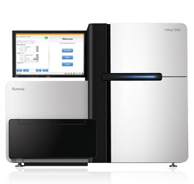
Typical File Sizes
One Sequencing Sample on the Illumina NextSeq
3,000,000 reads = 1 Gb
But typically you will sequence more than one sample
You may have different patients, different locations, replicates etc…
The size of the sequencing data file can easily become 100s of Gb
(or even bigger depending on the sequencer used)

Slide 78
Archived/Compressed Files
Commonly, people will archive directories and compress large files so that they are
easier to store or share. Here’s an example:
sequences.tar.gz
.tar – means that it is a tape archived directory
.gz – means that it is gzipped file
These can be used alone or in combination
To uncompress
A Tar Archive
(x = extract, v = verbose, f = all files)
A Gzipped file
A Gzipped Tar archive
$ tar -xvf <filename>
$ gunzip <filename>
$ tar -xzvf <filename>
Notes:
Consider where and how you are going to store all of your sequencing data
File in previous example is less than half the size once zipped.

Slide 79
Challenge 2!
Change to the workshop_materials directory at the following path:
You should find a compressed directory:
2. Make a copy of this file in the Backup directory you created earlier
3. Un archive the original directory
4. Unzip the read files
5. Rename the unarchived files – sequence_1.fq and sequence_2.fq
6. Delete the original .tar file
~/workshop_materials/unix
Sequences.tar
tar gunzip
cp mv
rm –i mkdir
cd

Slide 80
Any Questions So Far?

Slide 81
Other Cool Things Unix Can Do
Unix commands can be used to manipulate files.
Within workshop materials, there is a file called scientists.txt
cd ~/workshop_materials/unix
Use more to take a look at it.
Run the following commands and work out what cut and sort do.
cut –f 3 scientists.txt
sort –k 3 scientists.txt
These are really great with pipes… but more on that tomorrow!

Slide 82
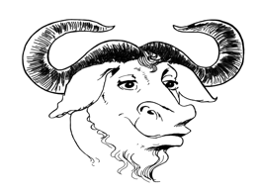


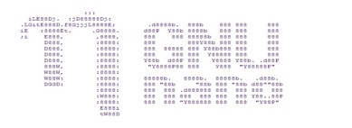
Text Editors
These are pieces of software which can be used to edit files.
Think of them as Unix versions of Notepad.
Some have an interactive user interface – E.G. gedit
Some work from within the command line – E.G. nano, vim, emacs
Use nano to open scientists.txt and add yourself to the list!
nano scientists.txt

Slide 83
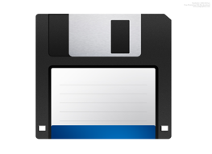

Key Nano Commands
Ctrl + O – This saves the file. You will be asked for a file name.
Type the name and press enter.
Ctrl + X – This exits nano. If the file is unsaved, you will be asked at this point if you’d like to save it.

Slide 84
Back to the AMI…
AMI (“Amazon Machine Image”)
Base computer with all data and software

Slide 85
How Do You Install Software?
Some binary programs come with Ubuntu e.g. mkdir, ls etc…
However most software for bioinformatics needs to be installed.
For this workshop, Guy has already installed everything you need, BUT
when you begin working on a different system you may need to do this.
If you’re using a shared compute resource, you’ll likely need to ask
your system administrator to do this.

Slide 86
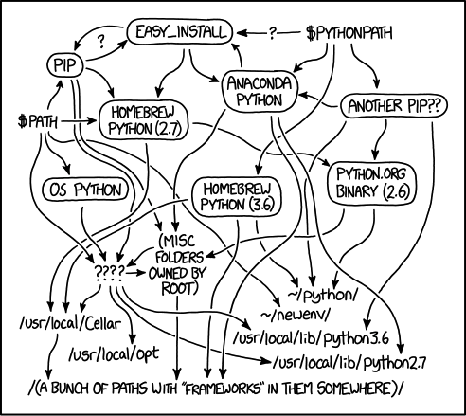
IT IS NOT AS EASY AS IT
SOUNDS
https://xkcd.com/1987/

Slide 87

Software Installation
The “get and compile” method!
Get the software from somewhere and then install in manually.
GitHub is a fantastic repository containing a lot of bioinformatics
software! It works using git so it’s easy to download.
There are others… sourceforge, personal webpages etc...
Commonly wget is used with these!

Slide 88
Challenge 3!
I want you to download and compile the software unicycler.
Here is the github page - https://github.com/rrwick/Unicycler
Make sure you are in your home directory.
Follow the instructions under “Build and run without installation”.
Take a read/glance of all of the information under “Requirements”
and “Installation” – I just want you to read here!

Slide 89

What Have We Just Done?
This has downloaded the software from github
This has changed the location to this new directory
This has COMPILED the software
But what happens if you type unicycler on the command line now?
Why!? Compiling ≠ Installing!

Slide 90
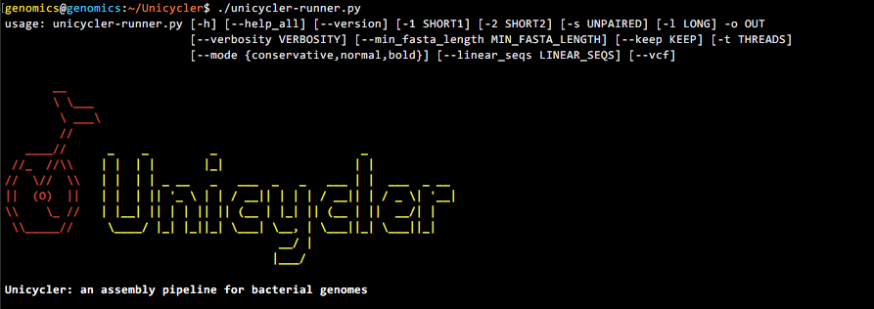
Installation
For software to be truly installed, it needs to be added to the directory
/usr/bin or /usr/local/bin
And this requires admin privileges which you don’t have!
However you can still run the newly compiled software directly by using the path:

Slide 91
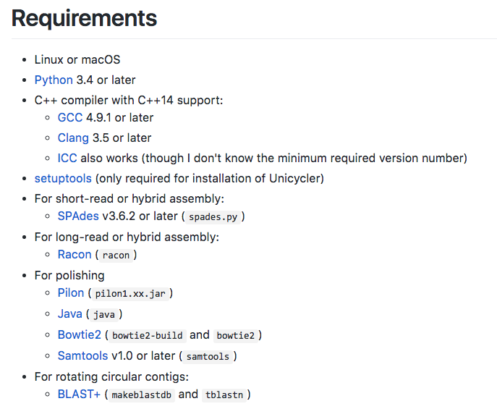
However! It still won’t work…
What! I hear you cry! Why!?

Slide 92
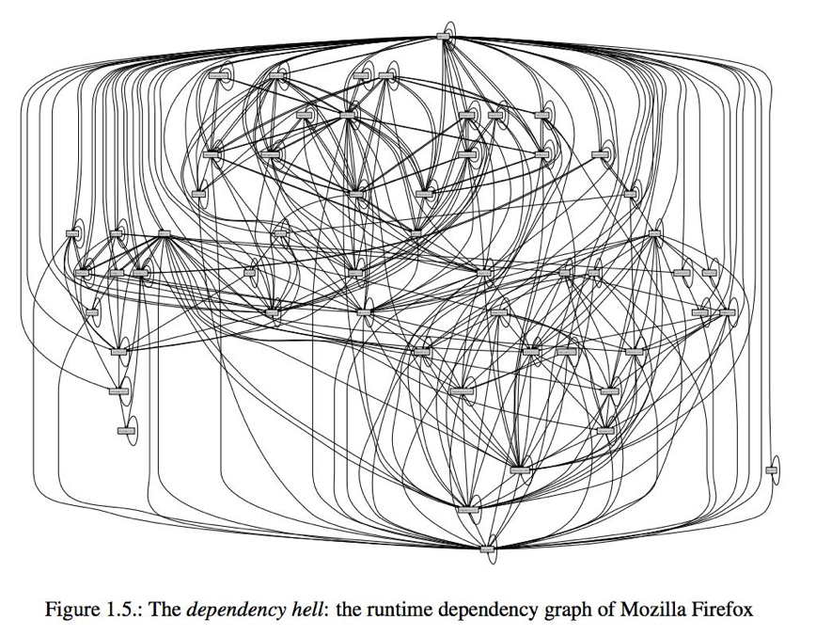
Dependencies
A lot of software needs other software to work…
Which in turn needs other software..
Which also needs other software...
https://nixos.org/~eelco/pubs/phd-thesis.pdf

Slide 93

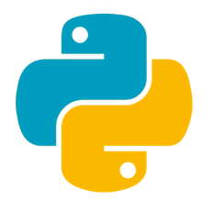


Software Managers
apt-get install
OR
yum
pip install
These are all trying to
make your life easier...
Don’t forget cpanm for perl
and install.packages() for R

Slide 94
Environments
This is your compute system.
You want to run qiime2. It’s not installed.
You’ve installed conda.

Slide 95
Environments
You use conda to create an environment for qiime2.
wget https://data.qiime2.org/distro/core/qiime2-2018.8-py35-linux-conda.yml
conda env create -n qiime2-2018.8 --file qiime2-2018.8-py35-linux-conda.yml
You then activate this environment.
source activate qiime2-2018.8

Slide 96
Environments
qiime2
(And all it’s many dependencies)
Installed and Ready to Use

Slide 97
Environments
You then deactivate this environment.
source deactivate qiime2-2018.8
qiime2 is no longer available.

Slide 98
Environments
Environments allow you to control which software
(and dependencies) are available and when.
This is particularly useful during conflicts or when you want
to use multiple versions of the same software.
Other systems such as Docker and module systems on clusters
aim to do the same thing.

Slide 99
Confused!?
Don’t worry, you aren’t the only one!
This section is just to make you aware of software installation techniques so you aren’t surprised when you get home and can’t find SAMtools on your system!

Slide 100
For after the workshop…
A Quick Guide to Organizing Computational Biology Projects.
Noble (2009) PLoS Computational Biology
http://journals.plos.org/ploscompbiol/article?id=10.1371/journal.pcbi.1000424
Best Practices for Scientific Computing.
Wilson et al. (2014) PLoS Biology
http://journals.plos.org/plosbiology/article?id=10.1371/journal.pbio.1001745
Codecademy
https://www.codecademy.com/learn/learn-the-command-line
Hackerrank
https://www.hackerrank.com/domains/shell
Lots of text books
Google!!

