Slide 1
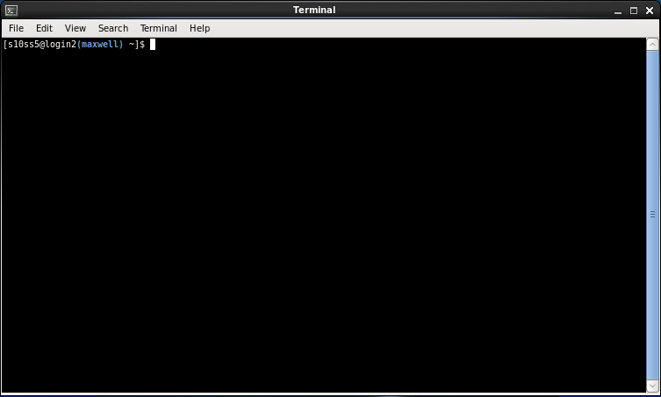
Introduction to Unix:
Getting to Grips with the Command Line
Dr. Sophie Shaw
University of Aberdeen, UK
s.shaw@abdn.ac.uk

Slide 2
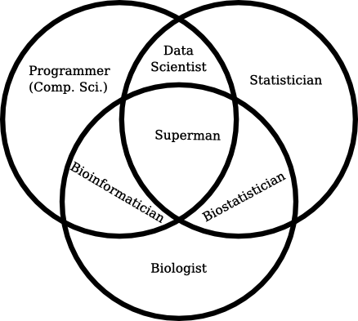


Slide 3
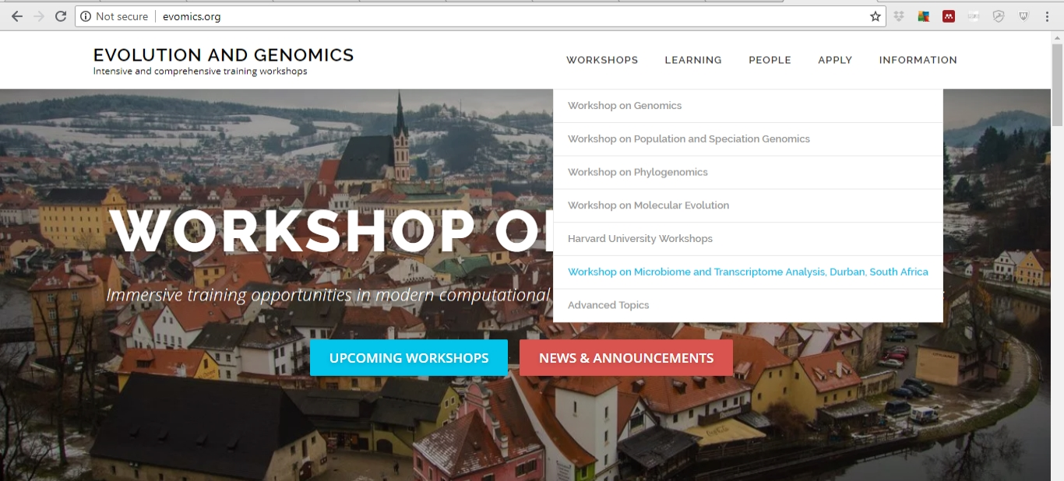
These Slides!
http://evomics.org/workshops/2019-workshop-on-microbiome-and-transcriptome-analysis-south-africa/

Slide 4
What We’re Going To Do
THIS MORNING
Getting Connected
Introduction to Unix
Software Installation
THIS AFTERNOON
Introduction to Sequencing
Checking the Quality of Sequencing Data

Slide 5

Good Workshop Practice
PowerPoint interspersed with Challenges
Ask lots of questions!
Work together
Take breaks
Cheat!

Slide 6
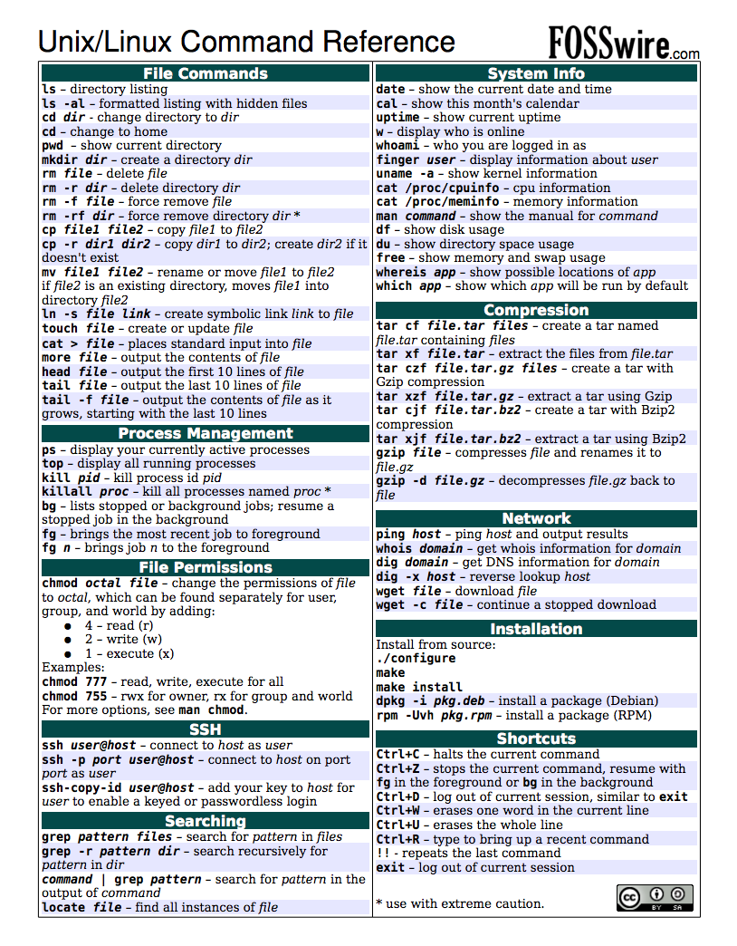

Slide 7


Watching vs Doing
Listen when you see this cat
Do when you see this cat

Slide 8

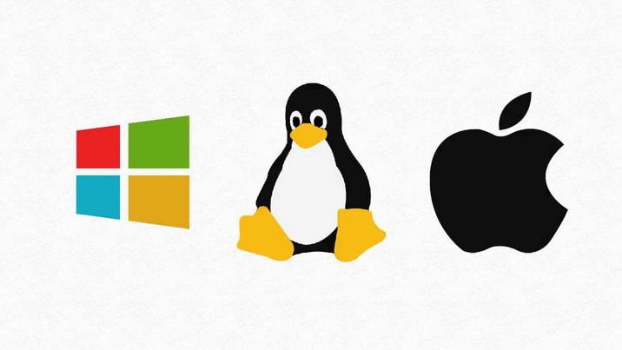
What is Unix?
Operating System

Slide 9



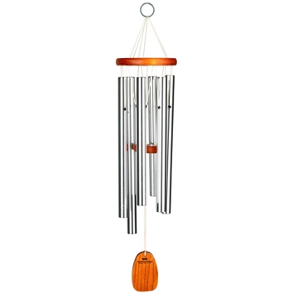



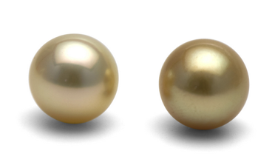
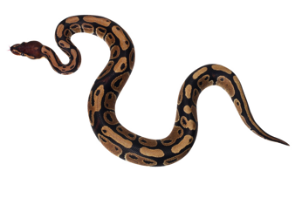
Why Unix?
Bioinformatics software designed to run on Unix platforms.
Large amounts of data.
Much faster than your Windows PC.

Slide 10

How Can We Use Unix?
Linux computers or servers.
Compute clusters.
The cloud.
  What we’re going to use this week

Slide 11
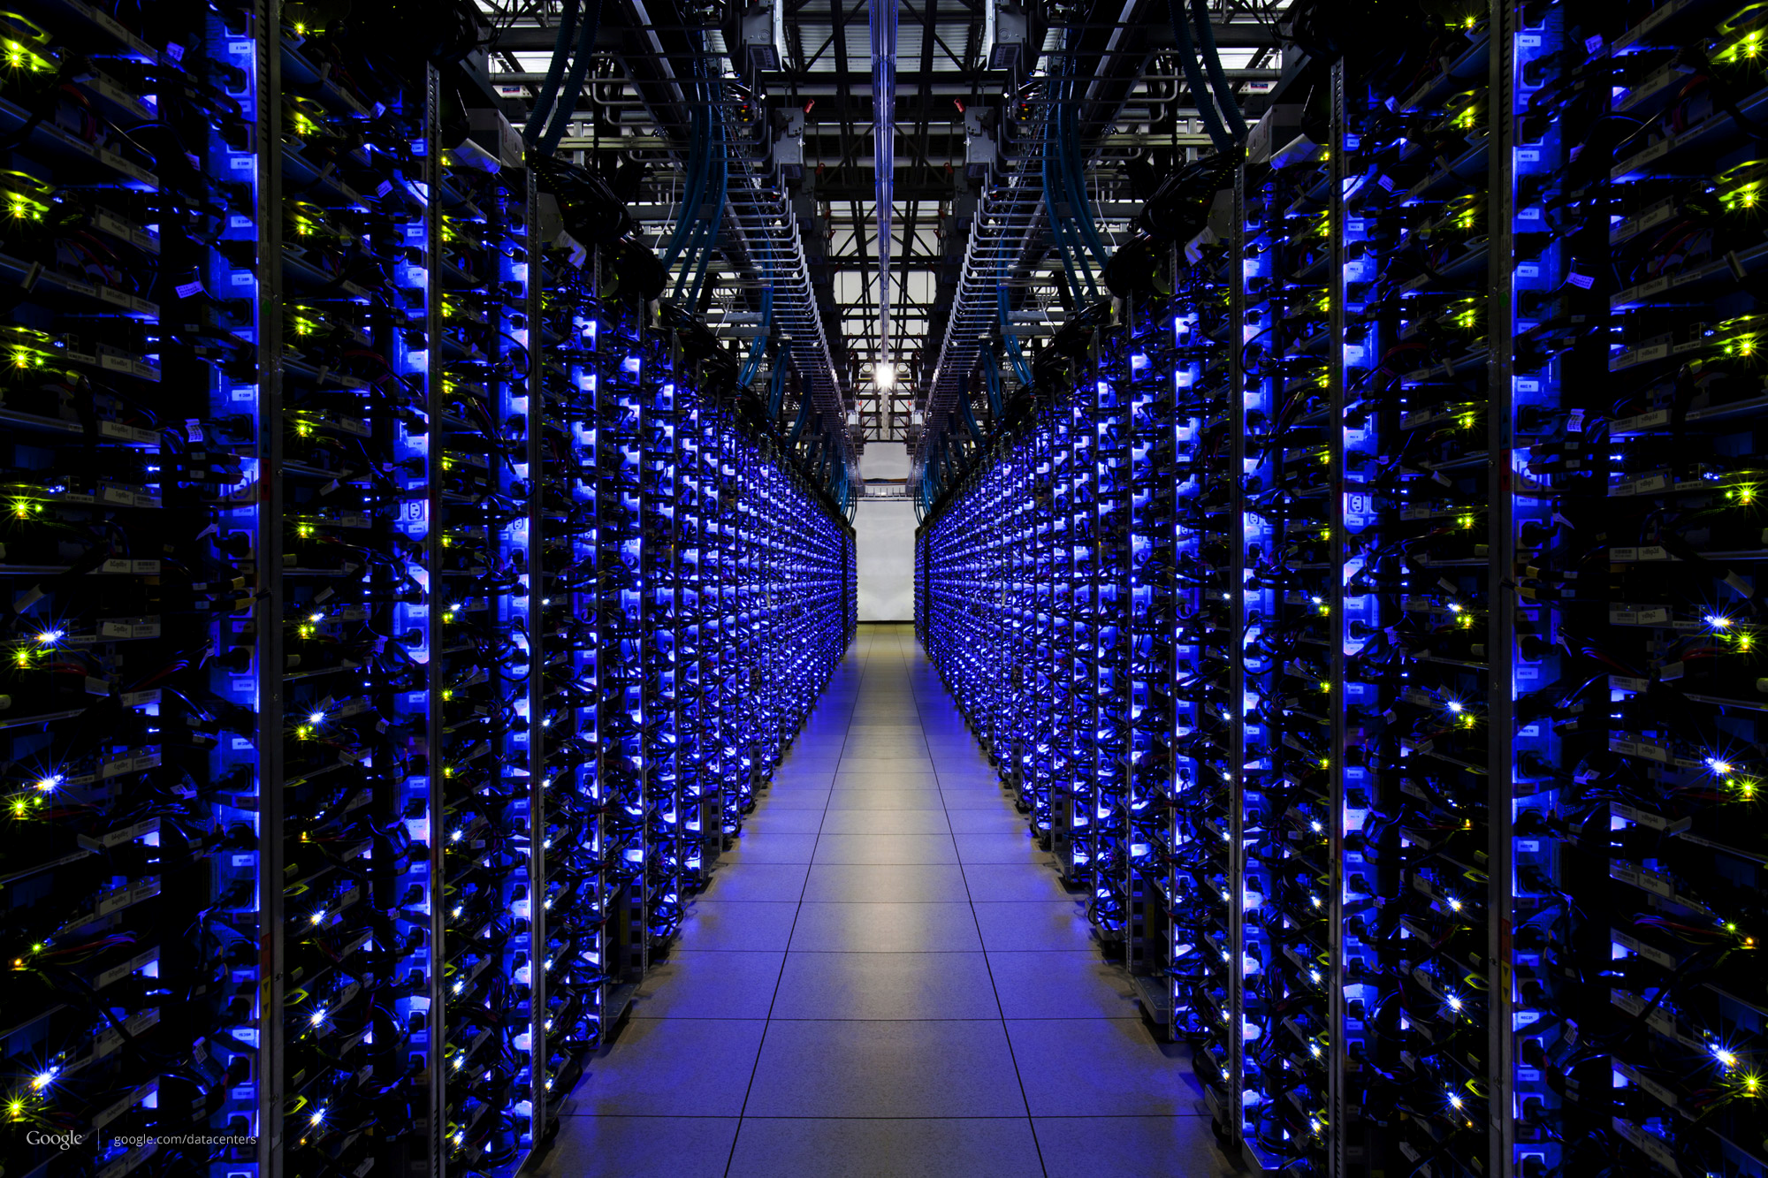

Slide 12



Cloud Computing Solutions

Slide 13
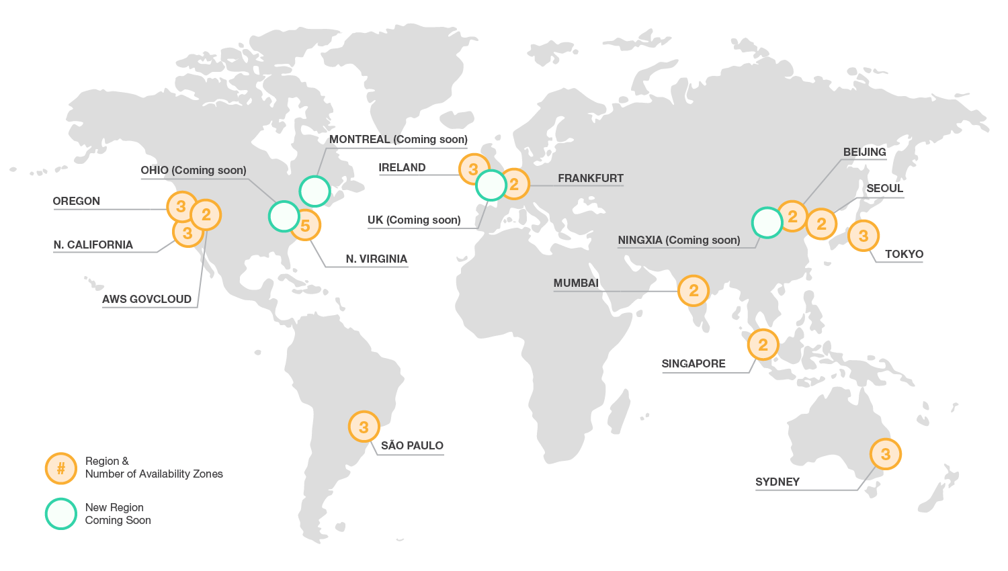
AWS “Availability Zones” and Data Centres

Slide 14
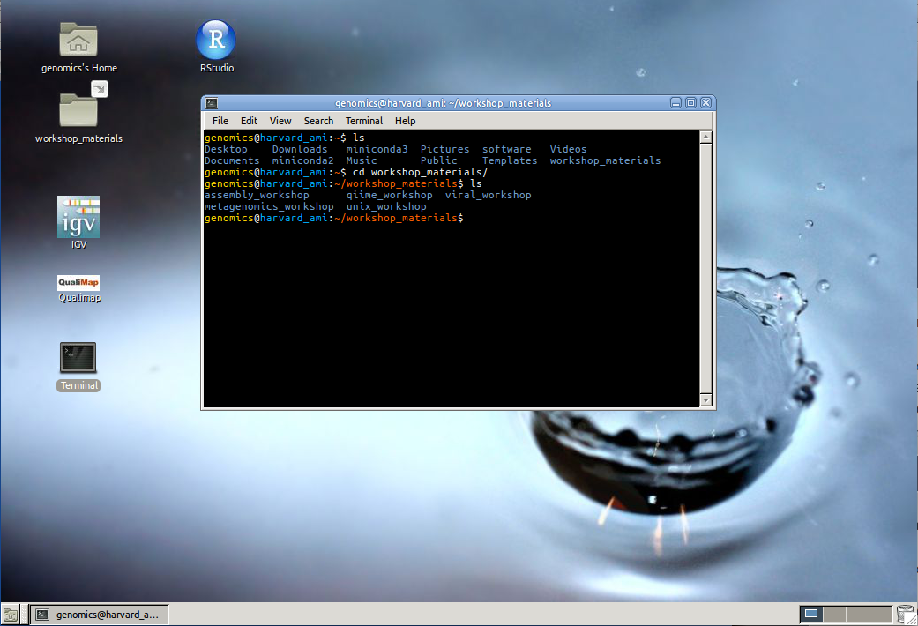
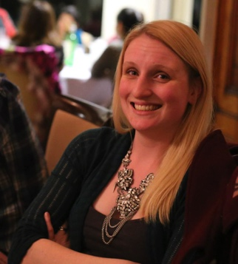

How it Works
AMI (“Amazon Machine Image”)
Base computer with all data and software

Slide 15
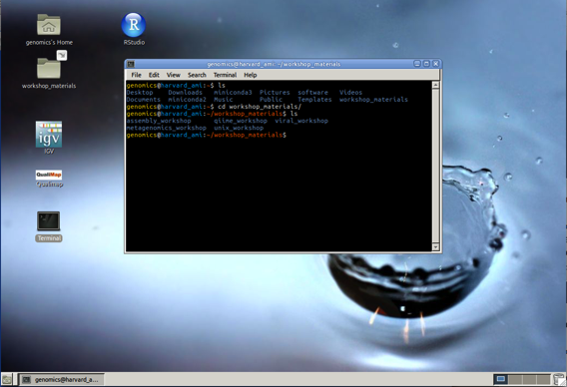

How it Works
Own copy of the AMI = Instance (Virtual Machine or VM)

Slide 16
Terminology
Creating an instance – buying a brand new computer with software already installed.
Starting an instance – turning that computer on.
Stopping an instance – turning that computer off.
Terminating an instance – setting that computer on fire and throwing it out of the window.

Slide 17



Connecting to Your Instance
Remote Desktop Software
e.g. X2Go
Secure Shell – “SSH”
e.g. SSH or PuTTY

Slide 18
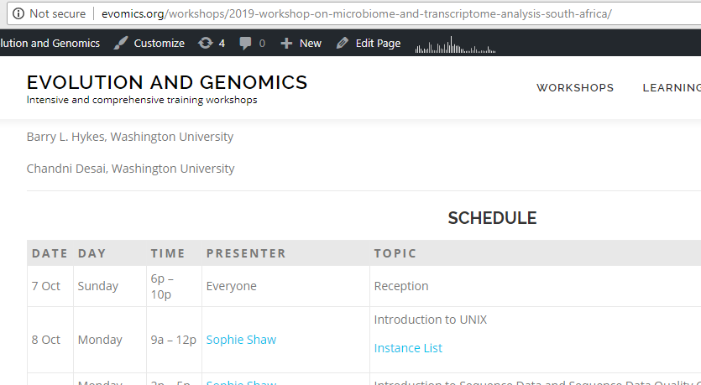
http://evomics.org/workshops/2019-workshop-on-microbiome-and-transcriptome-analysis-south-africa/

Slide 19
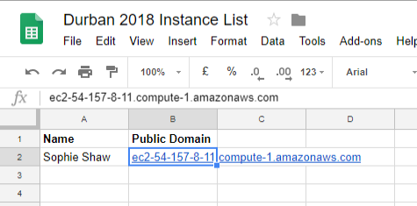
Find your name and copy your public domain

Slide 20
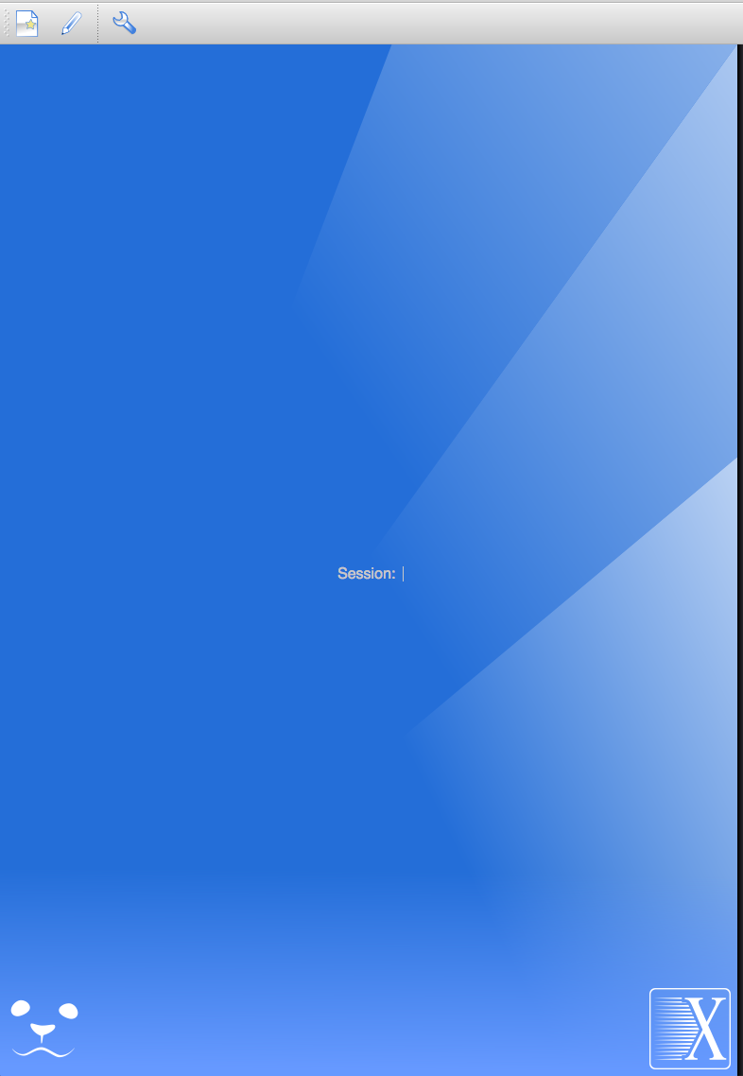

New Session

Slide 21
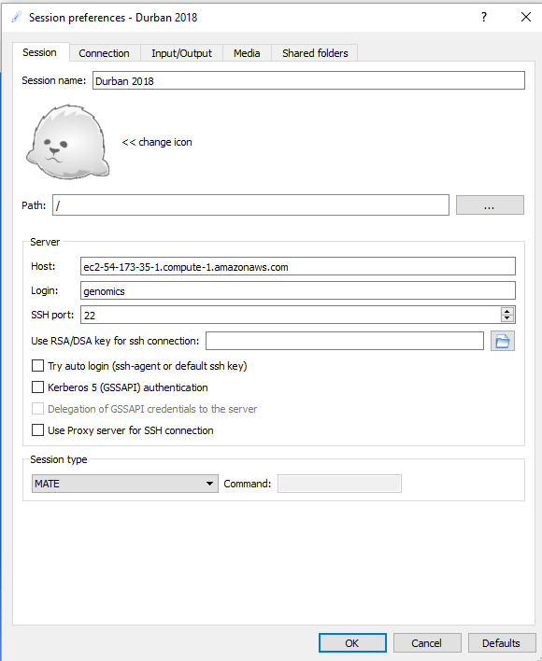
Session Name = Durban 2018
Host = Public Domain That You’ve Just Copied
Login = genomics
Session Type = MATE
Then Click “OK”

Slide 22
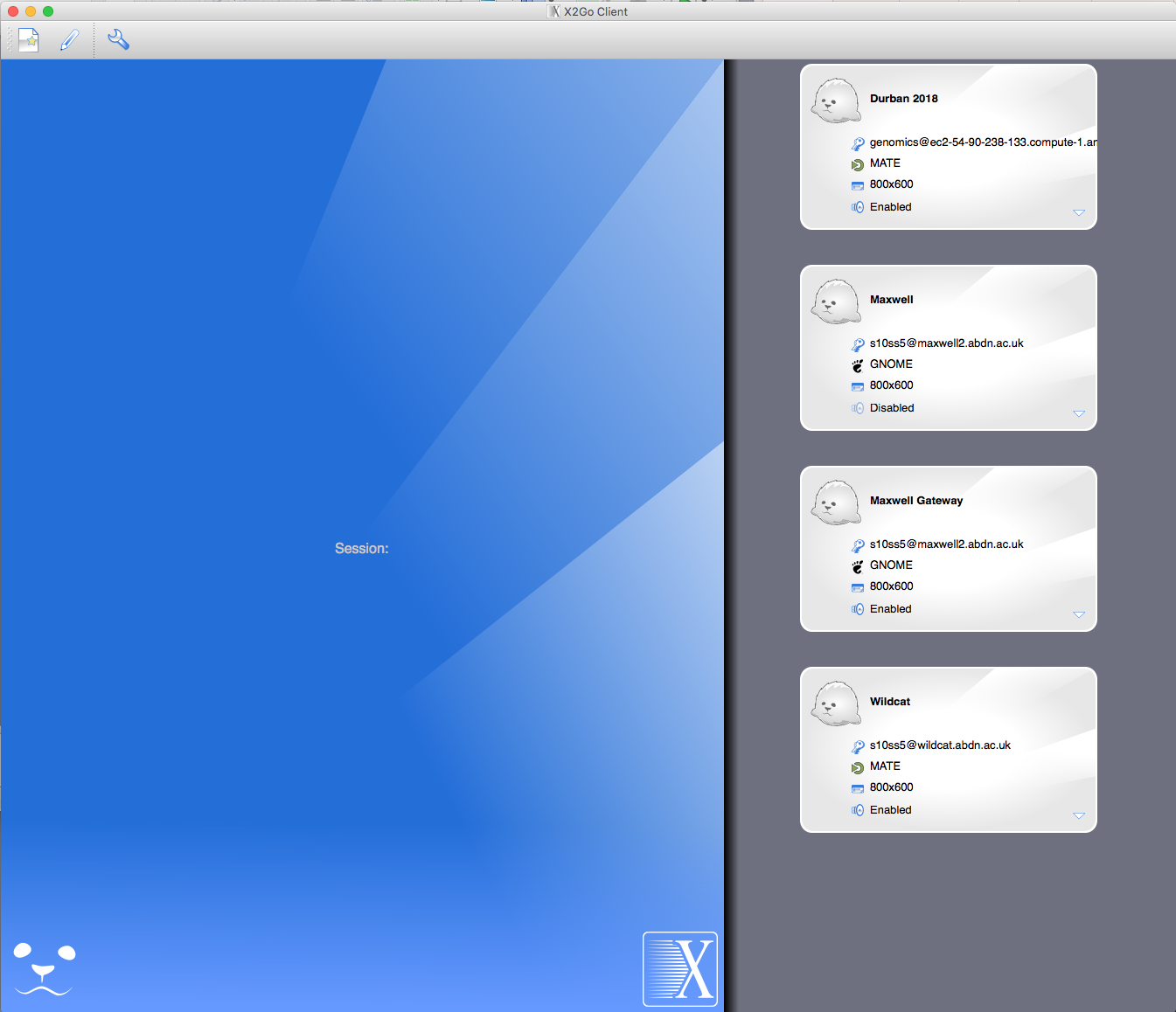

Click Here

Slide 23
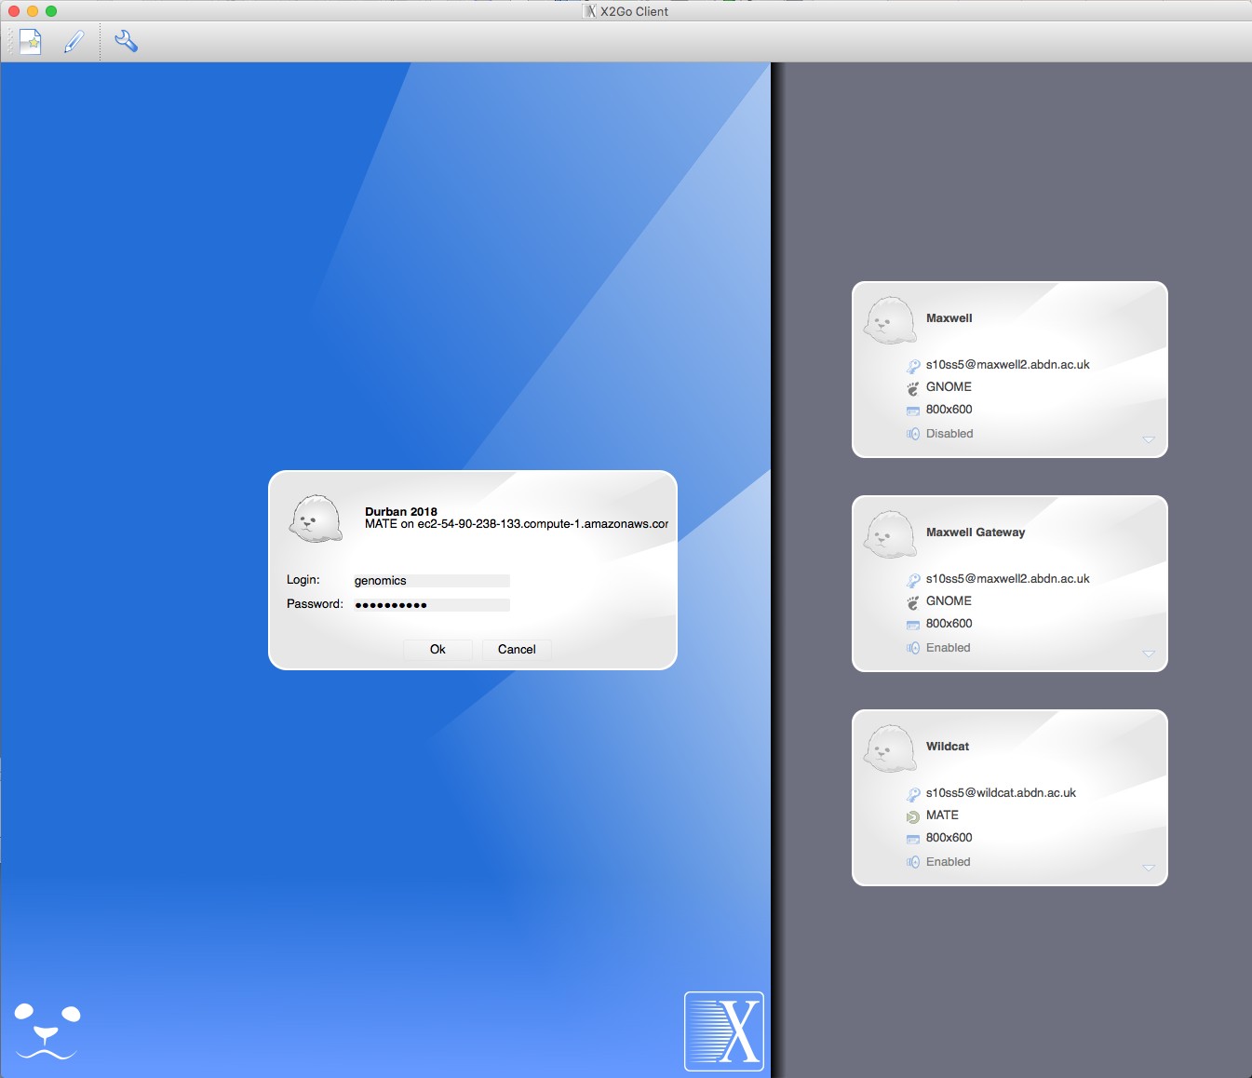
Log in using the password

Slide 24
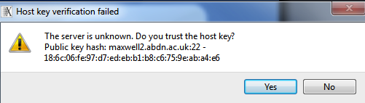
At this prompt click “Yes”

Slide 25
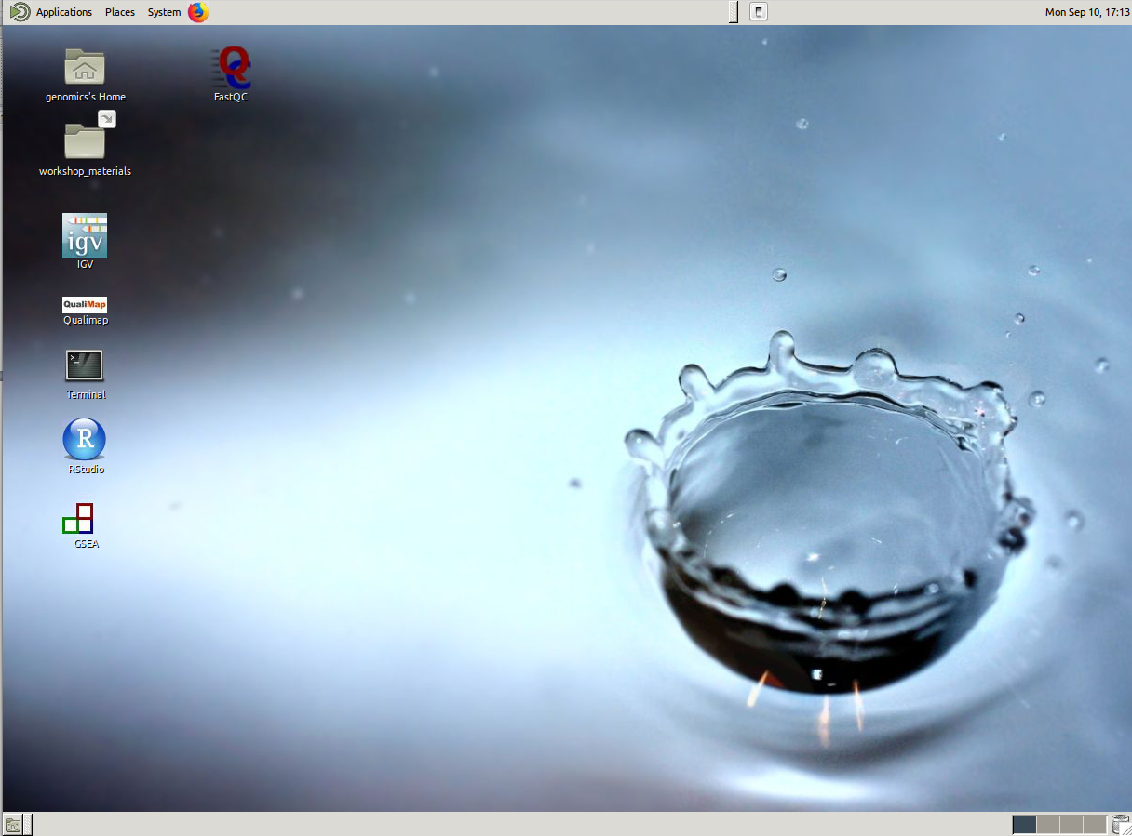
Open a Terminal Window using this icon

Slide 26
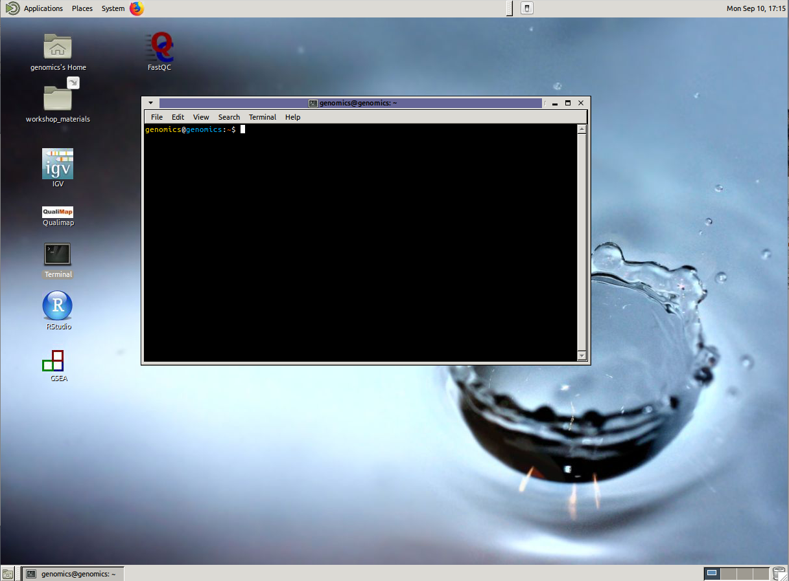
You’re now connected and you’re ready to learn some Unix!

Slide 27
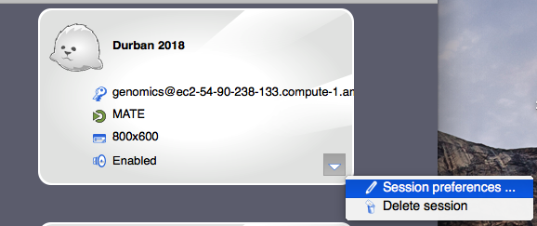
But First…
The domain address will change every day after I stop and re-start the instances.
Each morning, you will need to return to the “Instance List” webpage, retrieve your new address and update this in X2Go here:

Slide 28
Any Questions So Far?

Slide 29
The Terminal
The Command Line, The Shell, The Prompt
Where you see this “$” followed by text, I want you to type the text on your command line

Slide 30
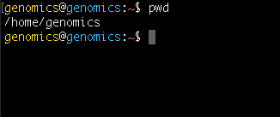
Location is Important
First Task – Where am I?
$ pwd
This is your “present working directory”.

Slide 31
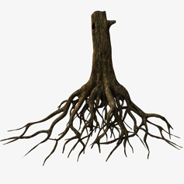

/
= ROOT
…
users
bin
lib
genomics
master
ubuntu

Slide 32
/
…
users
bin
lib
genomics
master
ubuntu

Slide 33

/
…
users
bin
lib
~
genomics
master
ubuntu
This location is also known as your Home Directory
Tilde is shorthand for Home ~

Slide 34
Now let’s create some directories
and files
Make a directory
$ mkdir Data
Change into this directory
$ cd Data
Now what is your present working directory?
NOTE! Directory names (and file names for the matter) can not contain spaces.
Underscores are often used instead if you want to separate words.

Slide 35

/
…
users
bin
lib
genomics
master
ubuntu
~
Data

Slide 36
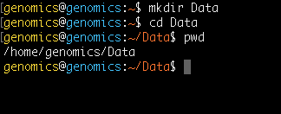
/
…
users
bin
lib
genomics
master
ubuntu
~
Data

Slide 37
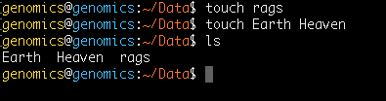
Now let’s create some directories
and files
Make an empty file
$ touch rags
And another two
$ touch Earth Heaven
Now let’s list the contents of the current directory (Data)
$ ls

Slide 38


home
genomics
master
ubuntu
~
Data
rags
Earth
Heaven

Slide 39

home
genomics
master
ubuntu
~
Data
Now list ALL of the files
$ ls -a
rags
Earth
Heaven

Slide 40
home
genomics
master
ubuntu
~
Data
Now list ALL of the files
$ ls -a
rags
Earth
Heaven
..
.

Slide 41
..
home
..
..
..
genomics
master
ubuntu
~
..
Data
These special files are in every directory
.. Points to one directory above
. Points to the current directory
rags
Earth
Heaven

Slide 42
.
home
.
.
.
genomics
master
ubuntu
~
.
Data
These special files are in every directory
.. Points to one directory above
. Points to the current directory
rags
Earth
Heaven

Slide 43

. and .. are used for specifying location
Whenever you do anything on Unix
(move around, move a file, rename a file etc…)
You have to tell the system where that thing is using a path
. and .. are part of RELATIVE paths

Slide 44
home
genomics
master
ubuntu
Moving from Data to New
RELATIVE PATH
~
Data
New
$ cd ../New

Slide 45
home
genomics
master
ubuntu
Moving from Data to New
RELATIVE PATH
~
Data
New
$ cd ../New

Slide 46
home
genomics
master
ubuntu
Moving from Data to home
RELATIVE PATH
~
Data
New
$ cd ../../

Slide 47
home
genomics
master
ubuntu
Moving from Data to home
RELATIVE PATH
~
Data
New
$ cd ../../

Slide 48
Relative paths will always change
depending on your location.
The alternative is ABSOLUTE paths.
These always start from root.

Slide 49
/
= ROOT
…
home
bin
lib
genomics
master
ubuntu
Moving from Data to New
ABSOLUTE PATH
~
Data
New
$ cd /home/genomics/New

Slide 50
/
= ROOT
…
home
bin
lib
genomics
master
ubuntu
Moving from Data to New
ABSOLUTE PATH
~
Data
New
$ cd /home/genomics/New

Slide 51
/
= ROOT
…
home
bin
lib
genomics
master
ubuntu
Moving from Data to home
ABSOLUTE PATH
~
Data
New
$ cd /home/

Slide 52
/
= ROOT
…
home
bin
lib
genomics
master
ubuntu
Moving from Data to home
ABSOLUTE PATH
~
Data
New
$ cd /home/

Slide 53
Let’s put this to practice
Where am I right now? (Should be the Data directory)
$ pwd
Change to the directory above
$ cd ../
Let’s list the contents of the Data directory
$ ls ./Data/
CHALLENGE 1!
Move into the Data directory and list the contents of your home directory
In Data, make a new directory and move into this location
From this new directory, move into your home directory IN ONE COMMAND and check your location

Slide 54

Challenge 1!
Move into the Data directory and list the contents of your home directory
$ cd Data
$ ls ..
OR
$ ls /home/genomics/
OR
$ ls ~
In Data, make a new directory and move into this location
$ mkdir new
$ cd new
From this new directory, move into your home directory IN ONE COMMAND and check your location
$ cd ../..
OR
$ cd /home/genomics/
OR
$ cd ~
OR
$ cd
$ pwd

Slide 55
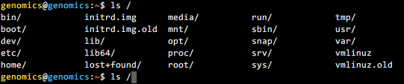
If You’re Typing, You’re Doing Something
Wrong!
Tab complete is a nice trick to save you typing paths
For this example we are going to list everything in the directory
/home/genomics/workshop_materials/
Start by typing:
Followed by tab twice quickly
$ ls /
This shows the contents of the root directory

Slide 56
If You’re Typing, You’re Doing Something
Wrong!
Now type:
$ ls /h
Followed by tab once. The path to the /home/ directory has filled in.
$ ls /home/
Now type:
$ ls /home/g
Followed by tab once. The path to the /home/genomics/ directory has filled in.
$ ls /home/genomics
Finally type:
$ ls /home/genomics/w
Followed by tab once to finish the path, and then enter.
You’ve now listed that directory contents.
Tab complete will fill in paths, save you time in typing
and prevent typos!

Slide 57
If You’re Typing, You’re Doing Something
Wrong!
Two more tricks for less typing!
* Represents a special character
For example:
Will list everything in my home directory ending .txt
The up arrow can be used to re-run commands
Press your up arrow and see
If you want all of these commands listed, simply type
$ ls /home/genomics/*.txt
$ history

Slide 58
Any Questions So Far?

Slide 59
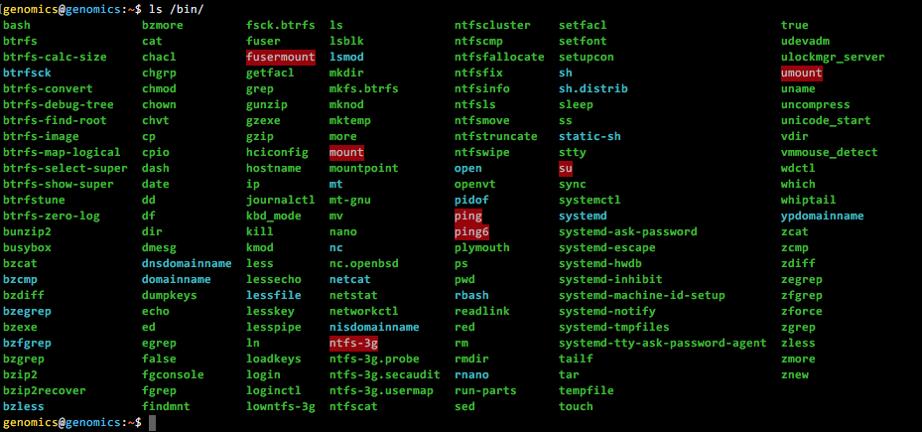
Binary programs
These are all programs installed on the Unix machine.
They can be found in /bin
$ ls /bin
These include pwd, mkdir, ls …

Slide 60
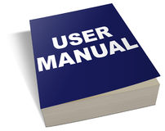
Every binary program has a
manual
To view the manual page, type man followed by the name of the program
Open the manual page for ls
Scroll through (enter) and find the options for:
long listing format (-l), human-readable sizes (-h) and sort by modification time (-t)
Exit the manual page (type q) and give these ls options a go in your Data directory
$ man <PROGRAMME>
$ man ls
$ ls –l ./Data
OR
$ ls –t ./Data
$ ls –l -h ./Data
OR
$ ls –lh ./Data
$ ls –l -h -t./Data
OR
$ ls –lht ./Data
$ ls –l –h –t -a ./Data
OR
$ ls –lhta ./Data

Slide 61
/
…
home
bin
lib
Examples!
genomics
master
ubuntu
~
First I need you to make a new directory
called “Working” within your home directory.
Afterwards your file structure should look like
this!
Data
Working
rags
Earth
Heaven

Slide 62
/
…
home
bin
lib
Moving Files
genomics
master
ubuntu
~
Lets move Heaven and Earth from Data to Working
Now move Heaven too
REMEMBER TAB COMPLETE!
$ cd ~/Data
$ mv ./Earth ../Working/
Data
Working
File
Location
rags
Earth
Heaven

Slide 63
/
…
home
bin
lib
Moving Files
genomics
master
ubuntu
~
mv can also be used to rename files
Let’s change rags to riches
Data
Working
$ mv ./rags ./riches
File
Location
rags
Earth
Heaven

Slide 64
/
…
home
bin
lib
genomics
master
ubuntu
~
Data
Working
riches
Earth
Heaven

Slide 65
/
…
home
bin
lib
Deleting Files
genomics
master
ubuntu
~
Now let’s delete Heaven
(Check your present working directory is Data)
When prompted type y for yes and press enter
Data
Working
$ rm –i ../Working/Heaven
riches
Earth
Heaven
Notes:
Describe the –I option

Slide 66
/
…
home
bin
lib
Deleting Files
genomics
master
ubuntu
~
Now let’s delete the entire Working directory
Including Earth
Data
Working
$ rm -r –i ../Working/
riches
Earth

Slide 67

/
…
home
bin
lib
Deleting Files
genomics
master
ubuntu
~
Deleting files is very dangerous! There is no recycle bin
in Unix! Once gone, files are gone for ever!
Therefore try to ALWAYS use rm –i
Data
riches

Slide 68
/
…
home
bin
lib
Copying Files
genomics
master
ubuntu
~
Let’s make a copy of riches within the home directory
(Make sure your present working directory is Data)
Data
$ cp ./riches ../
File
Location
riches

Slide 69
/
…
home
bin
lib
genomics
master
ubuntu
~
riches
Data
riches

Slide 70
/
…
home
bin
lib
Copying Files
genomics
master
ubuntu
~
You can also copy entire directories and use this function
to rename files/directories
Move to home
Make a copy of the Data directory here and call it Backup
riches
Data
$ cd ~
riches
$ cp –r ./Data ./Backup

Slide 71
/
…
home
bin
lib
genomics
master
ubuntu
~
riches
Data
Backup
riches
riches

Slide 72
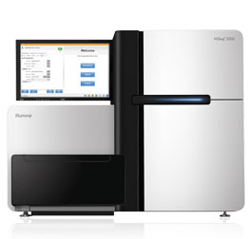
Typical File Sizes
One Sequencing Sample on the Illumina NextSeq
3,000,000 reads = 1 Gb
But typically you will sequence more than one sample
You may have different patients, different locations, replicates etc…
The size of the sequencing data file can easily become 100s of Gb
(or even bigger depending on the sequencer used)

Slide 73
Archived/Compressed Files
Commonly, people will compress large files so that they are easier to store or share
Here’s an example:
sequences.tar.gz
.tar – means that it is a tape archive
.gz – means that it is gzipped
These can be used alone or in combination
To uncompress
A Tar Archive
(x = extract, v = verbose, f = all files)
A Gzipped file
A Gzipped Tar archive
$ tar -xvf <filename>
$ gunzip <filename>
$ tar -xzvf <filename>
Notes:
Consider where and how you are going to store all of your sequencing data
File in previous example is less than half the size once zipped.

Slide 74
Challenge 2!
Change to the workshop_materials directory at the following path:
You should find a compressed directory:
2. Make a copy of this file in the Backup directory you created earlier
3. Un archive the original directory
4. Unzip the read files
5. Rename the unarchived files – sequence_1.fq and sequence_2.fq
6. Delete the original .tar file
~/workshop_materials/Unix
Sequences.tar
tar gunzip
cp mv
rm –i mkdir
cd

Slide 75
Challenge 2!
Get the File!
2. Make a copy of this file in the Backup directory you created earlier
3. Un archive the directory
4. Unzip the read files
5. Rename the unarchived files – sequence_1.fq and sequence_2.fq
6. Delete the original .tar file
cd ~/workshop_materials/Unix
$ cp Sequences.tar /home/genomics/Backup/
$ tar –xvf Sequences.tar
$ gunzip Sequences/E_coli_Sequence1.fq.gz
$ gunzip Sequences/E_coli_Sequence2.fq.gz
$ gunzip Sequences/E_coli_Sequence*
OR
$ mv Sequences/E_coli_Sequence1.fq Sequences/sequence_1.fq
$ mv Sequences/E_coli_Sequence2.fq Sequences/sequence_2.fq
$ rm –i Sequences.tar
Notes:
Mention the * options

Slide 76
Any Questions So Far?

Slide 77
Back to the AMI…
AMI (“Amazon Machine Image”)
Base computer with all data and software

Slide 78
How Do You Install Software?
Some binary programs come with Ubuntu e.g. mkdir, ls etc…
However most software for bioinformatics needs to be installed.
For this week, I’ve already installed everything you need, BUT when
you begin working on a different system you may need to do this.
If you’re using a shared compute resource, you’ll likely need to ask
your system administrator to do this.

Slide 79
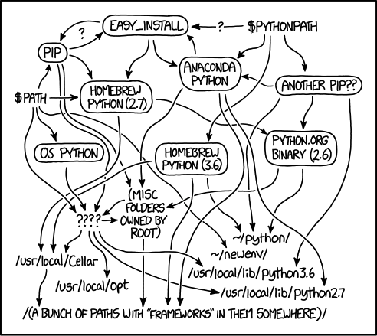
IT IS NOT AS EASY AS IT
SOUNDS
https://xkcd.com/1987/

Slide 80

Software Installation
The “get and compile” method!
Get the software from somewhere and then install in manually.
GitHub is a fantastic repository containing a lot of bioinformatics
software! It works using git so it’s easy to download.
There are others… sourceforge, personal webpages etc...
Commonly wget is used with these!

Slide 81
Challenge 3!
I want you to download and compile the software unicycler.
Here is the github page - https://github.com/rrwick/Unicycler
Make sure you are in your home directory.
Follow the instructions under “Build and run without installation”.
Take a read/glance of all of the information under “Requirements”
and “Installation” – I just want you to read here!

Slide 82

What Have We Just Done?
This has downloaded the software from github
This has changed the location to this new directory
This has COMPILED the software
But what happens if you type unicycler on the command line now?
Why!? Compiling ≠ Installing!

Slide 83
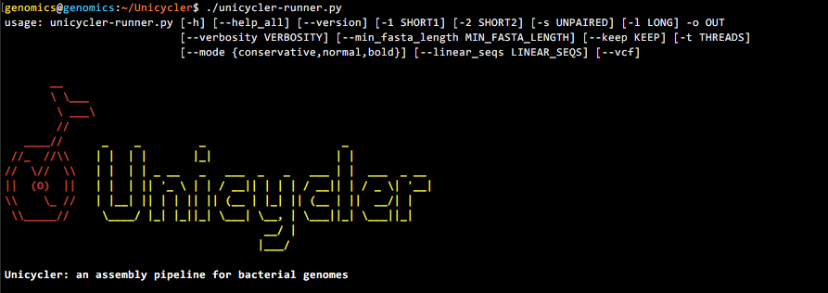
Installation
For software to be truly installed, it needs to be added to the directory
/usr/bin or /usr/local/bin
And this requires admin privileges which you don’t have!
However you can still run the newly compiled software directly by using the path:

Slide 84
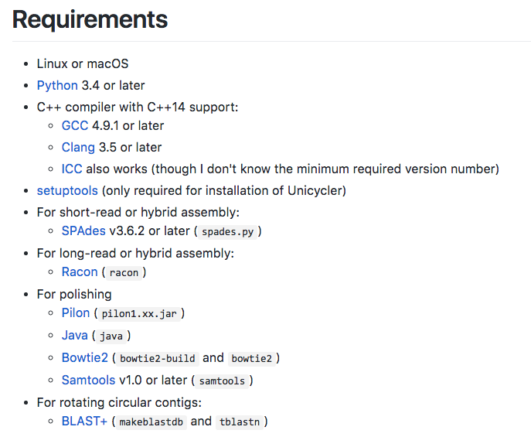
However! It still won’t work…
What! I hear you cry! Why!?

Slide 85
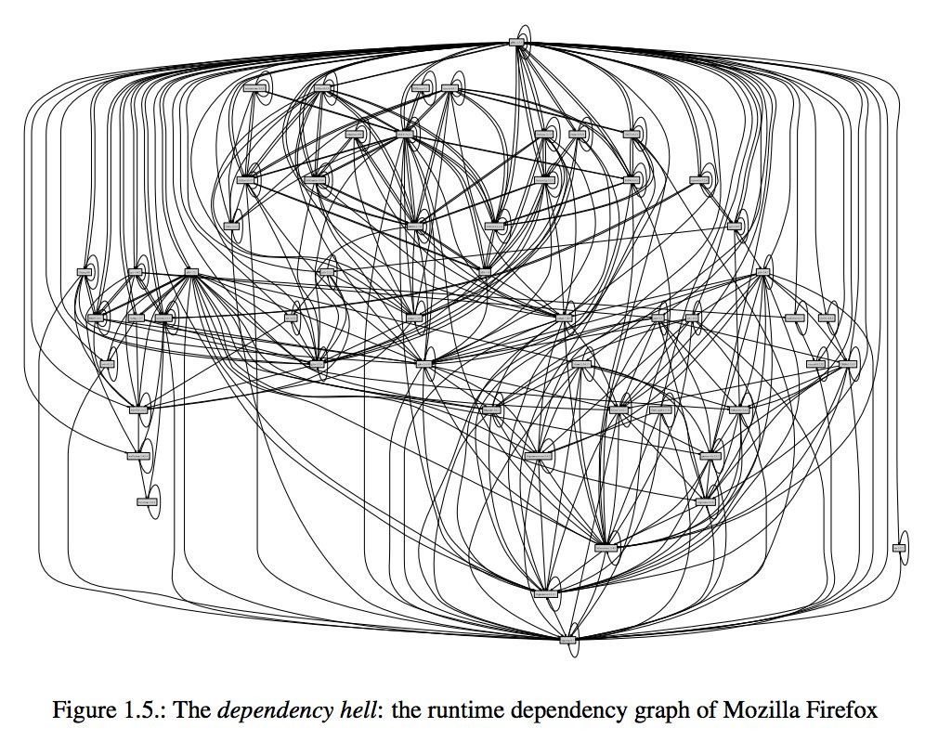
Dependencies
A lot of software needs other software to work…
Which in turn needs other software..
Which also needs other software...
https://nixos.org/~eelco/pubs/phd-thesis.pdf

Slide 86

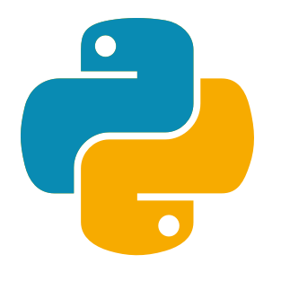


Software Managers
apt-get install
OR
yum
pip install
These are all trying to
make your life easier...
Don’t forget cpanm for perl
and install.packages() for R

Slide 87
Environments
This is your compute system.
You want to run qiime2. It’s not installed.
You’ve installed conda.

Slide 88
Environments
You use conda to create an environment for qiime2.
wget https://data.qiime2.org/distro/core/qiime2-2018.8-py35-linux-conda.yml
conda env create -n qiime2-2018.8 --file qiime2-2018.8-py35-linux-conda.yml
You then activate this environment.
source activate qiime2-2018.8

Slide 89
Environments
qiime2
(And all it’s many dependencies)
Installed and Ready to Use

Slide 90
Environments
You then deactivate this environment.
source deactivate qiime2-2018.8
qiime2 is no longer available.

Slide 91
Environments
Environments allow you to control which software
(and dependencies) are available and when.
This is particularly useful during conflicts or when you want
to use multiple versions of the same software.
Other systems such as Docker and module systems on clusters
aim to do the same thing.

Slide 92
Confused!?
Don’t worry, you aren’t the only one!
This section is just to make you aware of software installation techniques so you aren’t surprised when you get home and can’t find SAMtools on your system!

Slide 93
What We’re Going To Do
THIS MORNING
Getting Connected ✓
Introduction to Unix ✓
Software Installation ✓
THIS AFTERNOON
Introduction to Sequencing
Checking the Quality of Sequencing Data

Slide 94
For after the workshop…
A Quick Guide to Organizing Computational Biology Projects.
Noble (2009) PLoS Computational Biology
http://journals.plos.org/ploscompbiol/article?id=10.1371/journal.pcbi.1000424
Best Practices for Scientific Computing.
Wilson et al. (2014) PLoS Biology
http://journals.plos.org/plosbiology/article?id=10.1371/journal.pbio.1001745
Codecademy
https://www.codecademy.com/learn/learn-the-command-line
Hackerrank
https://www.hackerrank.com/domains/shell
Lots of text books
Google!!

