Slide 1
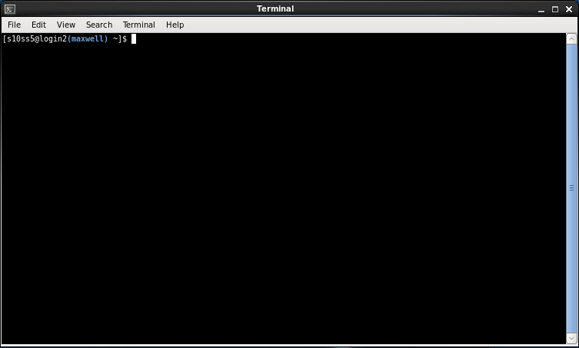
Introduction to Sequencing and Quality Control
Dr. Sophie Shaw
University of Aberdeen, UK
s.shaw@abdn.ac.uk

Slide 2

These Slides!
http://evomics.org/workshops/2019-workshop-on-microbiome-and-transcriptome-analysis-south-africa/

Slide 3
What We’re Going To Do
THIS MORNING
Getting Connected ✓
Introduction to Unix ✓
Software Installation ✓
THIS AFTERNOON
Introduction to Sequencing
Checking the Quality of Sequencing Data

Slide 4


Watching vs Doing
Listen when you see this cat
Do when you see this cat

Slide 5

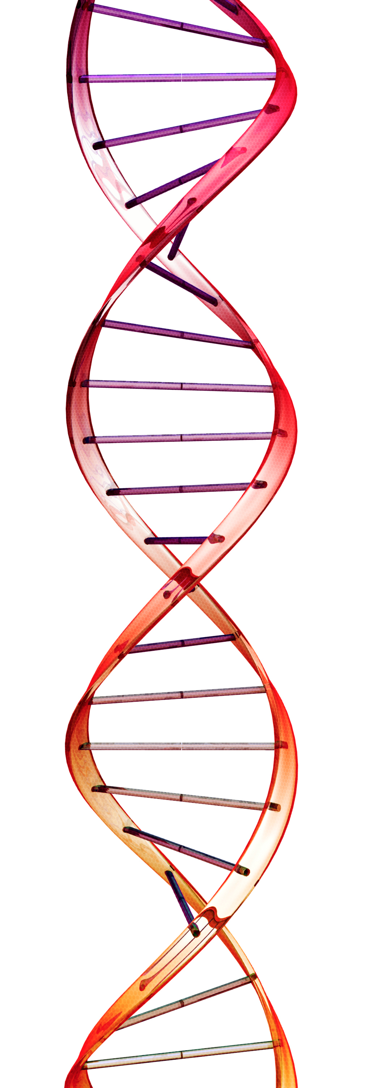
How do we study genomes?
Sequencing – determining the order of nucleotide bases to produce a REFERENCE GENOME.
A
T
T
A
G
C
A
T
A
T
A
T
C
G
T
A

Slide 6
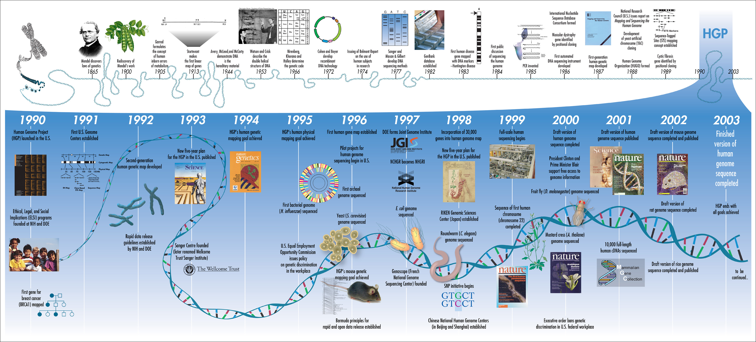
History of sequencing
Notes:
• Watson and Crick describe structure of DNA in 1953
• RNA sequencing in 1960s
• Developments in DNA sequencing in mid-1970s
• Development of chain-termination sequencing by Sanger, Nicklen and Coulson in 1977
• Planning of human genome project began in 1984

Slide 7
History of sequencing
2004 Solexa
2007 Illumina Sequencing Technologies
2005-2013 Roche 454 Sequencer
2006-~2015 ABI SOLiD Sequencer
2010 Ion Torrent
2011 Pacific Biosciences
“Second” Generation
2014 Oxford Nanopore
“Third” Generation
Notes:
• Watson and Crick describe structure of DNA in 1953
• RNA sequencing in 1960s
• Developments in DNA sequencing in mid-1970s
• Development of chain-termination sequencing by Sanger, Nicklen and Coulson in 1977
• Planning of human genome project began in 1984

Slide 8
The First Sequencers
Sanger Sequencing
Known as chain termination sequencing.
Uses a mixture of dNTP and fluorescently labelled ddNTP.
Polymerase is used to extend the DNA fragment, until a ddNTP is reached.

Slide 9
Sanger Sequencing
1. Unwind the DNA helix to get a single strand.

Slide 10
Sanger Sequencing
2. Polymerase makes a new strand based on complementary bases.
T
A
A
T
G
A
A
A
C
T
Polymerase

Slide 11

Sanger Sequencing
3. When a ddNTP is encountered, the polymerase stops.
T
A
C
T
T
A
T
G
A
A
A
C
T
Polymerase

Slide 12
Sanger Sequencing
4. Run the sequences on a gel
AT
ATA
ATAC
ATACC
ATACCG
ATACCGT
ATACCGTA…
Capillary
Electrophoresis
The shorter the
fragment,
the further it travels

Slide 13
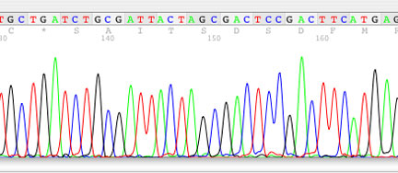
Sanger Sequencing

Slide 14
The First Sequencers
Slow ✗
Expensive ✗
Prone to error – repetitive regions ✗
Prone to bias – amplification ✗
Not high throughput ✗

Slide 15
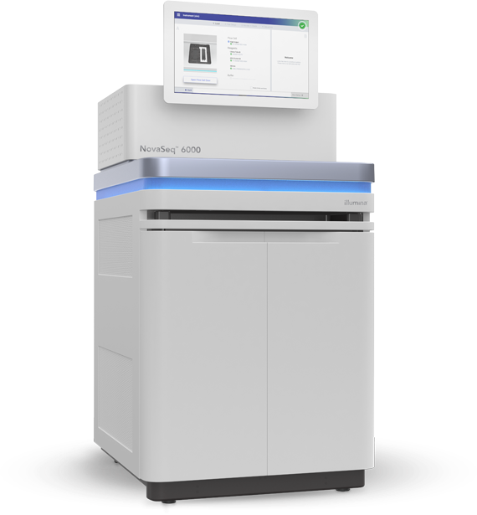
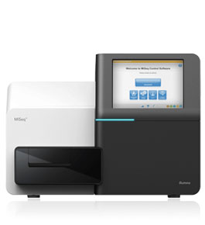
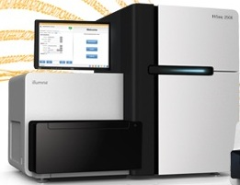
Next Generation Sequencers
Roche 454
Life Technologies SOLiD
Illumina
MiSeq
HiSeq
NovaSeq

Slide 16
How it Works
Library Preparation
Cells
DNA/ RNA
Fragmented
50 – 1000 bp
Adaptors
Amplified

Slide 17
How it Works
Sequencing
A
Laser
T
Fluorescence Recorded
G
A
A
A
C
T

Slide 18
How it Works
Sequencing
A
Laser
T
G
Fluorescence Recorded
A
A
A
C
T

Slide 19
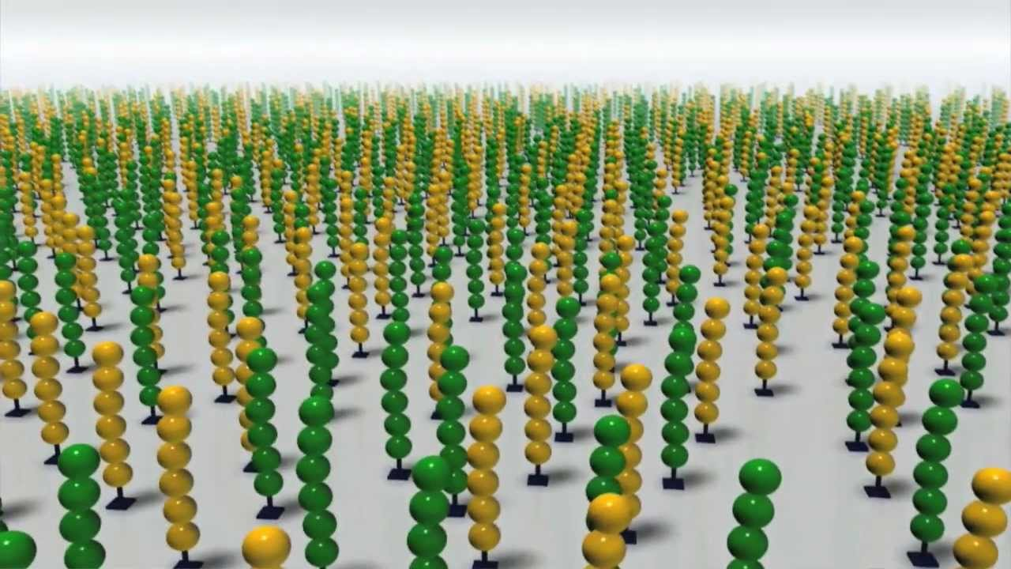
How it Works
Sequencing
Millions of “clusters”

Slide 20
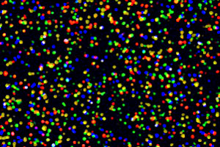
How it Works
Sequencing
Image taken at every nucleotide incorporation

Slide 21
Next Generation Sequencers
Fast ✓
Cheap ✓
High throughput ✓
Prone to error – repetitive regions ✗
Prone to bias – amplification ✗
Restricted by length ✗
Notes:
Cheap – but only if you have lots of samples
Length restriction impacts upon the analysis
Box specifies the main aims of third generation sequencers – to improve upon this.

Slide 22
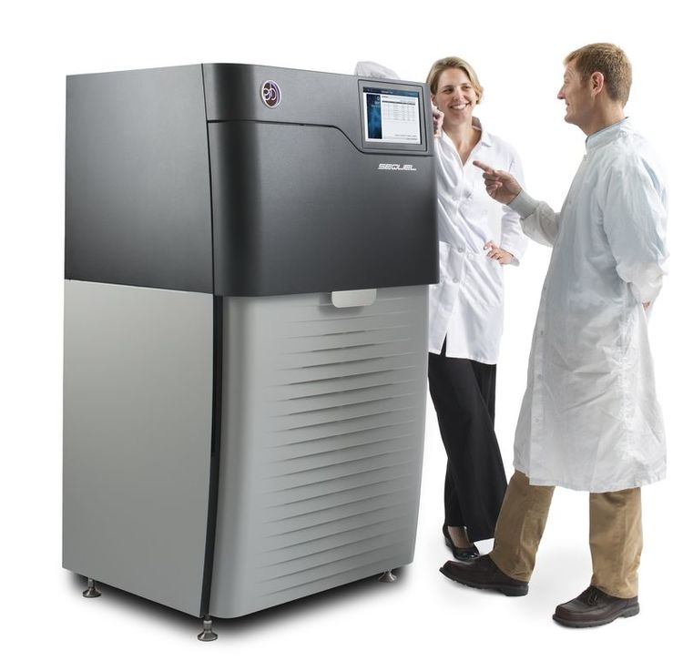
“Third” Generation Sequencers
PacBio SMRT
Single Molecule, Real-Time
Technology
Reads are held in “Zero-mode waveguides”
Signal read from DNA polymerase during DNA replication

Slide 23
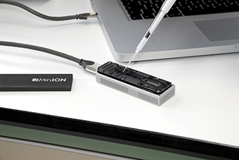
“Third” Generation Sequencers
Oxford Nanopore MinION
Notes:
1:15 is start of strand sequencing bit

Slide 24

“Third” Generation Sequencers
Oxford Nanopore MinION
Notes:
1:15 is start of strand sequencing bit

Slide 25
“Third” Generation Sequencers
Fast ✓
Cheap(ish) ✓
High throughput ✓
Single strand ✓
Long ✓
Prone to error ✗
Notes:
Length allows for phasing and closing of genomes

Slide 26
Types of Sequencing Reads
Single end (up to 300 bp)
Paired end (up to 800 bp span)
Mate pair (up to 20 kbp span)
Long reads (up 1 Mbp)
/----/
Notes:
Types of sequence data
• Sanger sequence data (up to 800bp) vs Next generation
• Paired end can give more information
• Small insert size for local assembly
• Large insert size to resolve longer range
• Long read either for scaffolding along with other data or used alone

Slide 27
Paired Reads
Illumina Adaptors
DNA for Sequencing
Illumina Adaptors
Fragment
R1
Forward Read
Insert
R2
Reverse Read
An example: 300 bp paired end reads with a 700 bp fragment size
R1 = 300 bp, R2 = 300 bp, Insert = 100bp

Slide 28

Any Questions So Far?

Slide 29


Now to look at some data!
Open X2Go and re-connect to your instance
It should still be set up from this morning so just re-connect

Slide 30
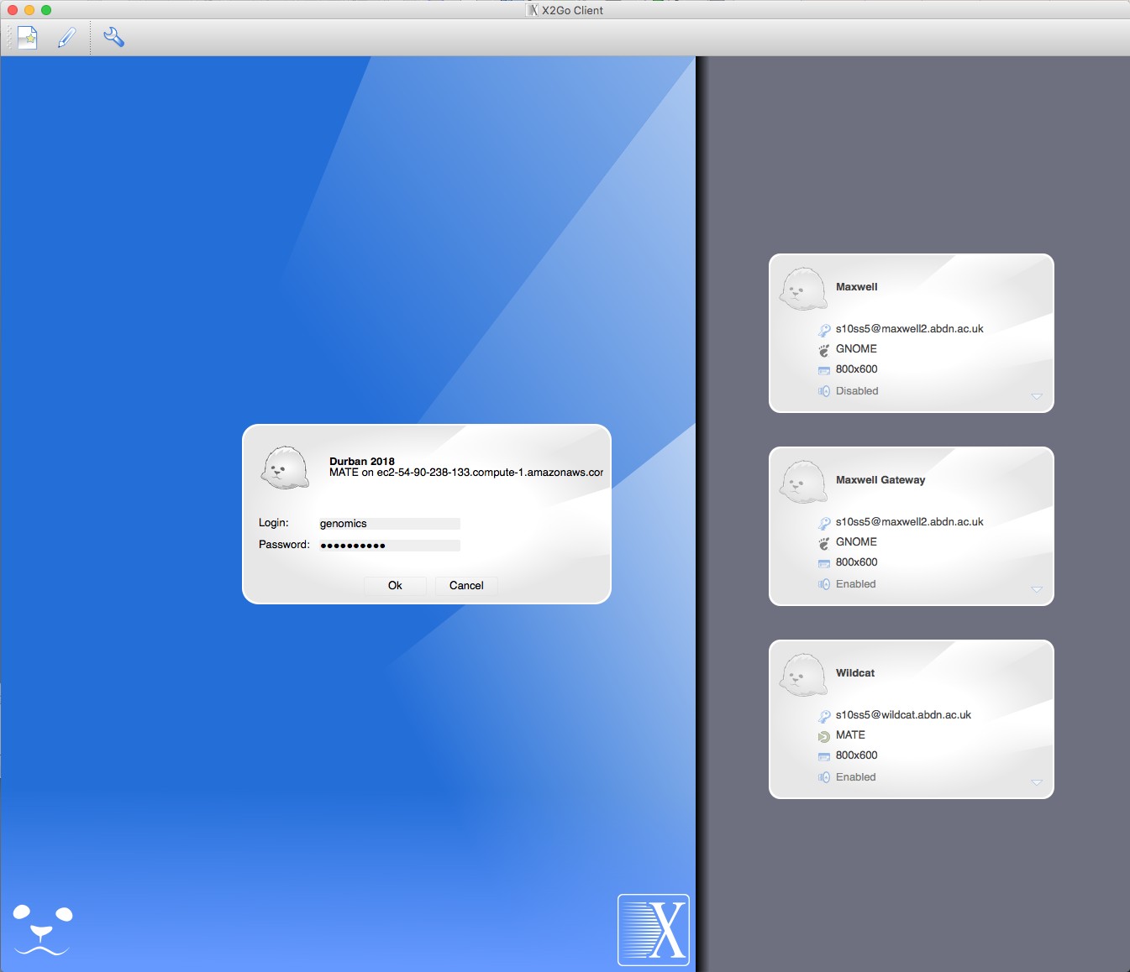

Log in using the password

Slide 31
Looking at File Contents
Navigate back to the Sequence files that we unarchived and renamed this morning. They should be in this path:
Don’t forget about tab complete whilst changing directories!
cd ~/workshop_materials/Unix/Sequences
List the files to make sure that you have two sequencing files
called sequence_1.fq and sequence_2.fq
If your file names are different, you will need to use these names in
all of the following examples.

Slide 32
Paired Reads
Illumina Adaptors
DNA for Sequencing
Illumina Adaptors
Fragment
R1
Forward Read
Insert
R2
Reverse Read
An example: 300 bp paired end reads with a 700 bp fragment size
R1 = 300 bp, R2 = 300 bp, Insert = 100bp

Slide 33
Looking at File Contents
head | tail | more | less | cat
Shows the top lines of a file | Shows the bottom lines of a file | Shows the file one full screen at a time | Shows the file one full screen at a time | Shows an entire file all at once AND Used to combine files
-n specifies the number of lines (default 10) | -n specifies the number of lines (default 10) | Enter to scroll one line Space to scroll a page q to quit | Enter to scroll one line Space to scroll a page q to quit / to search n shows next | Ctrl + C to stop
Use these command line programs to look at the sequence files
head –n 10 sequence_1.fq

Slide 34
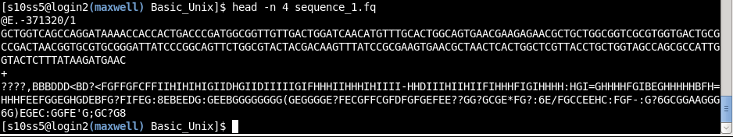
Let’s put this to use
ç
Fastq File Format:
Header
Sequence
Second Header (often +)
Phred Quality Score
Lot’s of analysis software like paired reads to be in the same order
CHALLENGE!
Use head and tail to check that the five bottom and top headers are in the same order in
sequence_1.fq and sequence_2.fq
(You may need to use the –n option to show more lines)

Slide 35
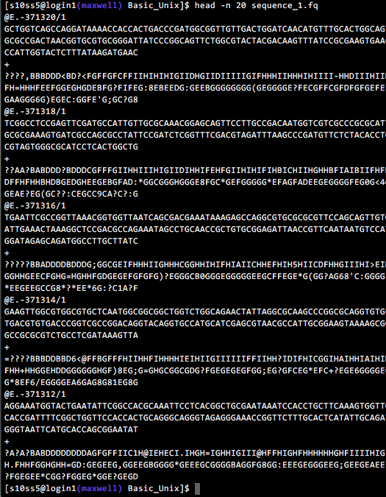
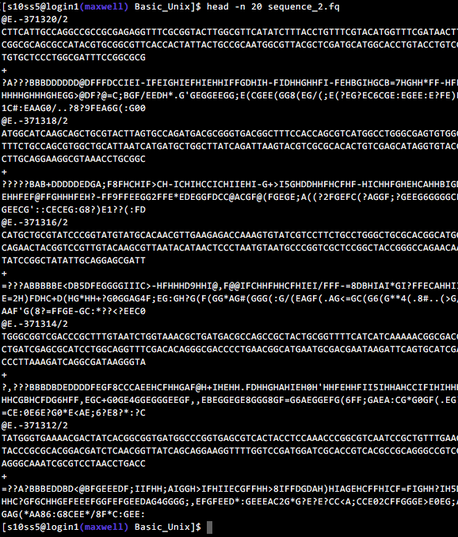
Challenge

Slide 36
Sequencing Stats
How many reads?
Count the number of lines
742640 lines THEREFORE 185660 reads
Are there the same number of reverse reads?
How about just counting the header lines?
Each header line starts @E
219153
BUT the numbers from the two programs don’t match?!
How about with this
185660
^ matches this pattern at the start of the line
This is the letter l
$ wc –l sequence_1.fq
$ grep –c “@E” sequence_1.fq
$ grep “@E” sequence_1.fq
$ grep –c “^@E” sequence_1.fq

Slide 37
So You’ve Got Some Sequencing Data – Now What?
The first thing you should do is check the quality of the data…

Slide 38
Fastq Format
Fastq File Format:
Header
Sequence
Second Header (often +)
Phred Quality Score
This line contains the Phred Quality Score for every base in the sequence

Slide 39
Read Quality – Base Calling
Sequencing
Image taken at every nucleotide incorporation

Slide 40
Read Quality – Base Calling
T
C
A?
C
T
Base pair sequences are called based on the fluorescence signal.
Quality scores are associated with each base call depending on how well it can
indiscriminately determine the base.

Slide 41
Why are some bases poorer quality?
The base caller is unable to determine the base when:
Cluster fluorescence is unclear.
  Dephasing of cluster.
  Reagent degradation.
Clusters overlap or are too close together.
Lack of sequence diversity.

Slide 42
Read Quality – Phred Score
Phred Quality Score | Probability of incorrect base call | Base call accuracy
10 | 1 in 10 | 90%
20 | 1 in 100 | 99%
30 | 1 in 1000 | 99.9%
40 | 1 in 10,000 | 99.99%
50 | 1 in 100,000 | 99.999%
60 | 1 in 1,000,000 | 99.9999%
https://en.wikipedia.org/wiki/Phred_quality_score

Slide 43
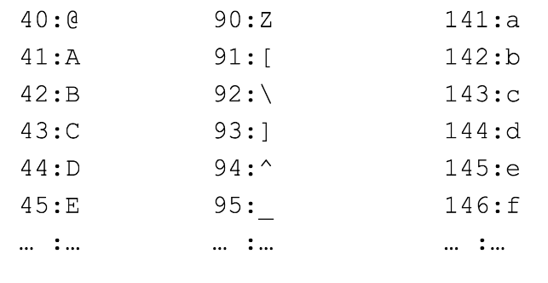
ASCII Encoding
Each number is converted to one symbol:

Slide 44
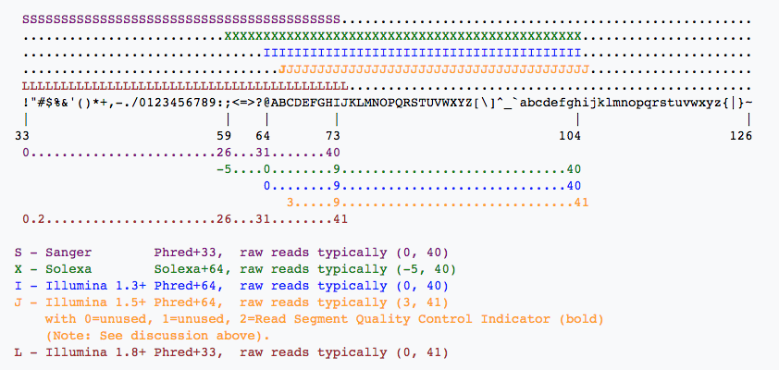
Different Phred Scores

Slide 45
Why Do We Care?
Low quality reads, contamination and adaptors introduce errors into data.
Filtering and trimming these sequences may help to improve downstream analysis.
Filtering isn’t always needed. Some programs take quality into account.
HOWEVER a visualisation of data quality should be carried out at the beginning of ANY analysis.

Slide 46
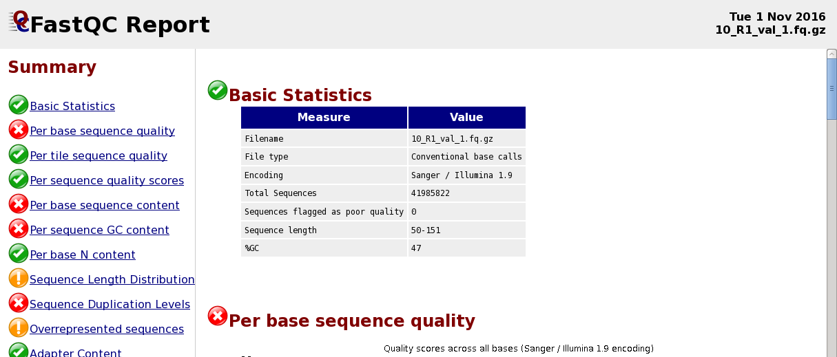
FastQC
How do we easily look at the quality of >100000 sequences?
FastQC is software that does this for us.

Slide 47
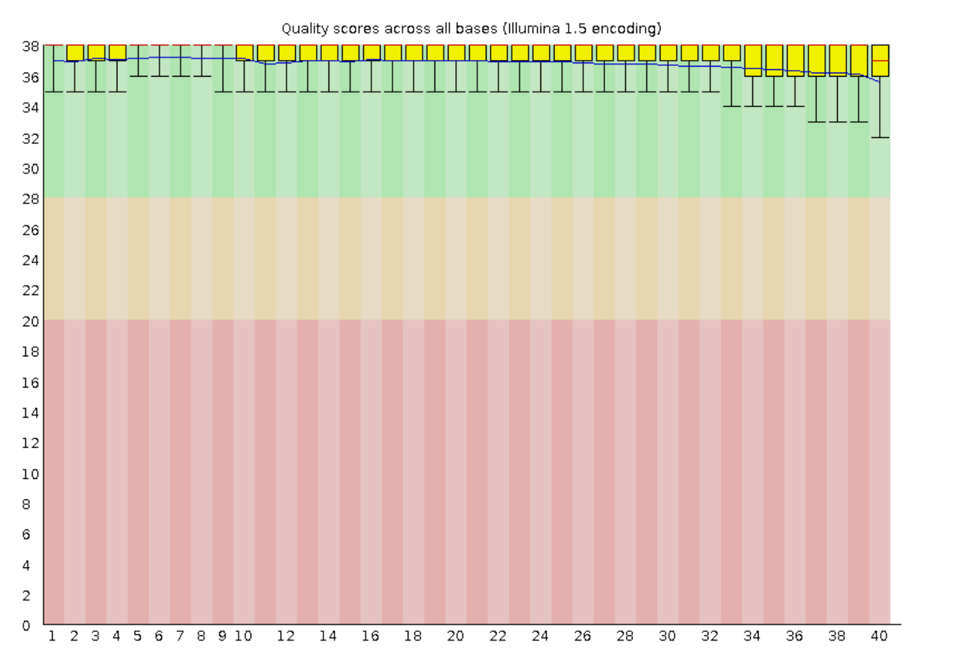
Per Base Sequence Quality

Slide 48
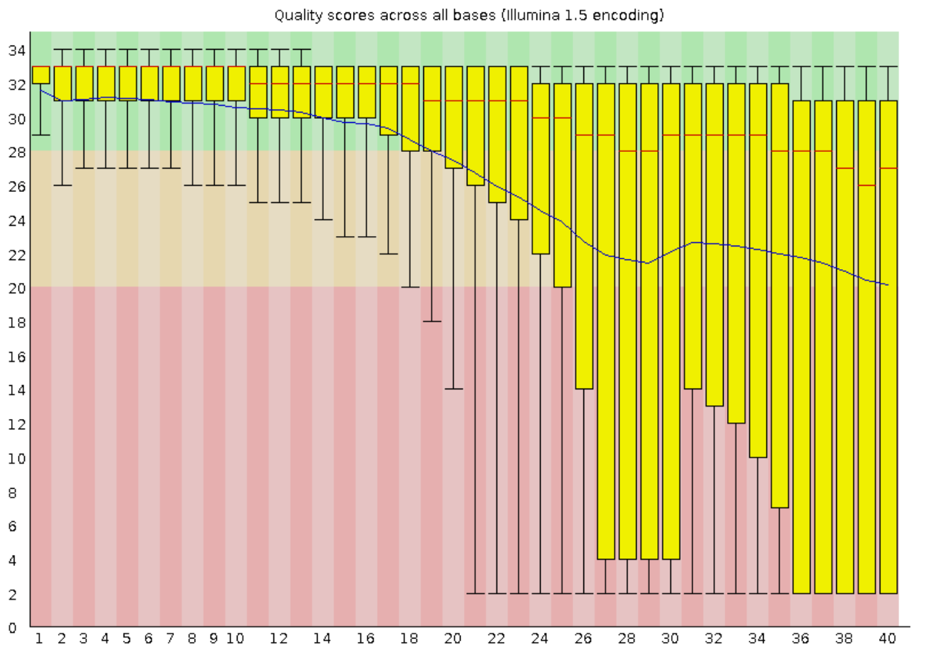
Per Base Sequence Quality

Slide 49
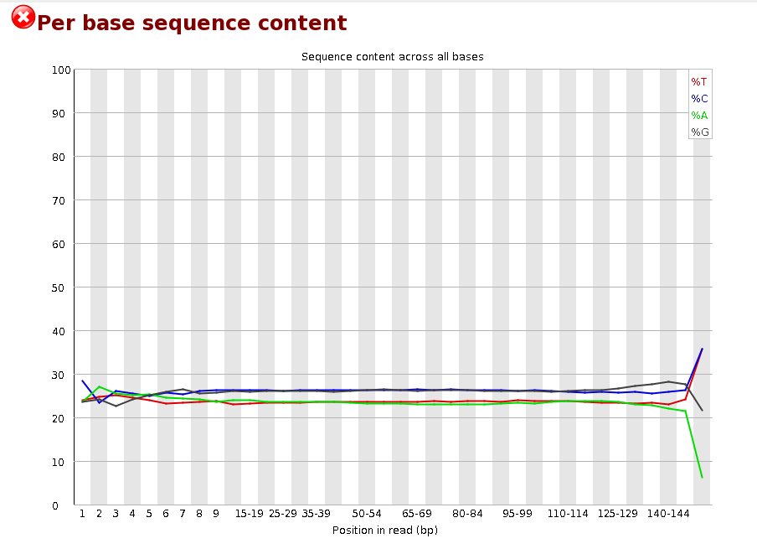
Per Base Sequence Content

Slide 50
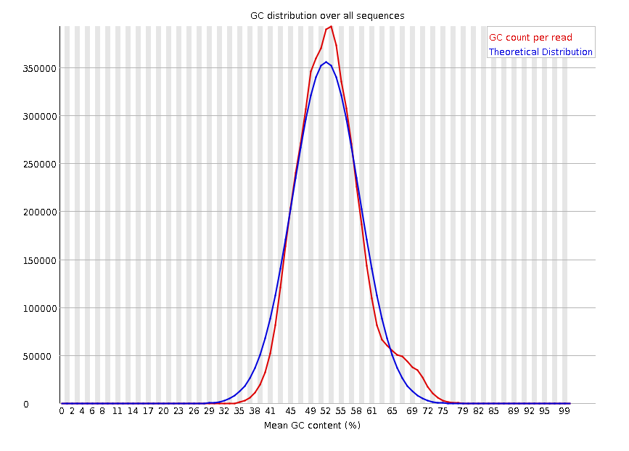
Per Sequence GC Content

Slide 51
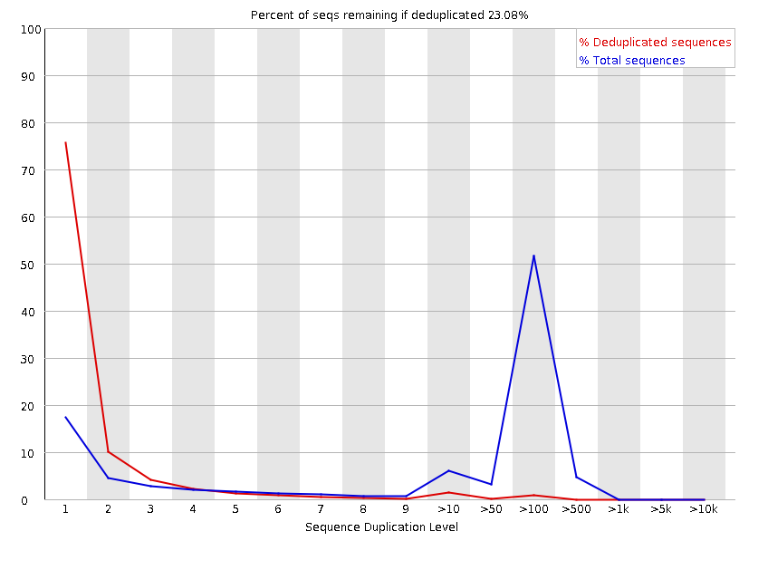
Sequence Duplication Levels

Slide 52
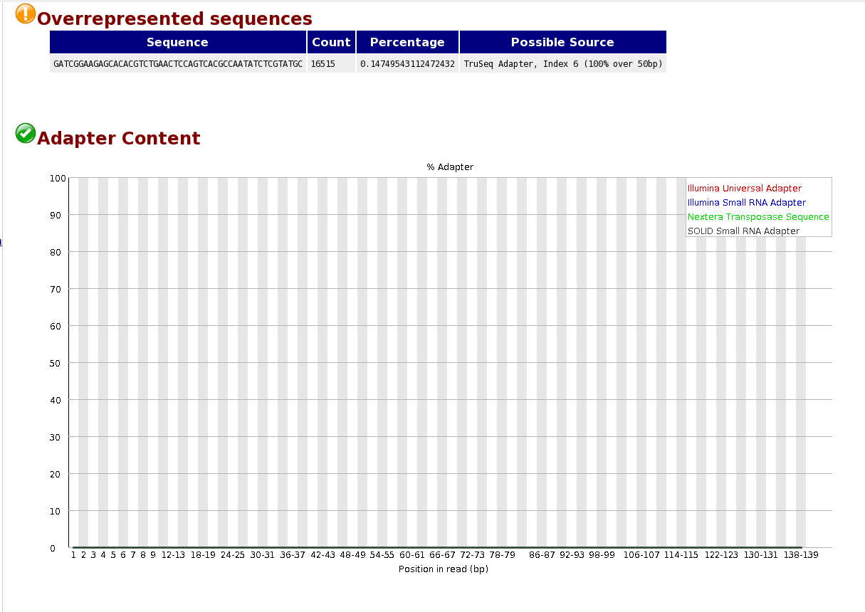
Over Represented Sequences and Adaptor Content

Slide 53
And the list goes on…
Per sequence quality scores
Per base N content
And more! (this changes slightly depending on your FastQC version)

Slide 54
How Do We Improve the Quality?
Software is available to filter reads based on quality and trim adaptor sequences.
Many(!) different software available but all essentially do the same thing.
  Today we’re going to use TrimGalore!

Slide 55
Any Questions So Far?

Slide 56
So let’s give this a go!
Exercise 1: Genome sequencing of the bacteria Bartonella
Exercise 2: Amplicon sequencing of 16S rRNA from the Earth Microbiome Project
Exercise 3: RAD sequencing data
Exercise 4: Amplicon sequencing of 16S rRNA from environmental samples
Exercise 5: Filtering of amplicon sequencing data
Exercise 6: Filtering of microRNA sequencing data

Slide 57
Amplicon Sequencing
Amplify Region via PCR
(16S rRNA gene)
Sequence
Clustering:
Based on Sequence
Similarity
Scott will talk about this data type and analysis in more detail on Wednesday!

Slide 58
RAD Sequencing
RAD = Restriction-site Associated DNA
Genomic DNA
Restriction Enzyme
Fragmented DNA
Sequencing

Slide 59
How to Run Software on the Command Line
Usage Statement:
$ software [options] <files>
For example:
$ fastqc [-o output] [-f fastq|bam|sam] <seqfile1..seqfileN>
Generally:
[ ] means optional
< > means mandatory files
| means or

Slide 60
Now What?!
Work through the Quality Control Exercises (link on the workshop web page).
At the end of the session, we’ll go over the answers!

Slide 61
Exercise One
Genome Sequencing Data
There are 10,000 sequences of 38 bp in length
The GC content is 37%
Quality score is > Q30, which = 1 error in 1000 so base call quality is 99.9%
Would you think this is good quality sequencing data?

Slide 62
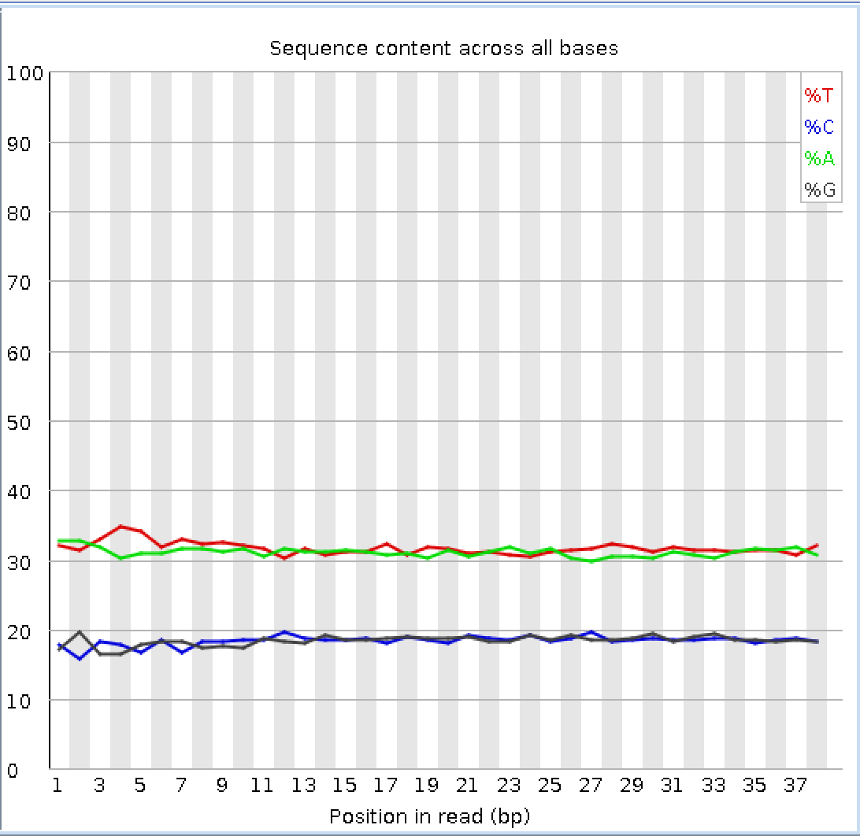
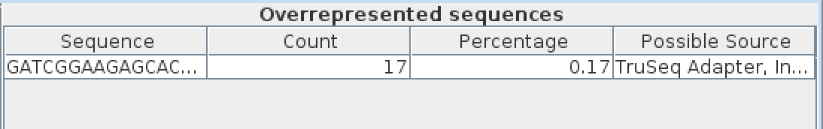
Exercise One
Genome Sequencing Data
Are we worried about this data?!
No - This shows the GC content we
expect and very few adaptors.

Slide 63
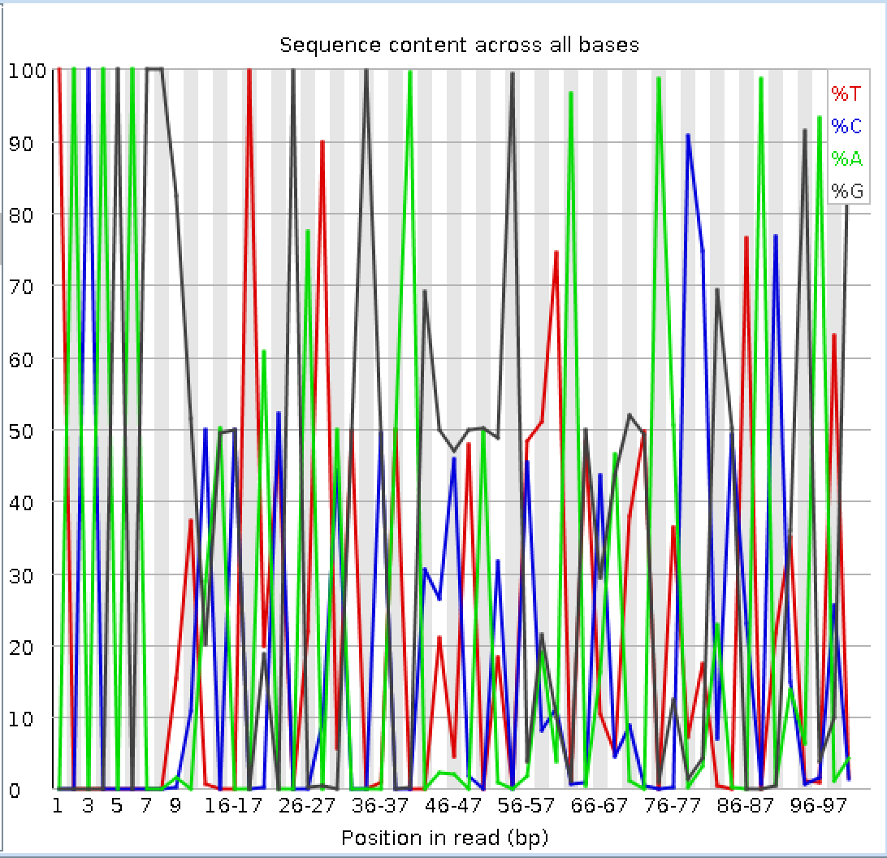
Exercise Two
Amplicon Sequencing Data
Conserved sequence at the beginning of the reads:
TACAGAGG
Lots of sequences with very similar sequence.

Slide 64
Exercise Two
Amplicon Sequencing Data
Filter Low Quality &
Remove the Primer Sequence

Slide 65
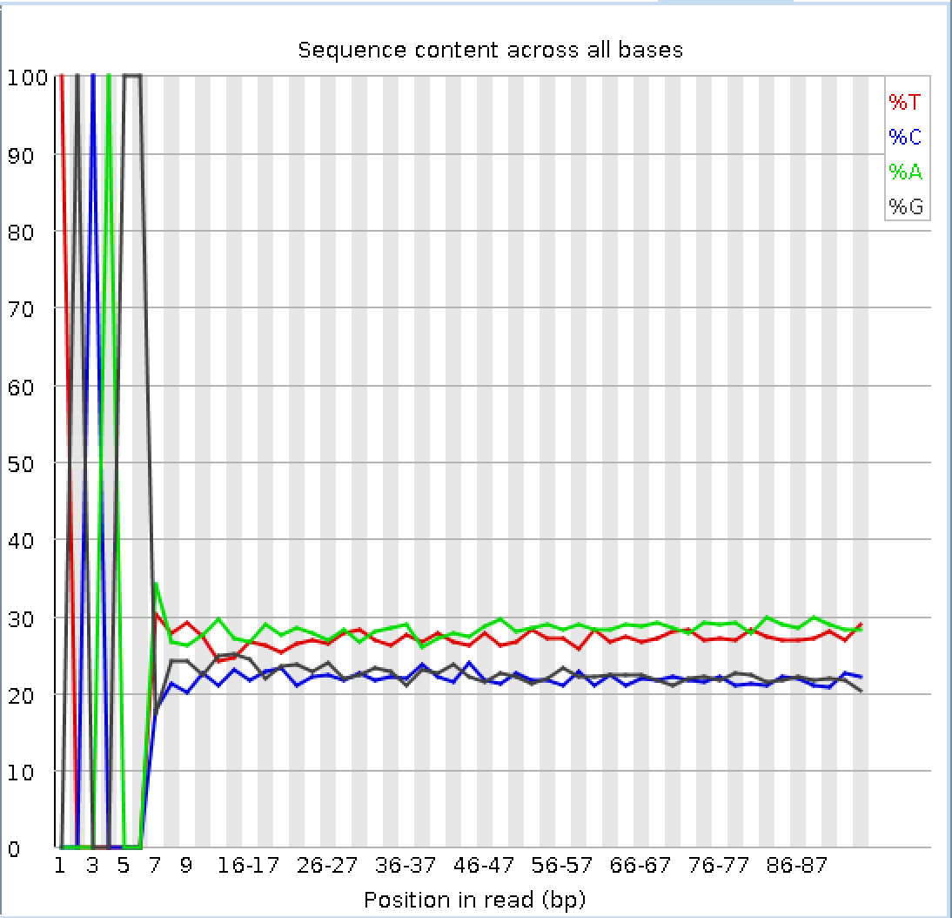
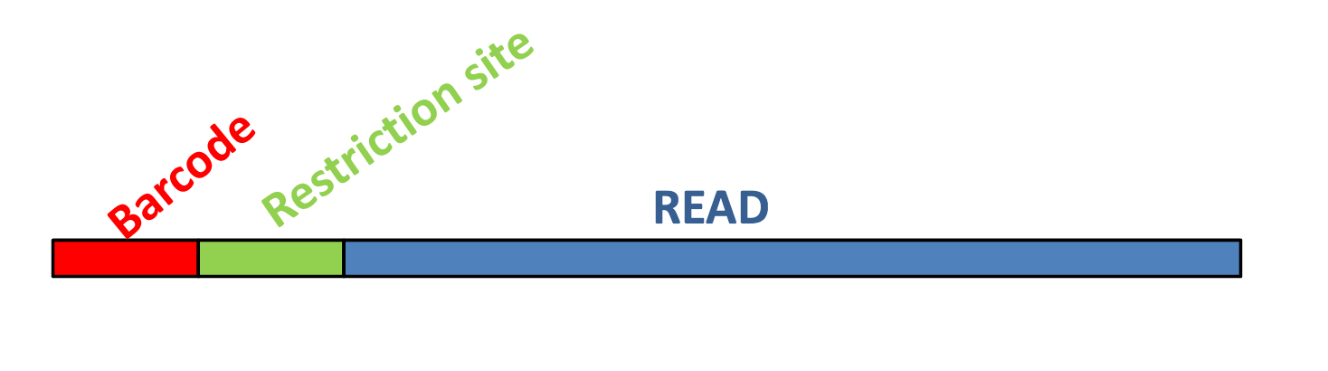
Exercise Three
RAD Sequencing Data
Restriction Enzyme Digestion Site

Slide 66
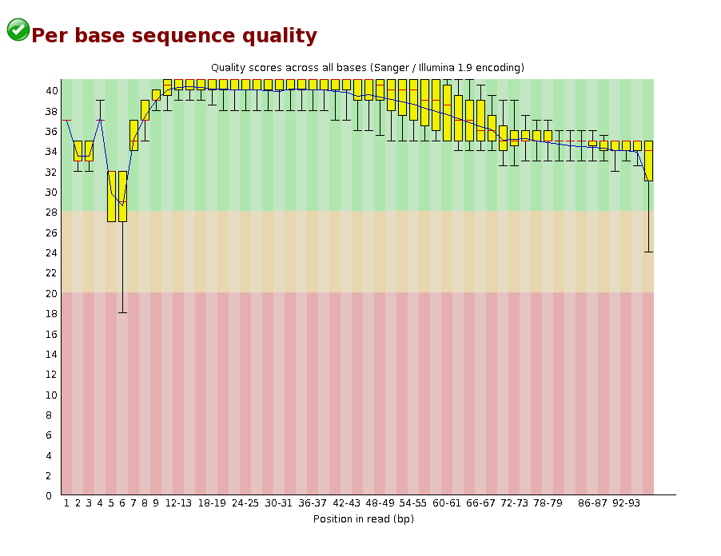
Exercise Three
RAD Sequencing Data
Lack of diversity between clusters confuses the sequencer.
All the dots are identical and therefore it can not decide where one cluster starts and one ends!

Slide 67
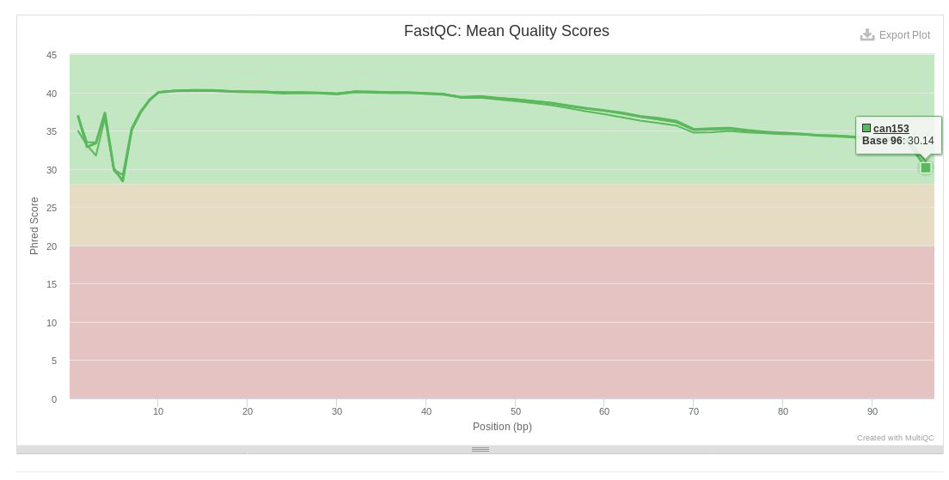
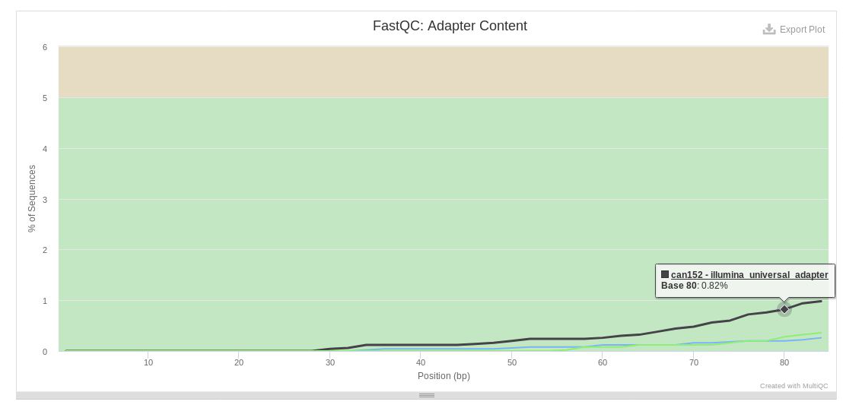
Exercise Three
RAD Sequencing Data
MultiQC makes it easier to compare multiple FastQC files at once.

Slide 68
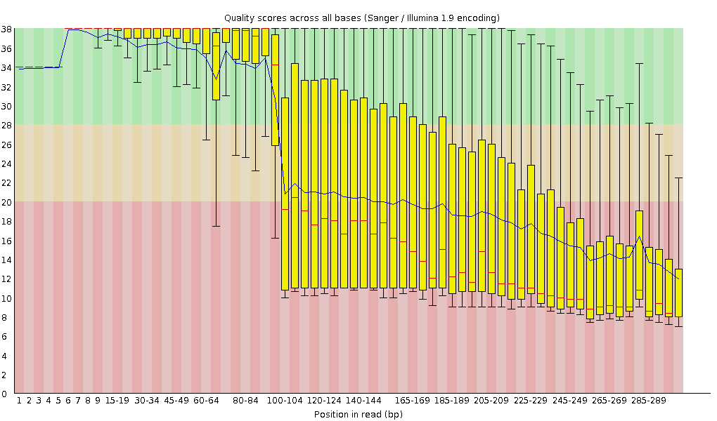
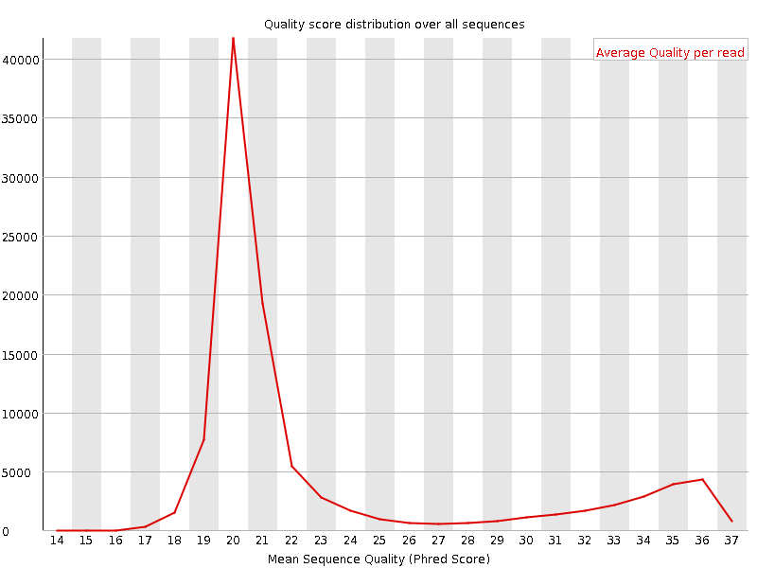
Exercise Four
Amplicon Sequencing Data
Very low average quality

Slide 69
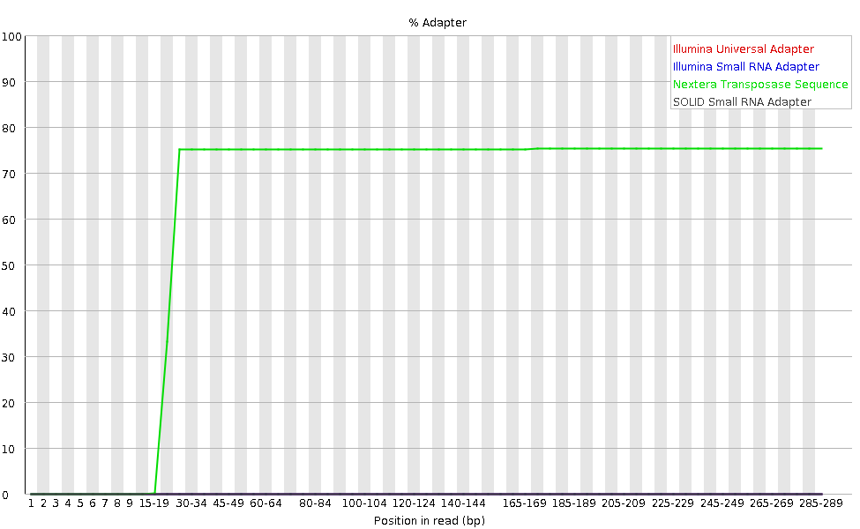
Exercise Four
Amplicon Sequencing Data
75% of bases are adapters after 15 bp
Majority adaptor dimers
Unlikely to be able to save this data!

Slide 70
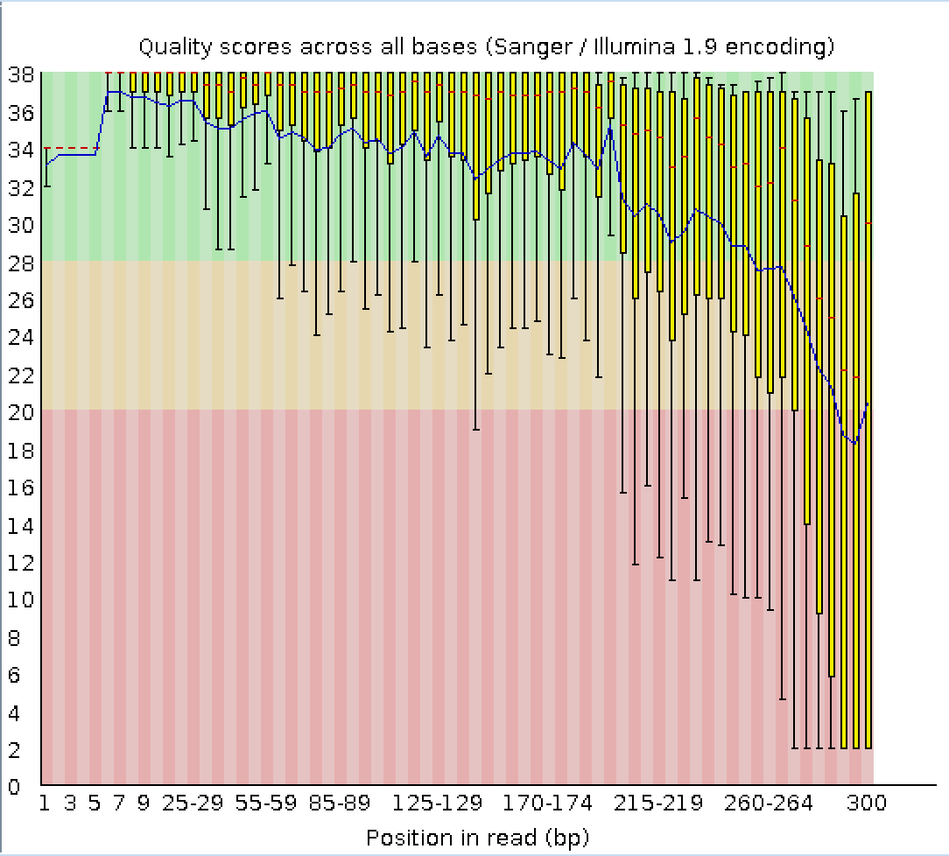
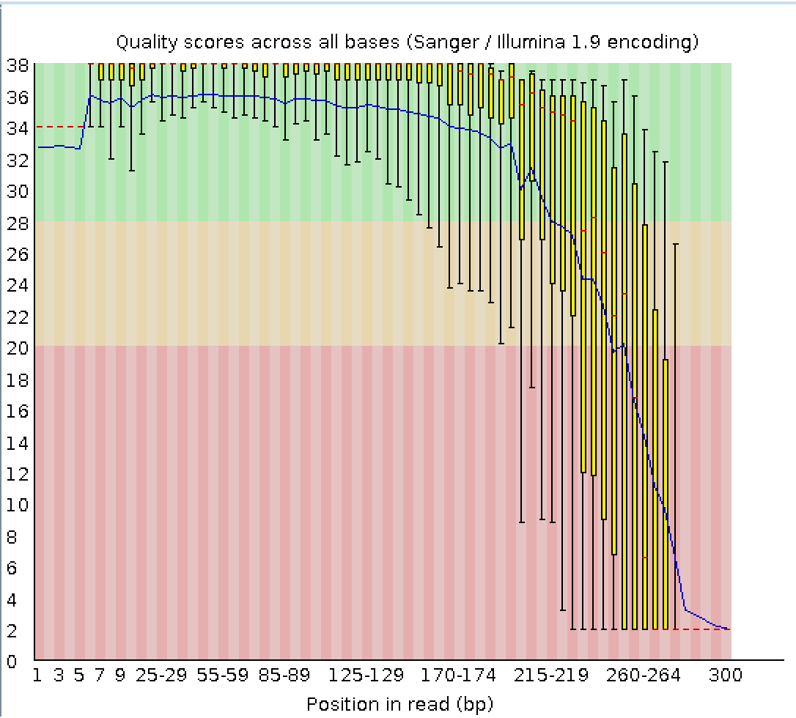
Exercise Five
Amplicon Sequencing Data
Read 1
Read 2

Slide 71
Exercise Five
Amplicon Sequencing Data
Your Trim Galore! Command
(all on one line):
$ trim_galore –q 35 --paired
1_TAAGGCGA-TAGATCGC_L001_R1_001.fastq.gz
1_TAAGGCGA-TAGATCGC_L001_R2_001.fastq.gz
Read 1 – 58204 (9.4 %) of reads with adaptors
Read 2 – 233549 (37.9 %) of reads with adaptors
138277 read pairs removed (22.45 %)

Slide 72
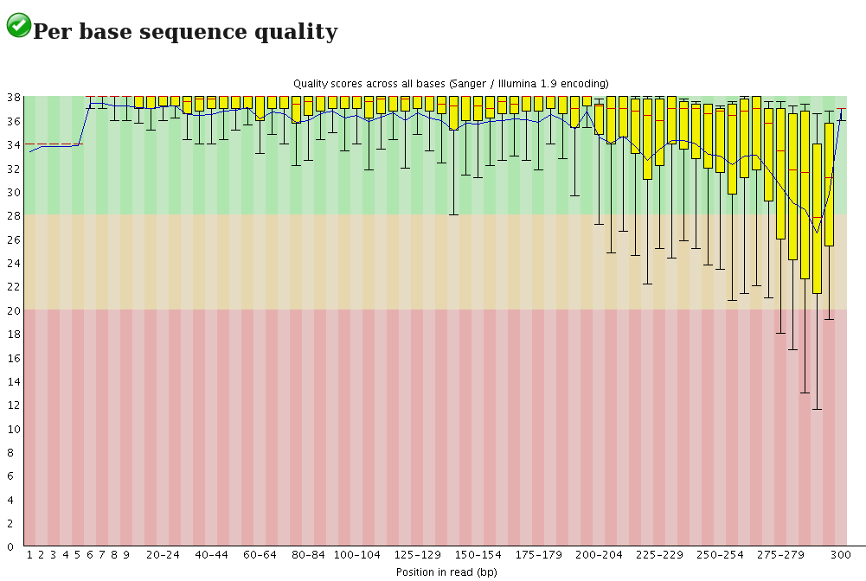
Exercise Five
Amplicon Sequencing Data
Read 1 Before
Read 1 After

Slide 73
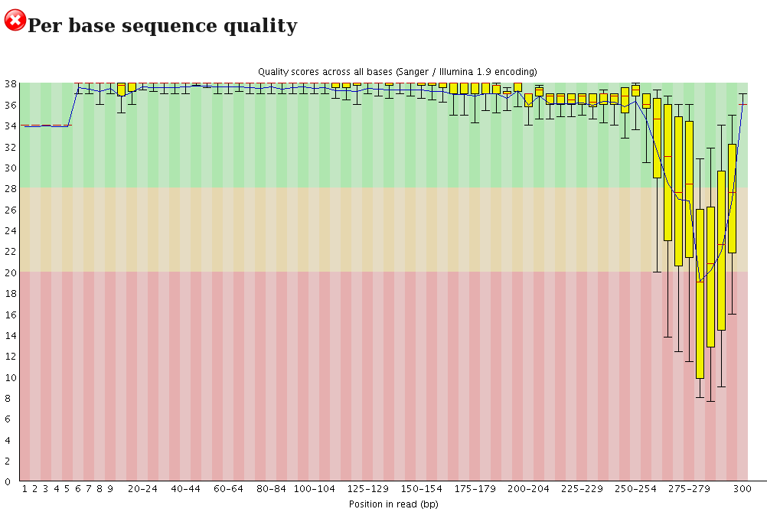
Exercise Five
Amplicon Sequencing Data
Read 2 Before
Read 2 After

Slide 74
Exercise Five
Amplicon Sequencing Data
When would you be less strict?
Quality vs. Quantity - Do you have enough data after filtering?
SOME alignments - RNA sequencing vs. SNP calling
Does your downstream software handle quality scores and filtering? E.G. DADA2, QIIME2, A5 assembler and Stacks

Slide 75
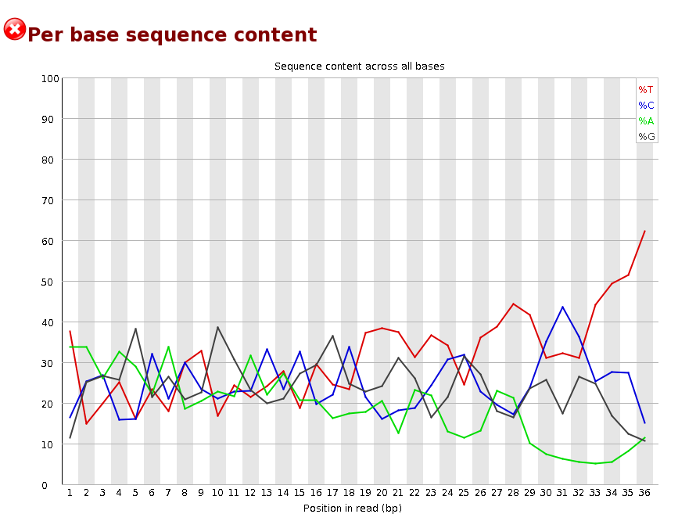
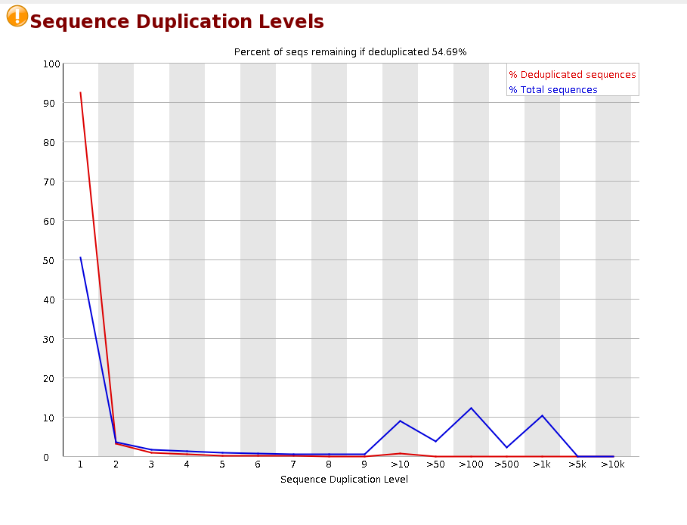
Exercise Six microRNA Sequencing Data
Think about the data you have! microRNAs are likely to be similar.

Slide 76
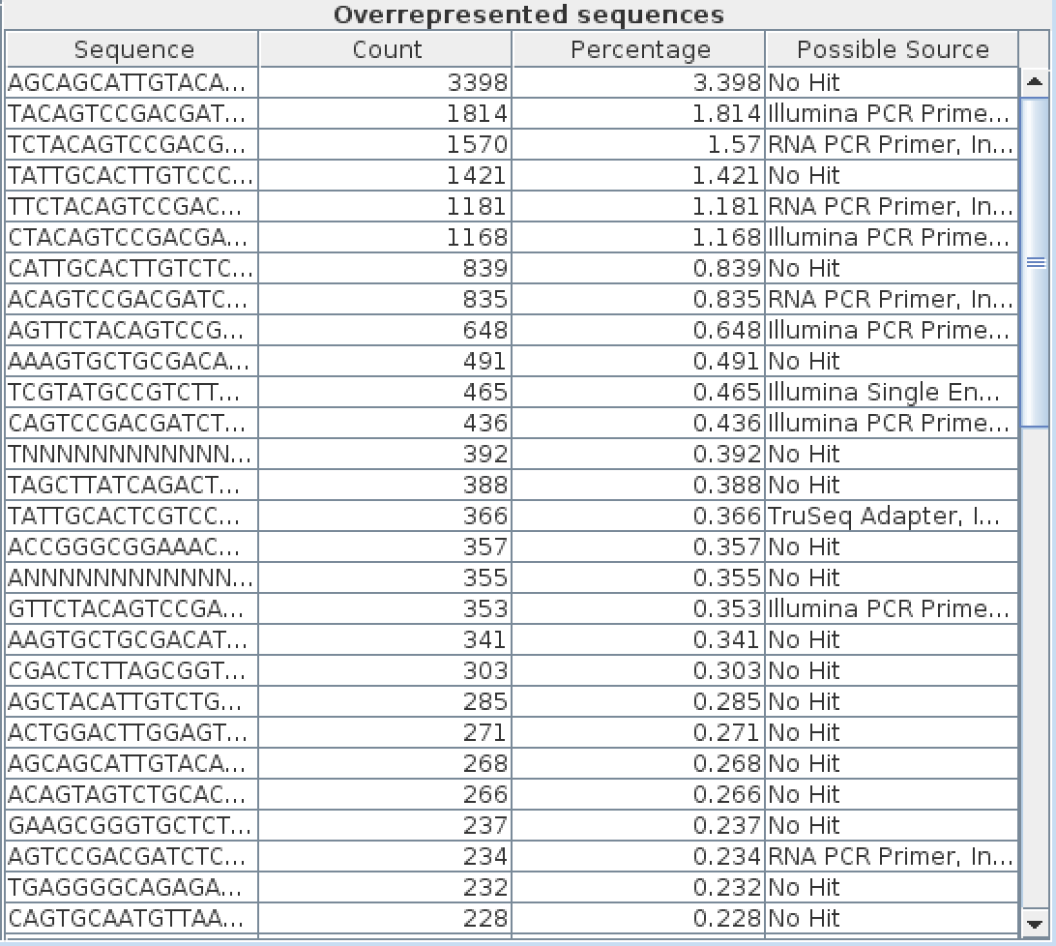
Exercise Six microRNA Sequencing Data
What is the source of the overrepresented sequences?

Slide 77
Exercise Six microRNA Sequencing Data
Your Trim Galore! Command
(all on one line):
$ trim_galore –a ATCTCGTATGCCGTCTTCTGCTTG SRR026762-sample.fastq.gz
Read 1 – 37661 (37.7 %) of reads with adaptors
33738 reads removed (33.7 %)

Slide 78
Exercise Five
Amplicon Sequencing Data
Are we happy with the final data?
What about the primer sequences that remain?
May need further rounds of removal or manual trimming.
This is an alignment project and therefore complete removal less important.
What about the quality trimming?
Trimmers work with a sliding window and calculates the average Q score in that window, if it’s higher on average than the cut off, it stays.

Slide 79
Any Questions So Far?

Slide 80
Take Home Message!
It is essential to QC your data before beginning analysis.
What are you expecting? Think about your experimental design, your species etc…
What are you doing with the data? Alignment, assembly etc…
No two datasets are the same!

Slide 81
What We’re Going To Do
THIS MORNING
Getting Connected ✓
Introduction to Unix ✓
Software Installation ✓
THIS AFTERNOON
Introduction to Sequencing ✓
Checking the Quality of Sequencing Data ✓

