Slide 1
Bacterial Comparative Genomics
Christopher Desjardins, Ph.D.
Earl Lab
Broad Institute

Slide 2
Outline
Genomics Terminology
Assemblies vs. Variants
Assembly-based analyses
Orthology
Variant-based analyses
How to choose?

Slide 3
Basic Genomics Terminology
Assembly: Reconstruction of a longer sequence from smaller sequencing reads
Annotation: Assigning a function to a string of nucleotides
Variant calling: Identifying differences between a set of sequencing reads and a reference assembly

Slide 4
Two Approaches to Microbial Genomics
Starting with sets of reads representing your study isolates…
A
B
C
D
Assembly-based
Assemble each set of reads into a genome sequence
Annotate each genome
Cluster genes and compare between each genome
Variant-based
Compare each read set to a reference genome assembly
Directly compare variants between each genome

Slide 5
Assembly-Based Approach
Assemble each genome (de novo or reference-based)
A
B
C
D

Slide 6
Assembly Basics
Genomic DNA
AGCTGTAAGC
AGCAACGCTTGTAAATGTAGCTTAG
contig
contig
supercontig (scaffold)

Slide 7
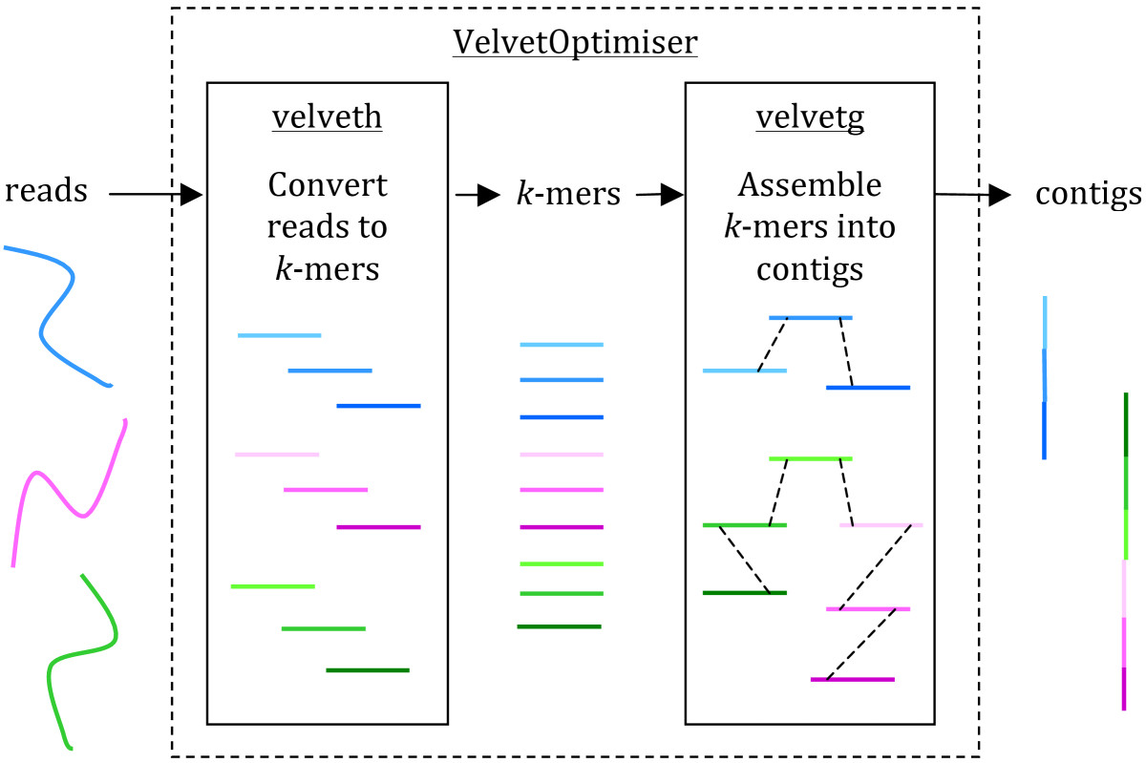
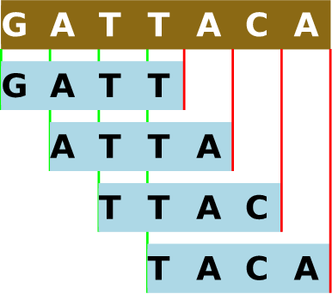
Assembly Methods
SPAdes (http://cab.spbu.ru/software/spades/)
Velvet (https://www.ebi.ac.uk/~zerbino/velvet/)
Both are De Bruijn graph assemblers
K-mers
Edwards and Holt 2013 MIE

Slide 8
Assembly-Based Approach
Annotate each genome
A
B
C
D

Slide 9
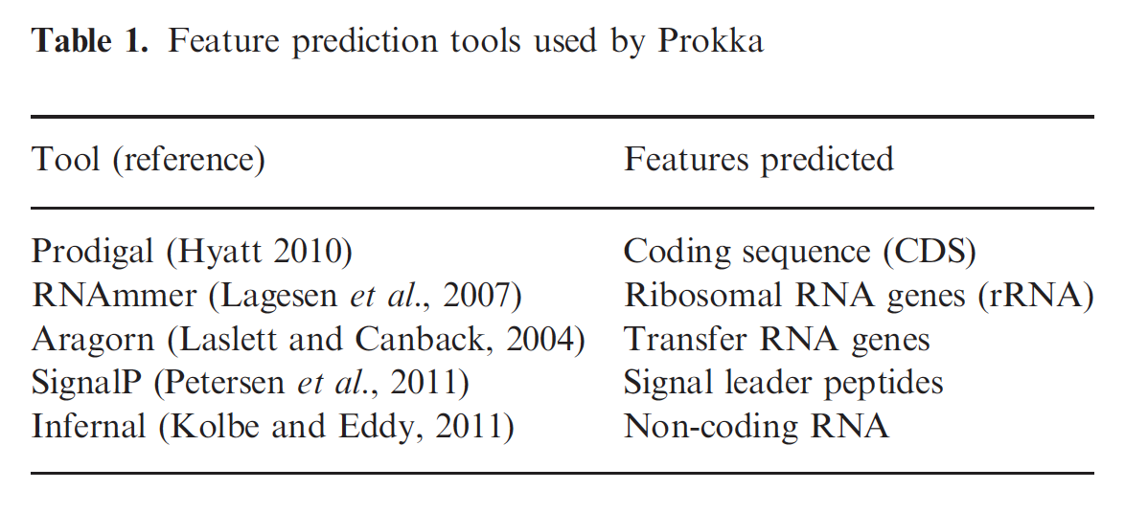
Annotation Methods
Annotation refers to assign function to DNA sequences
There are different annotation algorithms for protein-coding genes, tRNAs, rRNAs, other non-coding RNAs
Prokka (http://www.vicbioinformatics.com/software.prokka.shtml) is an all-in-one wrapper for these tools

Slide 10

Annotation of Protein-Coding Genes
Prodigal (http://prodigal.ornl.gov/)
  Identify high confidence genes (long ORFs +)
    ORF = open reading frame
  Identify features of those genes
  Find other areas on genome with shared features
  Refine predictions

Slide 11
Assembly-Based Approach
Cluster genes
A
B
C
D
7
6
7
6
7
8
7
8
1
5
1
5
1
5
1
2
2
4
3
4
3
4
5
3
3
2
2
4

Slide 12
Orthology
Orthologs are genes whose most recent divergence was a speciation event
Paralogs are genes whose most recent divergence was a gene duplication event
Groups of orthologous and paralogous genes are termed “ortholog clusters” or “gene clusters” or even just “genes” and form the basis of all gene-based comparative genomics

Slide 13
Gene Trees vs Species Trees
Species Tree
A
B
C

Slide 14
Gene Trees vs Species Trees
Species Tree
Gene Tree
A1 and B1 are orthologs
A1 and C1 are orthologs
B1 and C1 are orthologs
A1
B1
C1

Slide 15
Gene Trees vs Species Trees
Species Tree
Gene Tree
B1 and B2 are paralogs
A1 and B1 are orthologs
A1 and B2 are orthologs
All of these genes would
form a single gene cluster
A1
B1
B2
C1

Slide 16
Gene Names, Orthology, and Function
When you ask, does strain A have gene X?...
What you are really asking is, does strain A have an ortholog of gene X? (where gene X is characterized in another strain)
If two genes are orthologs, that does not imply they have same function, but they often do
If two genes are paralogs, they have traditionally thought to often differ in function, and paralogy is thought to be one of the main sources of “new” genes
…but there is some evidence to suggest that paralogs are often more similar in function

Slide 17
Gene Clustering - how it works
Assess the similarity of every gene to every other gene
  e.g., using BLAST
Use that similarity to join pairs of genes
  e.g., using Reciprocal Best Hits
Connect the gene pairs into larger clusters
  e.g., using Reciprocal Best Hits or Markov clustering

Slide 18
Pairwise Clustering - Reciprocal Best Hits
Reciprocal Best Hits (RBH) is a simple and popular clustering algorithm
Two proteins X and Y from species A and B, respectively, are considered orthologs if protein X is the best BLAST hit for protein Y and protein Y is the best BLAST hit for protein X (i.e., they are reciprocal best hits)
Genome A
Genome B
X
Y

Slide 19
Clustering - Reciprocal Best Hits
The logic of RBH can then be extended from pairs of genomes to three or more genomes
  i.e., Three proteins X, Y, and Z, respectively, from species A, B, and C, respectively, are considered orthologs if each protein is the best BLAST hit for each protein all genomes
Addition of paralogs is not part of the RBH algorithm, but can be done as post-processing step
X
Y
Z

Slide 20
Clustering - OrthoMCL
OrthoMCL is an extremely popular gene clustering program
OrthoMCL uses reciprocal best hits to identify orthologs between pairs of genomes
Beyond genome pairs, it uses a Markov cluster algorithm (MCL) to assemble groups of orthologs and paralogs
If that sounds “black box,” it’s because it is!
It does not scale well to hundreds of genomes, so as sequencing throughput continues to increase, OrthoMCL is losing popularity

Slide 21
Gene Content Profiles
Orthologous gene clusters can then be used to build gene content profiles - binary coding of gene presence/absence across genomes
These profiles can then be easily queried to identify genes unique to a given set of genomes
  easily identifies clade-specific genes
  can also look for perfect correlations of genes with phenotypes
 | Species A | Species B | Species C | Species D
Cluster W | 1 | 1 | 0 | 0
Cluster X | 0 | 0 | 1 | 1
Cluster Y | 1 | 1 | 1 | 0
Cluster Z | 1 | 1 | 1 | 1

Slide 22
Gene Content Profiles
 | Species A | Species B | Species C | Species D | Profile Type
Cluster S | 1 | 1 | 1 | 1 | Single copy core
Cluster T | 1 | 2 | 2 | 1 | Multi-copy core
Cluster U | 1 | 1 | 0 | 0 | Auxillary
Cluster V | 2 | 0 | 0 | 0 | Unique
Cluster terminology:
  Core = orthologs are present in all genomes
  Auxillary = genes with orthologs in at least two genomes but not all genomes
  Unique = genes without orthologs
  Sum of all of these genes is called the “pan genome”
  Single-copy = genes without paralogs in any genome
  Multi-copy = genes with paralogs in at least one genome

Slide 23
Organismal Phylogenies
Single-copy core genes are often used to create organismal phylogenies
Genes can be aligned with MUSCLE or CLUSTAL
Then sequences are concatenated, or attached together end-to-end, so that the end of gene A is followed by the beginning of gene B
Then a phylogeny is generated using available software like RAxML or FastTree
Beware horizontal transfer!

Slide 24
Other potential downstream analyses
Look for rapidly evolving genes by calculating evolutionary rates
Functional enrichment of genes specific to a clade
Association tests of gene presence/absence with a specific phenotype

Slide 25
Two Approaches to Microbial Genomics
Starting with sets of reads representing your study isolates…
A
B
C
D
Assembly-based
Assemble each set of reads into a genome sequence
Annotate each genome
Cluster genes and compare between each genome
Variant-based
Compare each read set to a reference genome assembly
Directly compare variants between each genome

Slide 26
Variant-Based Approach
Align reads to a reference genome
A
B
C
D

Slide 27
Read Alignment Methods
Goal: to find the best match or matches of a read to reference genome
While it seems simple, it’s actually a difficult problem since you cannot check all possibilities (need heuristics)
Un-spliced aligners (DNA to DNA, cDNA to cDNA)
  BWA (http://bio-bwa.sourceforge.net/)
  Bowtie2 (http://bowtie-bio.sourceforge.net/bowtie2/index.shtml)

Slide 28
Variant-Based Approach
Call variants
A
B
C
D

Slide 29
Variants
Single nucleotide polymorphisms (SNPs)
Insertion
Deletion
Substitution
Ref AGGTCGT
Alt AGGCCGT
Ref AGGT---CGT
Alt AGGTCCCCGT
Ref AGGTCGT
Alt AGG-CGT
Ref AGGTATGCGT
Alt AGGCCC-CGT

Slide 30
Variant Calling Methods
Variant calling process: decide which differences in an alignment to a reference represent real differences and not errors in alignment or sequencing
Pilon (https://github.com/broadinstitute/pilon/wiki):
  Program for assembly improvement and also SNP calling
  Initially developed for haploid genomes but now also works on diploid genomes
  Uses internal heuristics for quality control
GATK (https://software.broadinstitute.org/gatk/):
  Program for SNP calling only
  Initially developed for diploid genomes but has been adapted to other ploidies
  Requires “truth set” or hard filters for quality control

Slide 31
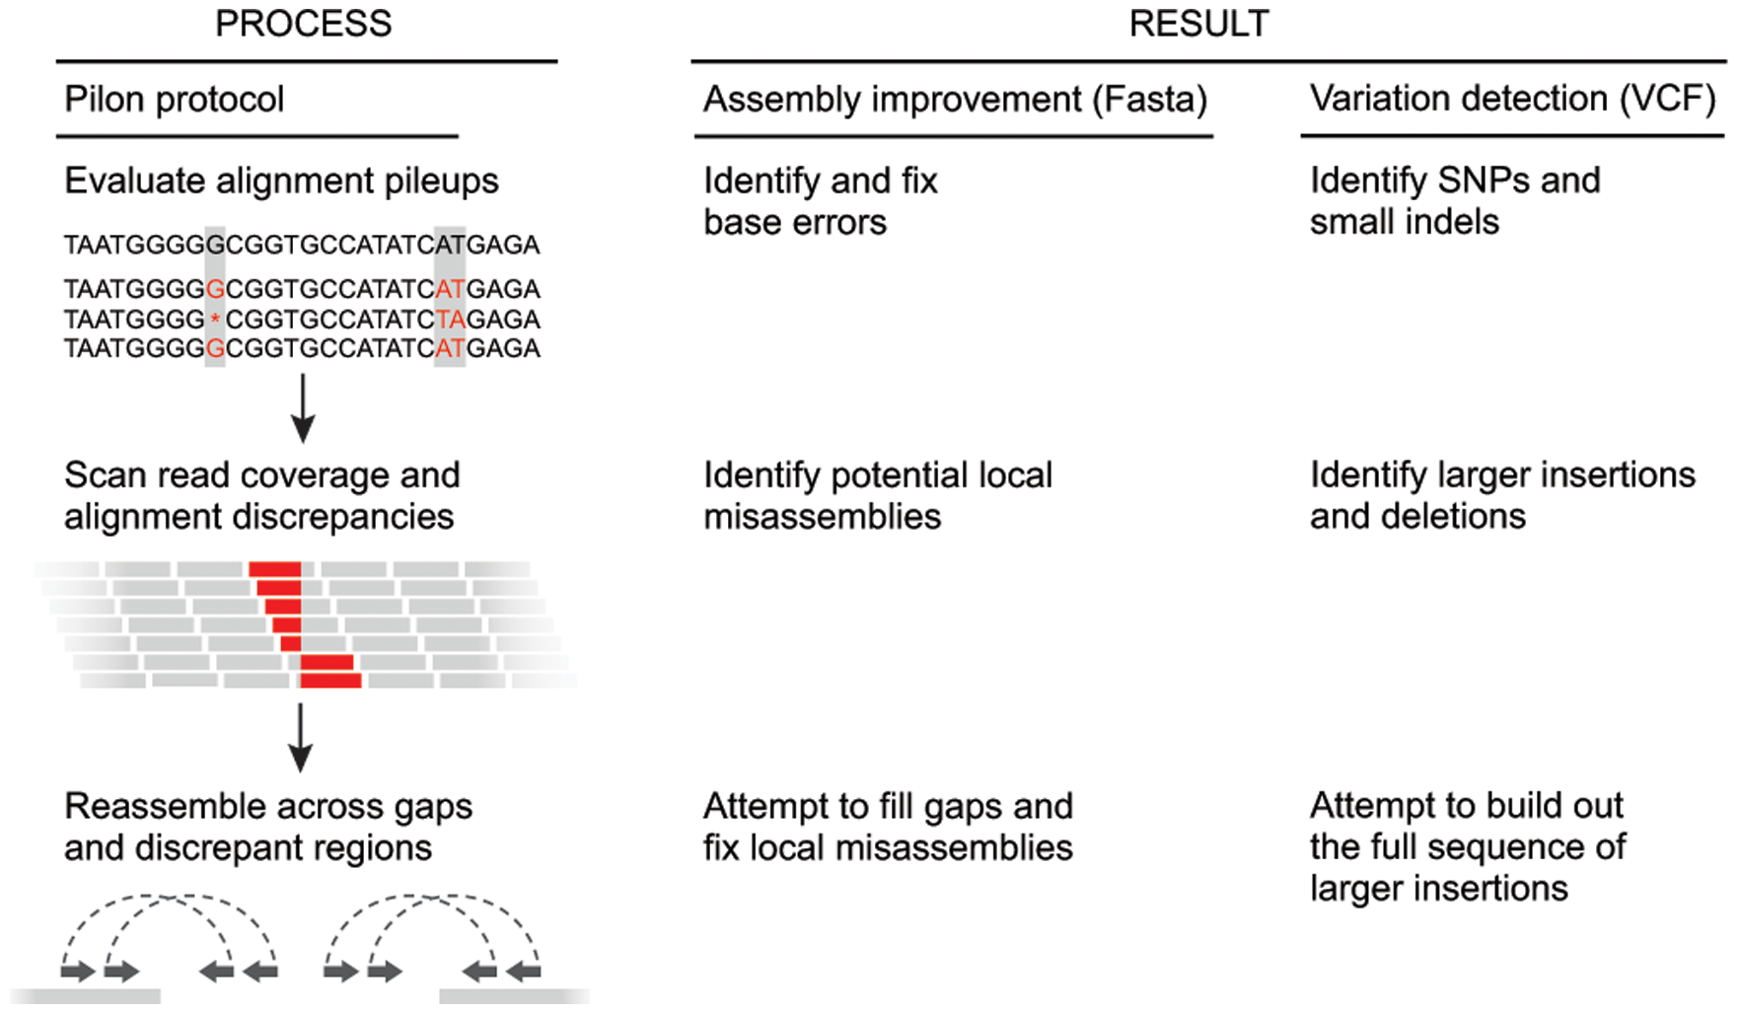
Pilon
Walker, Abeel, et. al 2014 PLOS ONE

Slide 32
Variant-Based Approach
Compare variants directly
A
B
C
D

Slide 33
Downstream analyses of variants
Annotation of variant effects
  Captures very different information than gene presence/absence: nonsynonymous and synonymous changes, frameshifts and introduced stop codons, promoter mutations
SNP-based phylogenetic analysis
SNP-based analysis of evolutionary rates
Enrichment of variant types in specific sets of genes
Association tests of variants with a specific phenotype (GWAS)

Slide 34
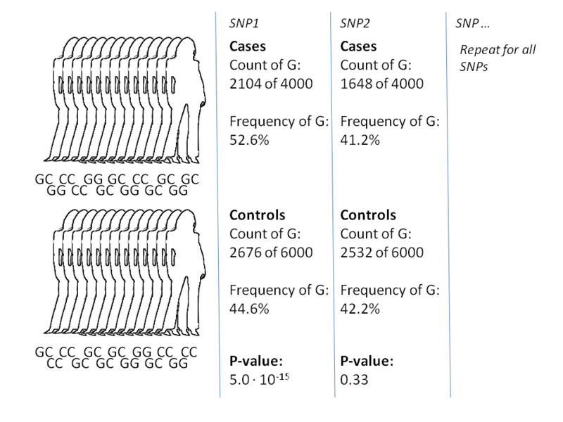
Genome-Wide Association Studies (GWAS)
Basic anatomy of GWAS:
Count alleles for each polymorphic site
Evaluate allele with Chi-squared or Fisher’s exact test
Correct for multiple comparisons
Countless more complex variations of GWAS exist
Fundamentally the same idea as an “enrichment test”
image from Wikipedia

Slide 35
2x2 Contingency Tests
 | Phenotype A | Phenotype B
Genotype X | 17 | 5
Genotype Y | 3 | 23
Fisher’s exact test
  follows the hypergeometric distribution
  an exact statistic, so, it becomes difficult to calculate for large numbers
  recommended use case: any cell < 5
Chi-Squared test
  follows the chi-squared distribution
  an approximate statistic, so, easy to calculate for large numbers
  recommended use case: all cells are > 5

Slide 36
Multiple Comparison Correction
Basic concept: the more statistical tests you do, the more likely one is to be significant by chance
Bonferroni
  multiply the p-value by the number of comparisons
  simple but very conservative
False Discovery Rate (FDR)
  more complicated but less conservative

Slide 37
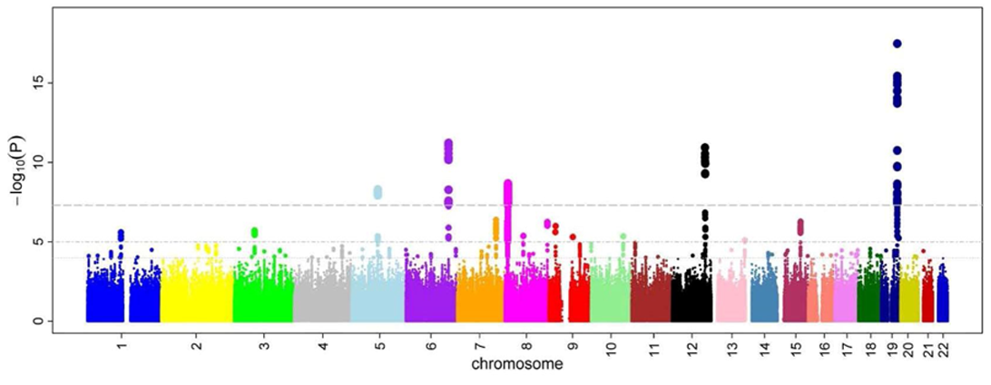
Manhattan Plots
Statistical significance values are plotted on the Y axis, while genome position is plotted on the X axis
-log normalizes values between 0-1 such that 10-fold decrease in p-value causes the normalized value to increase by 1
image from Wikipedia

Slide 38
Bacteria and GWAS
Most GWAS methods depend on linkage disequilibrium being slowly broken up by meiotic recombination, such that alleles physically distant from each other are independent
Many bacteria have limited or no recombination, making GWAS difficult
Adapting GWAS to bacteria is an active area of research
Figure from Weissglas-Volkov et al. Diabetes 2006

Slide 39
Pros and Cons of Approaches
Assembly-based
Results are not directly comparable and must be clustered
Large number of steps increases chance of error (n + n + (n-1)!)
Captures unique regions in each strain
Works on both closely and distantly related strains
Variant-based
Can compare variants directly without clustering
Small number of steps decreases chance of error (1 + 1 + n)
Only captures regions present in reference
Works only on closely related strains x

Slide 40
Deciding on an Approach
Does my reference contain most of my genes of interest?
Are my strains closely related to a reference (>=95% identity)
If the answer to both questions is yes, the variant-based approach is favored
If the answer to either question is no, the assembly-based approach is favored

Slide 41
The afternoon laboratory will walk through the variant-based approach
Questions?

