Slide 1
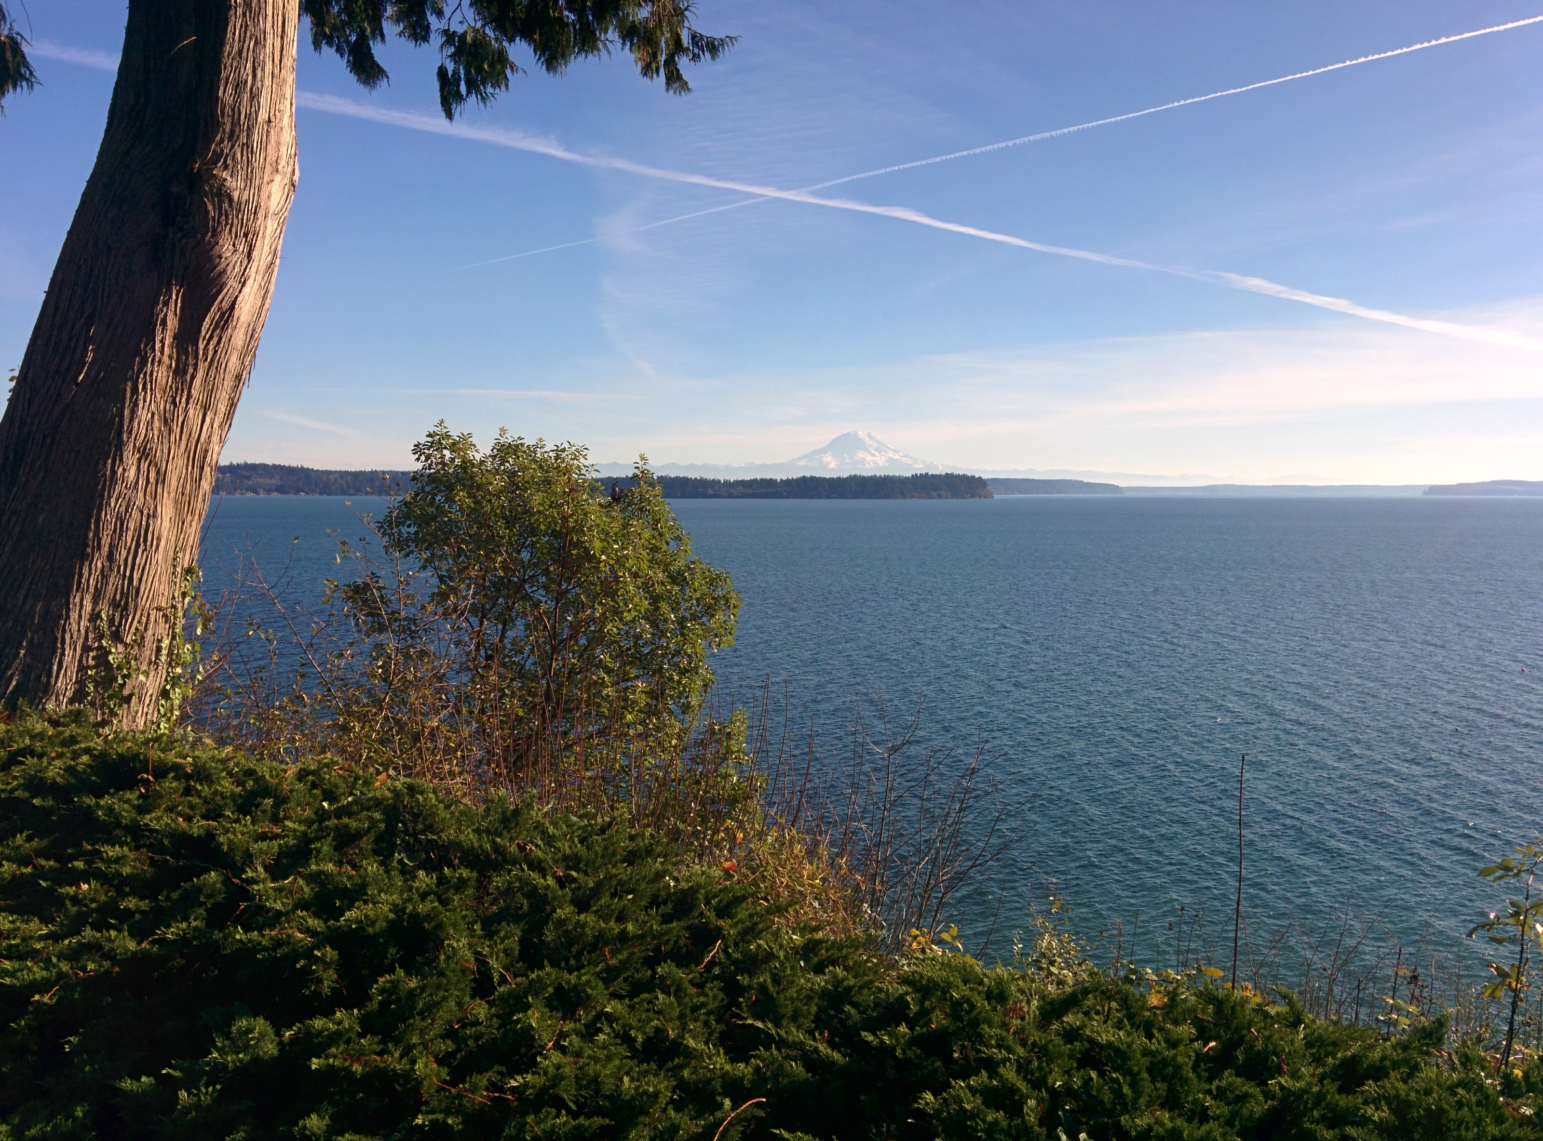

Daniel McDonald
Workshop on Genomics
January 18, 2016

Slide 2
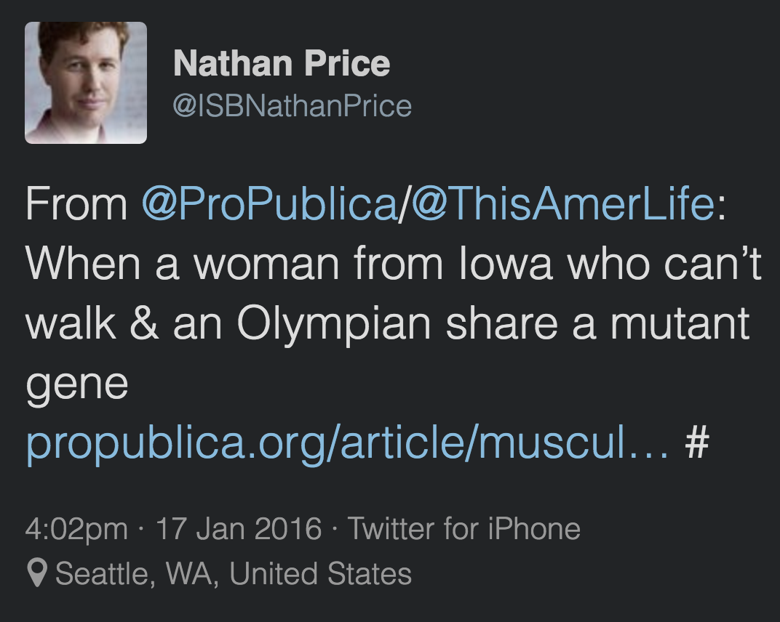

Slide 3
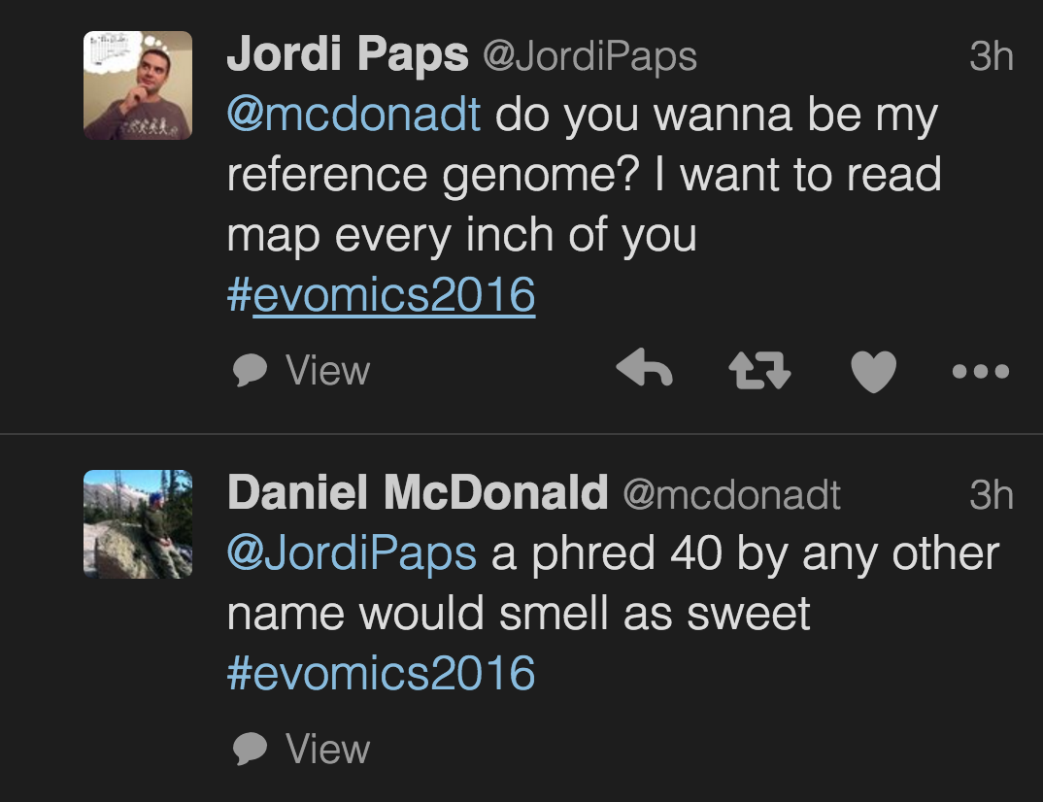

Slide 4

Layout of talk
Why the microbiome?
QIIME!
If we have time, qiita
Image from: http://solvingtheibspuzzle.com/
Notes:
Establish motivation for the American Gut
The problem statement on the prior slide will be discussed in detail within the AG section

Slide 5
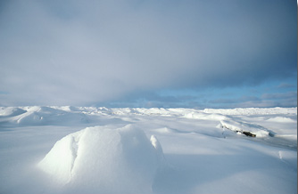
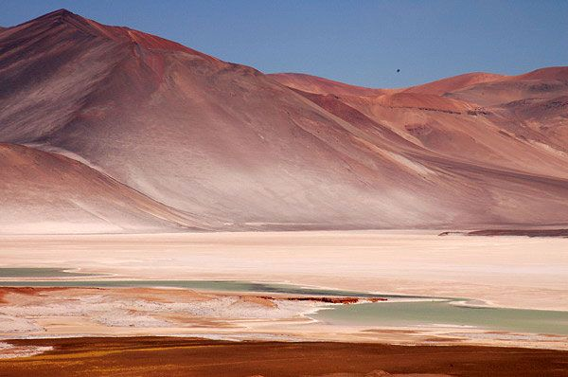
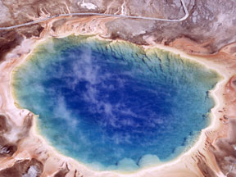
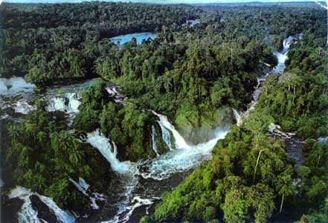
A microbe dominated world
Notes:
Go anywhere in the environment and you can find microbial life
drivers of the global ecosystem
Estimated at 10^30 cells (whitman)

Slide 6
A microbe dominated world
The universal nature of biochemistry. Pace NR.
Proc Natl Acad Sci U S A. 2001 Jan 30;98(3):805-8.
Notes:
…but it isn’t just that they’re everywhere, they are the dominant form of life
Billions of years of evolution and incredible genetic diversity
Complex microbial relationships
But of course, the environment selects (becking)
So if you shove a q-tip everywhere in the environment you can imagine, what distinguishes the collection of microbes found the most?

Slide 7

You are more related to…
http://www.g4tv.com/attackoftheshow/blog/post/717271/velociraptor-riding-a-shark/
Notes:
we are more related to dinosaurs and sharks than some of our bacteria are to each other

Slide 8
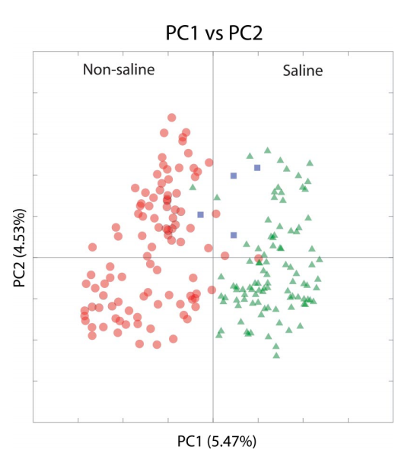
A microbe dominated world
Lozupone and Knight PNAS. 2007 Jul 3;104(27):11436-40
Notes:
And it turns out, whether samples are from saline or non-saline envs
This is a principal coordinates plot, will be showing a few, and will go into detail later on how these plots are created. For now, I want you to interpret as “each point is a sample, points closer are more similar, and PC1 is more meaningful than PC1”
Hotsprings/hydrothermal vents are not outliers
Estuarys in the center
How do animals fit in?

Slide 9
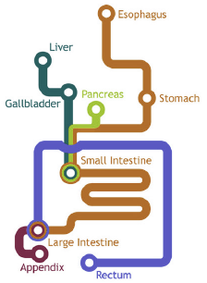
A microbe dominated world
Lozupone and Knight PNAS. 2007 Jul 3;104(27):11436-40
Subway image adapted from http://laughingsquid.com/the-gastrointestinal-system-represented-as-a-subway-map/
Notes:
Rather, what about the organisms that have specialized to gastrointestinal tracts?

Slide 10
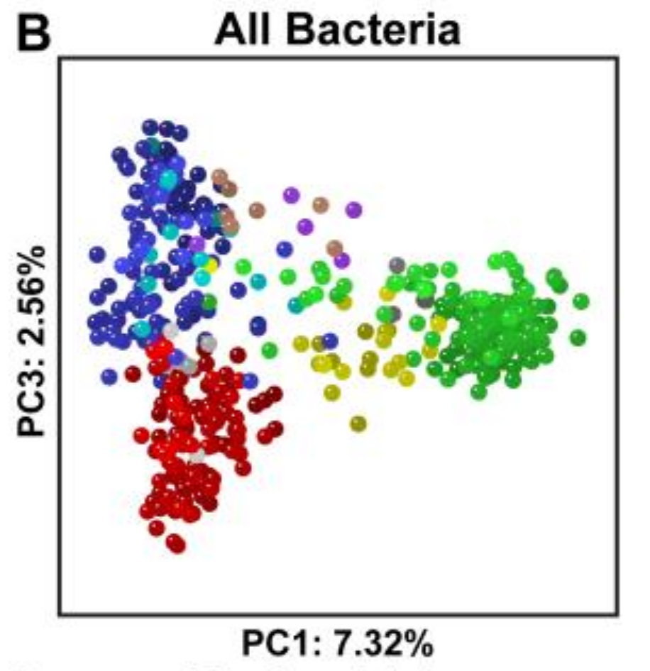
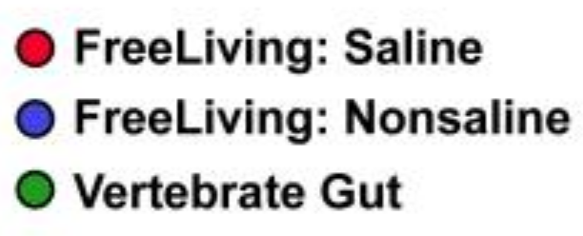
A microbe dominated world
Ley et al Nat Rev Microbiol. Oct 2008; 6(10): 776–788
Subway image adapted from http://laughingsquid.com/the-gastrointestinal-system-represented-as-a-subway-map/
Notes:
Incredibly, notice signal is washed out, primary difference is now env or vertebrate
Notice salne/nonsaline split is still present
3lbs of organisms in and on you

Slide 11

Huttenhower et al. Nature. 2012 486(7402):207-14
Notes:
* …so the HMP was formed to build a reference for human microbial diversity

Slide 12
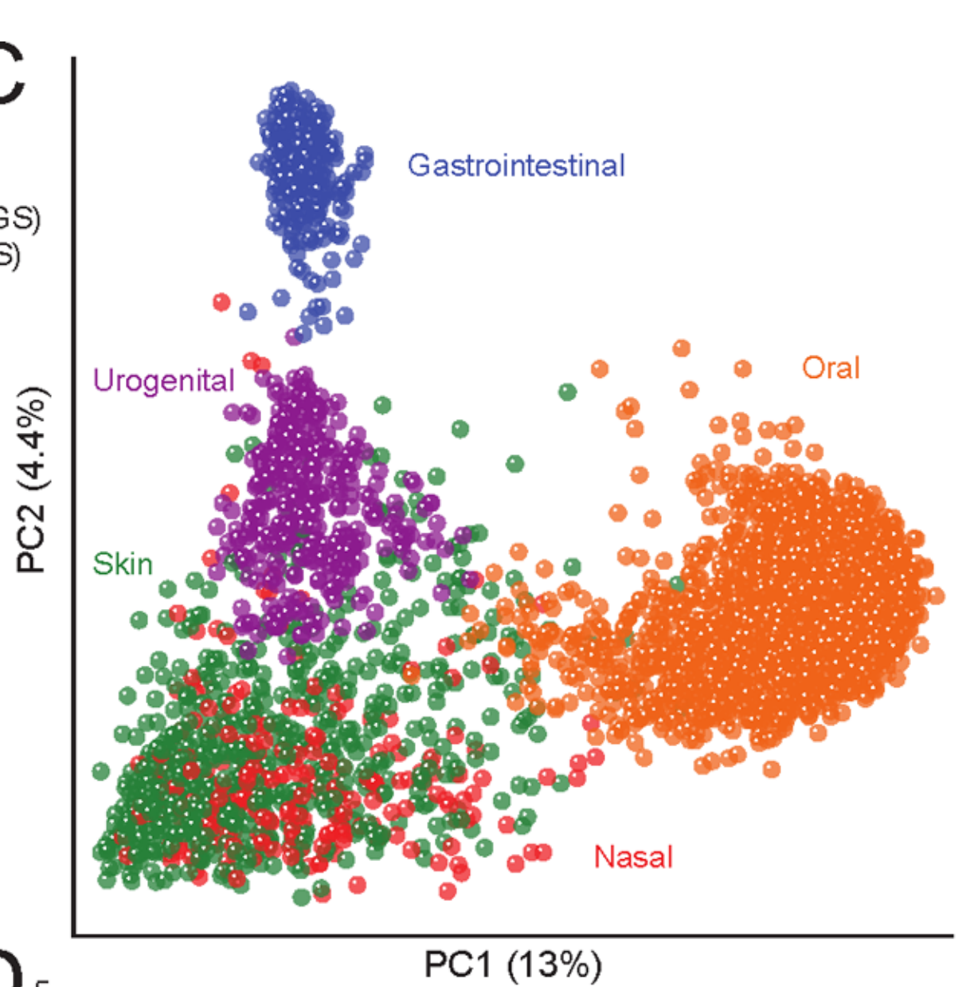
Huttenhower et al. Nature. 2012 486(7402):207-14
Notes:
…however, they only collected samples from 242 healthy medical students from two universities in the United States
Same basic plot as before, but a lot more samples (oddly, surprisingly few from GI despite it having the bulk of life in/on your body)
…but, is this diversity representative of the human population?

Slide 13
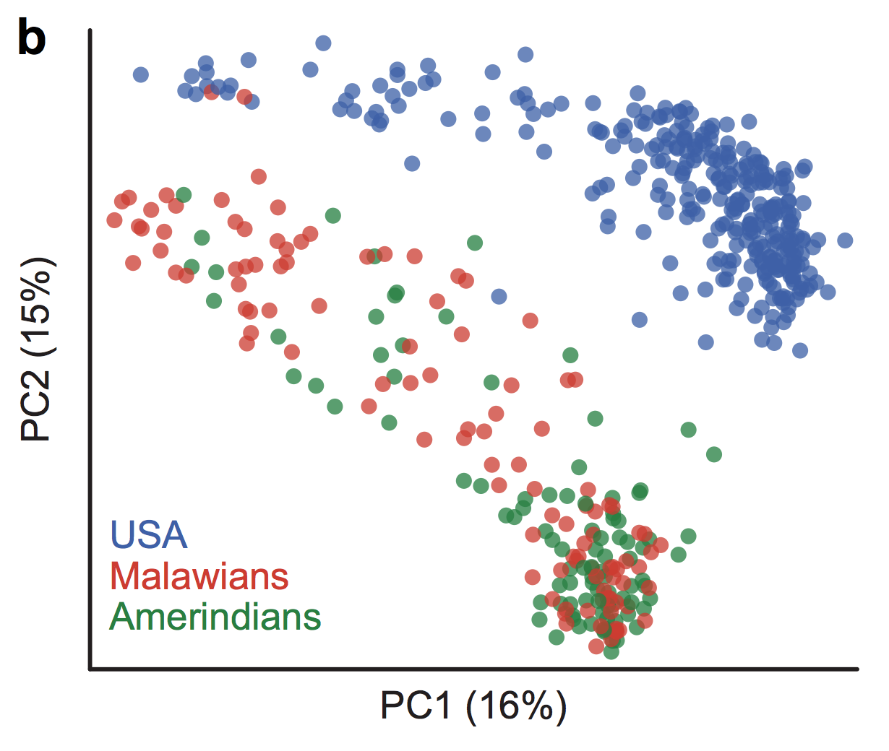
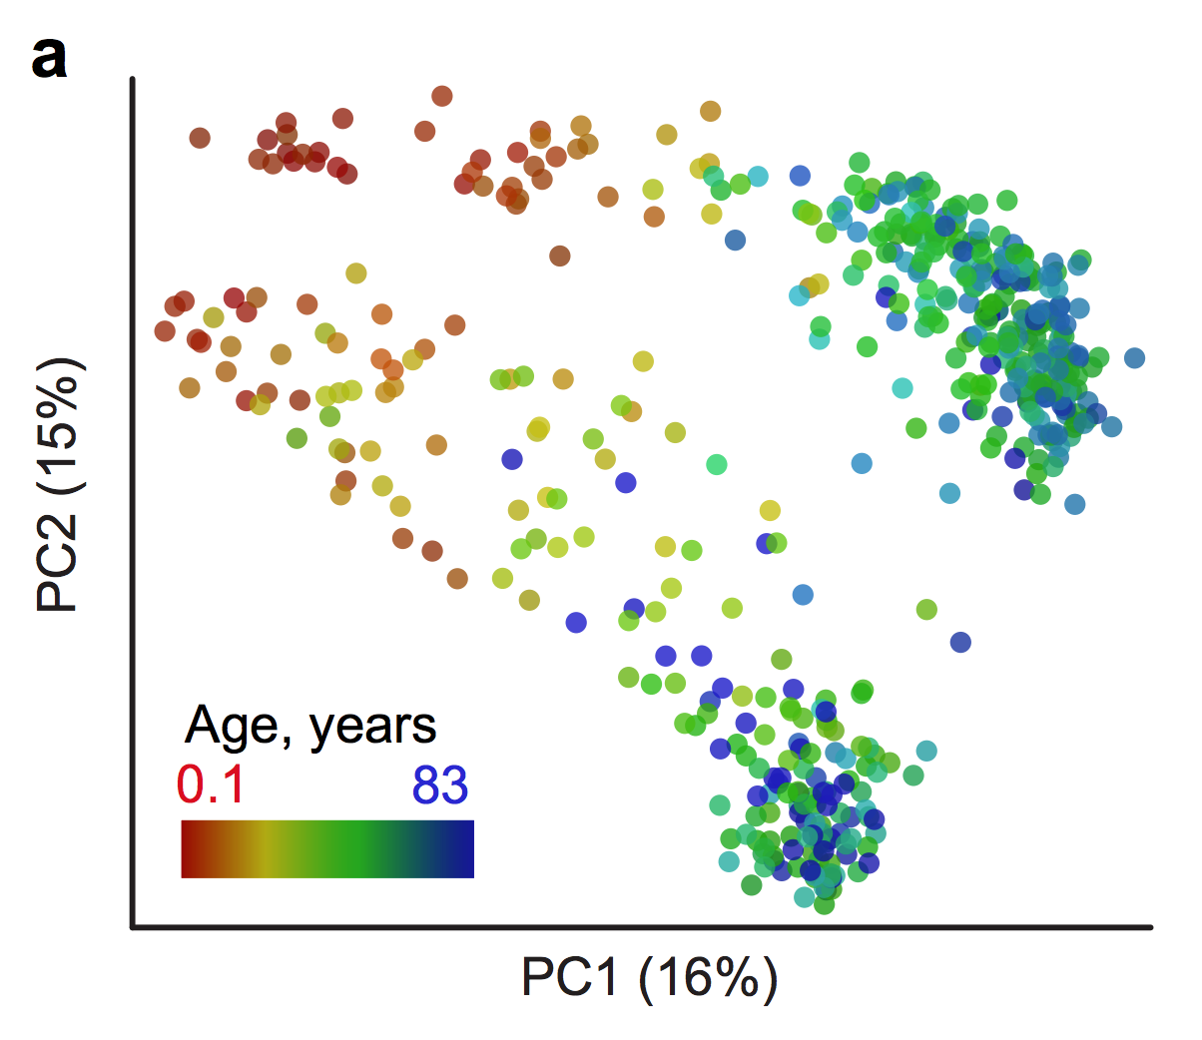
Yatsunenko et al. Nature. 2012 486(7402):222-7
Notes:
…in the same issue of Nature as the HMP, another study called the Global Gut was published
Samples from three different populations, USA, Malawians, and a hunter gather group in Venezuela
Samples from a range of ages within each population were also collected
Primary separation of clusters explained by geographic location

Slide 14
Human Microbiome Project
Yatsunenko et al. Nature. 2012 486(7402):222-7
Notes:
In other words, the HMP despite its goal only characterized a small portion of the recognized diversity at time of publication
To make matters worse, its exceedingly difficult to get phenotypic information about the participants in the HMP
Simply put, we do not know the bounds of diversity associated with healthy or unhealthy individuals or the extent these bounds are modulated by lifestyle choices

Slide 15



Slide 16
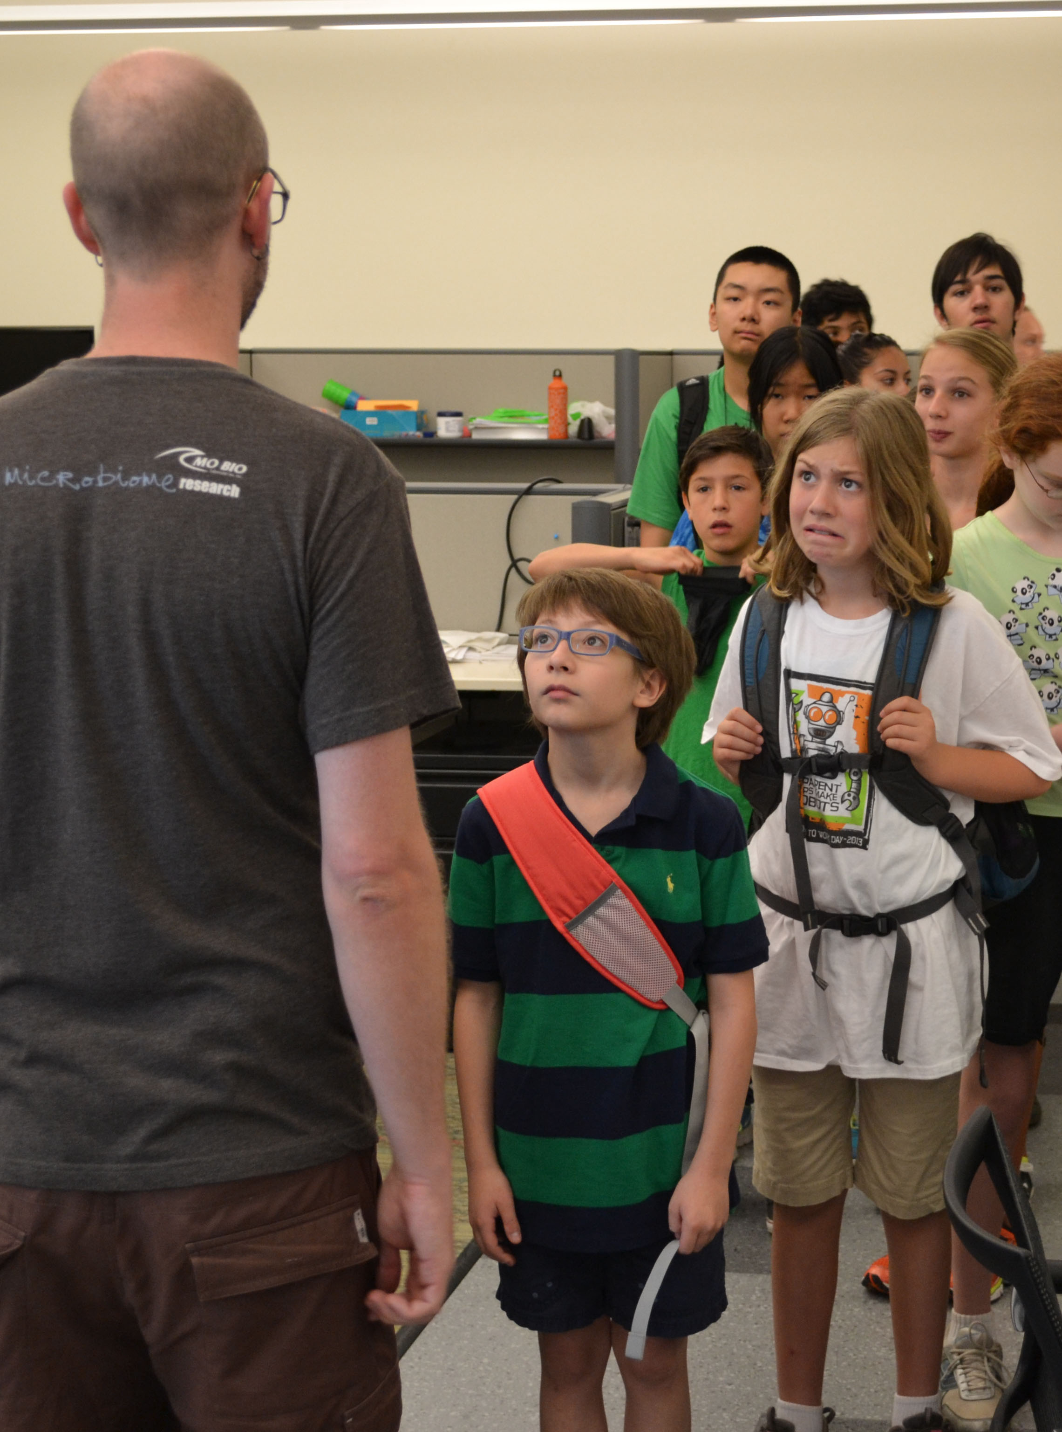

Slide 17
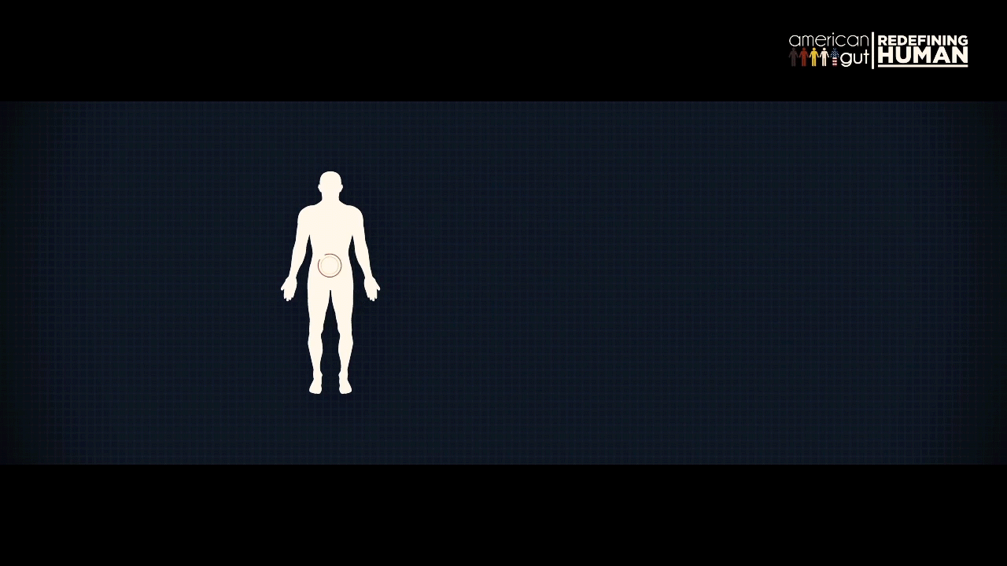
Adapted from http://redefininghuman.com
Please see https://fundrazr.com/campaigns/aoaif/
Notes:
Yes, that is a poop conveyor belt.

Slide 18
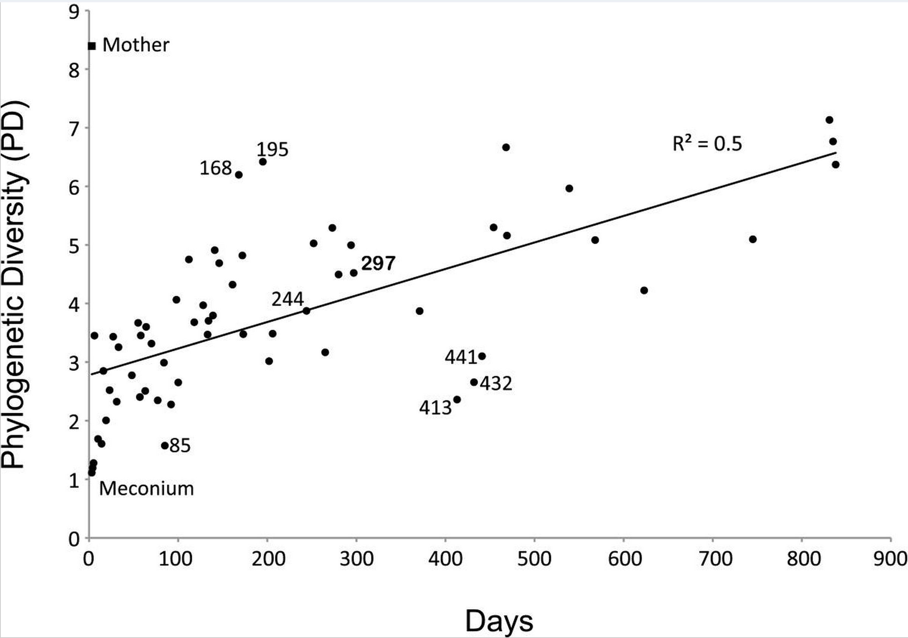
Koeing et al. Proc Natl Acad Sci U S A. 2011 Mar 15;108
Notes:
SWITCH TO VIDEO!

Slide 19
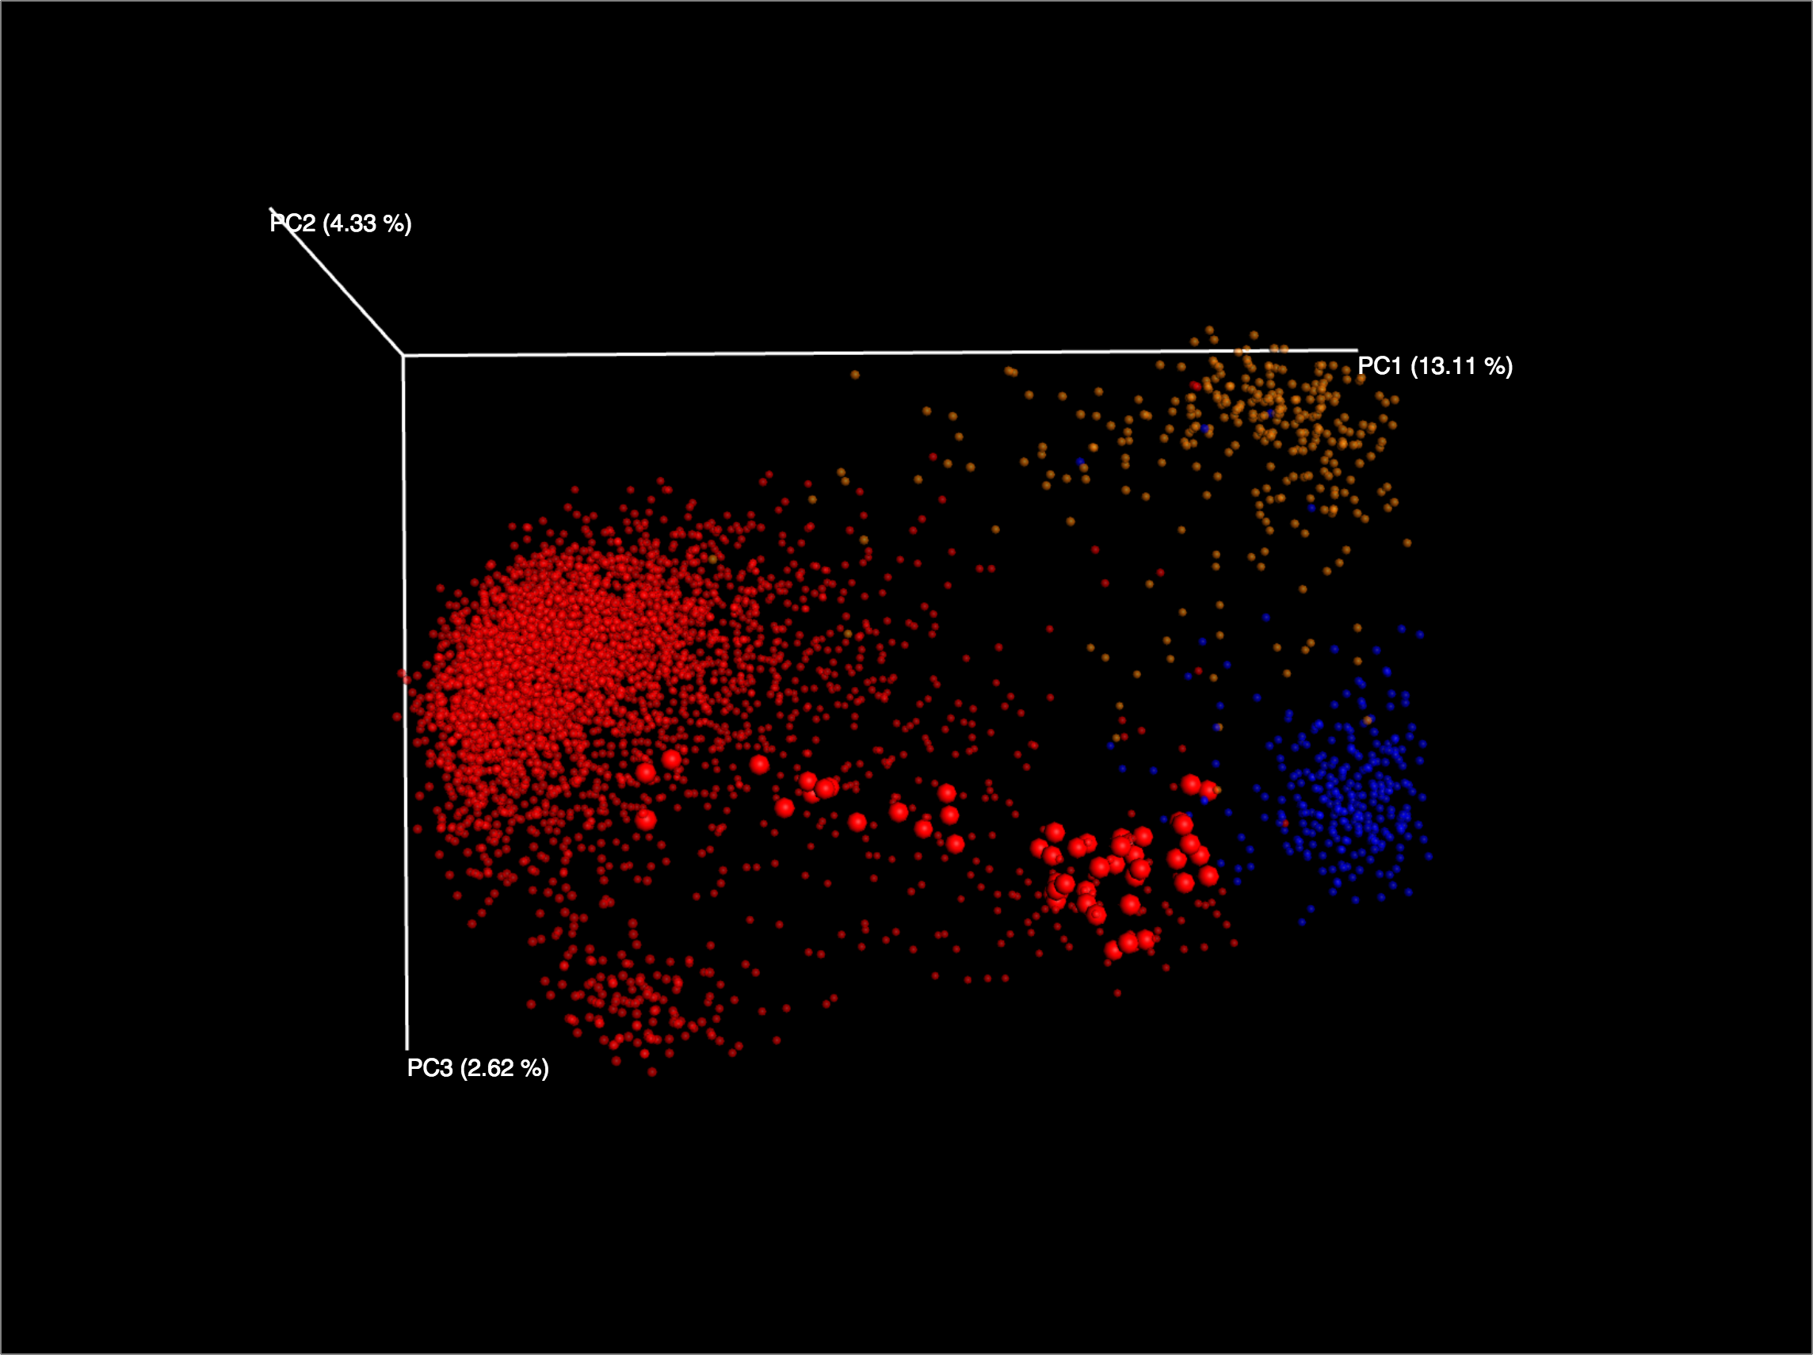
Skin
Fecal
Oral
Notes:
* Setup and orient

Slide 20
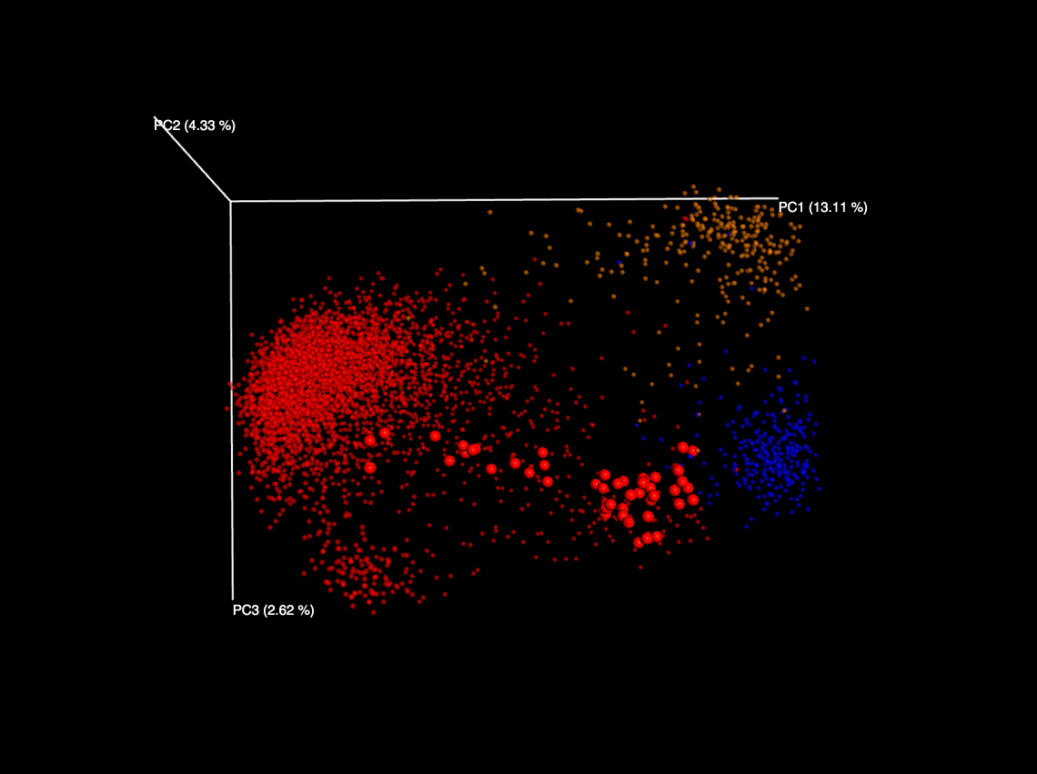
Skin
Fecal
Oral
Notes:
Discuss what points are turned on/off

Slide 21
Skin
Fecal
Oral
Notes:
Note the global gut samples

Slide 22

Skin
Fecal
Oral
Notes:
* Discuss connecting from successive time points
Trending toward the main fecal cloud
Baby obviously wasn’t born orally, but we have few urogenital samples in AG
…

Slide 23
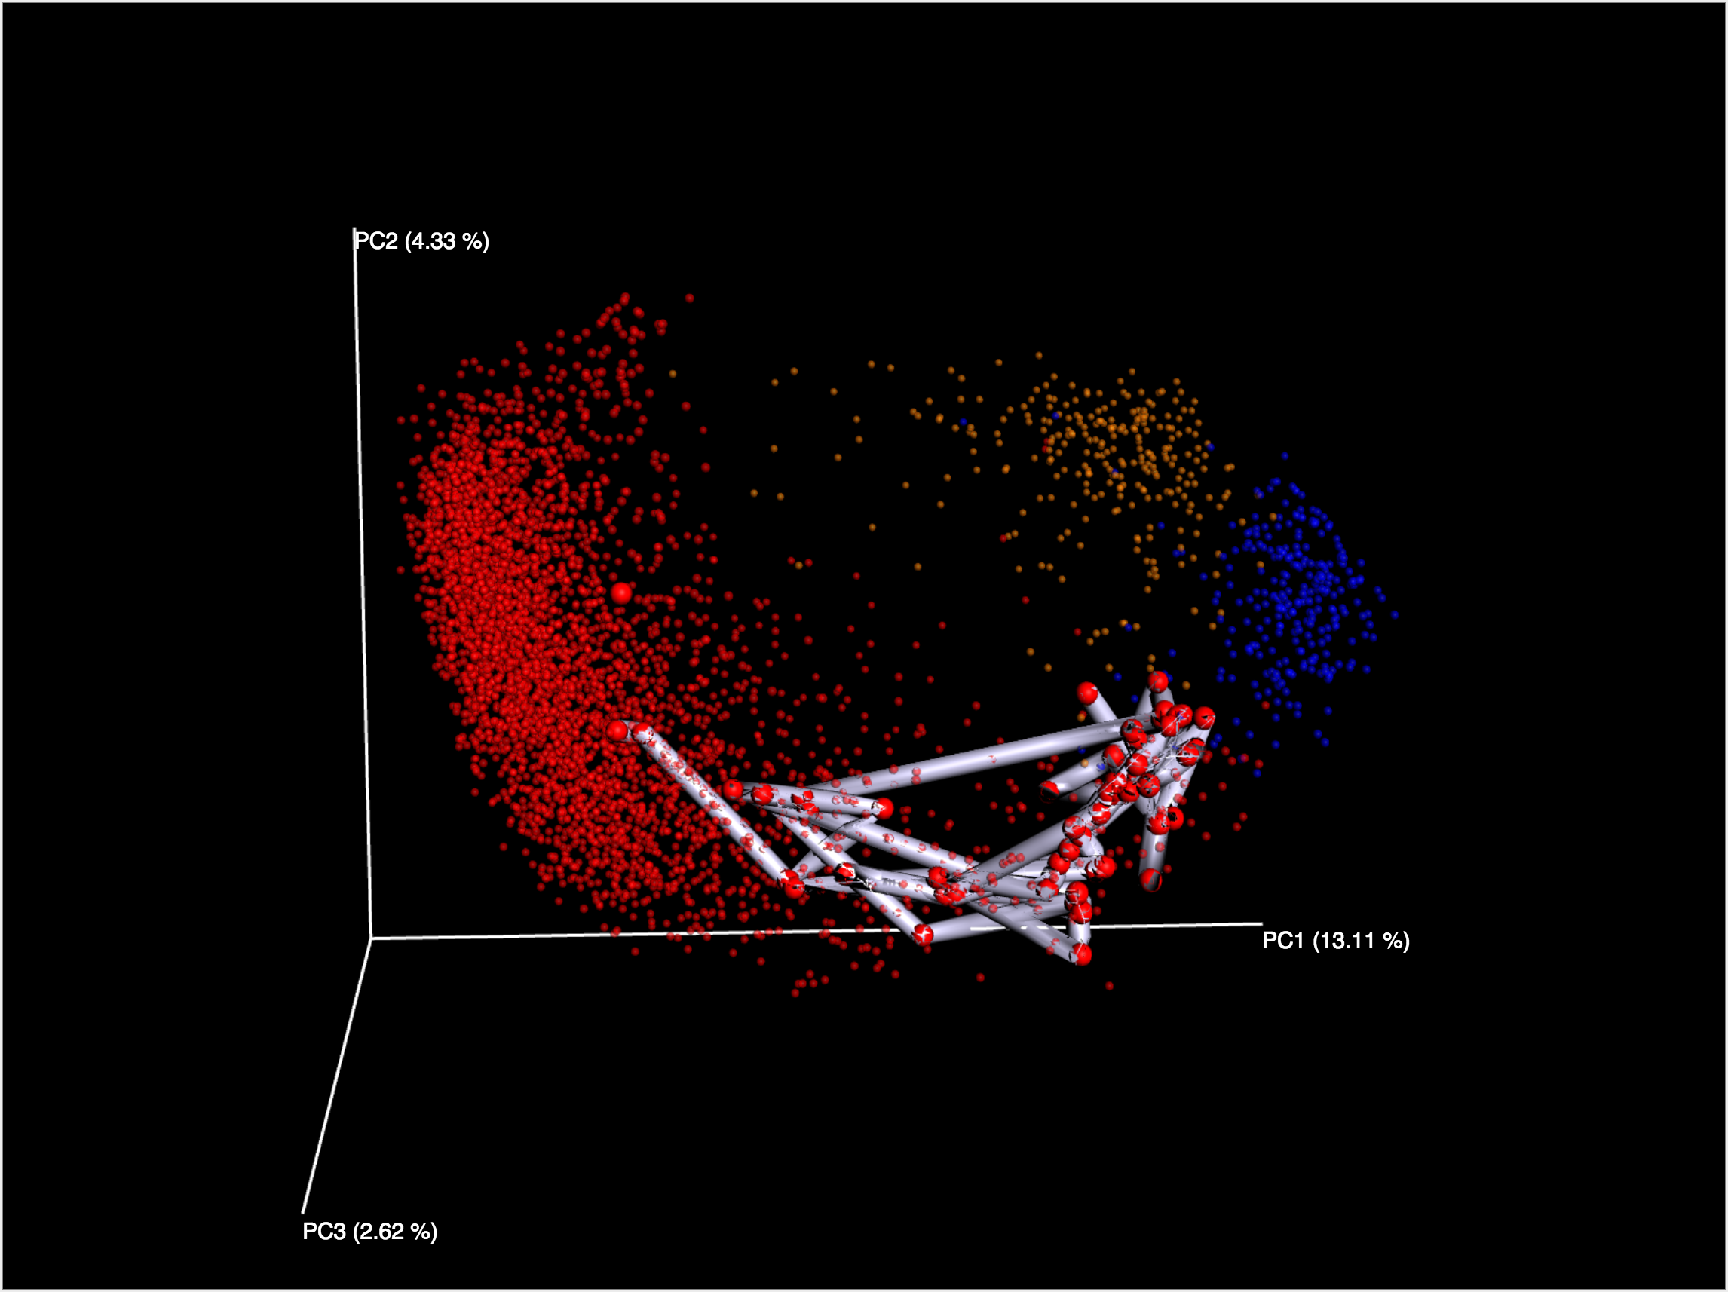
Skin
Fecal
Oral
Notes:
We can watch the succession of these samples, and put life events such as ABX into more perspective

Slide 24


Slide 25
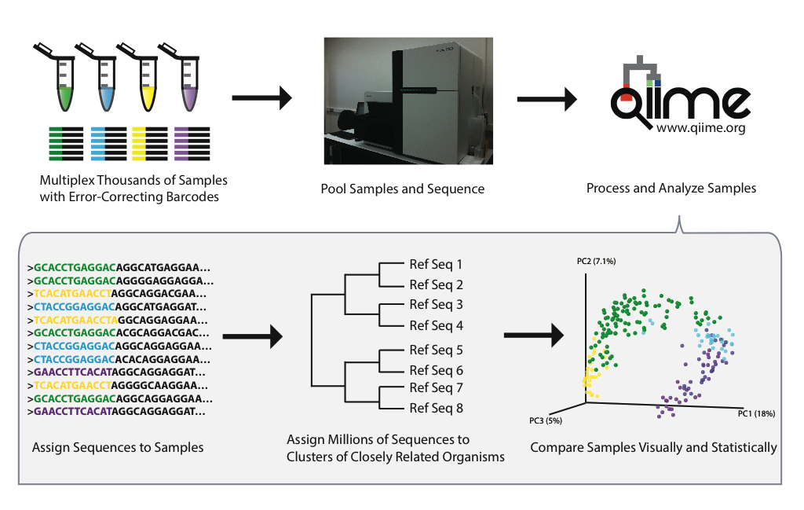
Metcalf, Jessica (2014): Overview of data generation, processing and analysis using QIIME. figshare.
http://dx.doi.org/10.6084/m9.figshare.902219

Slide 26
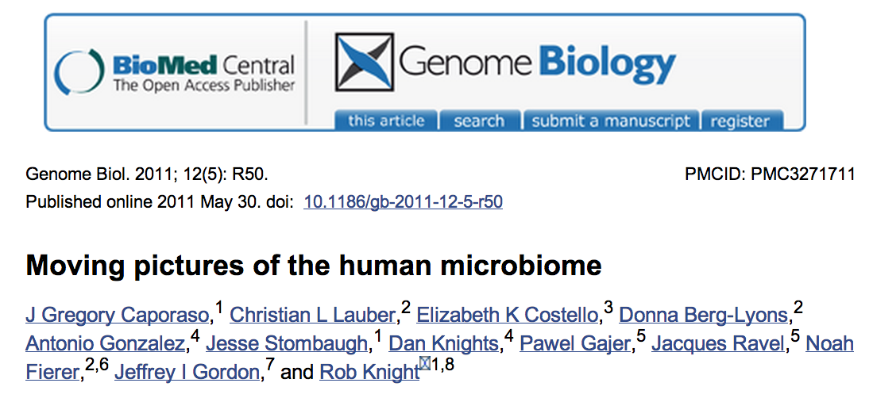
http://www.ncbi.nlm.nih.gov/pubmed/21624126

Slide 27
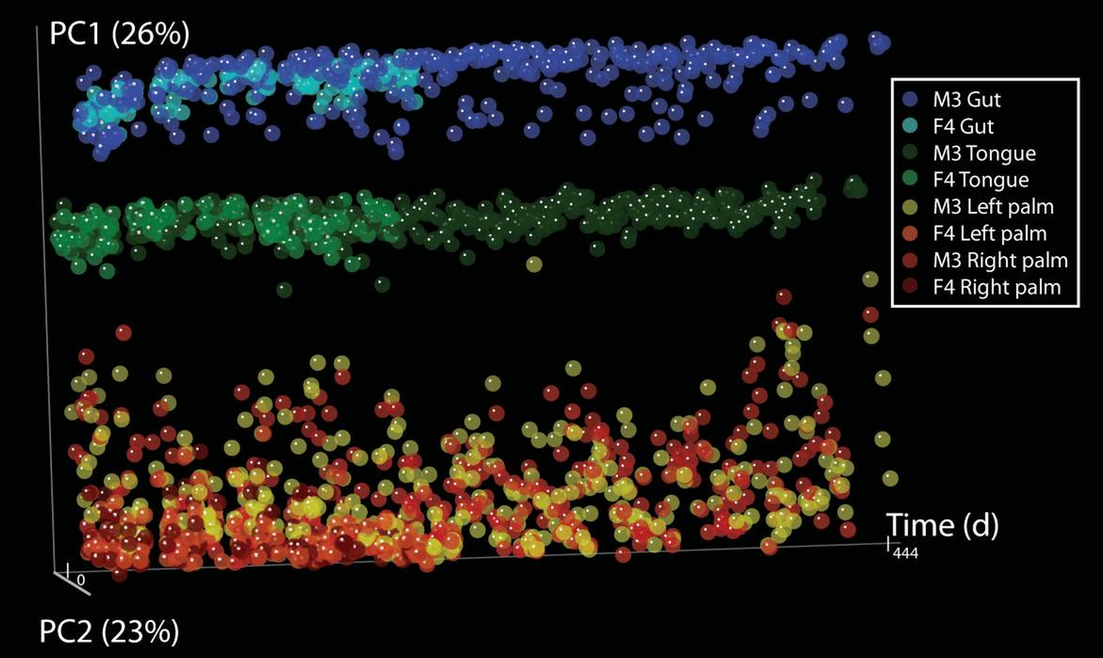
Figure 1, http://www.ncbi.nlm.nih.gov/pubmed/21624126

Slide 28
Start up the notebook
Directions are on the QIIME lab on the evomics.org website

Slide 29
Jupyter Notebook Introduction
Please click on the file named
“Notebook Introduction.ipynb”
Please go through read through the material and execute the contained cells.

Slide 30
QIIME tutorial
Please click on the file named
“illumina_overview_tutorial.ipynb”
Read through the introduction
Read through and execute the cells in the “Getting started” section of the notebook

Slide 31
http://www.qiime.org

Slide 32
http://www.qiime.org

Slide 33
Mapping files

Slide 34

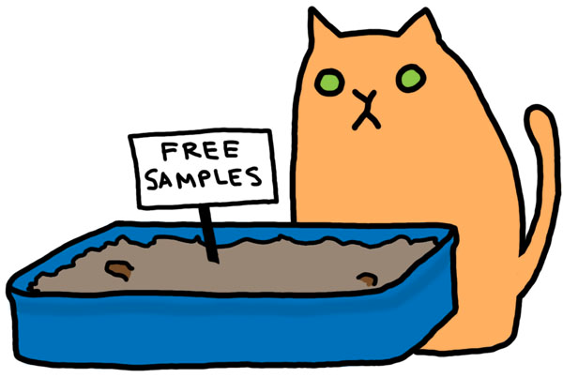
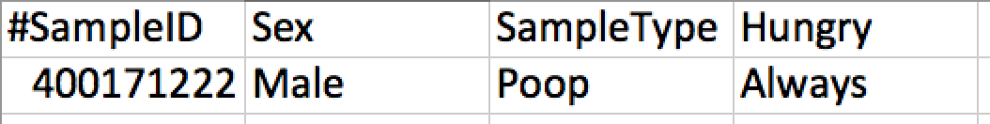
Relates samples to variables
Image: http://www.heatherbrookes.org/hb-blog/?p=2341
Notes:
Relate physical samples to study variables
Is straight forward but…

Slide 35
Check for errors
Work through the “Check our mapping file for errors” section, and execute the command
Try validating the “bad” mapping file
Notes:
Show how to view the full command

Slide 36

Adventure Time, Cartoon Network
Notes:
A children’s cartoon based in a post-apocalyptic world. A true work of art.

Slide 37
Split libraries
Perform quality filtering
Demultiplex sequences
http://www.earthmicrobiome.org/emp-standard-protocols/16s/

Slide 38
Demultiplex your data
Read through and execute the “Demultiplexing and quality filtering sequences” section

Slide 39
http://www.qiime.org

Slide 40
Pick OTUs
Execute the cell that begins with:
  !pick_open_reference_otus.py –o mov…

Slide 41
Understanding OTU picking

Slide 42
Understanding OTU picking

Slide 43
Understanding OTU picking

Slide 44
Understanding OTU picking

Slide 45
Understanding OTU picking

Slide 46
Understanding OTU picking

Slide 47
Understanding OTU picking

Slide 48
Understanding OTU picking
3%
97% OTU, a “species”

Slide 49
Understanding OTU picking
Representative
Sequence
3%
97% OTU, a “species”

Slide 50
Understanding OTU picking
Representative
Sequence
3%
97% OTU, a “species”

Slide 51
Understanding OTU picking
Representative
Sequence
3%
97% OTU, a “species”

Slide 52
Understanding OTU picking
Representative
Sequence
3%
97% OTU, a “species”

Slide 53
Understanding OTU picking
Representative
Sequence
3%
97% OTU, a “species”

Slide 54
Understanding OTU picking
Representative
Sequence
3%
97% OTU, a “species”

Slide 55
Understanding OTU picking
Representative
Sequence
3%
De novo OTU picking
97% OTU, a “species”

Slide 56
Understanding OTU picking

Slide 57
Understanding OTU picking
Representative
Sequence

Slide 58
Understanding OTU picking
Representative
Sequence
Failed
Sequences

Slide 59
Understanding OTU picking
Representative
Sequence
Failed
Sequences
Closed reference OTU picking

Slide 60
Understanding OTU picking
Representative
Sequence
New
Clusters

Slide 61
Understanding OTU picking
Representative
Sequence
New
Clusters
Open reference OTU picking

Slide 62
Understanding OTU picking
De novo
  Single study
  Poor characterization of existing taxa
  Good characterization of novel taxa
Closed-reference
  Combine studies
  Good characterization of existing taxa
  Poor characterization of novel taxa
Open-reference (QIIME default)
  Single study
  Good characterization of existing taxa
  Good characterization of novel taxa
In depth discussion here in Rideout et al 2014 (https://peerj.com/articles/545/)

Slide 63
Pick open reference OTUs
Workflow script, performs all steps through building an OTU table
  Determine the OTU clusters
  Pick the representative sequence for each OTU cluster
  Align the sequences to a template or other reference alignment
  Assign taxonomy if performing a de novo OTU picking
  Remove non-phylogenetically informative positions
  Construct a phylogeny from an alignment
  Constructs the actual OTU table object

Slide 64
Pick OTUs
Read through the rest of the text in the “OTU Picking…” section
Once the “pick_open_reference_otus.py” cell has completed, execute the remaining cells in the section
Read through and execute the “Create a single mapping file…” section

Slide 65
What is this BIOM thing?

Slide 66



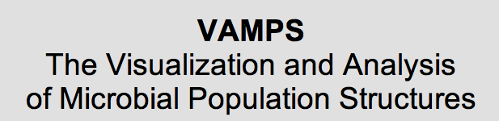
http://biom-format.org
Genomic Standards Consortium standard format
The Biological Observation Matrix (BIOM) format or: how I learned to stop worrying and love the ome-ome. McDonald, Clemente, et al. Gigascience 2012 1:7

Slide 67
What do these things look like?

Slide 68
sample x observation contingency matrix
Observation
counts

Slide 69
sample x observation contingency matrix
Observation
counts

Slide 70
sample x observation contingency matrix
Marker
gene (e.g., 16S)
surveys
Comparative
genomics
Marker
gene (e.g., 16S)
surveys
Metagenomics
Metatranscriptomics
. . .
Metabolomics

Slide 71
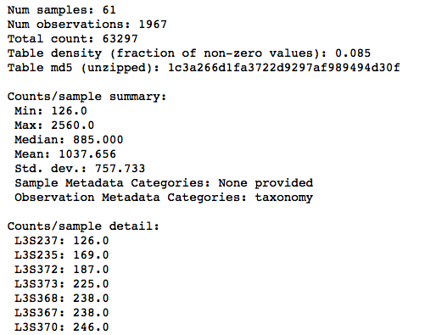
biom summarize-table

Slide 72
biom summarize-table
Fingerprint

Slide 73
biom summarize-table
Statistics

Slide 74
biom summarize-table
Breakdown per sample

Slide 75
http://www.qiime.org

Slide 76
Diversity
Execute the cell that begins with:
  !core_diversity_analyses.py –o mo…

Slide 77
Alpha and beta diversity
Alpha is within a sample
  E.g., how many species are in a sample
Beta is between samples
  E.g., how similar are two samples
Lots of ways to calculate these

Slide 78
Alpha diversity
A
B

Slide 79
Alpha diversity
A
B
Alpha diversity = 3
Alpha diversity = 4

Slide 80
Alpha diversity
A
B
Alpha diversity = 3
Alpha diversity = 4
Sample B is more diverse than sample A

Slide 81
Alpha diversity
A
B
Alpha diversity = 3
Total sequences = 4
Alpha diversity = 4
Total sequences = 8

Slide 82
Rarefaction
A
B
Alpha diversity = 3
Total sequences = 4
Alpha diversity = 4
Total sequences = 8
Randomly select 4 sequences from B

Slide 83
Rarefaction
A
B
Alpha diversity = 3
Total sequences = 4
Alpha diversity = 4
Total sequences = 8
Rarefy to 4 sequences

Slide 84
Rarefaction
A
B

Slide 85
Rarefaction
A
B
Alpha diversity = 3
Alpha diversity = 2

Slide 86
Rarefaction
A
B
Alpha diversity = 3
Alpha diversity = 2
Sample A is more diverse than sample B

Slide 87
Multiple Rarefaction
adiv
?
100
# seqs
1,000
2,000
Repeatedly calculate alpha div at different number of sequences

Slide 88
Multiple Rarefaction
adiv
100
80
40
# seqs
250
500
1,000
Higher sequencing effort will probably result in higher observed diversity

Slide 89
Multiple Rarefaction
adiv
100
95
# seqs
250
500
1,000
Higher sequencing effort will probably not add to observed diversity

Slide 91
Alpha diversity

Slide 92
Alpha diversity

Slide 93
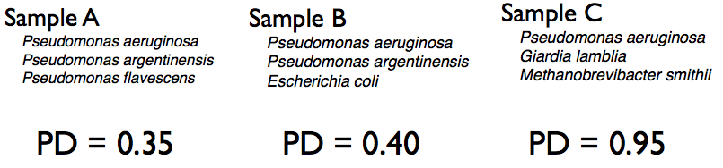
Phylogenetic Diversity (PD)

Slide 94

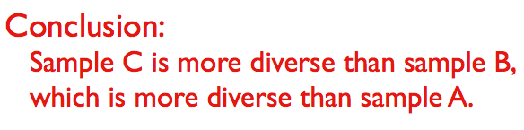
Phylogenetic Diversity (PD)

Slide 95
Beta diversity
A
B
C

Slide 96
Beta diversity
A
B
A – B = 2
C

Slide 97
Beta diversity
A
B
A x B = 2
A x C = 2
C

Slide 98
Beta diversity
A
B
A x B = 2
A x C = 2
B x C = 1
C

Slide 99
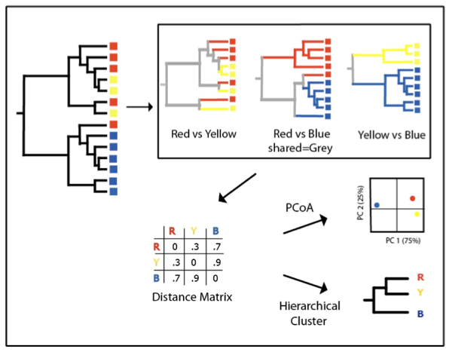
Beta diversity

Slide 100
Let’s look at the results!

Slide 101
You can also…
Change to the tutorial directory and explore the results using commands in bash
The path is long, it is under:
  ~/workshop_data/qiime/moving_pictures_tutorial-1-9.0/illumina/otus/cdout

Slide 102

QIIME Forum
Search the forum
http://forum.qiime.org
We try to answer within 24 hours
forum

Slide 103
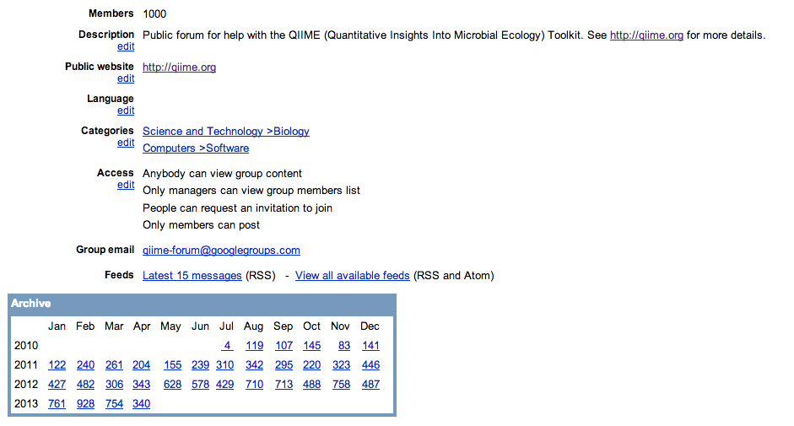
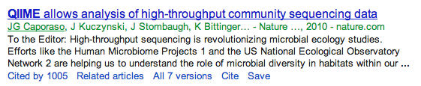
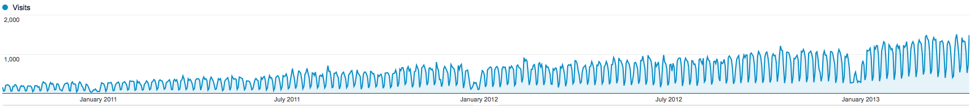
QIIME Forum

Slide 104

Modified from http://bio.sacnas.org/uploads/Judges/we_need_you.jpg

Slide 105

http://github.com/biocore/qiime
http://octodex.github.com/front-end-conftocat/

Slide 106
What’s coming up?

Slide 107
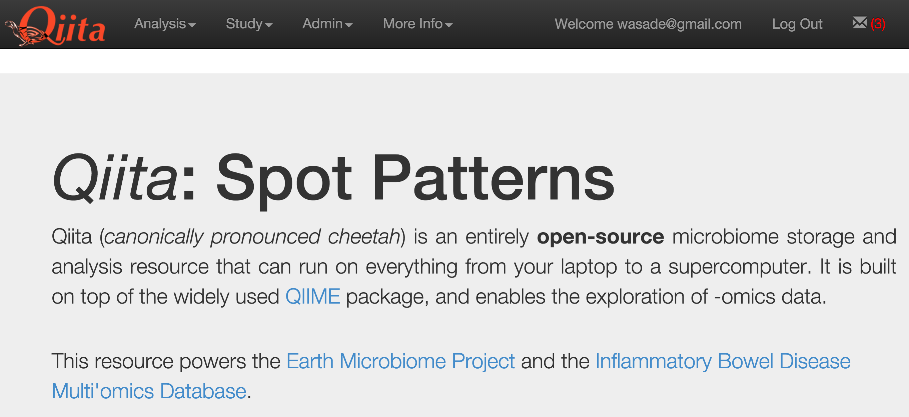

Slide 108
QIIME2: the sequel
https://hackpad.com/QIIME-2-planning-7-Dec-2015-cdA98OygNKF

Slide 109


Slide 110
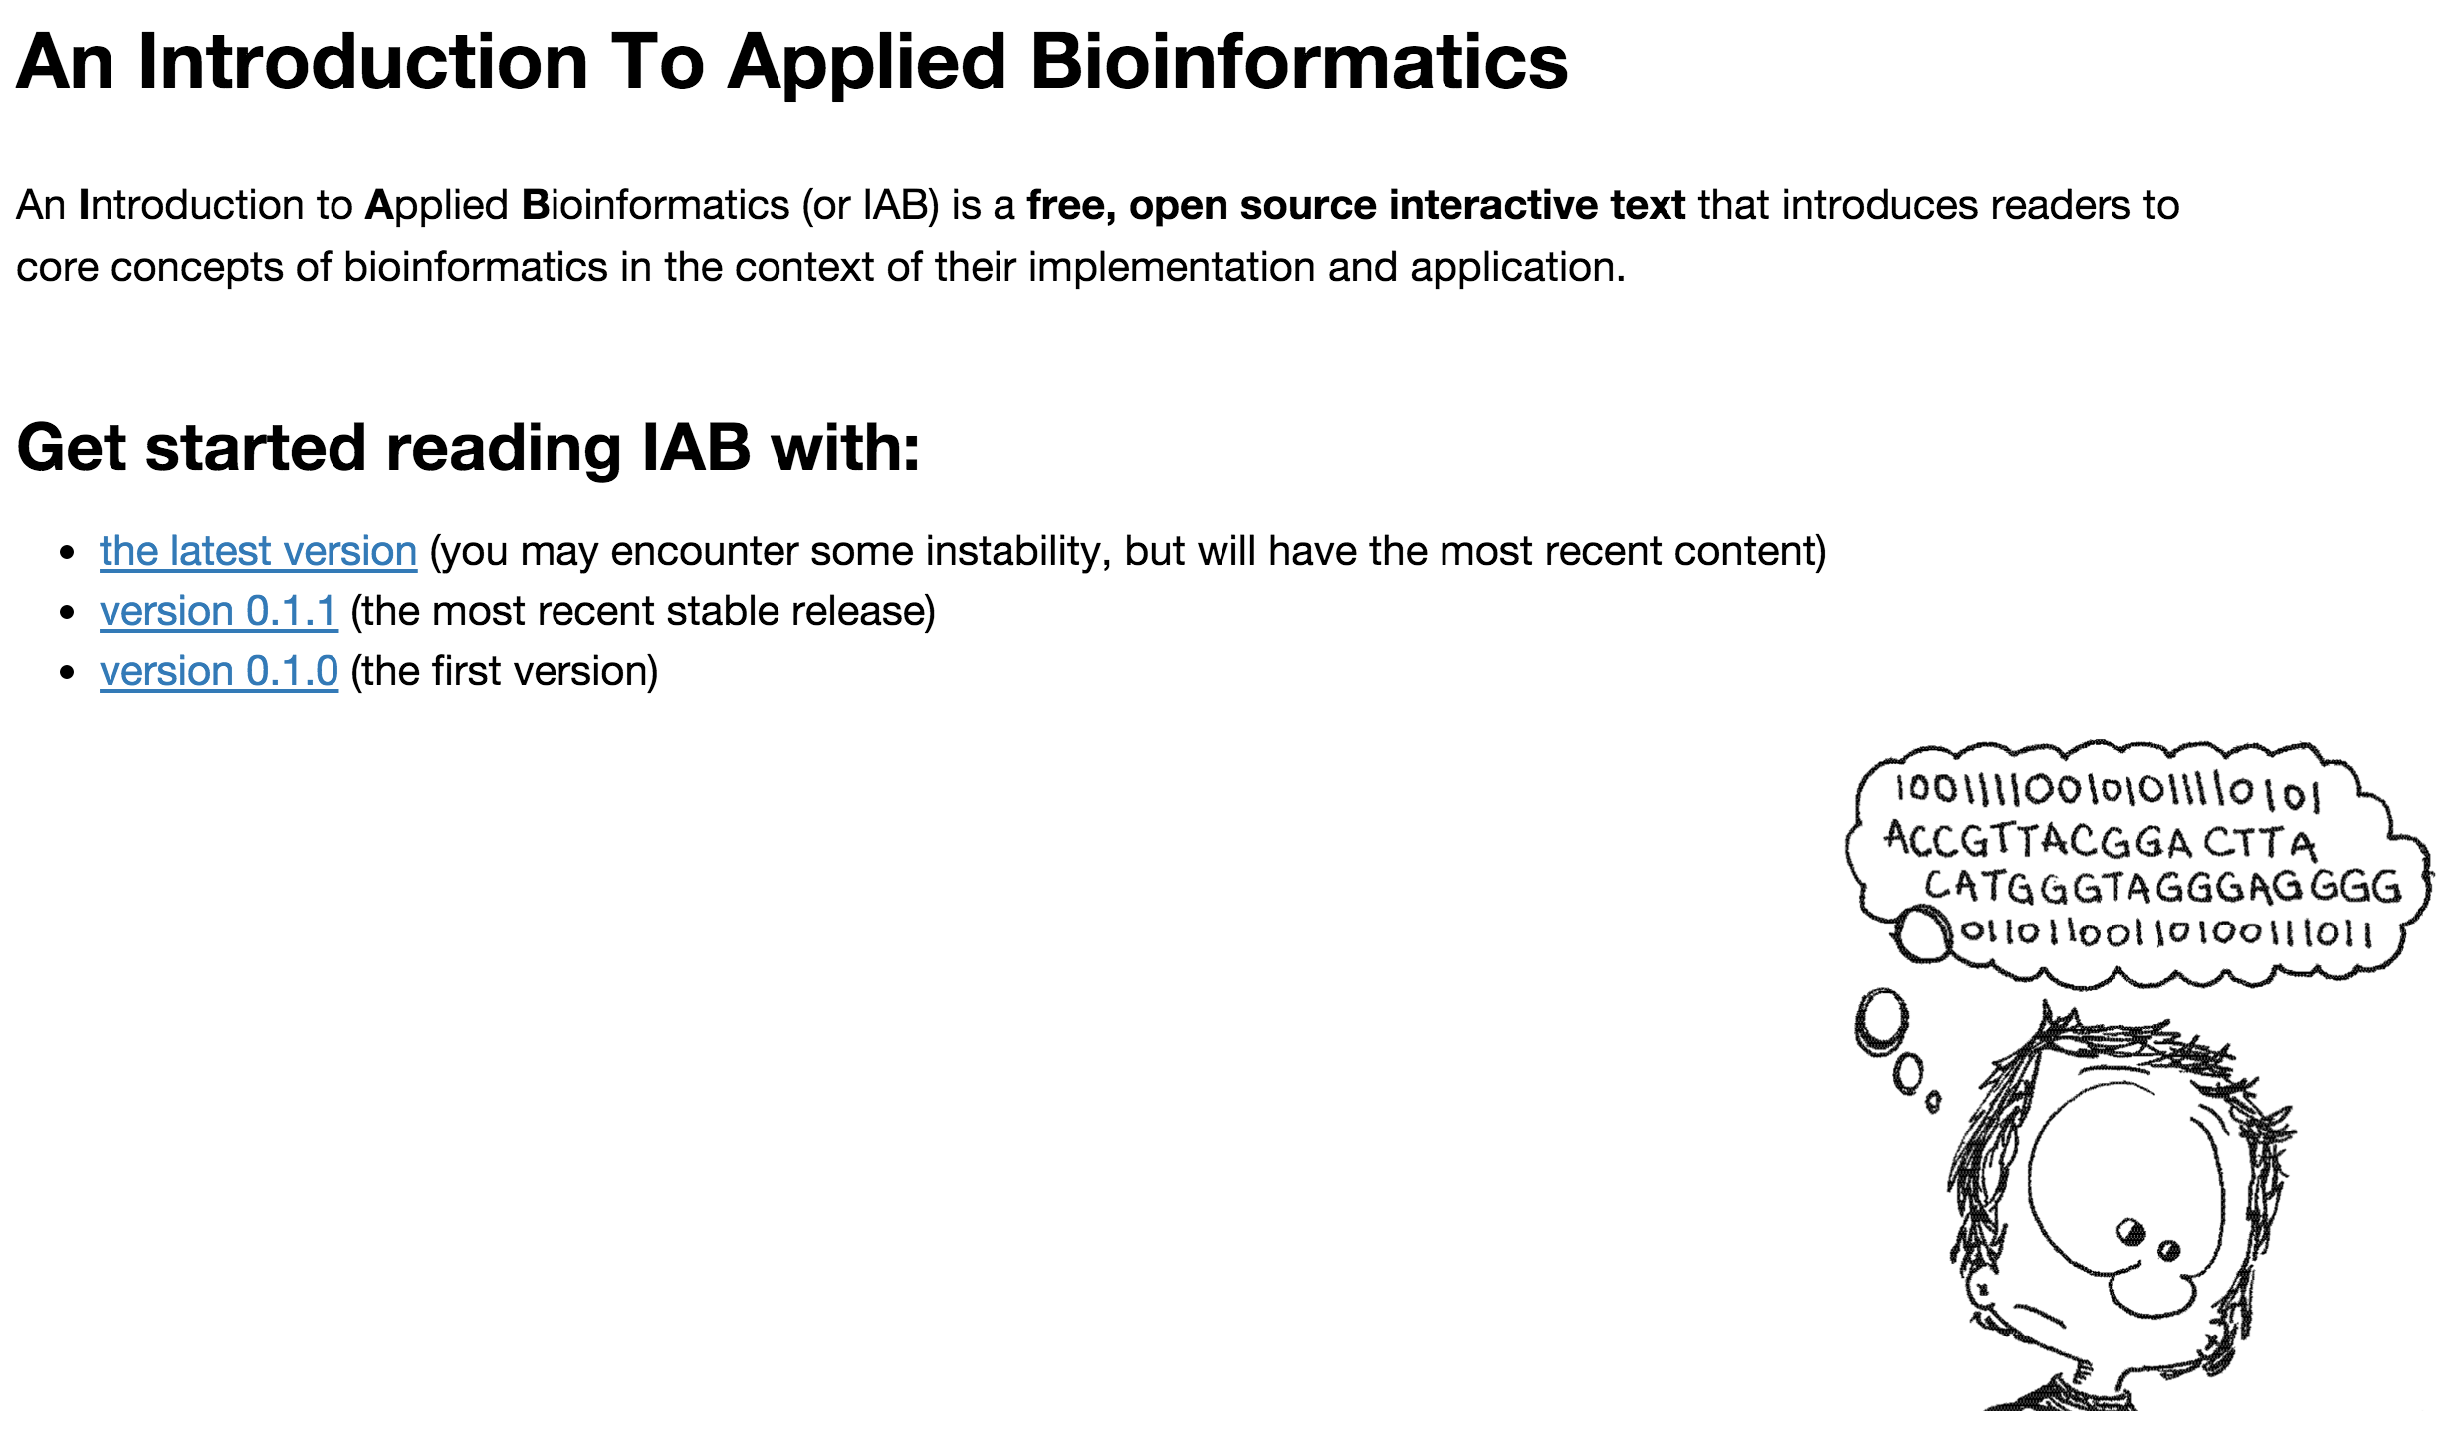

Slide 111





Acknowledgments
Rob Knight
Antonio Gonzalez
Adam Robbins-Pianka
Will Van Treuren
Luke Ursell
Jose Clemente
Daniel McDonald
Greg Caporaso
Yoshiki Vazquez Baeza
The Knight Laboratory
Team of QIIME Developers
These slides have been adapted from multiple sets of slides.
daniel.mcdonald@systemsbiology.net
Twitter: @mcdonadt
Github: @wasade
www: http://wasade.github.io

