Slide 1


Modern approaches to sequencing
(and some history)
Konrad Paszkiewicz
January 2015

Slide 2
Contents
History of DNA
Review of first generation sequencing techniques
Short read second generation sequencing technology
Third generation single molecule sequencing
Nanopore sequencing

Slide 3
A history of DNA

Slide 4
“The double helix is indeed a remarkable molecule.
Modern man is perhaps 50,000 years old, civilization
has existed for scarcely 10,000 years and the United
States for only just over 200 years; but DNA and
RNA have been around for at least several billion
years.
All that time the double helix has been there,
and active, and yet we are the first creatures on Earth
to become aware of its existence.”
Francis Crick (1916–2004)
Notes:
We’re all brought here by the study of DNA.
I'm amazed by DNA. It is a molecule which over the course of 3-4 billion years has evolved an organism capable of discovering, studying and modifying the molecule which encodes it.
We're the first creatures to be able to do this. And it all happened over the course of the last 150 years.

Slide 5
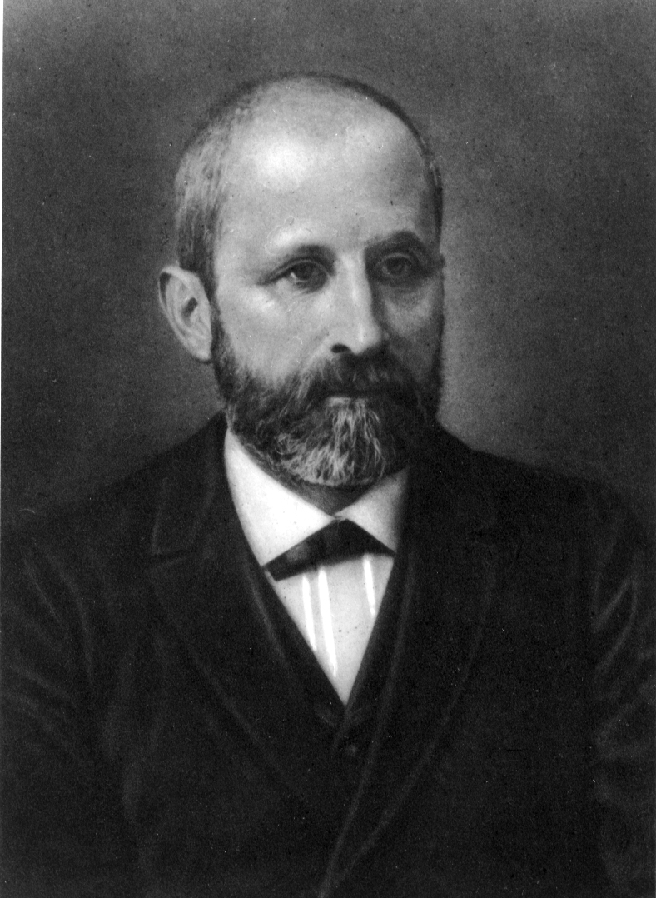
The first person to isolate DNA
Friedrich Miescher
  Born with poor hearing
  Father was a doctor and refused to allow Freidrich to become a priest
Graduated as a doctor in 1868
  Persuaded by his uncle not to become a practising doctor and instead pursue natural science
  But he was reluctant…
Friedrich Miescher

Slide 6
Biology PhD angst in the 1800s
“I already had cause to regret that I had so little experience with mathematics and physics… For this reason many facts still remained obscure to me.”
His uncle counselled:
“I believe you overestimate the importance of special training…”
Friedrich Miescher
Notes:
His uncle basically said ‘ eh, don’t worry about it. So, long as you work hard and do your best, you’ll be fine’

Slide 7
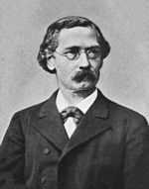
1869 - First isolation of DNA
Worked in Felix Hoppe-Seyler’s laboratory in Tubingen, Germany
  The founding father of biochemistry
The lab was one of the first to crystallise haemoglobin and describe the interaction between haemoglobin and oxygen
Freidrich extracted ‘nuclein’ on cold winter nights
  Initially from human leukocytes extracted from bandage pus from the local hospital
  Later from salmon sperm
Felix Hoppe-Seyler
Friedrich Miescher

Slide 8
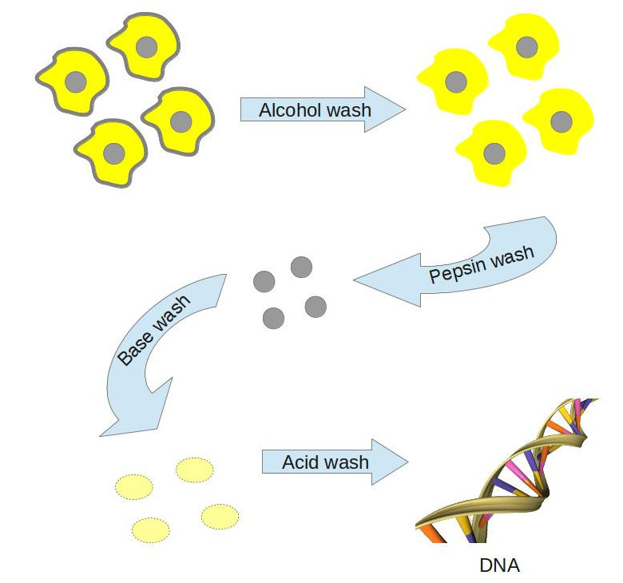
Meischer’s isolation technique
Cells from surgical bandages or salmon sperm
Alcohol to remove outer cell membrane
Pepsin from pig stomachs
Basic solution to dissolve nuclein in the nucleus
Acid solution to precipitate the nuclein
Difficult to do without also precipitating bound protein
http://www.howdoweknowit.com/2013/07/03/how-do-we-know-the-genetic-code-part-2/

Slide 9
Biology PhD angst in the 1800s
“I go at 5am to the laboratory and work in an unheated room. No solution can stand for more than 5 minutes… Often it goes on until late into the night.”
His student remembered:
Friedrich failed to turn up for his own wedding. We went off to look for him. We found him quietly working in his laboratory.
Friedrich Miescher

Slide 10
1874 - First hints to composition
By 1874 Meischer had determined that nuclein was
  A four basic acid
  High molecular weight
  Nuclein was bound to ‘protamin’
Came close to guessing its function
  “If one wants to assume that a single substance is the specific cause of fertilisation, the one should undoubtedly first and foremost consider nuclein”
  Discarded the idea because he thought it unlikely that nuclein could encode sufficient information
Friedrich Miescher

Slide 11
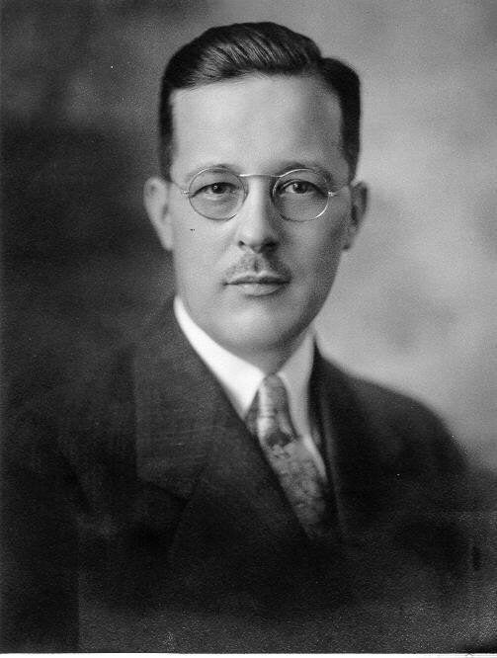
1881 - Discovering the composition of nuclein
Kossel worked in the same lab as Freidrich Miescher
Discovered fundamental building blocks of nuclein
  Purine and pyrimidine bases, sugar and phosphoric acid
  Identified histone proteins and that nuclein was bound to histone in the nucleus
  Inferred that nuclein was not used for energy storage but was linked to cell growth
Albrecht Kossel

Slide 12
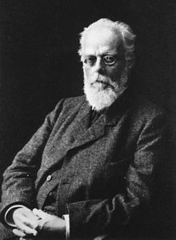
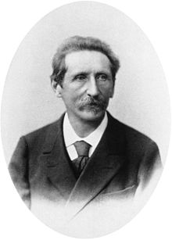
1890s - Molecular basis of heredity
Lots of theories
  Stereo-isomers
  Asymmetric atoms
  Complex molecules
Realisation that hereditary information is transmitted by one or more molecules
1893 August Weismann – germ plasm theory
1894 Eduard Strasburger- “nuclei from nuclei”
August Weismann
Eduard Strasburger
Notes:
August Weismann - His germ plasm theory states that multicellular organisms consist of germ cells that contain and transmit heritable information, and somatic cells which carry out ordinary bodily functions. Inheritance takes place only via the gonads
He came up with one of the modern laws of plant cytology: "New cell nuclei can only arise from the division of other nuclei." and originated the terms cytoplasm and nucleoplasm.
Together with Walther Flemming, and Edouard van Beneden he elucidated chromosome distribution during cell division. His work on the upward movement of tree sap proved that the process was physical and not physiological

Slide 13
1900 - What we knew
Known
Unknown
Distinction between proteins and nucleic acids
Somehow nuclein was involved in cell growth
Somehow the nucleus was involved in cell division
Mendel’s lost laws
Base composition of nucleic acids
Role of the nucleus
Distinction between RNA and DNA
Significance of chromosomes
That enzymes were proteins
Most of biochemistry

Slide 14
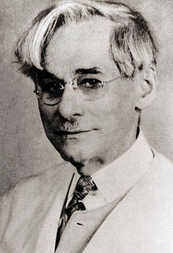
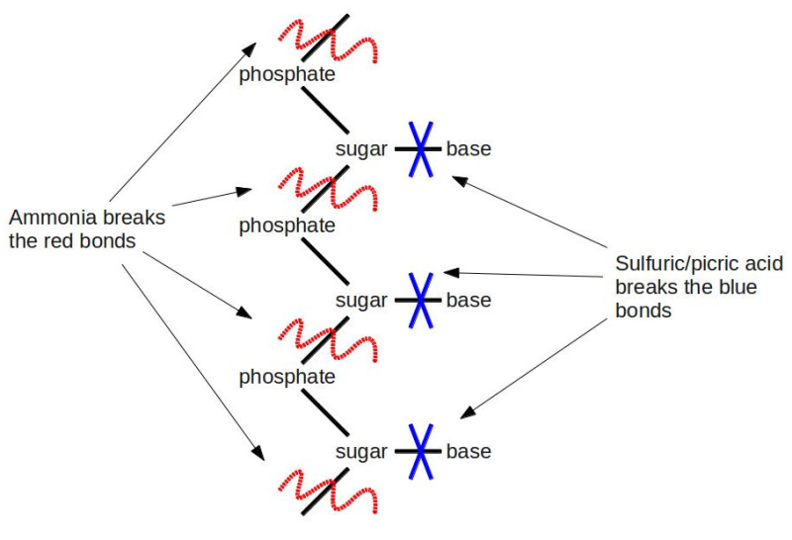
1910s - More on the composition of DNA
Determined relative composition of sugars, phosphate and sugars by hydrolysis of nucleic acid
Phoebus Levene
Close relative of TNT explosive
Enabled the discovery of DNA and RNA bases
Unfortunately, this method can destroy bases and bias results
Made it impossible to compare composition between species
Phoebus Levene proposed the tetranucleotide hypothesis
  DNA consisted of repeating units of thymine, guanine adenine and cytosine
  E.g. GACT GACT GACT
  Convinced many that DNA could not be a carrier of hereditary information
  Led to the assumption that DNA was just a structural component of cells

Slide 15
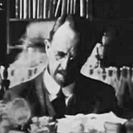
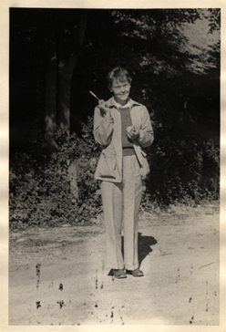
1910-30s - Chromosome theory of heredity
Chromosome as a unit of heritability confirmed by Thomas Morgan
Alfred Sturtevant creates the first genetic linkage map
Genetic recombination shown to be caused by physical recombination of chromosomes by McClintock & Creighton
Thomas Morgan
Barbara McClintock
Notes:
Remember that at this stage we still had no idea what genes were composed of

Slide 16
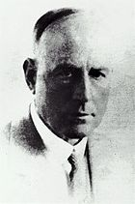
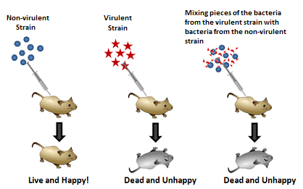
1928 - Inheritance of virulence
Established that non-virulent pneumococci bacteria could be converted be made virulent by exposure to lysed virulent bacteria
Frederick Griffiths
“Could do more with a kerosene tin and a primus stove than most men could do with a palace”
Hedley Wright
What was the ‘transforming principle’ which underlay this observation?
http://mic.sgmjournals.org/content/73/1/1.full.pdf

Slide 17
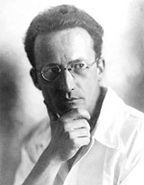
1944 – What is life?
An ‘aperiodic solid crystal’ could code for an organism
“A well-ordered association of atoms endowed with sufficient resistivity to keep its order permanently”
Also placed living systems into a thermodynamic framework
Inspiration for Watson & Crick
Erwin Schrodinger
Notes:
Postulated that an (aka a polymer) aperiodic solid crystal’ could code for an organism

Slide 18
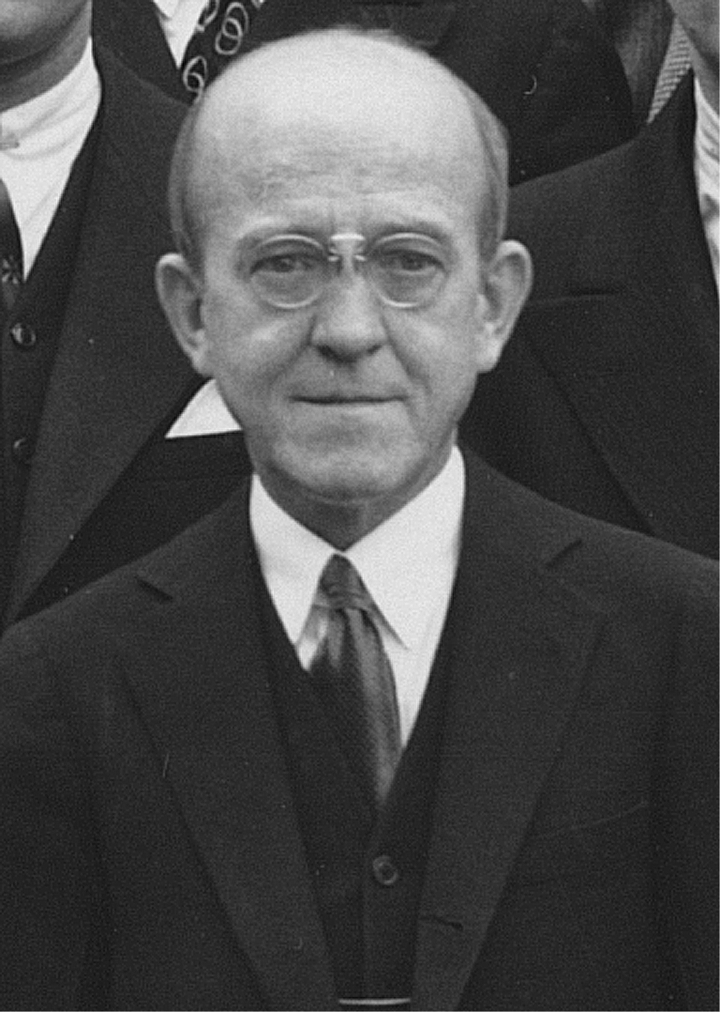
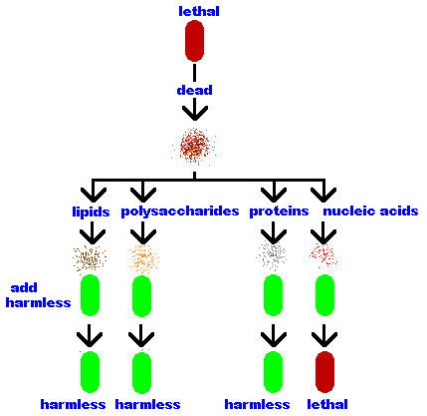
1944 – Establishing DNA as the transforming principle
Separated cellular components and repeated Griffiths experiments
Enabled by new ‘ultra-centrifugation’ technology
Extended Griffiths work to prove that nucleic acids were the ‘transforming principle’
Also demonstrated that DNA, not RNA was the genetic material
Incredibly small amounts – 1 in 600 million were sufficient to induce transformation
Oswald Avery
http://www.ncbi.nlm.nih.gov/pmc/articles/PMC2135445/
Notes:
Idea still encountered a lot of resistance.

Slide 19
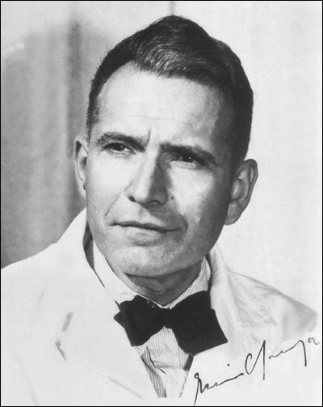
1950 – Base composition between organisms
Developed the base complementarity hypothesis
Determined that the molar ratio of A/T and G/C were always very close to 1
Relative proportions of bases varied between species but was the same within species
Refuted Levene’s 30 year-old tetranucleotide hypothesis
Erwin Chargaff
Notes:
Later in life he decried the field of molecular biology saying that it was “running riot and doing things that can never be justified"

Slide 20
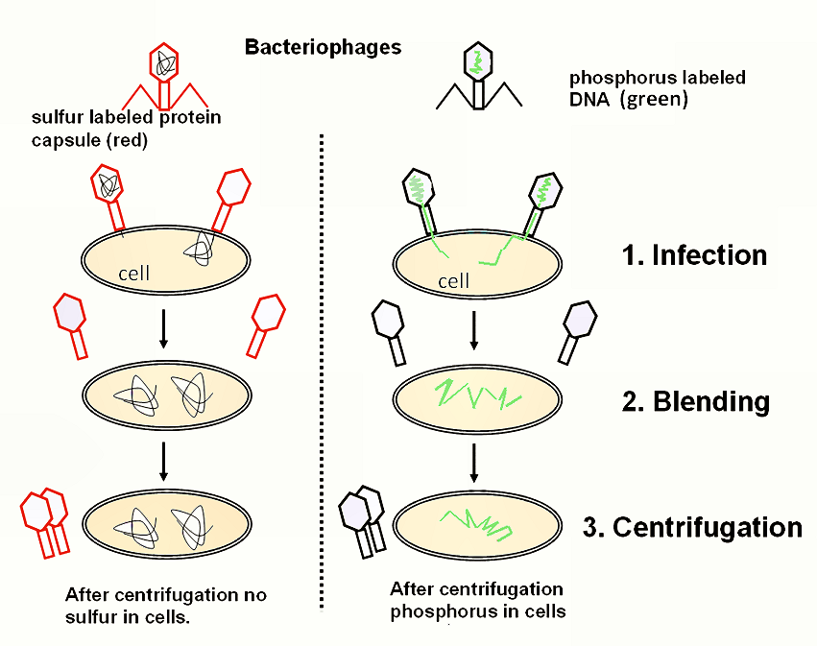
1952- Confirmation of Avery’s experiment
Bacteriophages infected bacteria by injecting DNA, not protein
Finally confirmed the role of DNA as genetic material
Hershey Chase experiment
http://en.wikipedia.org/wiki/Hershey%E2%80%93Chase_experiment
Notes:
Label phage protein coat red and DNA green. Demonstrated that it was only the DNA which entered the cell and not the protein.

Slide 21
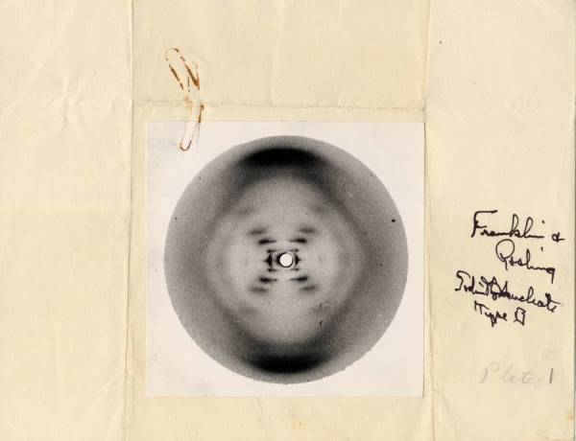
1952 – X-ray diffraction patterns of DNA
Wilkins, Franklin and Gosling
Much improved X-ray diffraction patterns of the B-form of DNA
Wilkins developed a method to obtain improved diffraction patterns using sodium thymonucleate to draw out long thin strands of DNA
Photo Number 51
http://paulingblog.wordpress.com/2009/07/09/the-x-ray-crystallography-that-propelled-the-race-for-dna-astburys-pictures-vs-franklins-photo-51/
Notes:
Previous experiments had always been hindered by a mixture of B-form and Z-form DNA

Slide 22
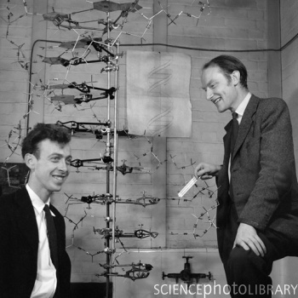
1953 – Watson & Crick obtain a structure for DNA
B-model of DNA
Relied upon data from Maurice Wilkins and Rosalind Franklin via Maz Perutz
"It has not escaped our notice that the specific pairing we have postulated immediately suggests a possible copying mechanism for the genetic material.“
Broad acceptance of the structure did not occur until around 1960
Francis Crick & James Watson

Slide 23
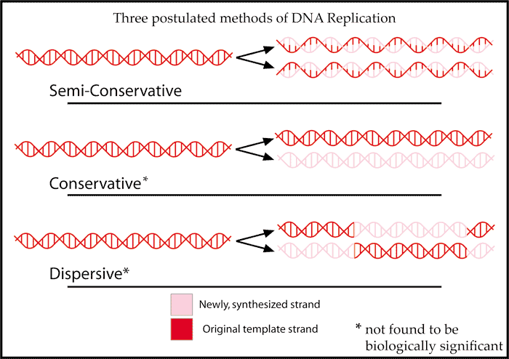
1958 – Evidence for the mechanism of DNA replication
Meselson & Stahl
Supported Watson & Crick’s hypothesis of semi-conservative DNA replication
http://en.wikipedia.org/wiki/Meselson%E2%80%93Stahl_experiment
Notes:
E. coli were grown for several generations in a medium with ¹⁵N. When DNA is extracted from these cells and centrifuged on a salt density gradient, the DNA separates out at the point at which its density equals that of the salt solution. The DNA of the cells grown in ¹⁵N medium had a higher density than cells grown in normal ¹⁴N medium. After that, E. coli cells with only ¹⁵N in their DNA were transferred to a ¹⁴N medium and were allowed to divide; the progress of cell division was monitored by microscopic cell counts and by colony assay.
DNA was extracted periodically and was compared to pure ¹⁴N DNA and ¹⁵N DNA. After one replication, the DNA was found to have intermediate density. Since conservative replication would result in equal amounts of DNA of the higher and lower densities (but no DNA of an intermediate density), conservative replication was excluded. However, this result was consistent with both semiconservative and dispersive replication. Semiconservative replication would result in double-stranded DNA with one strand of ¹⁵N DNA, and one of ¹⁴N DNA, while dispersive replication would result in double-stranded DNA with both strands having mixtures of ¹⁵N and ¹⁴N DNA, either of which would have appeared as DNA of an intermediate density.
The authors continued to sample cells as replication continued. DNA from cells after two replications had been completed was found to consist of equal amounts of DNA with two different densities, one corresponding to the intermediate density of DNA of cells grown for only one division in ¹⁴N medium, the other corresponding to DNA from cells grown exclusively in ¹⁴N medium. This was inconsistent with dispersive replication, which would have resulted in a single density, lower than the intermediate density of the one-generation cells, but still higher than cells grown only in ¹⁴N DNA medium, as the original ¹⁵N DNA would have been split evenly among all DNA strands. The result was consistent with the semiconservative replication hypothesis.^{[6]}
Locked in a room by Max Delbruck to write the paper. Feynmann took an interest too!

Slide 24
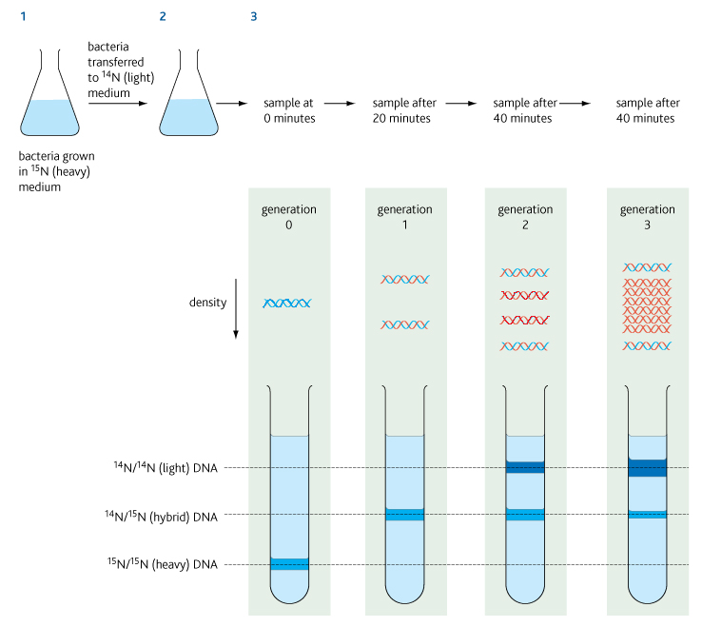
1958 – Evidence for the mechanism of DNA replication

Slide 25
Other developments in molecular biology
1954 - George Gamow proposed a 3-letter code
1955 – Polynucleotide phosphorylase discovered
  Enabled synthesis of homogeneous nucleotide polymers
1957 – Crick lays out ‘central dogma’
1957-1963
  RNA structure
  Work on DNA-RNA hybridization
1960s
  Crystal structures of tRNAs
  Role in protein synthesis
  Role of ribosomes

Slide 26
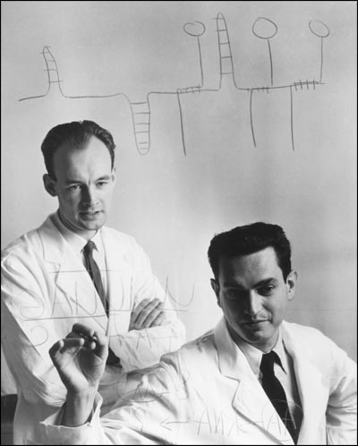
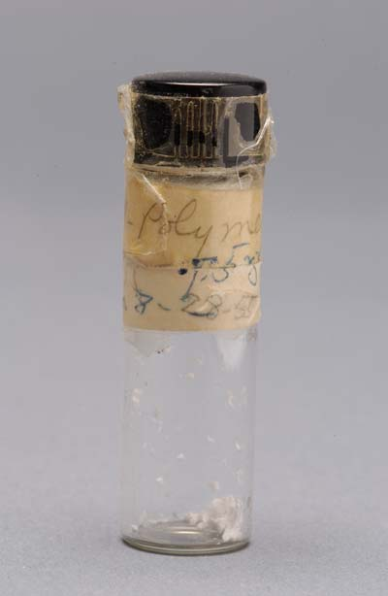
1961 - Deciphering the genetic code
How did DNA code for proteins?
Nirenberg and Matthaei
Used polynucleotide phophorylase to construct a poly-uracil polymer
Added to a cell-free system containing ribosomes, nucleotides, amino acids, energy
This produced an amino acid chain of phenylalanine
Completed in mid 1960s by Har Gobind Khohrana

Slide 27
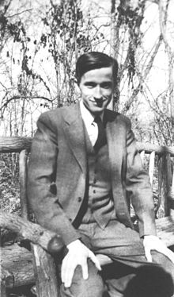
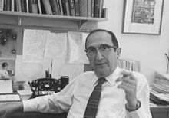
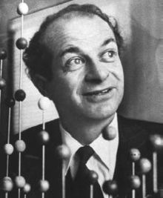
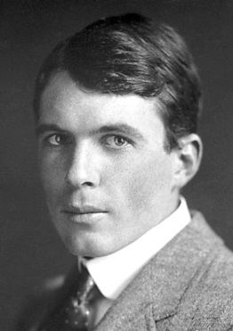
Other key figures
Max Delbruck
  Physicist who helped found molecular biology
Salvador Luria
  James Watson’s PhD supervisor
  Demonstrated with Delbruck that inheritance in bacteria was Darwinian and not Lamarkian
Linus Pauling
  Proposed triple helix model for DNA
Lawrence Bragg
  Hosted Watson & Crick
  Rival of Pauling’s
Jerry Donohue, William Astbury, Raymond Gosling, John Randall, Fred Neufield, Herbert Wilson…
Notes:
Heritability of acquired characteristics

Slide 28
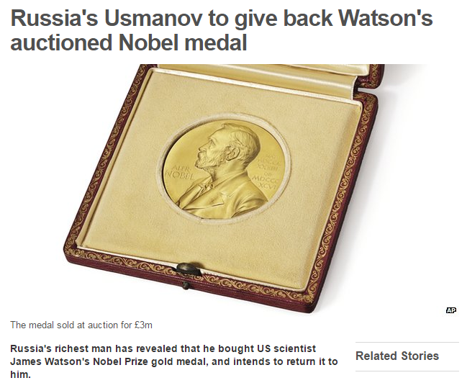
1962
Nobel Prize awarded for Physiology or Medicine to Watson, Crick and Wilkins
Rosalind Franklin died in 1958 of suspected radiation induced cancer

Slide 29
First generation sequencing

Slide 30
The development of sequencing methodologies
What do we mean by ‘sequencing’?
Determining the order and identity of chemical units in a polymer chain
  Amino acids in the case of proteins
  Nucleotides in the case of RNA and DNA
Why do we do it?
  3D structure and function is dependent on sequence

Slide 31
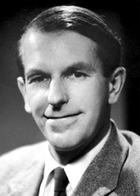
1949 – Amino acids
Sequenced bovine insulin
Developed a method to label N-terminal amino acids
  Enabled him to count four polypeptide chains
Used hydrolysis and chromatography to identify fragments
Fred Sanger

Slide 32
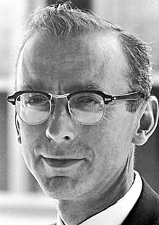
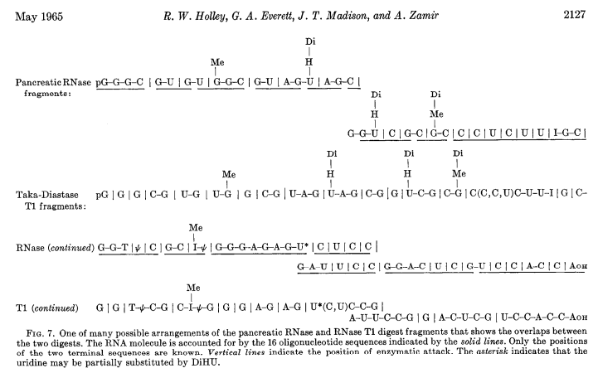
1965 - RNA sequencing and structure
Sequenced transfer RNA of alanine
Used 2 ribonuclease enzymes to cleave the enzyme at specific motifs
Chromatography
1968 Nobel prize
Robert Holley
http://www.sciencemag.org/content/147/3664/1462

Slide 33
1975 - The dawn DNA sequencing
Between 1975-1977 three methods of DNA sequencing were published
Fred Sanger’s Plus/Minus method
Maxam-Gilbert
Fred Sanger’s chain termination method
Notes:
Sanger tried to use the methods he developed for proteins, but found the similarity of nucleotides prevented easy separation

Slide 34
Maxam-Gilbert Sequencing
Dimethyl Sulfate
Dimethyl Sulfate
+
Formic Acid
Hydrazine
+
NaCl
Hydrazine
G
G
C
C
G
A
T
C
G
G
T
C
G
G
C
A
T
C
Radio label
G
C
A
C
A
T
Maxam-Gilbert sequencing is performed by chain breakage at specific nucleotides.
Notes:
How to maim yourself in a lab in 4 easy steps:
Dimethyl sulfate – extremely toxic
Formic acid – ant defensive spray
Rocket fuel
Oh and salt…

Slide 35
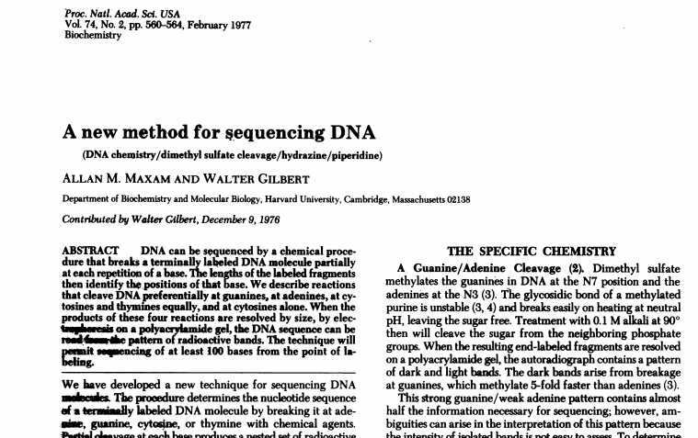
Maxam-Gilbert Sequencing

Slide 36
Maxam-Gilbert Sequencing
3′
A
A
G
C
A
A
C
G
T
G
C
A
G
5′
G G+A T+C C
Longer fragments
Shortest fragments
A
G
Sequencing gels are read from bottom to top (5′ to 3′).

Slide 37
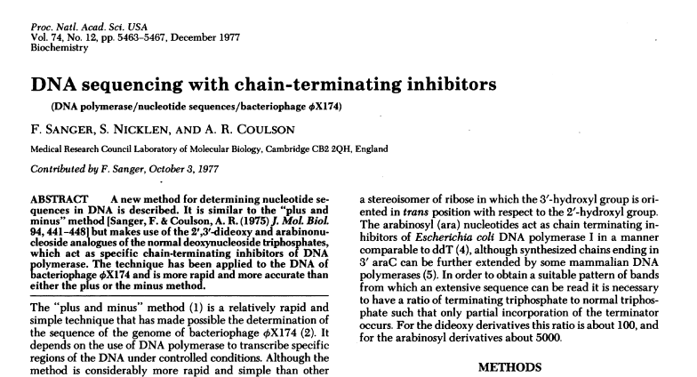
Sanger di-deoxy sequencing method

Slide 38
Sanger Sequencing
Uses a mixture of radio-labelled di-deoxy (ddNTP) and dexoy (dNTP) nucleotides to terminate base incorporation as soon as a ddNTP is encountered
With addition of enzyme (DNA polymerase), the primer is extended until a ddNTP is encountered.
The chain will end with the incorporation of the ddNTP
With the proper dNTP:ddNTP ratio (about 100:1), the chain will terminate throughout the length of the template.
All terminated chains will end in the ddNTP added to that reaction

Slide 39
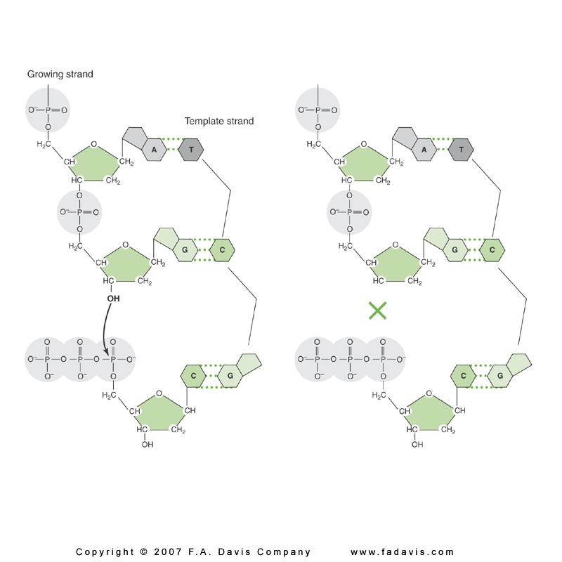
How is sequencing terminated at each of the 4 bases?
The 3′-OH group necessary for formation of the phosphodiester bond is missing in ddNTPs
Chain terminates
at ddG

Slide 40
Sanger sequencing
AGCTGCCCG
A
C
G
T
ddATP +
ddA
four
dNTPs
dAdGdCdTdGdCdCdCdG
ddCTP +
dAdGddC
four
dNTPs
dAdGdCdTdGddC
dAdGdCdTdGdCddC
dAdGdCdTdGdCdCddC
ddGTP +
dAddG
four
dNTPs
dAdGdCdTddG
dAdGdCdTdGdCdCdCddG
ddTTP +
dAdGdCddT
four
dNTPs
dAdGdCdTdGdCdCdCdG

Slide 41
Sanger di-deoxy method
3′
A
A
G
C
A
A
C
G
T
G
C
A
G
5′
ddG ddA ddT ddC
Longer fragments
Shortest fragments
A
G

Slide 42
1985: Automating Sanger Sequencing
Disadvantages of Sanger sequencing
  Labour intensive
  Used radioactive labels
  Interpretation/analysis was subjective
Difficult to scale up
Leroy Hood, Michael Hunkpiller developed an automated method utilising:
  Fluorescent labels instead of radioactivity
  Utilise computerised algorithms to analyse data
  Robotics

Slide 43
Dye Terminator Sequencing
A distinct dye or “color” is used for each of the four ddNTP.
Since the terminating nucleotides can be distinguished by color, all four reactions can be performed in a single tube.
A
T
The fragments are distinguished by size and “color.”
AC
GT
G
T

Slide 44
Dye Terminator Sequencing
The DNA ladder is resolved in one gel lane or in a capillary
GATCAC
G A T C
G
T
C
T
G
A
Slab gel
Capillary

Slide 45
Dye Terminator Sequencing
The DNA ladder is read on an electropherogram.
Slab gel
Capillary
Electropherogram
5′ AGTCTG

Slide 46
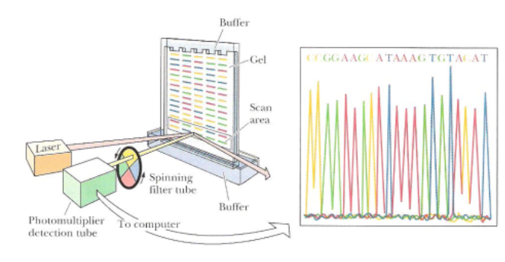
Automated Version of the Dideoxy Method

Slide 47
Automated Sequencing
Dye primer or dye terminator sequencing on capillary instruments.
Sequence analysis software provides analyzed sequence in text and electropherogram form.
Peak patterns reflect mutations or sequence changes.
T/T T/A A/A
5′ A G T C T G
5′ AG(T/A)CTG
5′ A G A C T G

Slide 48
First generation (Sanger) sequencing
Throughput | 50-100kb, 96 sequences per run
Read length | 0.5-2kbp
Accuracy | high quality bases - 99%: ~900bp very high quality bases - 99.9%: ~600bp 99.999%: 400-500bp
Price per raw base | ~$200,000/Gb

Slide 49
Sanger Sequencing
Useful videos
http://www.youtube.com/watch?v=91294ZAG2hg&feature=related
http://www.youtube.com/watch?v=bEFLBf5WEtc&feature=fvwrel

Slide 50
The challenge of DNA sequencing
1869 – First DNA isolated
1944 – Establishing DNA as the genetic material
1953 – Double helix discovered
1957 – Central dogma proposed
1961 – Genetic code deciphered
1965 - First RNA sequence determined
1977 – Sanger DNA sequencing method published
How did we come to know so much about a molecule without being able to read it?
Why did it take so long?

Slide 51
Some possible reasons
The chemical properties of different DNA molecules were so similar that it appeared difficult to separate them
The chain length of naturally occurring DNA molecules is much greater than for proteins and made complete sequencing seem unapproachable.
The 20 amino acid residues found in proteins have widely varying properties that had proven useful in the separation of peptides.
  Only four bases in DNA made sequencing a more difficult problem for DNA than for protein.
No base-specific DNAases were known.
  Protein sequencing had depended upon proteases that cleave adjacent to certain amino acids
DNA was considered boring compared to proteins
Clyde A. Hutchison III
DNA sequencing: bench to bedside and beyond Nucl. Acids Res. (2007) 35 (18): 6227-6237 a
Notes:
Great example of how development of technology enabled paradigm shifts in thinking

Slide 52
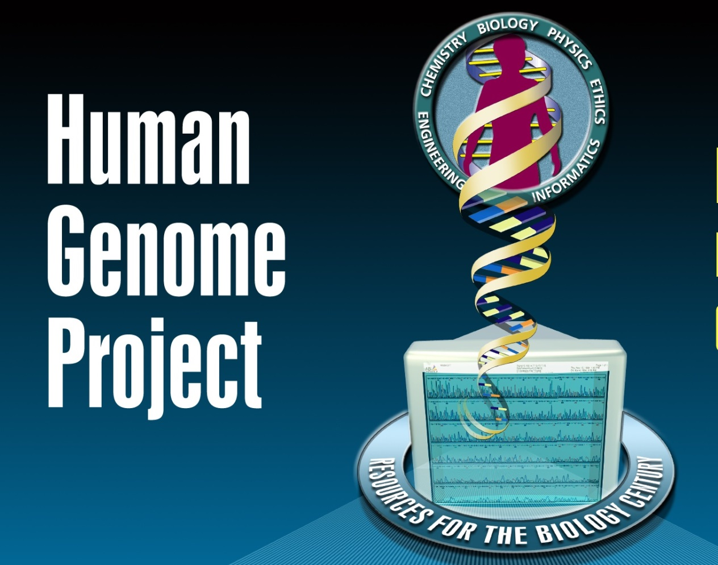

Human genome project

Slide 53
Human Genome Project
One of the largest scientific endeavors
  Target accuracy 1:10,000 bases
  Started in 1990 by DoE and NIH
  $3Billion and 15 years
  Goal was to identify 25K genes and 3 billion bases
Used the Sanger sequencing method
Draft assembly done in 2000, complete genome by 2003, last chromosome published in 2006
Still being improved

Slide 54
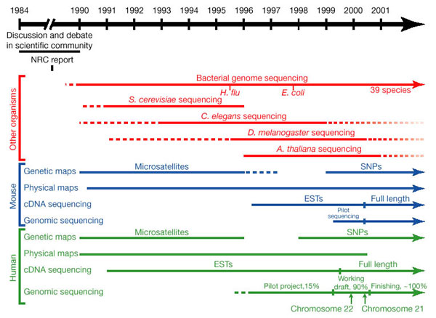
Human Genome Project
http://bit.ly/q3Qsd5

Slide 55
How it was Accomplished
Public Project
  Hierarchical shotgun approach
  Large segments of DNA were cloned via BACs and located along the chromosome
  These BACs where shotgun sequenced
Celera
  Pure shotgun sequencing
  Used public data (released daily) to help with assembly

Slide 56
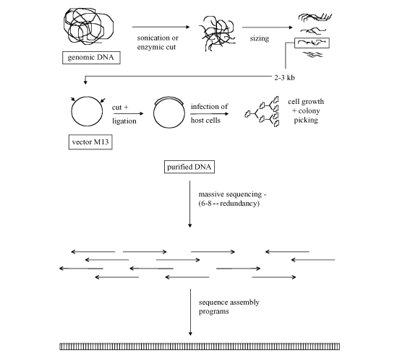
Hierarchical Sequencing
http://www.icb.uncu.edu.ar/upload/dnasequencing.pdf

Slide 57
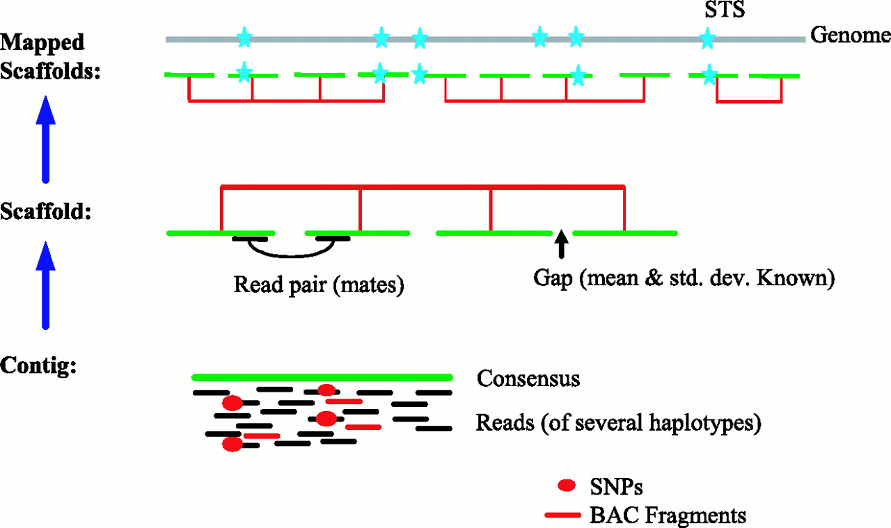
Celera Shotgun Sequencing
Used paired-end strategy with variable insert size: 2, 10, and 50kbp

Slide 58
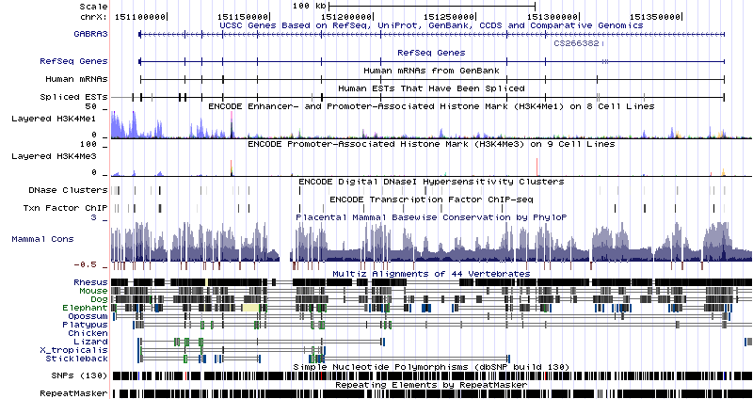
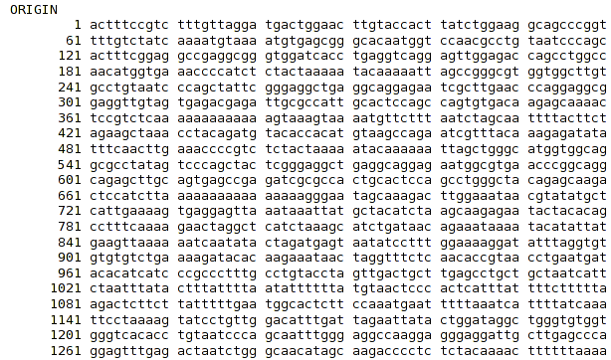
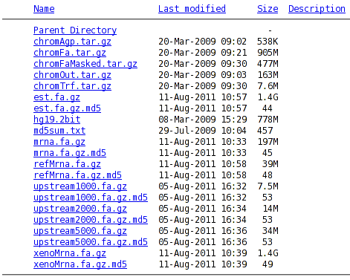
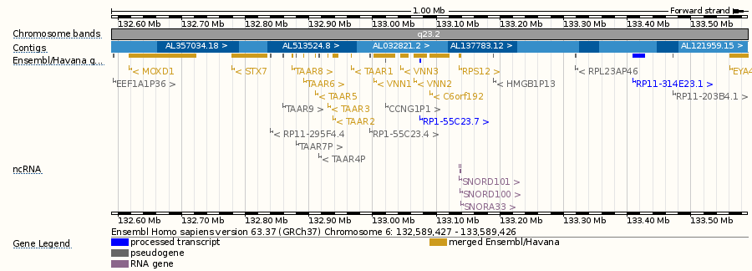
HGP Data Access
Results in GenBank, UCSC, Ensembl & others

Slide 59
Outcome of the HGP
Spurred the sequencing of other organisms
  36 “complete” eukaryotes (~250 in various stages)
  1704 “complete” microbial genomes
  2685 “complete” viral genomes
Enabled a multitude of related projects:
  Encode, modEncode
  HapMap, dbGAP, dbSNP, 1000 Genomes
  Genome-Wide Association Studies, WTCCC
  Medical testing, GeneTests, 23AndMe, personal genomes
  Cancer sequencing, COSMIC, TCGA, ICGC
Provided a context to organize diverse datasets
20110813 http://www.ncbi.nlm.nih.gov/sites/genome

Slide 60
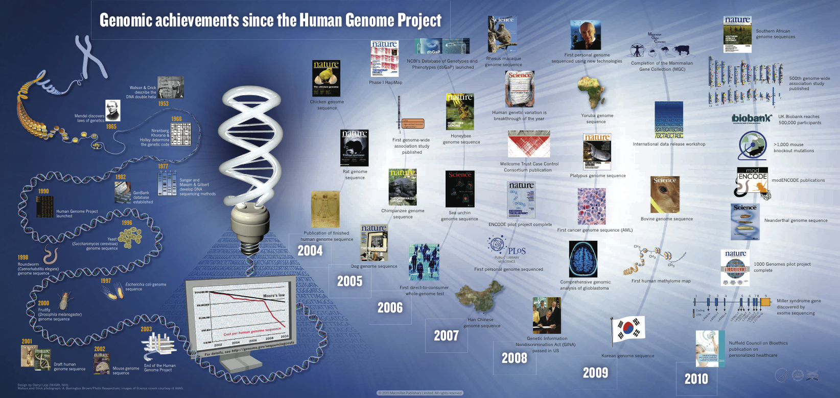
Achievements Since the HGP
ED Green et al. Nature 470, 204-213 (2011) doi:10.1038/nature09764

Slide 61
Economic Impact of the Project
Battelle Technology Partnership Practice released a study in May 2011 that quantifies the economic impact of the HGP was $796 billion!
Genomics supports:
  >51,000 jobs
  Indirectly, 310,000 jobs
  Adds at least $67 billion to the US economy
http://www.genome.gov/27544383

Slide 62
2004 onwards:
Beyond 1 species, 1 genome
Cost of producing a single genome could vary from $10,000s to $100,000s using capillary sequencers
Labour intensive methodology
New methods were required to lower the overall cost per genome

Slide 63
Second generation short read technologies

Slide 64
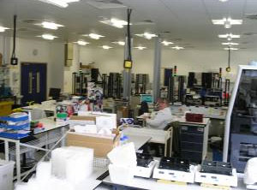
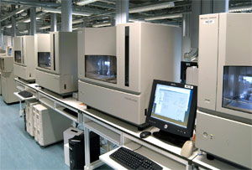
Large scale sequencing 2006
PRODUCTION
Rooms of equipment
Subcloning > picking > prepping
35 FTEs
3-4 weeks
SEQUENCING
74x Capillary Sequencers
10 FTEs
15-40 runs per day
1-2Mb per instrument per day
120Mb total capacity per day

Slide 65
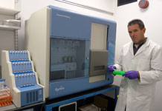
Large scale sequencing 2008
Illumina GAII sequencer

Slide 66
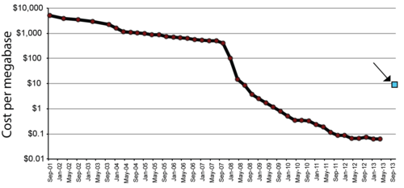
Key advantages over Sanger Sequencing
Hugely reduced labour requirements
Cost per sequence
Reduced time to result
Decentralisation
Illumina era
Sanger era
454 era
PacBio

Slide 67
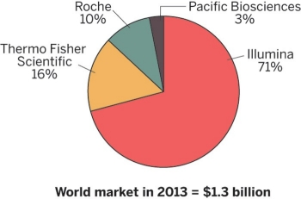
Market share

Slide 68
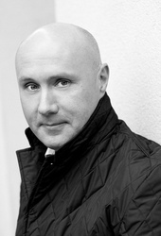
Fun fact
Clive Brown
Formerly director of Computational Biology at Solexa (Illumina)
Chief Technology Officer at Oxford Nanopore

Slide 69



Illumina Sequencing By Synthesis
Illumina HiSeq
Illumina NextSeq
Illumina MiSeq

Slide 70









Illumina Sequencing
http://www.illumina.com/Documents/products/techspotlights/techspotlight_sequencing.pdf

Slide 71

Step 1: Sample Preparation
Active Chromatin
1
Genomic DNA
(Min 1ng)
Small RNA
mRNA
1 ug total RNA
0.5ug total RNA
ChIP-Sequencing
Other Apps
10 ng
Notes:
Take purified genomic DNA (HOW MUCH?)
Fragment by nebulization
End up with fragments <800 bp
Repair ends (end polished) to form blunt end fragments with 5’ phosphorylated
DO WE DO A BLUNT END LIGATION or ADD AN ‘A’ OVERHANG? (ASK MARK)
Ligate adapters
Purify ligation product
Remove unligated adapters by gel purification (120-170 bp)
Now you have your gDNA library which is random fragments of DNA with an adapter ligated onto each end.
Purpose: To segue from explaining Solexa sequencing technology to demonstrate the flexibility of the system and discuss all current application data
Details: This slide represents many of the applications enabled by ILMN’s Genome Analyzer. Each application is animated to enter the slide individually.
Conclusion: ILMN’s Genome Analyzer enables much more than whole genome sequencing. One capital investment, one technology and training enables all these applications.

Slide 72

Step 2: Clonal Single Molecule Arrays
Modified DNA (adapters on both ends)
Attach single molecules to surface
Amplify to form clusters
~1000 molecules per ~ 1 um cluster
~2 billion clusters per flowcell
1 cluster = 1 sequence
100um
Random array of clusters
Notes:
Purpose: Graphic support to explain Solexa technology.
Details: There are 2 market unique features to the Solexa technology for genome analysis = template clusters (in the flow cell) and reversibly terminated, individually fluorescently labeled nucleotides for sequencing by synthesis. The steps for cluster generation supported by this slide are:
Initial DNA fragments (gDNA, ChIP or cDNA).
Ligate on adaptors to generate a template library.
Denature and deliver into the flow cell.
The flow cell is pre-coated with oligonucleotides complimentary to the adaptors.
On a random basis, the single strand template will hybridize with the complimentary oligo lawn.
This is a priming event that can be enzymatically extended to covalently attach the initial single strand template to the flow cell surface.
The other end of the template remains complimentary to the oligo lawn and will bridge over to it oligo compliment
This is a priming event that can be enzymatically extended to generate a clonal copy of the original template strand.
Repeating this process allows the generation of clusters of ~1000 clonal copies of the original single stranded template.
Graphics close with an image of actual clusters in a flow cell.
Conclusion: Explanation of technology behind cluster generation

Slide 73
Step 3: Sequencing By Synthesis (SBS)
3’
5’
Cycle 1: Add sequencing reagents
First base incorporated
Remove unincorporated bases
Detect signal
A
T
G
Deblock and defluor
C
C
Base
Fluor
T
G
T
PPP
A
C
C
A
T
G
A
G
T
A
A
Cycle 2-n: Add sequencing reagents and repeat
C
T
C
C
G
G
A
C
T
C
G
A
T
5’
Notes:
Purpose: Graphic support to explain Solexa technology.
Details: There are 2 market unique features to the Solexa technology for genome analysis = template clusters (in the flow cell) and reversibly terminated, individually fluorescently labeled nucleotides for Sequencing by Synthesis. The steps for sequencing by synthesis supported by this slide are:
Hybridize sequencing primer (complimentary to terminal adaptor)
Add polymerase and all 4 dNTPs
Each dNTP is individually fluoerscently labeled and is reversibly blocked at the 3’ hydroxyl
The 3’ block ensures only a single base addition.
Once the single base addition occurs the clusters can be excited by a laser and the color of the added base can be imaged and determined.
For every cluster, in cycle 1, the first base is added turning the entire cluster the color of the base. In the example shown in this cartoon at “T” is added, turning this cluster “green”.
Once the first base has been imaged and determined, the fluorescent label is cleaved and 3’ blocking group is removed, regenerating a 3’-OH and enabling extension.
Add polymerase and all 4 dNTPs and single base extension will occur for the second base in the template (in this cartoon the 2nd base is a “G”)
The clusters can be excited by a laser and the color of the 2nd base is imaged and determined (in this cartoon the cluster color would be “blue”)
Repeating this process allow us to step-wise determine the sequence of the original template.
Conclusion: Explanation of technology behind sequencing by synthesis

Slide 74


Under the hood:

Slide 75


Illumina Sequencing : How it looks
A C
G T
2 BILLION CLUSTERS
PER FLOW CELL
20 MICRONS
100 MICRONS
Notes:
Purpose: To visually demonstrate sequencing by synthesis
Details: This is an actual cluster pattern from a flow cell (4-color overlay)
If you zoom in on one small section (the 20 micron box) you can follow each cluster through sequencing by synthesis
Conclusion: This is the visual set up to the following slide

Slide 76









Base calling from raw data
T
TG
TGC
T G C T A C G A T …
1
2
3
4
5
6
7
8
9
T T T T T T T G T …
The identity of each base of a cluster is read off from sequential images.
Notes:
Purpose: To visually demonstrate sequencing by synthesis
Details: A visual illustration of 9 cycles of sequencing by synthesis.
Following the 20 micron square from the previous slide you can see how the clusters change color each cycle.
Looking at the top circled cluster the color changes from green to blue, to red, to green…corresponding to T, G, C, T…
Looking at the bottom circled cluster the color is green, green, green, green, green…corresponding to a homopolymer T interrupted by a G (cycle 8)
This is a great moment to indicate our ability to accurately sequence homopolymers (unlike 454). Details are shown in the data description of our BAC sequencing standard later in this presentation.
Conclusion: Visual explanation of sequencing by synthesis
The current read lengths are 25-50 nt… this differs from what we are used to with capillary sequencing where sequence lengths of 650 bp can be achieved. So the next slides will give an introduction to how we use these highly parallel shorter reads.

Slide 77
Paired-End Sequencing
Provides distance relationship between two reads
Important for many applications
  Characterise insertions, deletions, copy number variants, rearrangements
  Required for de novo genome assembly
  Enables sequencing across repeats
  Useful for isoform inference, transcriptome assembly etc.

Slide 78
Illumina Paired-End Sequencing
Cluster
amplification
Read 1
1st cut
FLOWCELL
FLOWCELL
Linearize DNA
Sequence 1st strand
FLOWCELL
Strand re-synthesis
Read 2
2nd cut
FLOWCELL
FLOWCELL
Linearize DNA
Sequence 2nd strand

Slide 79
Paired-end reads are important
Known Distance
Read 1
Read 2
Repetitive DNA
Unique DNA
Paired read maps uniquely
Single read maps to
multiple positions

Slide 80
Working with Paired Reads
Applicable to different fragment size ranges
- up to ~800 bp for standard paired-libraries
- 2 - 20kb mate-pair libraries
Enables alignment software to assign unique positions to previously non-unique reads

Slide 81
Illumina platforms
Illumina HiSeq
Illumina NextSeq 500
Illumina MiSeq
500Gbase/flowcell
8 human genomes
7 day run time
High output or rapid run mode
Read lengths up to 250bp
Requires large numbers of samples (or large genomes) to obtain lowest cost
4 colour chemsitry
£750,000 incl 3 year servicing
90Gbase/flowcell
1 human genome
2 day run time
High output or rapid run mode
Read lengths up to 150bp
2-colour chemistry
£250,000 incl 3 year servicing
15Gbase/flowcell
2 day run time
Read lengths up to 300bp
4 colour chemsitry
£120,000 incl 3 year servicing

Slide 82




What does this mean?
Rapid run | High output run
48 genomes (£200 per sample) | 96 genomes/lane (<£100 per sample)
10 genomes (£400 per sample) | 10 genomes/lane (£250 per sample)
8 genomes (£500 per sample) | 8 genomes/lane (£300 per sample)
 | 1 genome (£3000)

Slide 83
Potential issues with Illumina sequencing
Specific motifs which are difficult to sequence
  GGC motif
  Inverted repeats
Now mostly resolved
  Low diversity sequences
    16S/amplicon sequences
    Custom adaptors with barcodes at 5’ end
    Now a much reduced problem thanks to software updates
  GC/AT bias
    GC clusters are smaller than AT
    (less of a problem post June 2011)
  Nakamura, K., Oshima, T., Morimoto, T., Ikeda, S., Yoshikawa, H., Shiwa, Y., Ishikawa, S., et al. (2011). Sequence-specific error profile of Illumina sequencers. Nucleic acids research, gkr344–. Retrieved from http://nar.oxfordjournals.org/cgi/content/abstract/gkr344v1

Slide 84

Why do quality scores drop towards the end of a read?

Slide 85

3 main factors
Phasing
Loss
Cross-talk
Schematic representation of main Illumina noise factors.
(a–d) A DNA cluster comprises identical DNA templates (colored boxes) that are attached to the flow cell. Nascent strands (black boxes) and DNA polymerase (black ovals) are depicted.
(a) In the ideal situation, after several cycles the signal (green arrows) is strong, coherent and corresponds to the interrogated position.
(b) Phasing noise introduces lagging (blue arrows) and leading (red arrow) nascent strands, which transmit a mixture of signals.
(c) Fading is attributed to loss of material that reduces the signal intensity (c).
(d) Changes in the fluorophore cross-talk cause misinterpretation of the received signal (blue arrows; d). For simplicity, the noise factors are presented separately from each other.
http://arep.med.harvard.edu/pdf/Fuller_09.pdf
Erlich et al. Nature Methods 5: 679-682 (2008)
Notes:
85

Slide 86
New Illumina developments
2x250bp reads (HiSeq rapid run mode)
Ordered flowcells (HiSeq X-Ten)
10kb synthetic reads (approx. 5-6 million per lane)
  Useful for phasing of haplotypes and denovo assembly

Slide 87

New Illumina Developments

Slide 88
Limits to Illumina technology
Limitations:
  Reagent degradation
  Dephasing
    Leads to higher error rates
    A 1% loss of signal or polymerase error every cycle leads to only 35% correct signal after 100 cycles
  Sequencing time is always governed by the cyclic nature of the instrument (one base at a time)
    Ideally dispense with incorporate, image, wash cycles
  Size of fragments which can be clustered on the flowcell
    Read lengths beyond the size of the DNA fragment are useless
    Inefficient clustering >800bp

Slide 89



454 and Ion Torrent

Slide 90

Fun fact
Jonathan Rothberg
Set up 454 in late 90s
Sold to Roche in 2007
Founded Ion Torrent in 2007
Superseded 454
Sold to Life Tech in 2010

Slide 91

454 Step 1: Sample preparation
4. The single stranded DNA library is immobilised onto proprietary DNA capture beads
Genomic DNA is isolated and fragmented.
Adaptors are ligated to single stranded DNA
This forms a library

Slide 92

454 Step 2: Amplification
Water-based emulsion PCR

Slide 93


454 Step 3: Load emPCR products
Picotitre plate

Slide 94

454 Step 4: Pyro-sequencing
Nucleotides are pumped sequentially across the plate
~ 1 million reads obtained during 1 run
Addition of nucleotides to DNA on a particular bead generates a light signal

Slide 95

454 Chemistry

Slide 96

Life Technology Ion Torrent
454-like chemistry without dye-labelled nucleotides
No optics, CMOS chip sensor
Up to 400bp reads (single-end)
2 hour run-time (+5 hours on One Touch)
Output is dependent on chip type (314, 316 or 318)
318 (11M wells) >1Gbase in 3 hours
$700 per run
$50K for the instrument, plus $75k for additional One Touch station and Server
Libraries not compatible with Ion Proton

Slide 97

Life Technology Ion Proton
454-like chemistry without dye-labelled nucleotides
No optics, CMOS chip sensor
Up to 200bp reads (single-end)
2 hour run-time (+8 hours on One Touch)
Output is dependent on chip type (P1 or P2 coming soon)
60-80 million reads (P1)
$1500 per run
$150K for the instrument, plus $75k for additional One Touch station and Server
Libraries not compatible with Ion Torrent

Slide 98

Ion Torrent vs Ion Proton

Slide 99

Ion Torrent

Slide 100
Library prep
454 style library using emulsion PCR

Slide 101

Ion Torrent

Slide 102

Ion System

Slide 103
Homopolymer errors
Length of homopolymer
A ?c TT - AAAAA?a
Different between signal of 1 and signal of 2 = 100%.
Different between signal of 5 and 6 is 20%
More difficult to decide if we have AAAAA or AAAAAA
Is the final sequence: ACTTNAAAAA or ANTTAAAAAAA or ATTAAAA…. Etc

Slide 104
Third generation sequencers
My definition: single-molecule sequencing
Currently only PacBio RS is commercially available

Slide 105

Pacific Biosciences RS II

Slide 106
Introduction
Based on monitoring a single molecule of DNA polymerase within a zero mode waveguide (ZMW)
  150,000 ZMWs on a SMRT flowcell on PacBio RSII
Nucleotides with fluorophore attached to phosphate (rather than base) diffuse in and out of ZMW (microseconds)
As polymerase attaches complementary nucleotide, fluorescent label is cleaved off
Incorporation excites flurorescent label for milliseconds -> nucleotide recorded

Slide 107

Library prep

Slide 108


SMRT Cell

Slide 109

Free nucleotides
Zero mode
waveguide
Immobilised DNA
polymerase
Laser and detector

Slide 110

Observing a single polymerase

Slide 111

What it looks like
PacBio ZMWs with single DNA strand
Ordered
Illumina DNA mono-colonal clusters
Unordered

Slide 112
Output statistics
Approximately 50,000 sequences per SMRT flowcell
500Mb output per SMRT flowcell
  $500 per run
Library prep required
  ~$500 per sample
  ~0.5ug per sample
Size selection required to get the longest reads
Read lengths
  Distribution
  Mean 12kb up to 20-40kb

Slide 113


Read lengths

Slide 114
Novel applications
Epigenetic changes (e.g. Methylation) affect the amount of time a fluorophore is held by the polymerase
Circularise each DNA fragment and sequence continuously

Slide 115

Epigenetic changes

Slide 116
Circular consensus sequencing

Slide 117

Circular consensus sequencing
Fichot, E. B., & Norman, R. S. (2013). Microbial phylogenetic profiling with the Pacific Biosciences sequencing platform. Microbiome, 1(1), 10. doi:10.1186/2049-2618-1-10

Slide 118

Circular consensus sequencing for rRNA or microsatellites
http://www.sciencedirect.com/science/article/pii/S0167701213002728
http://www.biotechniques.com/multimedia/archive/00230/BTN_A_000114104_O_230651a.pdf
http://www.microbiomejournal.com/content/1/1/10

Slide 119

Long reads to sequence highly repetitive loci
http://www.pacificbiosciences.com/pdf/Poster_AlleleLevelSequencing_PhasingFulllengthHLAClassIandIIGenes.pdf
Notes:
HLA genes are around 6kb

Slide 120
Issues to be aware of
PCR chimeras (affects all PCR amplicon methods)
Chimeric sequences can be generated during library preparation
Shorter sequences can be loaded preferentially
  Uniform amplicon size reduces this
  PacBio Magbead loading system

Slide 121
Circular consensus sequencing (CCS)
Raw error rates of a single pass read is high (10-15%)
It is possible to read the same molecule repeatedly using CCS mode sequencing
Can do this 7-8 times to reduce error rates < 1%
Disadvantages
  Reduction in read length proportional to number of passes (e.g 7 passes – max read length 3kb).
  Reduction of total number of reads as some ZMW polymerases will fail

Slide 122
Pacific Biosciences
Advantages
  Longer reads lengths (median 14kb up to 40kb with P6-C4 chemistry)
  40 minute run time
  Cost per run is low ($400 per run plus $400 per library prep)
  Same molecule can be sequenced repeatedly
  Epigenetic modifications can be detected
  Long reads enable haplotype resolution
Disadvantages
  Library prep still required (micrograms needed)
  If you use PCR based methods – you are no longer seqeuncing true single molecules
  Still enzyme based
  Only 50,000 reads/run. 400-500Mb yield
  High (10-15%) error rate per run (but consensus can reduce <1%)
  $900k machine

Slide 123
Bioinformatics Implications
Relatively low data and high per base cost limits practical widespread use
Can obtain useful 20-40kb fragments (C6 chemistry)
Best used in conjunction with error correction algorithms utilising shorter PacBio reads (or Illumina data)
Excellent to assist scaffolding of genomes
Able to generate complete bacterial genomes
Has been used to generate higher eukaryote genomes (e.g. Drosophila) but cost is prohibitive
Sergey Koren, Adam M Phillippy, One chromosome, one contig: complete microbial genomes from long-read sequencing and assembly, Current Opinion in Microbiology, Volume 23, February 2015, Pages 110-120, ISSN 1369-5274, http://dx.doi.org/10.1016/j.mib.2014.11.014. (http://www.sciencedirect.com/science/article/pii/S1369527414001817)
Koren, Sergey; Schatz, Michael C; Walenz, Brian P; Martin, Jeffrey; Howard, Jason T et al. (2012)
Hybrid error correction and de novo assembly of single-molecule sequencing reads
Nature biotechnology vol. 30 (7) p. 693-700
Chin, C.-S., Alexander, D. H., Marks, P., Klammer, A. A., Drake, J., Heiner, C., … Korlach, J. (2013). Nonhybrid, finished microbial genome assemblies from long-read SMRT sequencing data. Nature methods, 10(6), 563–9. doi:10.1038/nmeth.2474

Slide 124

Genome assembly methods
http://www.sciencedirect.com/science/article/pii/S1369527414001817
Notes:
Overview of long read assembly methods. (a) The hierarchical method uses a two-step process. Due to the difficulty of detecting noisy overlaps (i), other sequences (ii) are used to correct the noisy data. The sequences used for correction can be high-identity reads, assemblies of other reads, or even other long reads. Once the noisy reads are corrected, an assembly graph (iii) is constructed from the now high-accuracy data and the graph is simplified to a single contig (iv). (b) The scaffolding and gap patching methods start with complementary high-identity sequence data, which is first assembled. Once assembled, long reads are aligned and used to connect contigs (iii) or fill in missing sequence (iv). The filled and scaffolded contigs are output (v). (c) Read threading relies on resolving a short-read assembly graph using long reads. It differs from the scaffolding approach because it operates on the assembly graph rather than the contigs. First, an assembly graph is constructed from the complementary data (ii). The long reads are then layered onto the graph (iii) and used to resolve repeat-induced graph structures. The graph structure may then be resolved (iv).

Slide 125
PacBio training resources
https://github.com/PacificBiosciences/Bioinformatics-Training/wiki

Slide 126

Data processing

Slide 127

Data processing

Slide 128

Nanopore sequencing

Slide 129
What is a nanopore?
Nanopore = ‘very small hole’
Electrical current flows through the hole
Introduce analyte of interest into the hole ➔ identify “analyte” by the disruption or block to the electrical current
Current
flow
out
current
in

Slide 130

Detection
http://ieeexplore.ieee.org/xpls/icp.jsp?arnumber=5626570

Slide 131
Types of pore
Either biological or synthetic
Biological
  Lipid bilayers with alpha-haemlolysin pores
  Best developed
  Pores are stable but bilayers are difficult to maintain
Synthetic
  Graphene, or titanium nitride layer with solid-state pores
  Less developed
  Theoretically much more robust

Slide 132


Nanopore DNA sequencing
Theory is quite simple
Feed a 4nm wide DNA molecule through a 5nm wide hole
As DNA passes through the hole, measure some property to determine which base is present
Holds the promise of no library prep and enormously parallel sequencing
In practice this is not easy to achieve
http://thenerdyvet.com/category/tech/

Slide 133
Nanopore sequencing
In practice, it is much harder
Problems:
  DNA moves through the pore quickly
  Holes are difficult/impossible to design to be thin enough so that only one base is physically located within the hole
  DNA bases are difficult to distinguish from each other without some form of labelling
  Electrical noise and quantum effects make signal to noise ratios very low
  Search space for DNA to find a pore is large
http://omicfrontiers.com/2014/04/10/nanopore

Slide 134

Nanopore sequencing
http://www.nature.com/nbt/journal/v30/n4/full/nbt.2181.html

Slide 135


Nucleotide Recognition
135
Notes:
135
135

Slide 136
Approaches to simplify nanopore sequencing
Slow down movement of bases through nanopore
  Use an enzyme to chop DNA up and sequence individual bases as they pass through a pore
  And/or use an enzyme to slow the progress of DNA through a pore
  Monitor capacitive changes in the bilayer
Hybridize labels to single stranded DNA
  Force the labels to disassociate as they pass through the pore
  Detect the labels
Niedringhaus, T. P., Milanova, D., Kerby, M. B., Snyder, M. P., & Barron, A. E. (2011). Landscape of next-generation sequencing technologies. Analytical chemistry, 83(12), 4327–41. doi:10.1021/ac2010857

Slide 137



Companies involved
  ONT is closest to commercialisation
  Two approaches to sequencing
    Exo-nuclease sequencing (originally part of a co-marketing agreement with Illumina)
    Strand sequencing (now in commercialisation)
  Strand sequencing method is being commercialised by Oxford Nanopore

Slide 138
Oxford Nanopore MAP programme
MinIon Access Programme
Provides access to several flowcells and reagents for library preparation
Beta testing programme – round 1
Round 1 closed to new applicants
Round 2 may re-open applications

Slide 139





Oxford Nanopore

Slide 140

Oxford Nanopore platforms

Slide 141


DNA binding to membrane
Double stranded DNA fragment
Pore

Slide 142

Oxford Nanopore principle

Slide 143

http://www2.technologyreview.com/article/427677/nanopore-sequencing/

Slide 144
MinIon features
512 pores
Library preparation is required
Read lengths up to 40-50kb
  Limited by input DNA
30Mb-500Mb output
  Very variable

Slide 145

Library preparation
Input requirements
Upwards of 5ug of DNA
Issues – keeping long DNA fragments

Slide 146

Challenge of basecalling

Slide 147
Preliminary Oxford Nanopore R6 results
Oxford Nanopore have two chemistries – R6 and R7
R7 is more advanced but testing is only just beginning
R8 should arrive in the coming months

Slide 148

Challenge of 5-mer basecalling
TTTTTATTTTT vs TTTTTCTTTTT

Slide 149

Challenge of 5-mer basecalling
CGTATTCGAA vs CGTATCTCGAA

Slide 150

Basecalling 1D vs 2D reads
Both the template and complementary strand can be sequenced
This doesn’t always work
If it does, the base-calling can be improved
Different kmers at the same locus can improve basecalling
Up to 40% of reads using latest chemistry are 2D
Attempts are being made to modify the library preparation to increase the proportion of 2D reads

Slide 151

Lengths of 2D vs 1D reads

Slide 152

Read lengths
Highly dependent on input DNA length
Difficult to preserve DNA lengths

Slide 153

Longest perfect stretches

Slide 154


Slide 155

Hard to read motifs
Hard Kmers
AAAAA
ACCTA
ACCTC
AGCGC
AGCTA
AGGTC
Easy Kmers
AAGAA
ACGAA
CGTTC
CTTTC
GAACG

Slide 156

Coverage of an E.coli genome

Slide 157


Slide 158
Borrelia burgdorferi
Assembly stats
Assembly | N50 | Longest contig | Percentage of chromosome recovered in one contig | Misassemblies (Quast) | Mismatch errors/Indel errors
MiSeq only | 288kb | 434kb | ~48% | 3 | 161 / 46
MiSeq & MinION | 910kb | 910kb | ~100% | 6 | 662 / 107

Slide 159
Improvements
FASTQ – per base quality values don’t make much sense
Improvements to pore types
  Utilise multiple pore types on a single flowcell
  This would not make it a true single molecule sequencer since we would rely upon consensus (probably does not matter)
Library preparation
Flowcell reliability
Access to basecalling API

Slide 160
ONT costs
Currently ~1500 euro per flowcell
  ONT anticipate approximate costs of 1000 euro per flowcell
Library preparation costs are considerable
  Hundreds of euros per sample

Slide 161
Cost per megabase
Illumina era
Ox. Nanopore MinIon
Sanger era
454 era
PacBio

Slide 162
Software packages
Processing ONT data
  Poretools https://github.com/arq5x/poretools
  poRe http://sourceforge.net/projects/rpore/
Alignment
Sensitive but slow aligners
    BLAST
    BLAT
    LAST
    BWA with the right parameters
Assembly
  At the moment data quality is too poor to attempt this with ONT data only
  Error correction with other data types should be possible with 15-20% error rate
  Short term fix, but may offer an alternative to PacBio or Illumina synthetic long reads

Slide 163
Summary
Very encouraging but still early days
Far from portable although the potential exists
Error rate is ~30-40% for R6 2D reads
  Indications that it is ~20% for R7.3 2D reads
  Some success with completing bacterial genomes using this data
Probably 12 months before full commercial launch

Slide 164
Opportunities for software development
Converting reference genomes to ‘wiggle-space’
Developing ‘wiggle-space’ aligners
Online ‘streaming’ bioinformatics
  Analytics - one read at a time

Slide 165
General issues with nanopores
Single base-pair resolution is not available
  Typically 4-5 nucleotides fit into a nanopore
Only one detector per DNA strand
Fast translocation of DNA through pore
Small signal and high noise
Unstable lipid bilayers

Slide 166

Nanowire alternatives
QuantumDx QSEQ

Slide 167
Many others in development
http://www.allseq.com/knowledgebank/sequencing-platforms

Slide 168

In conclusion
Francis Crick’s predictions for molecular biology in the year 2000:
  Replication of DNA
  Structure of chromosomes
  Meaning of the nucleic acid sequence
  Significance of repetitive sequences
  “In short, the whole field is likely to be even more fascinating in the year 2000 than it is now”
Francis Crick
1971
Notes:
Man had only just landed on the moon…

Slide 169




Thanks to:
Karen Moore
Audrey Farbos
Paul O’Neill
Wellcome Trust
Contact me:
k.h.paszkiewicz@exeter.ac.uk
http://biosciences.exeter.ac.uk/facilities/sequencing

