Slide 1


Mapping and variant calling from short read data
Cesky Krumlov
January 2012
Gerton Lunter
Wellcome Trust Centre for Human Genetics
Oxford

Slide 2
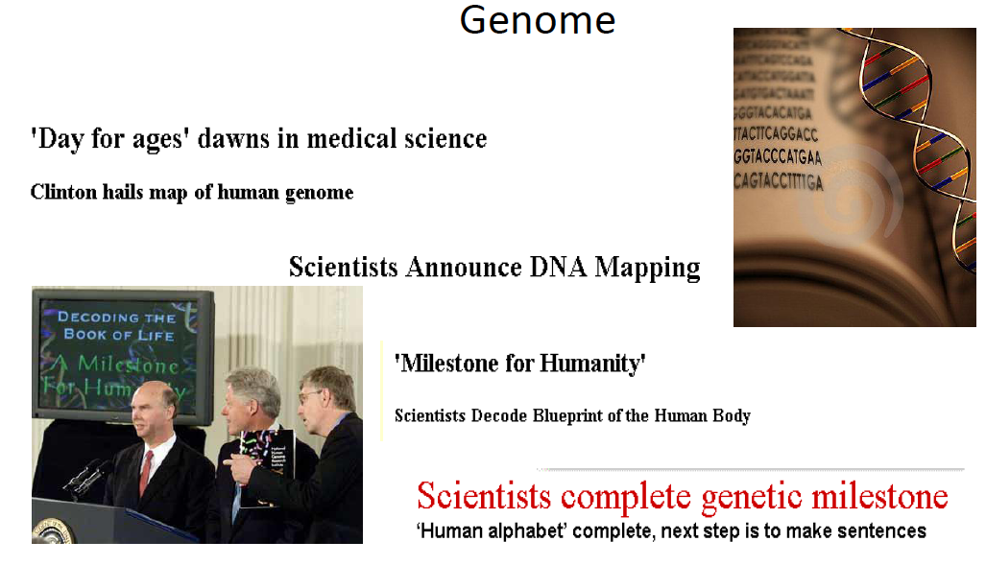
June 26, 2000: “G-Day”
Completion of the Working Draft of the Human Genome

Slide 3
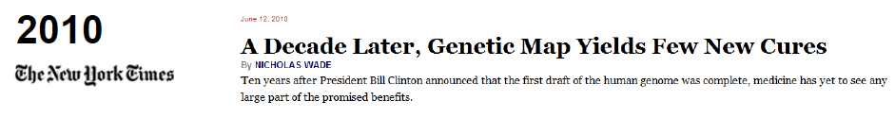
"Let us be in no doubt about what we are witnessing today: A revolution in medical science whose implications far surpass even the discovery of antibiotics, the first great technological triumph of the 21st century.” (Tony Blair)
"Having the genetic code is not a very important moment other than it's the beginning of what we can do with it”. (Craig Venter)
the benefits of human genome mapping will include “a new understanding of genetic contributions to human disease” and “the development of rational strategies for minimizing or preventing disease phenotypes altogether.” (Francis Collins)
“it is fair to say that the Human Genome Project has not yet directly affected the health care of most individuals.” (Francis Collins, more recently)

Slide 4
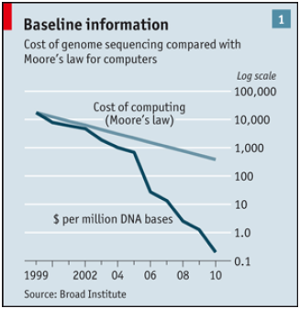
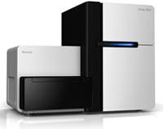
First human genome:
10 years, ~ $3 billion
A genome every 2 days
UK£ 3000
Economist June 17 2010

Slide 5
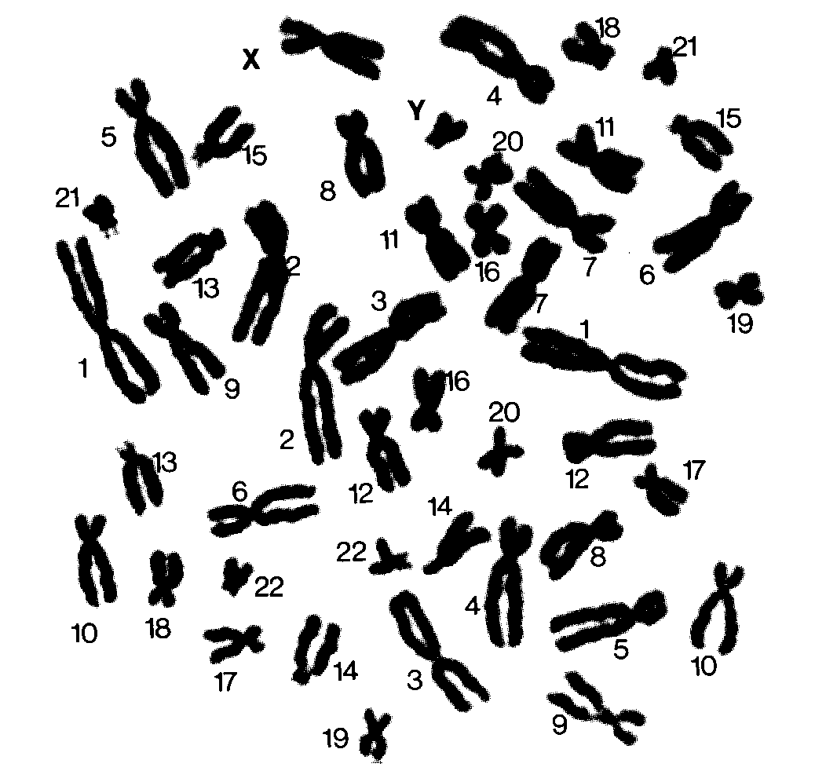

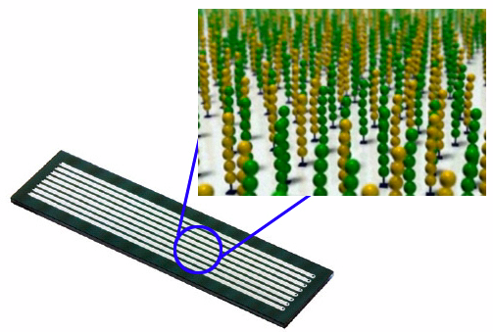
Notes:
For example, as part of this larger project we’re sequencing several parent-child trios, w child has a disease susp to be caused by a de novo mutation

Slide 6
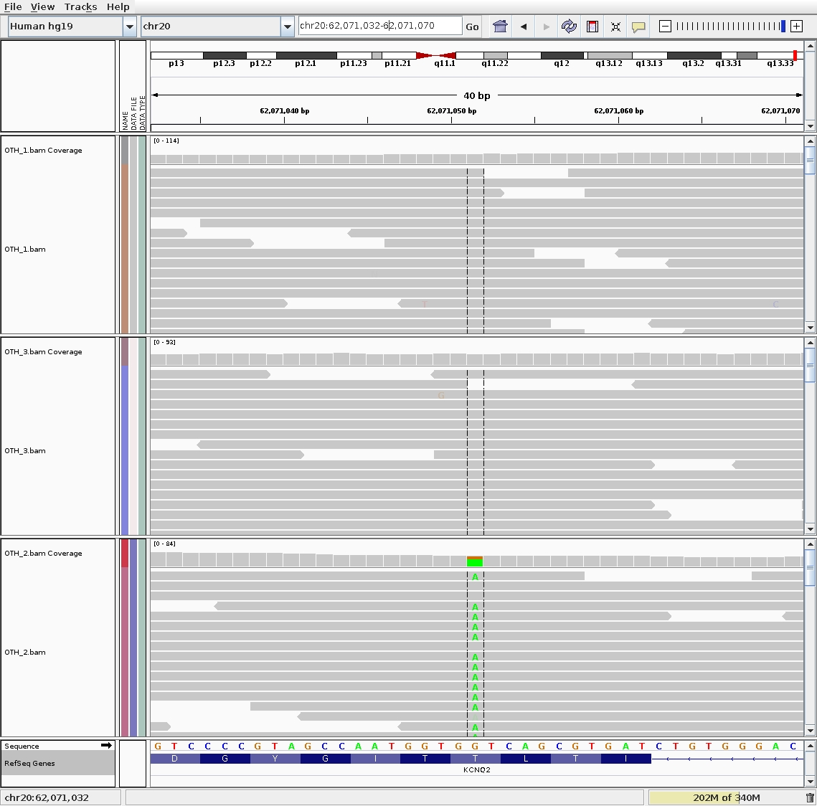
Ohtahara Syndrome (Early Infantile Epileptic Encephalopathy)
Trio 1
WGS500 project /
Ed Blair, ORH
Notes:
This is the canonical situation: point mutation unique to child, causing amino acid change
Other scenarios: SNP outside coding region; indel; structural variation e.g. CNV

Slide 7
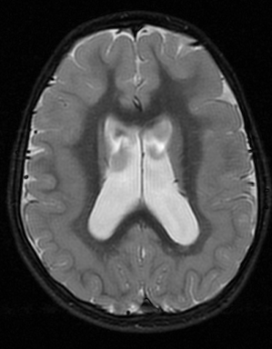
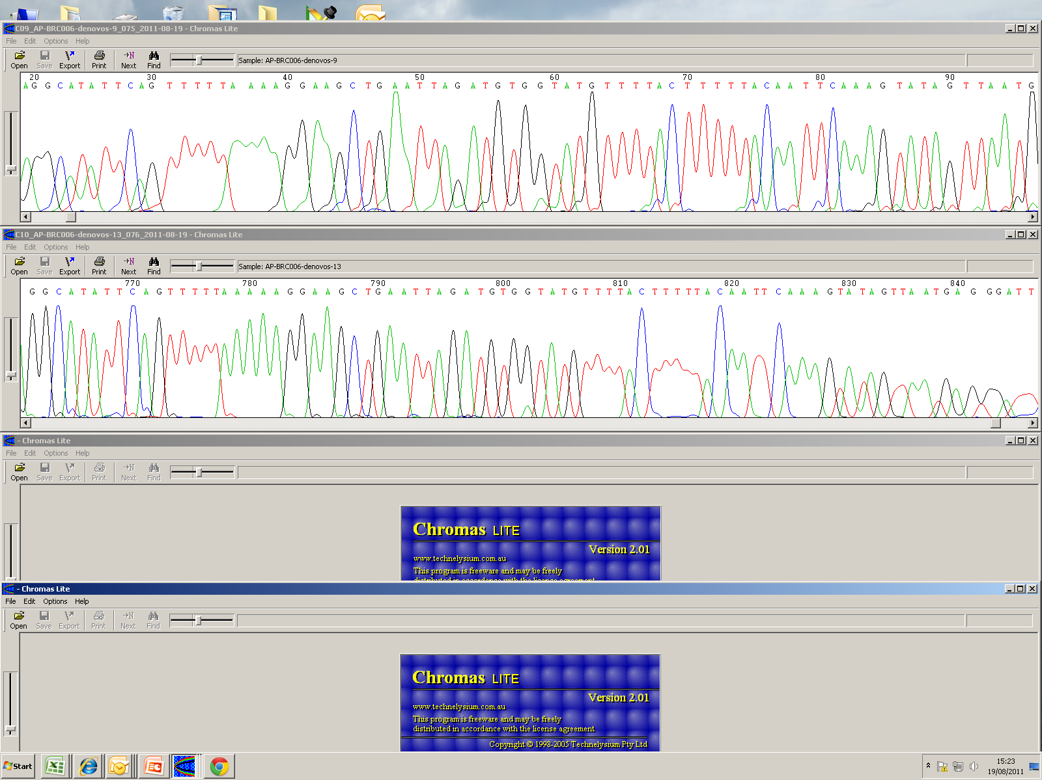
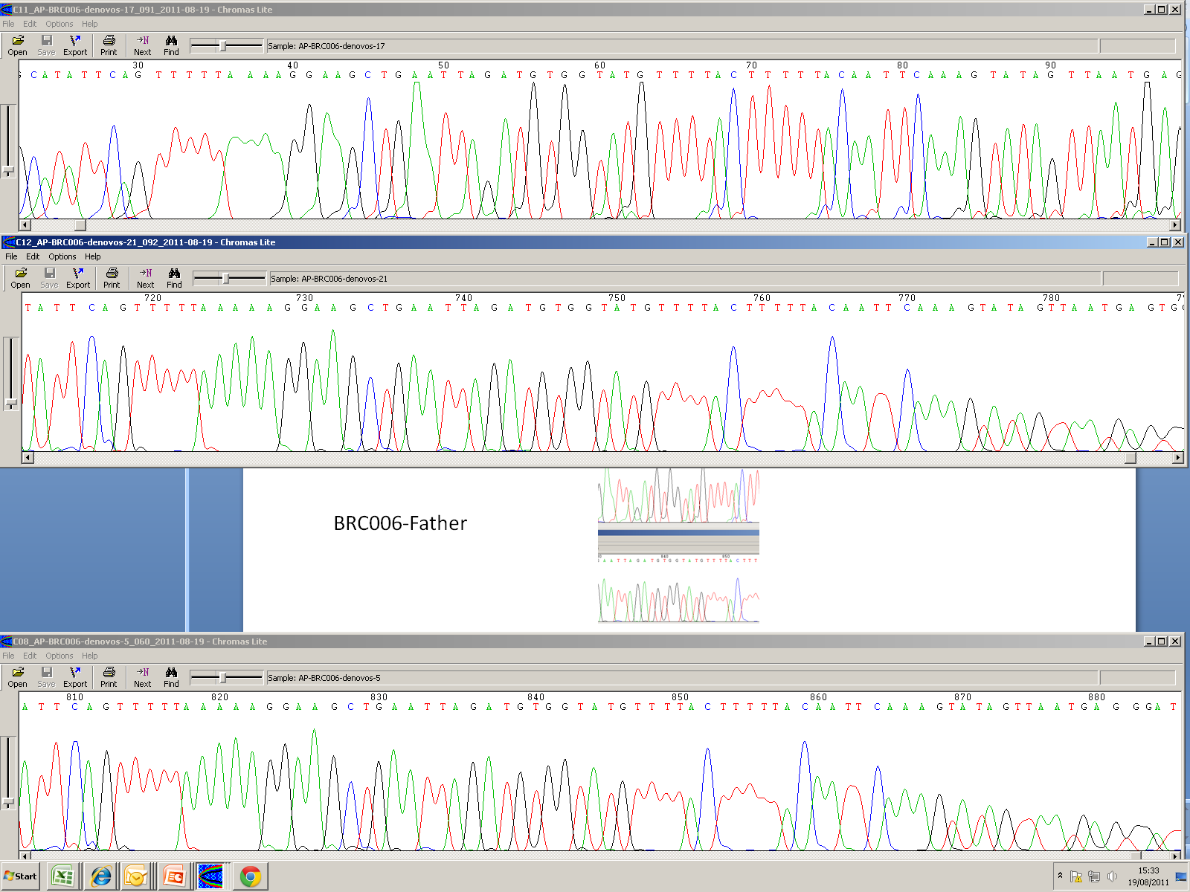
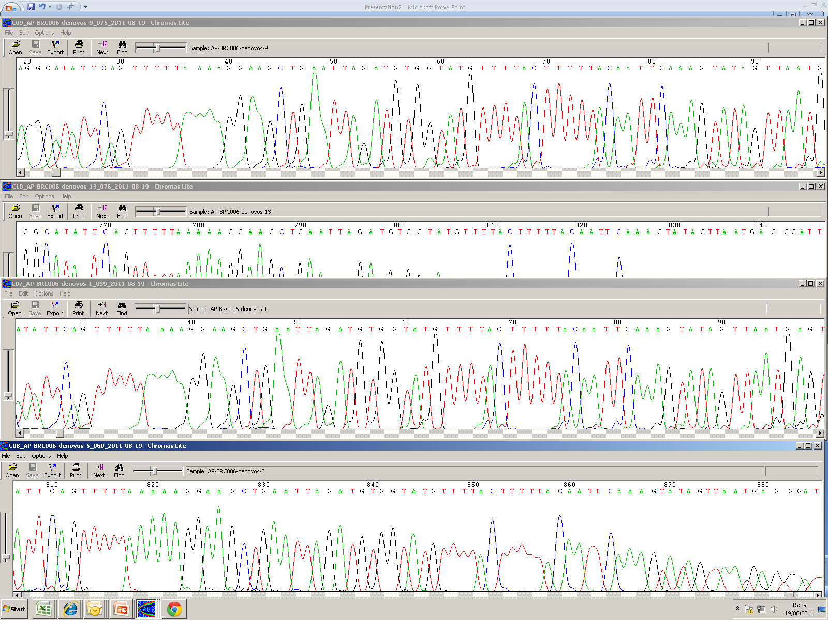
De-novo mutations in patients with cortical malformations
Trio-based whole-exome sequencing
5 putative de novo coding variants.
Manual review: 3 candidates
Two validated, one as mosaic (supported by 4/23 reads)
BRC006 BRC006-F BRC006-M
A.T. Pagnamenta and J.C. Taylor, WTCHG

Slide 8
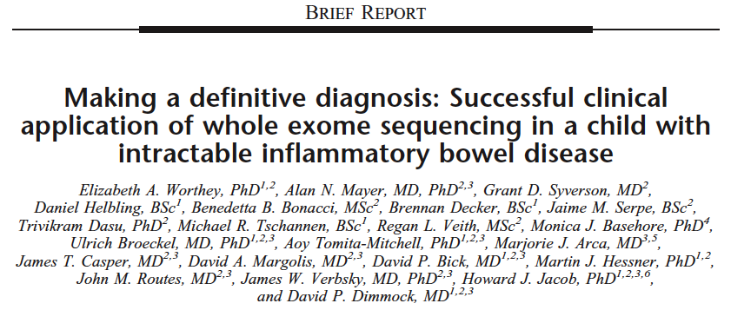
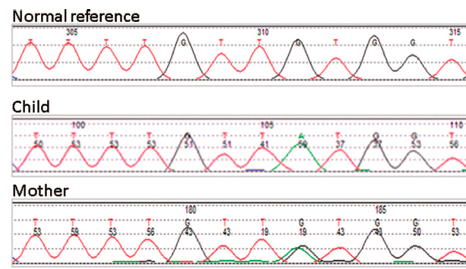
March 2011:
15 month old child with severe disease
No diagnosis, no clinical management
Sequencing: mutation found
Suggests therapy, child cured

Slide 9
Why is this a hard problem?
SNPs: | Genome | Exome
Calls | 3,591,286 | 17,085
Mendel errors | 169,571 | 577
Indels: | Genome | Exome
Calls | 545,485 | 286
Mendel errors | 166,546 | 41
Notes:
solve by looking at plausible variants, stringent filtering, visual inspection, validation
this talk: first part of processing pipeline: calling the variants

Slide 10
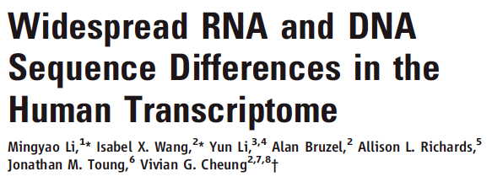
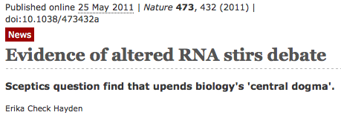
Mapping issues (uniqueness)
Alignment issues across splice sites
No stringent filtering of calls
  http://www.nature.com/news/2011/110525/full/473432a.html

Slide 11
Plan for today
Mapping
    Sequencing (Illumina)
    Mapping
    BAM files
    Algorithms
Variant calling
    Data artefacts
    A simple caller: Samtools
    Advanced calling: GATK
    Allele-based calling: Platypus
    Assembly-based calling: Cortex
Afternoon: DIY de-novo disease-causing mutation finding

Slide 12
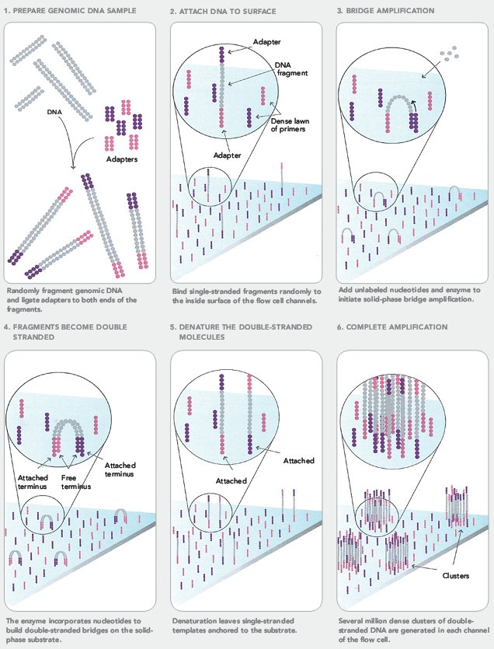
Illumina sequencing
Notes:
1. Ligate adapters. 2 Attached to the flow cell surface. 3. Anneal with primers on flowcell – bridge amplification

Slide 13
Illumina sequencing
Notes:
Denature and continue until a cluster of copies of the same molecule is produced

Slide 14
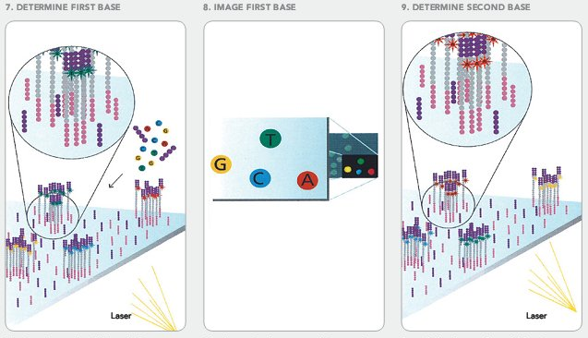
Illumina sequencing
Notes:
Sequence using reversible terminator dyes.

Slide 15
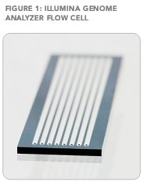
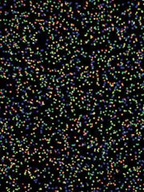
Illumina sequencing
8 lanes x 2 flowcells x 48 tiles x 100 bp x 2 reads…
= about 640 Gbase (HiSeq)
~ 210X coverage of the human genome

Slide 16
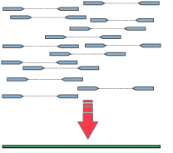
Sequencing: Paired-end reads
Sequencing both ends helps placement onto genome
Note on orientation:
  FIRST read may be the FW or BW read
  LEFTMOST mapping read is the FW read, rightmost the BW read

Slide 17
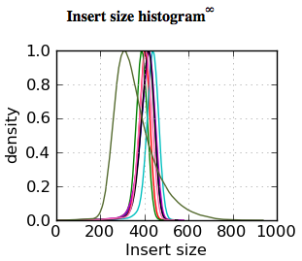
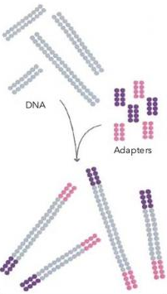
Sequencing: Paired-end reads
Distance between outermost ends is called insert size
    DNA insert between the two adapters
Insert size distribution can be controlled at the
library preparation stage
    Illumina: max ~ 600, but see later

Slide 18
Sequencing: Coverage
Coverage: average number of times a genomic base is represented
  Read coverage: represented in the output as a read base
  Physical coverage: represented as an insert (i.e. also counting unsequenced bases)
Contributions to coverage variation:
  Statistical (Poisson distribution)
  Polymorphisms (large indels, high SNP diversity e.g. in MHC)
  Structural variation (seg dups, karyotype abnormalities)
  Reference issues (e.g. centromere, telomere)
  PCR biases (extremes of GC content usually under-represented)

Slide 19
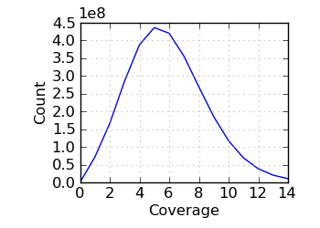
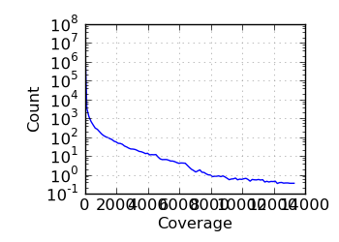
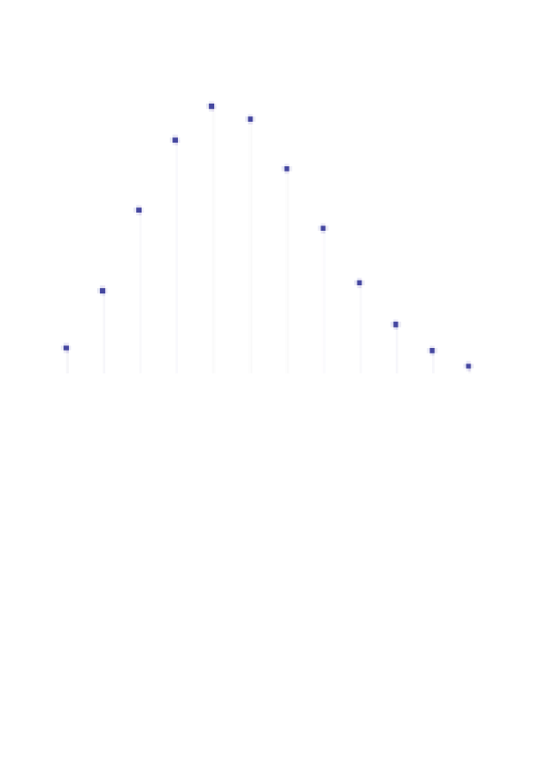
Sequencing: Coverage

Slide 20
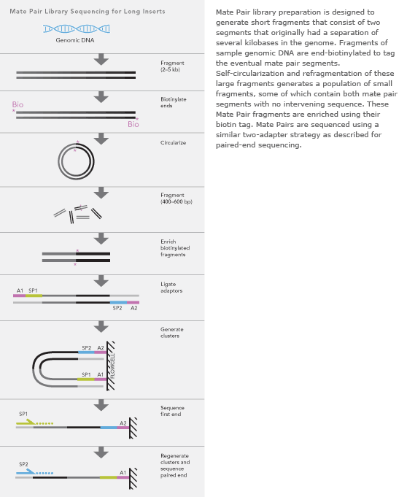
Sequencing – mate pair libraries

Slide 21
Sequencing – mate pair libraries
Stampy has a mode to map mixture of normal (FW/BW) and mate pair (BW/FW) fragments
Each uses their own insert size distribution

Slide 22

Library complexity, duplicate reads
Some sequences are read several times:
  Optical duplicates; secondary seeding
  Low amount of starting material
Problem for variant calling
  Any (PCR) error will be seen twice: evidence for variant
Post processing: duplicate removal
  Standard processing step (e.g. Samtools, Picard)
    Not always appropriate: CHiP-seq, mRNA-seq, pooled sequencing
Useful statistic:
  (Usage fraction=) α ≈ 2 δ (=duplicate fraction)
    α = fragments sequenced / unique fragments in library
    δ = fraction of (PCR) duplicates among sequenced reads
  Duplicate fraction δ approx additive across lanes (same library)
    E.g.: sequencing library on one lane gives 3% duplicate fraction;
    sequencing additional lane (same library): ~6% duplicates in combined data

Slide 23
Library complexity, duplicate reads
Assume N unique fragments, usage fraction α
Let r be rate of usage. Then α = 1 – exp(-r) or r = log(1-α)
Number of times a PCR copy is sequenced: Poisson( r )
Expected number of reads sequenced: N α
Expected number of duplicates: N (e^{-r}-1+r)
As a fraction of all reads sequenced:
δ = (e^{-r}-1+r)/α = ½ α + …
n = | 0 | 1 | 2 | 3 | …
Poisson | e^{-r} | r e^{-r} | r² e^{-r}/2 | r³ e^{-r}/6 | …
Duplicates: | 0 | 0 | 1 | 2 | …

Slide 24
Mapping

Slide 25
Mapping reads
Mapping to a reference:
Often the first step in the processing of HT sequencing data.
Similar to the sequence alignment problem, with some unique features:
  reads (query) are short (36 – 150 bp)
  reads have relatively many errors (but are annotated with quality scores)
  the target can be long (human: 3Gb)
  many (easily >billion) reads to process
This has led to the development of “read mappers” :
  Focus on “placing” (mapping) the reads, not aligning them
  Focus on speed
Examples: BWA, Stampy, ELAND, Novoalign, MAQ, Bowtie, SOAP, …

Slide 26
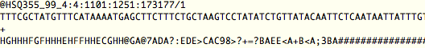
Mapping reads – fastQ format
Label: identifier & physical position.
/1 = read number (normally 1 or 2)
Read
Qualities
Base qualities: Phred scale
    -10 * log₁₀(probability of base error), e.g. “10” = 0.1 “30” = 0.001 etc
    Illumina: read often ends in low-quality tail (p~0.7, Q=2, encoded as B or #)
    Note: Q score does not encode probability of indel error
Represented as ASCII codes in 2 possible encodings:
    Illumina: base-64 (B=2, low quality; h = 40, high quality)
    Sanger/BAM: base-33 (#=2, low quality; I = 40, high quality)

Slide 27
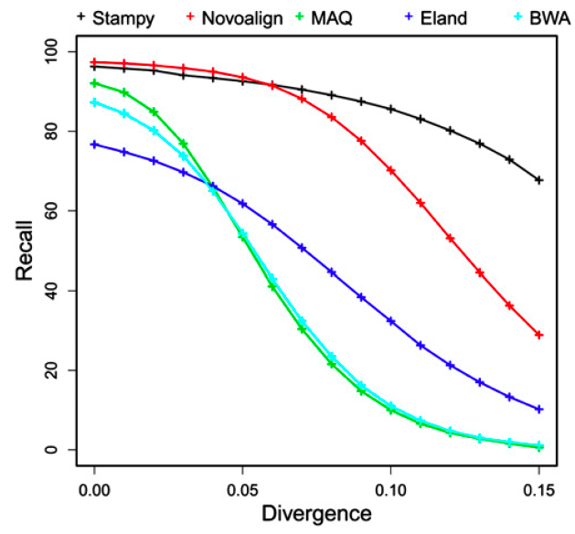
Mapping reads: Sensitive to divergence
Can be issue even in human data (e.g. MHC)
72 bp PE

Slide 28
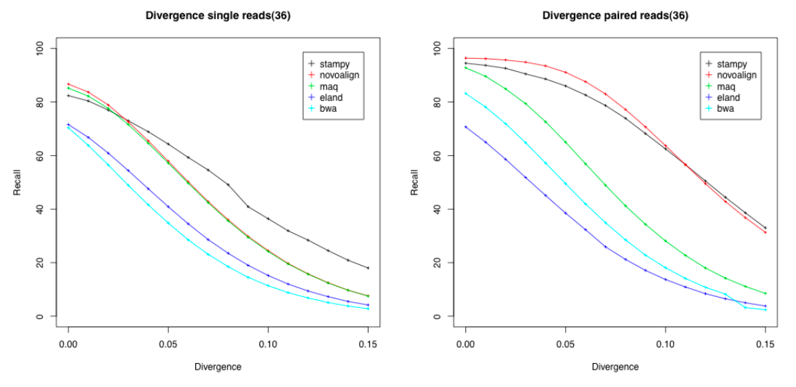
Mapping reads: Paired-end data helps
Increased accessibility of repetitive genome
Increased accessibility (less allele bias) at higher divergence
36 bp

Slide 29
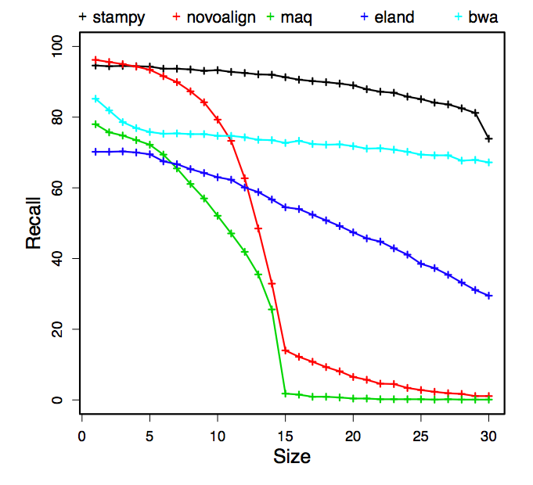
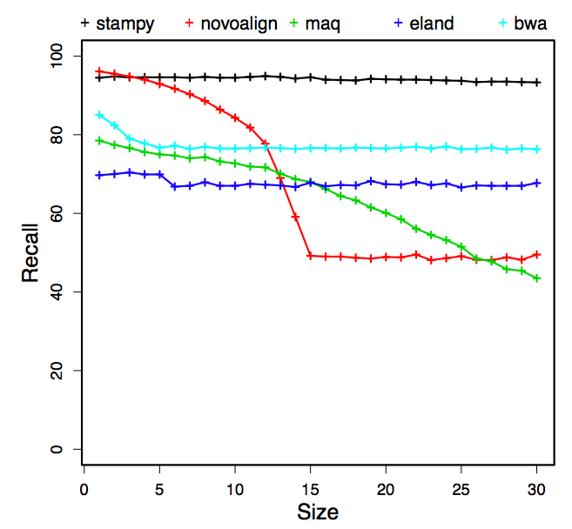
Mapping reads:
Indels can be challenging
insertions
deletions
72 bp PE

Slide 30
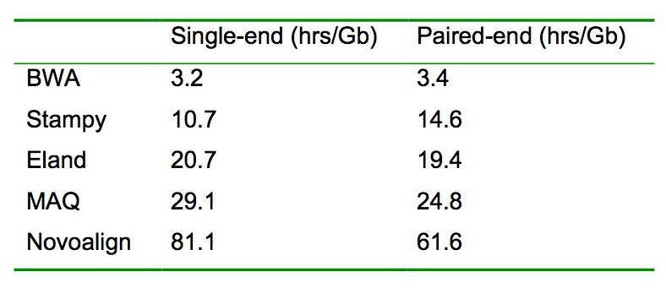
Mapping reads is computationally expensive
HiSeq flowcell ~320 Gb
Notes:
Because of these results we decided to make Stampy part of our standard sequencing pipeline

Slide 31
Mapping reads: anomalous pairs
Large insertions, deletions, and structural variation, may lead to anomalous read pairs that do not map to the expected distance of each other
Read mappers vary considerably in their sensitivity for such read pairs.
  BWA often only maps one read of an anomalous pair.
  Stampy will keep anomalous pairs as long as each read can be mapped with sufficient confidence
  ELAND treats each read independently

Slide 32
Split reads
This approach allows fragments of a single read to map to different locations. Works best with long reads (100bp+)
Applications:
  large deletions
  structural variation (chromosomal translocations, inversions, ..)
  mapping across introns for RNAseq data
Tools:
  BWASW (part of BWA. Single reads only)
  BLAT (Single reads only)
  SpliceMap (RNAseq data; single reads only)

Slide 33
RNAseq mapping
RNASeq is a widely-used protocol for analyzing the transcriptome, with advantages over microarrays:
    Unbiased assessment of expression (no probes)
    Better dynamic range
    Can assess expression of alternatively spliced transcripts
    Discovery of transcript and splice junctions
    Protocols available for miRNAs, ncRNAs, non-polyA RNAs, …
Mapping RNAseq data is challenging:
    To genome: good fraction of inserts/reads spans splice junction.
    Mapper that can deal with large insertions / partially mapping reads helps
    To transcriptome: no discovery; high degree of repetitiveness

Slide 34
RNAseq mapping
TopHat:
  Maps (fragments of) reads to genome, builds splice junctions
  Built on top of Bowtie
    very fast, not very sensitive
SpliceMap
  Maps 25bp fragments to genome, builds splice junctions
  Uses Bowtie
  There are currently no mappers that integrate splice-awareness into the mapping algorithm.

Slide 35
BAM files

Slide 36
BAM files
Standard file format to report mapped reads
  Capillary, Illumina, SOLiD, 454, PacBio, IonTorrent, Nanopore, …
Extensible
  Mix of obligatory and optional data fields
  Flexible: many read types
    single, paired-end, fragmented, unmapped, mix of libraries/platforms
  Holds meta information
Binary compressed file format
  Indexable
  ASCII version of format (SAM) defined (samtools.sourceforge.net/SAM1.pdf)
Developed by the 1000 Genomes Project consortium

Slide 37
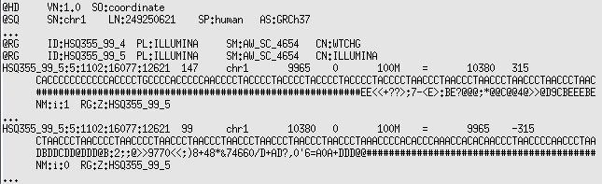
BAM (actually: SAM) files

Slide 38
BAM files
Header
Reads

Slide 39
BAM files
Header line:
version; sort order

Slide 40
BAM files
Reference definition
One for each chromosome/contig

Slide 41
BAM files
Read groups:
smallest physical grouping of reads (e.g. lane, multiplex)

Slide 42
BAM files
Identifier: Unique to fragment
1st/2nd read have same identifier

Slide 43
BAM files
Bit-wise flag:
147=1+2+16+128
Bit-wise flag:
99=1+2+32+64
1: multiple fragments (e.g. read pairs)
2: all fragments “properly” aligned
4: fragment unmapped
8: next (=other) fragment unmapped
16: sequence was rev complemented
32: next fragment’s sequence was rc’ed
64: first fragment
128: last fragment

Slide 44
BAM files
Chromosome read was mapped to

Slide 45
BAM files
Position read was mapped to

Slide 46
BAM files
Mapping quality
Mapping quality = posterior probability that mapping position is wrong
Expressed as Phred score (-10 log₁₀ p):
  “0”: p = 1.0 : almost certainly wrong
  “3”: p=0.5 : one other equally likely position found
  “10”: p = 0.1
  “30”: p = 0.001 etc.

Slide 47
BAM files
Alignment
Alignments are expressed as a “CIGAR” (Compact Idiosyncratic Gapped Alignment Report) string
M = match (bases may be different), I = insert, D = delete
S = soft clip (“insert” at either end of sequence deemed not to represent true bases)

Slide 48
BAM files
Chromosome and position of mate

Slide 49
BAM files
Inferred insert size

Slide 50
BAM files
Sequence
Sequence as it came off the machine
Reverse-complemented if mapped to the BW reference strand (flag: bit value 16)

Slide 51
BAM files
Qualities
Sequence as it came off the machine
Reversed if mapped to the BW reference strand (flag: bit value 16)
Encoding: Phred base 33 (# = 2)

Slide 52
BAM files
Optional additional information
Many fields have a defined meaning (e.g. NM: number or mismatches; RG: read group)
Controlled type (:i: = integer; :Z: = string, etc)
Tags starting with X, Y, Z are undefined: free for application-specific uses

Slide 53
Bam files - tools
Processing
  Samtools
    SAM<->BAM
    sorting, indexing, merging, duplicate removal
    Remote retrieval (FTP or HTTP) of BAM file fragment
  Picard
    merging, duplicate removal
Viewing
  Samtools view (SAM)
  Samtools tview (ASCII browser)
  IGV (Java graphical browser)

Slide 54
Algorithms

Slide 55
Algorithms
read mappers have similar aims to good-old BLASTn:
search and align a nucleotide query to a nucleotide database
Unique features:
  Very many queries (~10⁹)
  Queries are short (~36 – ~150 bp)
  Reference can be long
  Queries usually not very divergent from reference (0.1 - few %)
  Queries can have substantial numbers of base errors
  Reads come in pairs and have base qualities

Slide 56
Approach 1: Hashing reads
Process reads in batches: keeps hash table small
  Naïve hashing of whole genome requires:
  4 bytes per entry, times
  3*10^9 entries, divided by
  fill factor ~0.7 (less for repetitive data): 17 Gb: too much
Advantage
  Hashing allows for high sensitivity
Drawback: entire genome is scanned for each batch
  MAQ: genome is scanned 3 times per batch
  Slow, particularly for small number of reads

Slide 57
Approach 1: Hashing reads
Examples: ELAND, MAQ
n=9
keys
read 1
h(r1)
read 2
h(r2)
read 3
read 4
h(r3) h(r4)
h(r4)+1
read 5
h(r5)
m=5
Fill factor α=m/n

Slide 58
Approach 1: Hashing reads
scan genome
hash table (x6)
subsequence (12 nt)
6 patterns (MAQ)
candidate
reads

Slide 59
Approach 2: Burrows-Wheeler transform
Response to speed / memory issues of 1st approach
BWT:
  Compressed index
  Very efficient at storing (and retrieving) repetitive sequence
Advantages
  Good memory usage, very fast
Disadvantages
  Not best suited for inexact matches → lower sensitivity than hash-based approaches

Slide 60
The Burrows-Wheeler transform (1994; 1983)
c a c a a c g $
a c a a c g $ c
c a a c g $ c a
a a c g $ c a c
a c g $ c a c a
c g $ c a c a a
g $ c a c a a c
$ c a c a a c g
c a c a a c g $
$ c a c a a c g
a a c g $ c a c
a c a a c g $ c
a c g $ c a c a
c a a c g $ c a
c a c a a c g $
c g $ c a c a a
g $ c a c a a c
$ c a c a a c g
a a c g $ c a c
a c a a c g $ c
a c g $ c a c a
c a a c g $ c a
c a c a a c g $
c g $ c a c a a
g $ c a c a a c
g c c a a $ a c

Slide 61
BWT is reversible
$ c a c a a c g
a a c g $ c a c
a c a a c g $ c
a c g $ c a c a
c a a c g $ c a
c a c a a c g $
c g $ c a c a a
g $ c a c a a c
g c c a a $ a c
$ a a a c c c g

Slide 62
BWT is reversible
$ c a c a a c g
a a c g $ c a c
a c a a c g $ c
a c g $ c a c a
c a a c g $ c a
c a c a a c g $
c g $ c a c a a
g $ c a c a a c
g$ ca ca aa ac $c ac cg
$c aa ac ac ca ca cg g$

Slide 63
BWT is reversible
$ c a c a a c g
a a c g $ c a c
a c a a c g $ c
a c g $ c a c a
c a a c g $ c a
c a c a a c g $
c g $ c a c a a
g $ c a c a a c
$ c a c a a c g
a a c g $ c a c
a c a a c g $ c
a c g $ c a c a
c a a c g $ c a
c a c a a c g $
c g $ c a c a a
g $ c a c a a c

Slide 64
Relation with Suffix Arrays / Trees
Suffix array (Gene Myers, Udi Manber,1991):
Array of start positions of lexicographically sorted set of suffixes
a a c g
a c a a c g
a c g
c a a c g
c a c a a c g
c g
g
SA:
c a c a a c g
[4, 2, 5, 3, 1, 6, 7]
BWT:
$ c a c a a c g
a a c g $ c a c
a c a a c g $ c
a c g $ c a c a
c a a c g $ c a
c a c a a c g $
c g $ c a c a a
g $ c a c a a c
Set of substring prefixes occupy contiguous segment in SA
SAs are similar to Suffix Trees (1973), but more efficient and less powerful.
Suffix Trees take ~20N bytes for input of size N (“good implementations”)
SAs take 4N bytes
BWT take N bytes, and can be compressed

Slide 65
FM index (Ferragina and Manzini, 2000)
Two tables:
  A: Compressed version of BWT
  B: Table of starting positions of a subset of suffixes
Two algorithms (~ the two stages in the BWA mapping process):
  I: Lookup the index k (or range k…l) in the BWT table for a substring
  II: Compute the starting position(s) in the reference of suffix BWT[k]...BWT[l]
Algorithm I uses table A, takes O(1) time
Algorithm II uses table B, and takes O(log₂ N ) time (N = genome size)
Together, the number and location of substrings of length p can be found in
O( p + number-of-occurrences * log₂ N ) time.

Slide 66
Read mappers implementing BWT
BWA
  Fast, accurate, fairly sensitive, popular (eg. 1000G project)
  Provides mapping qualities
  Does not use base qualities
Bowtie
  Very fast; not very sensitive; mostly for mRNA-seq data
  No mapping qualities
  Does not use base qualities
Soap2
  No experience

Slide 67
Approach 3: Fast hashing
Stampy
Advantages:
  Sensitive
    SNPs + indels, better than BWA, ELAND, MAQ; similar to Novoalign
  Good memory footprint (similar to BWA, MAQ, ELAND)
Disadvantage
  Slower than BWA

Slide 68
Approach 3: Fast hashing
n=9
keys
Successful search:
time ~ O[ log (1-α) / α ]
Logarithmic growth as α→1:
Fast
Unsuccessful search:
time ~ O[ 1 / (1-α) ]
Hyperbolic growth as α→1:
Slow
In practice, need to keep α<0.7
In practice, need to keep α<0.7
a
b
d
c
e
m=5
Fill factor α=m/n

Slide 69
Approach 3: Fast hashing
Modern fast hashing algorithms not applicable
  Cuckoo hashing, Robin Hood hashing
  Only hash unique objects (i.e. don’t implement multimap / multiset)
Idea: mark last object in chain, for early termination of search
  Requires new data structure and hash algorithm
Result:
  Successful and unsuccessful searches in logarithmic time
  Fill factors of 0.98 possible, still faster than standard hash table with α=0.7
  Deletion is easy to implement (not possible in standard hash table)

Slide 70
Stampy – first part of algorithm
scan read
4 bytes x
2²⁹ entry (2 Gb)
hash table
candidate
positions
15 bp subsequence;
0 or 1 mismatch
Remove
rev-comp
symmetry
29 bit word

Slide 71
Stampy – second part of algorithm
Banded alignment
(max 15 bp indels)
Standard algorithm, special
implementation
Using x86 vector instructions:
Linear-time
Dynamic Programming table
in registers
Genome
Read

Slide 72
Part 2: Variant calling

Slide 73
Variant calling
Aim: produce variant calls (w.r.t. reference), and genotype calls
True variants usually easy to spot
  But: SNPs easier than indels easier than SVs
  And: Sufficient coverage required
Divergence / diversity often low (human: 0.1%)
  False positives are an issue
Content:
  Some examples
  Data issues
    indel errors
  Three callers: Samtools, GATK, Platypus

Slide 74
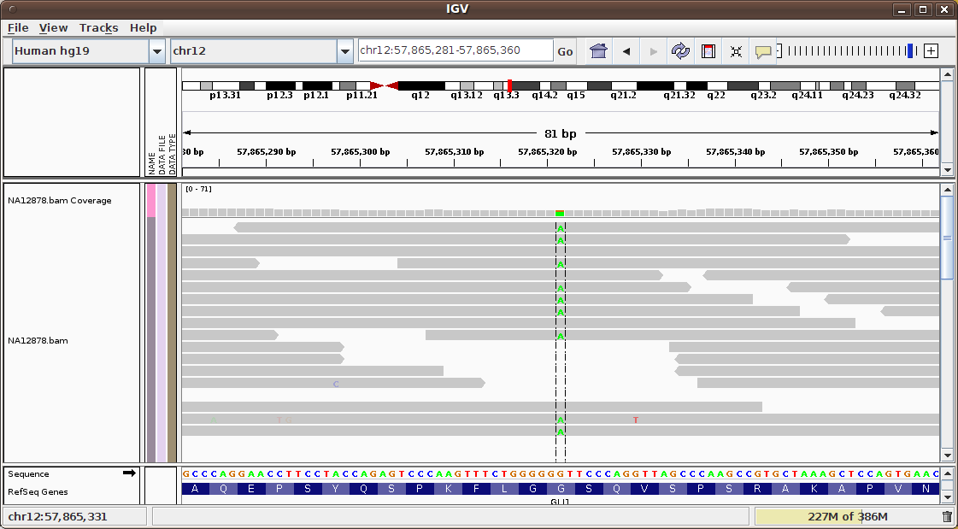

Slide 75
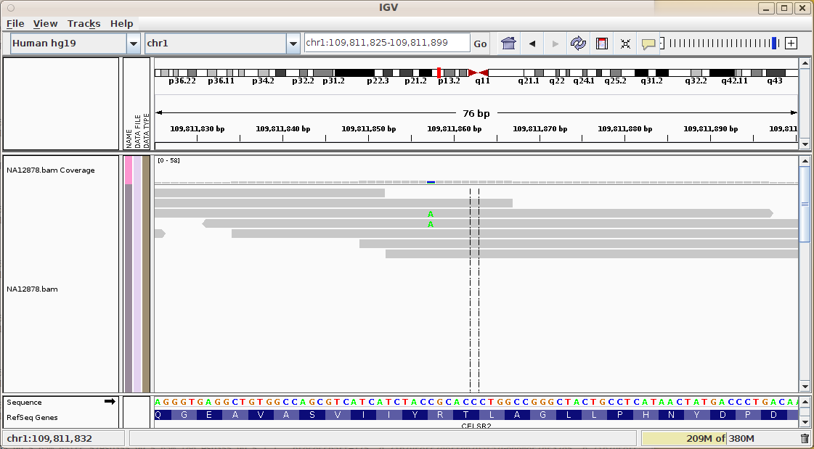

Slide 76
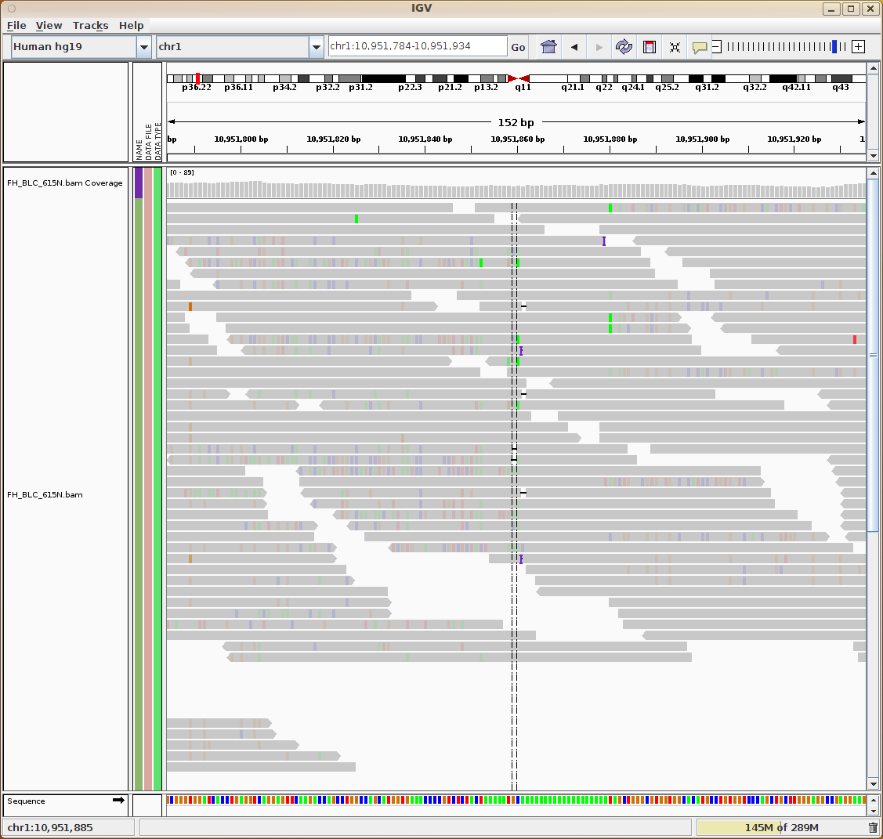

Slide 77
4 reads:
1 bp insertion

Slide 78
5 reads:
1 bp deletion

Slide 79
4 reads:
reference

Slide 80
Data issues
Primary data
  PCR errors (base errors)
    SOLiD: reference bias (reference-based color decoding)
  Base quality calibration
  Indel errors
  Overlaps
  Duplicates
  Primers
Alignment
  Base-level misalignments around indels
Reference / mapping
  Unrepresented seg dups
  Repetitive sequence

Slide 81
Data issues
Primary data
  PCR errors (base errors)
    SOLiD: reference bias (reference-based color decoding)
  Base quality calibration
  Indel errors
  Overlaps
  Duplicates
  Primers
Alignment
  Base-level misalignments around indels
Reference / mapping
  Unrepresented seg dups
  Repetitive sequence

Slide 82
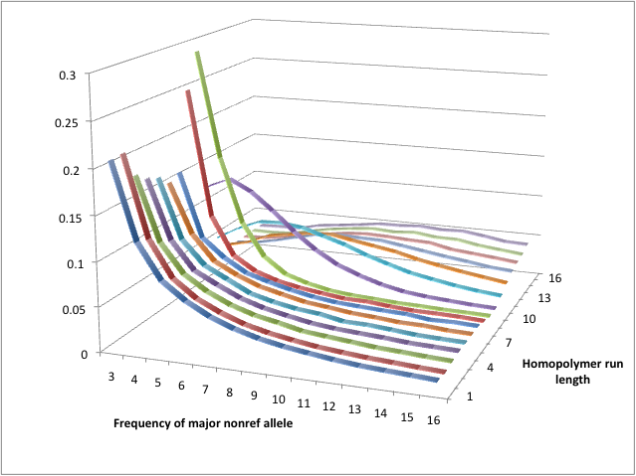
Site frequency spectra – indels in homopolymer runs
…TTTCGTACGTGAAAAAACCTGTGCGAAGTG… : homopolymer run 6

Slide 83
Method 1 (TRIO):
Non-Mendelian alleles in trios
Mother:
20 x ref
2 x +A
Father:
12 x ref
12 x -AA
Child:
14 x ref
3 x +A
1 x +AAA
Choose parsimonious child alleles from mother and father:
- explain largest number of reads in M+F+C
- alleles supported by >= 2 reads in each of M,C / each of F,C
Remaining child alleles classified as errors

Slide 84
Method 2+3 (DISTRIB, high/low coverage resp.):
Modeling the allele count distribution
Hom ref (N_{hr})
Hets (N_{h})
Hom alt (N_{ha})
Errors (ε)
← Allele bias (β)

Slide 85
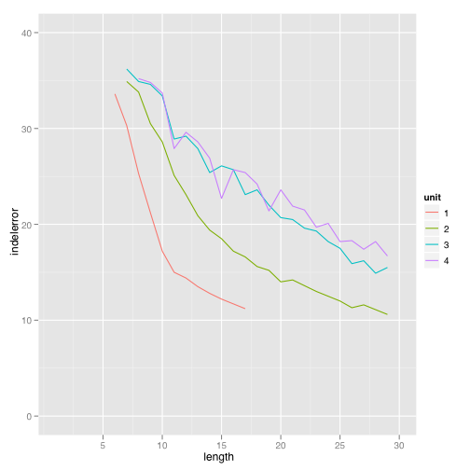
Indel errors occur in repeat tracts
repeat unit
(phred scale)
Higher error rates
Longer repeat tracts

Slide 86
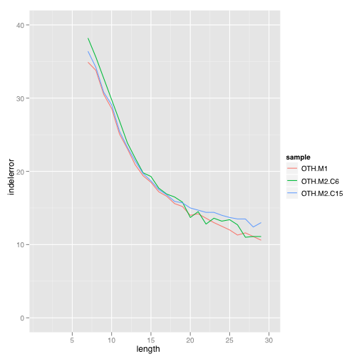
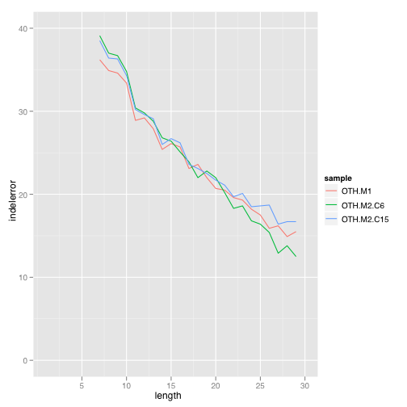
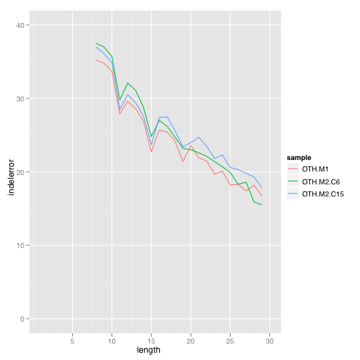
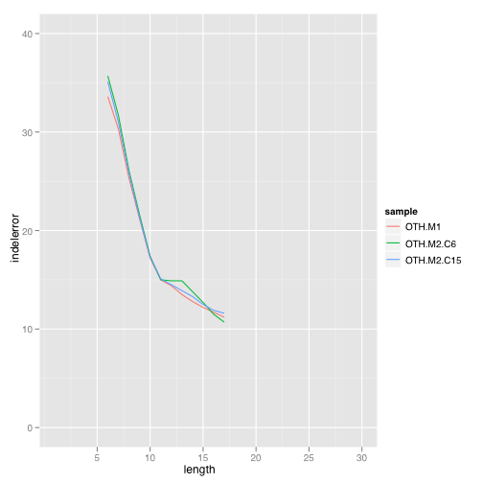
All 3 methods give similar results
Homopolymers
Tandems (unit 2)
OTH.TRIO
OTH.DISTRIB.C6
OTH.DISTRIB.C15
Tandems (unit 3)
Tandems (unit 4)

Slide 87
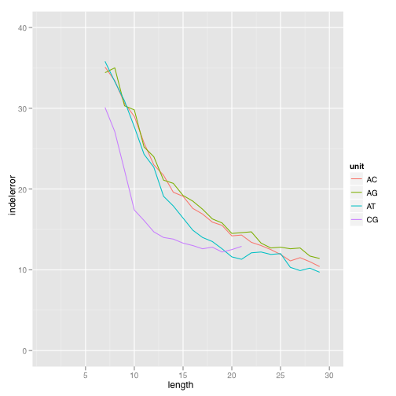
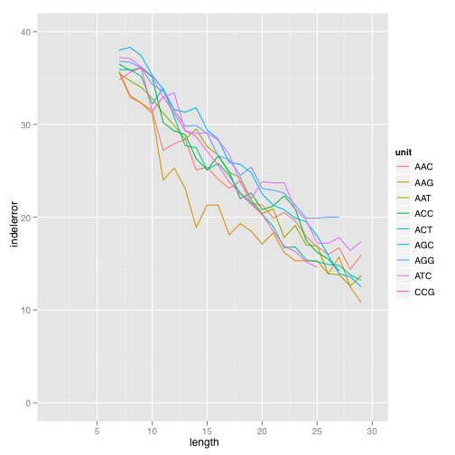
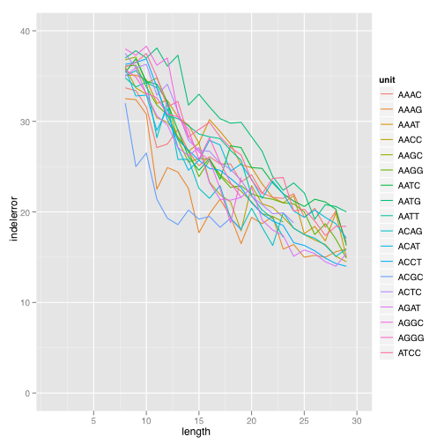
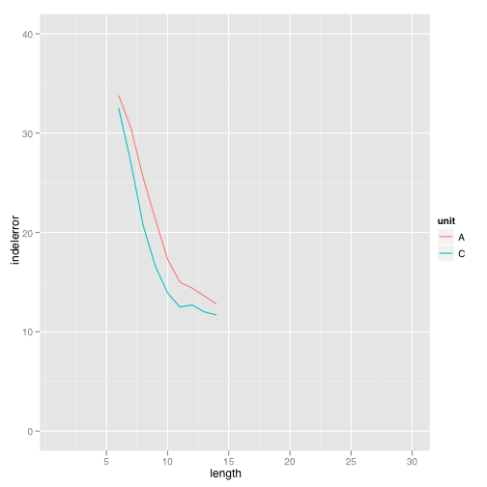
Sequence composition matters
OTH. TRIO

Slide 88
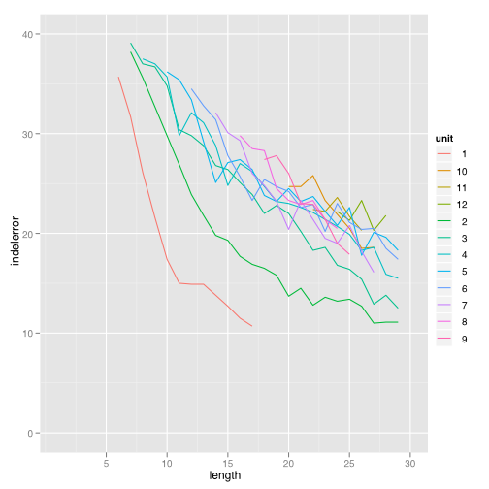
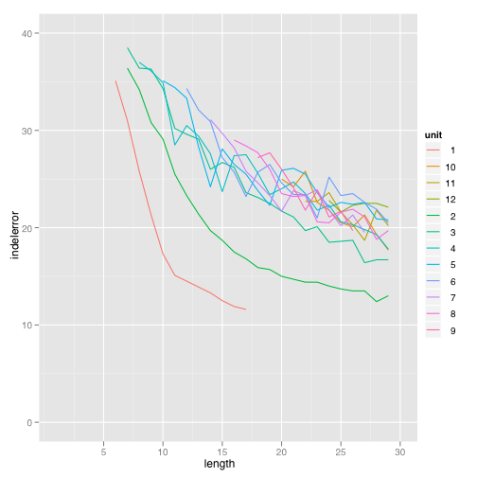
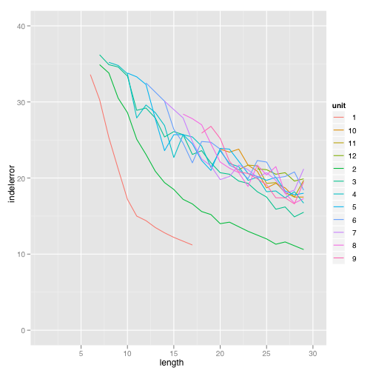
Tandem repeats composed of longer units are also prone to errors
OTH. TRIO
OTH.DISTRIB.C15
OTH.DISTRIB.C6

Slide 89
Variant callers

Slide 90
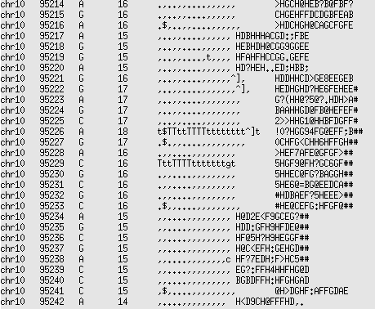
Samtools
Uses “pileup”: column-by-column approach
Uses “BAQ” (base alignment quality) to suppress spurious SNPs due to unrecognized indels
Advantages:
  Fast, simple to use
  Good for low coverage data
Disadvantages
  Can have high FP rate for
  high coverage data
  Not very good for indels

Slide 91


The topology of the profile HMM for BAQ computation.
Li H Bioinformatics 2011;27:1157-1158
© The Author 2011. Published by Oxford University Press. All rights reserved. For Permissions, please email: journals.permissions@oup.com
Notes:
The topology of the profile HMM for BAQ computation. It consists of five types of states: alignment matches (M), insertions to the reference (I), deletions (D), alignment start (S) and alignment end (E). The S state points to every M and I state while every M and I points to E. States S and E are plotted together to avoid excessive dotted lines in the figure.

Slide 92

Transition–transversion ratio (ts/tv) as a function of the number of SNP calls.
Li H Bioinformatics 2011;27:1157-1158
© The Author 2011. Published by Oxford University Press. All rights reserved. For Permissions, please email: journals.permissions@oup.com
Notes:
Transition–transversion ratio (ts/tv) as a function of the number of SNP calls. SNPs are sorted by the posterior probability of the site being a SNP (SNP probability). Given a threshold on the SNP probability, the number of SNPs of higher probability and their ts/tv are plotted. For the solid line, filters in use are as follows: (i) total depth below 500; and (ii) root mean square mapping quality above 10; (iii) P-value of reference and non-reference bases being evenly distributed on both strands is above 10−4 (by exact test).

Slide 93
GATK
“Genome Analysis ToolKit” – Broad institute
Features:
  Base quality recalibration
  Re-alignment around known indels
  BAQ
  VQSR (variant quality-score recalibration)
Advantages:
  High quality SNP calls (in combination with BWA, not Stampy)
Disadvantages:
  Difficult to use
  Slow
  Requires high-quality SNP set for training, known indels for re-alignment
  Indel call quality currently not great

Slide 94


VQSR
Builds empirical model to classify calls in true and false
Can combine many (interdependent) covariates
Requires training set of trusted calls

Slide 95
Platypus
Haplotype-based approach
  Windowed, rather than column-by-column
  Integrated SNP and indel calling
  Accounts for actual (LD) and technical (alignment) interaction between variants
3-step process: candidate generation; haplotype alignment; calling
  Can use candidates from different sources (e.g. known set, local assembly, read alignm’t)
  Haplotype alignment allows detailed error modeling
Advantages
  Good SNP calls, better indel calls
  No need for indel realignment, BAQ
  Fast
Disadvantages
  Not yet published…

Slide 96
Integrated SNP and indel calling
Indels are often mis-called as SNPs.
Example:
1000G: chr20:257160 A → T;
chr20:257162 T → C
Platypus: chr20:257157: +TCTTTCTTTT
Reference: CTTGCGCTCTATTTTT
1000G SNPs: CTTGCGCTCTTTCTTT
Platypus insertion: CTTGCGCTCTTTCTTTTCTATTTTT

Slide 97


Platypus
Candidate
variants
+AT
-AAAT
C/T
Haplotypes
…GTCAAATCCT…
…GTCAAATTACCT…
…GTC[-]CCT…
…GTC[-]TACCT…
…GTTAAATCCT…
…GTTAAATTACCT…
…GTT[-]CCT…
…GTT[-]TACCT…
…GTCAAAT--CCT…
TTAAATTACC
…GTCAAATTACCT…
TTAAATTACC
…GTTAAATTACCT…
TTAAATTACC
……
Variant and
genotype calls
Read
alignments
Frequencies

Slide 98

Samtools:
25103279: 21 bp deletion
25103291: 9 bp deletion
25103294: 6 bp deletion
25103296: A→G
25103301: 6 bp insertion
Platypus:
25103279: 21 bp deletion

Slide 99
Cortex
Assembly-based caller
  Analyzes the topology of the de Bruijn graph to call variants
  Can use reference to improve sensitivity (hom alt calls)
Advantages:
  Works for a range of variants, including large SVs
  Works in highly divergent regions (e.g. human MHC)
  No reference required (but is useful)
Disadvantages
  Sensitivity for SNPs, small indels lower than mapping-based approaches
  Only works in unique regions
  Requires high coverage (30X or more)
  In press (Z. Iqbal et al., Nature Genetics)

Slide 100

Analyzing the de Bruijn graph

Slide 101

Up to 80% power to detect variants

Slide 102

Good sensitivity for larger indels

Slide 103
Structural variation
Larger deletions (>50 bp), larger insertions (TEs), segmental duplications, copy number variations (CNVs), complex events (eg. insertion+deletion), translocations, inversions
Difficult
  Rare events; false positives are a real problem
Some tools
  GenomeSTRiP: good for large deletion calls
  Pindel: medium-sized insertions and deletions
  BreakDancer: wide range of variants. High FP rate.
  Cortex: (not much experience yet)

Slide 104
Variant calling – best practice I
Coverage
  Single samples: aim for average 25X or more
    avg 8X is borderline sufficient if you’re looking for homozygous variants
  Multiple samples from same population/family/organism:
    Less is possible (e.g. 1000G, avg 4X per individual)
    Very low coverage:
      call sites;
      compute genotype likelihoods;
      use Beage/Impute/etc. to leverage LD for genotype calls
  Exon capture
    Check average on-target coverage (as opposed to total mapped reads)
    Large variation: Aim for 25X minimum coverage at large fraction of target.
    Rule of thumb: 150X average (6 times 25X)
  PCR amplicons
    Shearing of short fragments inefficient → uneven coverage
    Differential efficiency for different amplicons
    Potential for allele bias if primer overlaps unknown variant

Slide 105
Variant calling – best practice II
  If possible, call multiple sample simultaneously (High cov data: Not necessary but may still help)
  Families, tumor/normal, population
  Reduces FP rate; can improve genotype calls
Creating your BAM file
  Remove duplicates (in data merged across libraries or samples)
  Use most complete reference available to map to
    include unplaced / badly assembled contigs
  (With GATK / Samtools:) Consider re-alignment around indels (expensive!)
Use filtering
  PCR errors: allele bias
  Reference issues, seg dups: anomalous coverage
  Primers/adapters; mapping issues: strand bias
  If appropriate:
    Restrict to non-synonymous coding variants; remove common variants (dbSNP, 1000G, …), remove variants seen multiple times in your pipeline (removes systematic errors)
Check quality of calls
  ti/tv (Human: ~2.3; higher in exons; FPs tend to have ti/tv of 0.5)
  triplet / non-triplet ratio in coding exons
    higher is better, but beware of strange bias in Samtools
  look at raw number of calls, to sanity check

Slide 106
Lunch!

